Slide 1

SEMICON INDIA HACKATHON 2026 · TRACK 1 — KLA
SIV-AI
Dual-Frequency Wavelet-Guided Neural Architecture for
Semiconductor Image Restoration
A frequency-aware deep-learning framework that restores degraded semiconductor inspection images while preserving fine structures and critical edges.
TEAM
GLADIOPS
MEMBERS
Logesh. S · Mohammed Yunus. M · Laksmana Venkadesh. G · Mohammed Tasfiq Raja. M
TRACK
AI-Based Restoration of Degraded Images for Semiconductor Inspection
URL
https://logeshsk-ind.github.io/SIV_AI/
01

Slide 2
RESTORING INFORMATION, NOT JUST ENHANCING APPEARANCE
Problem Understanding & Restoration Task
SEMICONDUCTOR INSPECTION IMAGES ARE DEGRADED BY
WHAT MAKES THIS DIFFERENT?
Speckle and structured noise
The challenge is not visual enhancement — it is faithful recovery of inspection-critical structures.
Spatial downsampling
Loss of high-frequency details
Blurred or weakened edges
SUCCESS CRITERIA
Distortion of microscopic structures
PSNR ↑
SSIM ↑
LPIPS ↓
Edges
Pixel fidelity
Structural fidelity
Perceptual similarity
Defect / detail fidelity
RESTORATION OBJECTIVE
Degraded Image → Restored Image
x̂ = fθ(y)
Success is measured by structural and perceptual fidelity — never by how sharp the image merely looks.
Restored image approximates the clean reference while preserving inspection-critical structures.
02

Slide 3
UNDERSTANDING THE DEGRADATION
Dataset Analysis & Degradation Observations
OBSERVED DEGRADATION
DATASET
Noise
Corrupts local intensity patterns
✓
Paired degraded and reference semiconductor images
✓
Grayscale metrology / inspection imagery
Downsampling
Removes fine structures
✓
.npy image representation
High-frequency loss
Weakens edges & tiny features
✓
128 × 128 restoration patches
Local variation
Makes uniform denoising ineffective
✓
Normalized floating-point intensity representation
KEY DATASET INSIGHT
The degradation is not equally distributed across frequencies — low-frequency components preserve global structure, while high-frequency components carry most edge and fine-detail information.
DESIGN IMPLICATION
Frequency-aware restoration is preferred over treating the image as a single, undifferentiated signal.
03

Slide 4
SIV-AI RESTORATION PIPELINE
End-to-End Pipeline
DECOMPOSE → RESTORE → RECONSTRUCT → VALIDATE
Degraded
Image
→
Preprocess &
Normalize
→
2D Discrete
Wavelet Transform
→
Frequency-Aware
Neural Restoration
→
Inverse
DWT
→
Restored
Image
→
PSNR · SSIM · LPIPS
Validation
2D DWT decomposes the image into four sub-bands:
LL
LH
HL
HH
low freq
h-detail
v-detail
diagonal
WHY THIS PIPELINE?
Instead of forcing one network to simultaneously model global structure, noise, edges, textures, and fine detail, SIV-AI explicitly exposes frequency-specific information to the restoration network — focusing capacity where degradation actually concentrates.
04

Slide 5
Degraded Image
BLOCK DIAGRAM
Visual & Structural Validation
Preprocessing
PSNR / SSIM / LPIPS
2D Discrete Wavelet Transform
Restored Image
LL
NAFNET
LH
Inverse DWT
HL
Restormer
HH
Frequency-Aware Neural Restoration
Restored Sub-bands

Slide 6
RELIABLE DATA PREPARATION
Preprocessing & Augmentation
PREPROCESSING
AUGMENTATION
Load paired degraded / reference samples
Horizontal flipping
Validate dimensions and numerical values
Vertical flipping
Convert to float32
90° rotations
Normalize intensity range
Random paired crops
Convert to model-ready tensors
Conservative intensity variation
Preserve exact input–target correspondence
DESIGN PRINCIPLE
Augmentation improves robustness without introducing artificial semiconductor structures or breaking image–target alignment. Every spatial transform is applied identically to the degraded image and its reference.
05

Slide 7
FREQUENCY-AWARE NEURAL RESTORATION
Model Architecture & Design Rationale
1 · FREQUENCY DECOMPOSITION
3 · RECONSTRUCTION
Input
Image
LL
LH
HL
HH
2D DWT →
low freq
h-detail
v-detail
diagonal
Restored LL + LH + HL + HH
↓
LL — global / coarse structure
Inverse DWT
LH — horizontal detail
HL — vertical detail
↓
HH — high-frequency / diagonal detail
Final Restored Image
2 · NEURAL RESTORATION
NAFNet-inspired restoration
DESIGN RATIONALE
Efficient reconstruction of degraded features
Wavelets provide explicit frequency separation; neural restoration provides learned reconstruction — letting the model focus on the information most vulnerable to degradation.
Restormer-inspired attention
Captures contextual and long-range dependencies
06

Slide 8
MULTI-OBJECTIVE RESTORATION
Loss Functions & Training Setup
L = λ₁ L_L1 + λ₂ L_SSIM + λ₃ L_Edge
CURRENT LOSS WEIGHTS
L1
0.03
SSIM
L1 Loss
0.2
Provides direct pixel-level reconstruction. Goal: reduce absolute intensity error.
Edge
0.1
SSIM Loss
Encourages preservation of local structural information. Goal: maintain image structure.
TRAINING SETUP
✓
Framework: PyTorch
Edge Loss
✓
Hardware: CUDA GPU
Sobel gradients compare predicted and reference edges. Goal: preserve sharp boundaries.
✓
Validation-based checkpoint selection
✓
Best-performing checkpoint retained for inference
Sobel-based edge supervision is the direct link between the loss function and defect-relevant fidelity — not just pixel accuracy.
07

Slide 9
CONTROLLED EXPERIMENTAL EVALUATION
Experiment Tracking & Baseline Comparison
TRACKED PER EXPERIMENT
BASELINE PROGRESSION
Training loss
Validation loss
PSNR
1
Classical interpolation
SSIM
LPIPS
Parameter count
↓
2
Simple CNN baseline
Runtime
GPU memory
Failure cases
↓
3
Full-band neural restoration
PHASE-4 CHECKPOINT EFFICIENCY
~110K parameters
↓
A compact restoration model
4
SIV-AI — Frequency-Aware Restoration
Every model is evaluated with the same data split, preprocessing and metrics for a fair comparison.
08

Slide 10
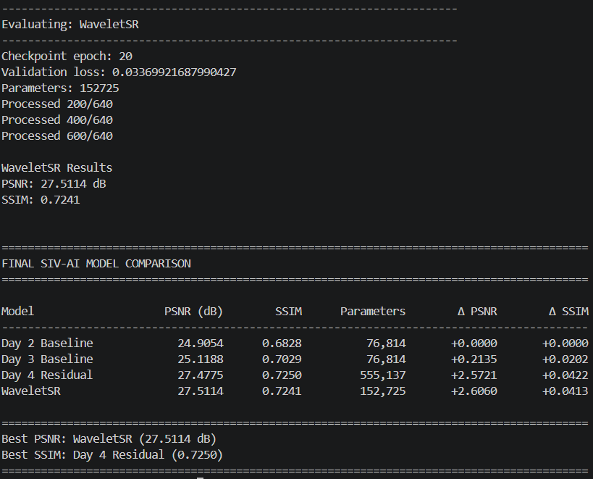
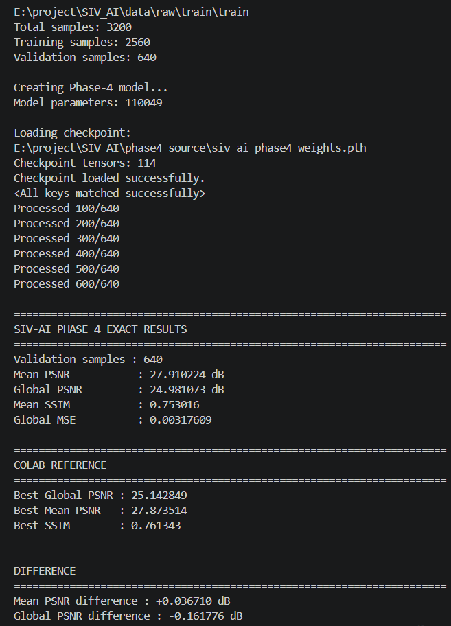
QUANTITATIVE RESTORATION PERFORMANCE
PSNR, SSIM & LPIPS Results
MODEL
PSNR ↑
SSIM ↑
LPIPS ↓
TARGET PERFORMANCE
Bicubic
TBD
TBD
TBD
≥ 27.8 dB
CNN Baseline
TBD
TBD
TBD
PSNR
Full-Band Model
TBD
TBD
TBD
≥ 0.76db
SIV-AI
TBD
TBD
TBD
SSIM
Fill in after final evaluation on the held-out test set.
INTERPRETATION
PSNR measures reconstruction fidelity, SSIM measures structural preservation, and LPIPS provides complementary perceptual evaluation.
Bottom line: the best model has the highest structural fidelity and lowest perceptual distortion — not merely the sharpest-looking image.
09

Slide 11
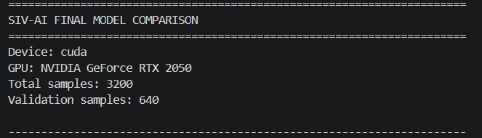
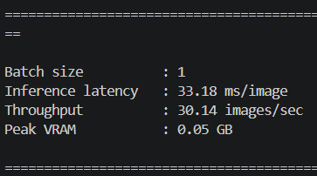
ACCURACY MEETS EFFICIENCY
Runtime, Batch Size & Optimization
Accuracy ↔ Latency ↔ Memory
GPU
NVIDIA RTX 2050
OPTIMIZATION TECHNIQUES
✓
CUDA-accelerated inference
Input size
128 × 128
✓
torch.no_grad() execution
Batch size
1
✓
Efficient tensor operations
✓
Best-checkpoint deployment
Inference latency
33.18 ms / image
✓
FP16 / AMP optimization where applicable
Throughput
30.14 images / sec
ONNX
→
TensorRT
Peak VRAM
0.05 GB
Future deployment path
KEY MESSAGE
The objective is not maximum model size — it is maximum restoration quality per unit of computation.
10

Slide 12
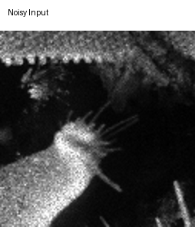
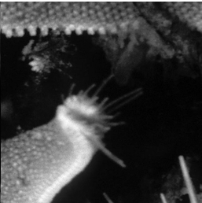
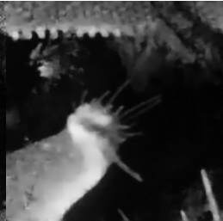
VISUAL VALIDATION
Visual Results, Failure Cases & Limitations
Add restoration sample here
Add restoration sample here
Add restoration sample here
Degraded
Ground Truth
SIV-AI Restored
Highlight: edge recovery · fine-structure recovery · noise suppression · texture preservation
FAILURE CASES
LIMITATIONS
Extremely low-SNR regions
Limited degradation diversity may affect generalization
Very thin structures
PSNR / SSIM cannot guarantee defect-level fidelity
Severe information loss
Perceptual metrics may not represent inspection value
Unseen degradation patterns
Completely lost information cannot be recovered
Ambiguous high-frequency details
Real semiconductor-tool validation still required
A visually pleasing restoration is not necessarily an inspection-safe restoration.
11

Slide 13
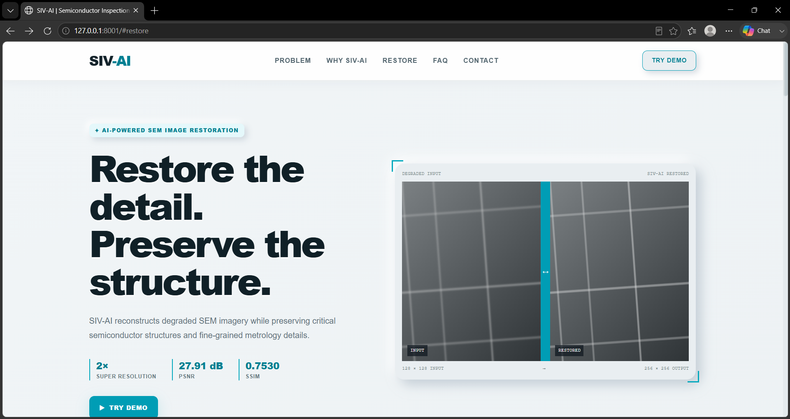
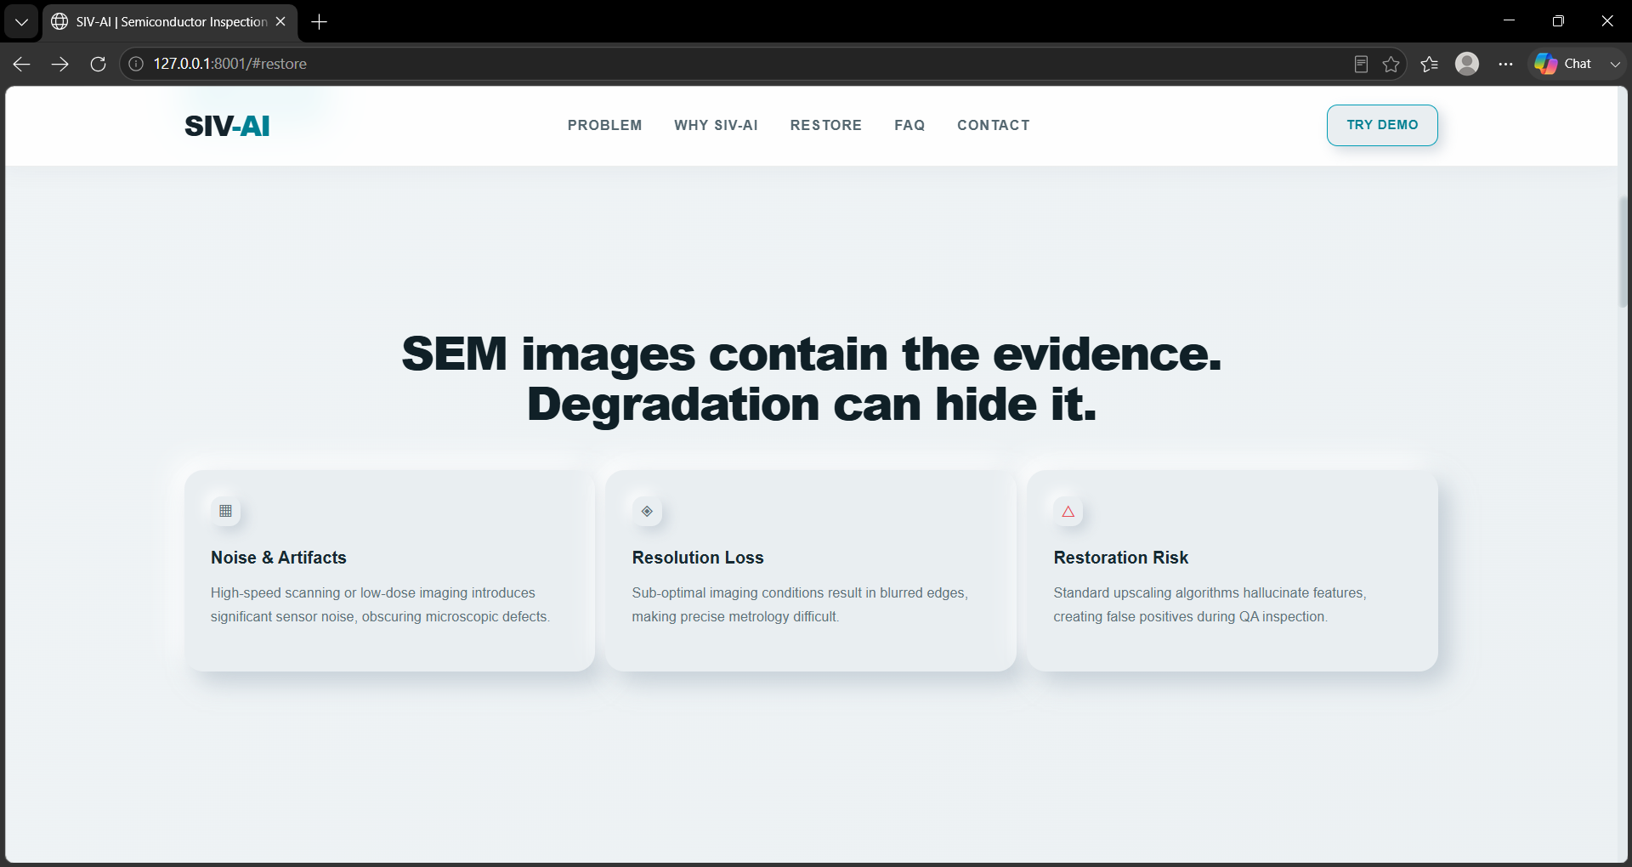
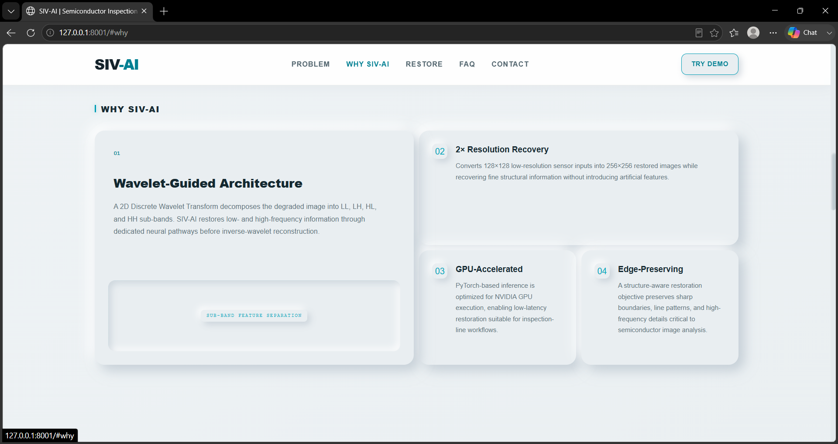
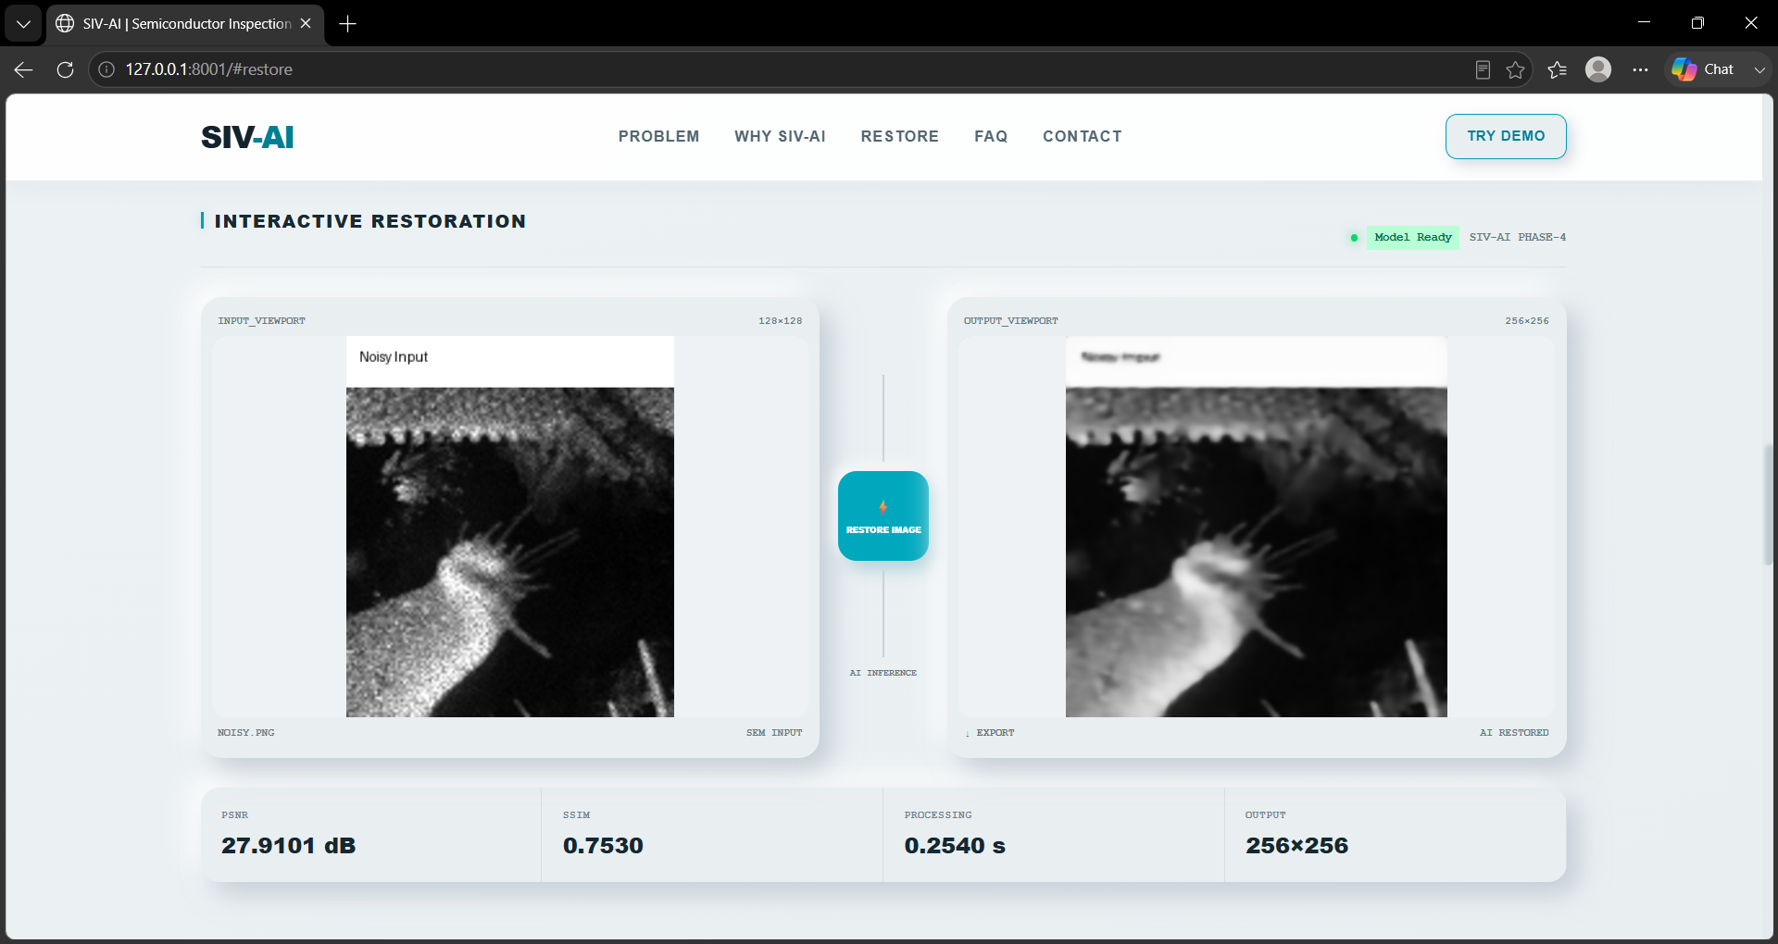
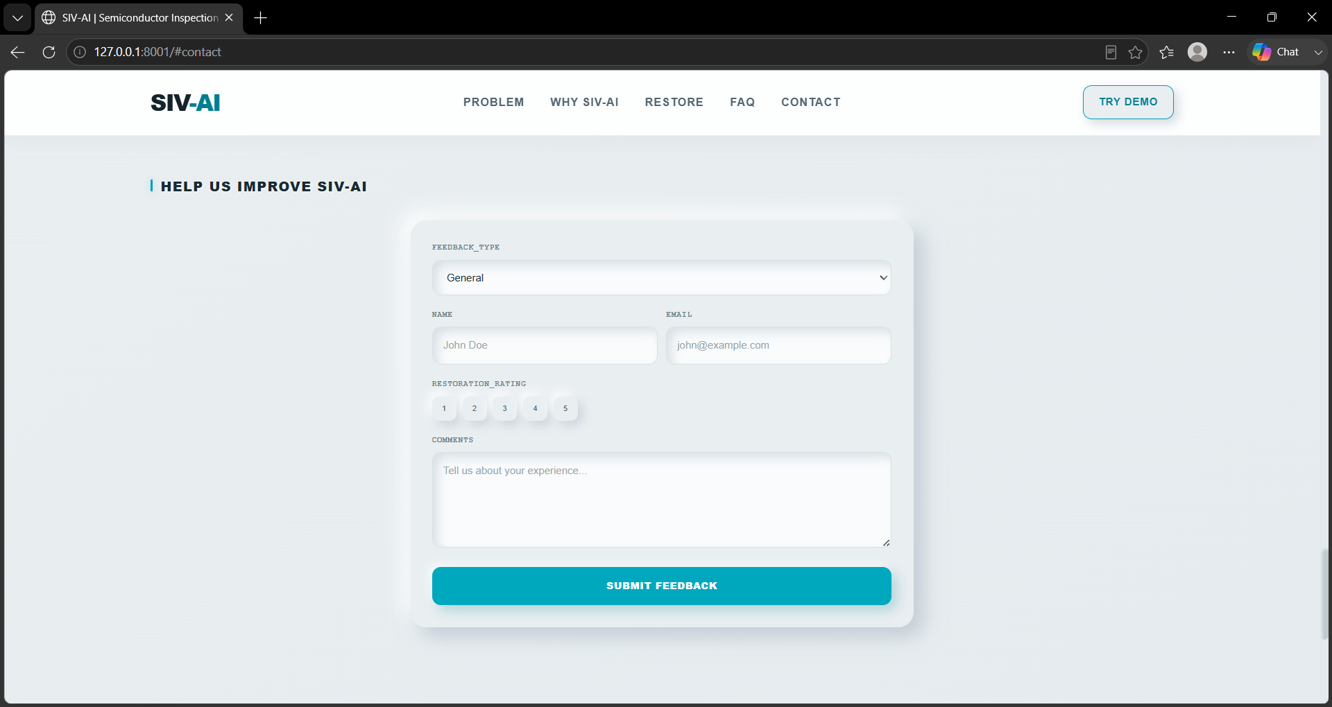
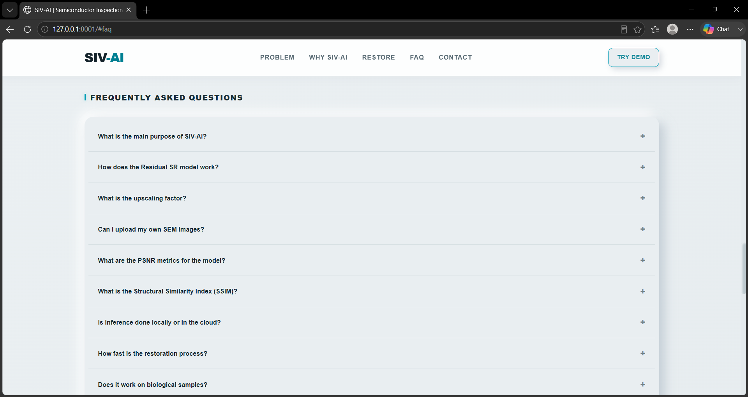
1
2
WEB DEMO
3
4
5
6

Slide 14
CONCLUSION
From degraded pixels to inspection-ready information.
01
Frequency Decomposition
02
Neural Restoration
DWT separates structural and high-frequency information.
Learned restoration reconstructs degraded frequency components.
03
Edge-Aware Supervision
04
Comprehensive Evaluation
Sobel-based loss preserves inspection-critical boundaries.
PSNR, SSIM, LPIPS, runtime and visual analysis validate results.
EXTERNAL RESOURCES
PyTorch
PyWavelets
OpenCV
FastAPI
NAFNet
Restormer
DWT
SSIM
Sobel Edge Loss
External libraries and published methods are acknowledged; the SIV-AI integration and restoration pipeline are our own implementation.
GITHUB
github.com/Logeshsk-Ind/SIV_AI
URL
https://logeshsk-ind.github.io/SIV_AI/
12

