Slide 1
Employee Data Analysis using Excel
STUDENT NAME: INDDU ROHINI K B
REGISTER NO: 312208943 / unm135122/c/110
DEPARTMENT: B.COM (GENERAL)
COLLEGE: CHEVALIER T. THOMAS ELIZABETH COLLEGE FOR WOMEN

Slide 2
PROJECT TITLE
1.CURRENT EMPLOYEE RATING

Slide 3


AGENDA
Problem Statement
Project Overview
End Users
Our Solution and Proposition
Dataset Description
Modelling Approach
Results and Discussion
Conclusion
3/21/2024 Annual Review

Slide 4
PROBLEM STATEMENT
A THOROUGH ANALYSIS OF THE CURRENT EMPLOYEE RATINGS USING EXCEL
Employee ratings are used as a key matric in determining promotions, compensation adjustments, and development opportunities. To evaluate the current employee rating system to ensure it accurately reflects individual performance.
Ensuring that ratings are consistently applied across different departments and by different managers.
Providing insights in how the current rating system could be refined to better reflect actual employee performance

Slide 5

PROJECT OVERVIEW
This project focuses on analysing the current employee rating system to ensure it effectively and accurately reflects employee performance across the organization.
DATA COLLECTION:
Gather employee rating data, including relevant attributes like employee id, department, business units, Gender code etc..
PIVOT TABLETS AND CHARTS:
Create pivot tablets and charts to analyse ratings across different dimensions and to obtain the roles of the employees in order to maintain a standard of rating system in organization between employees like high, low, medium ratings.
REPORTINGS:
Summarize the findings in a report, supported by visualizations, and provide recommendations for enhancing the rating system.

Slide 6

WHO ARE THE END USERS?
HUMAN RESOURCES (HR) TEAM:
The HR team uses employee ratings to manage performance reviews, develop employee development plans, and make decision about promotions, raises or disciplinary actions.
SENIOR LEADERSHIP AND EXECUTIVES:
Senior leaders use aggregated employee rating data to understand overall organizational performance, identify trends across different department with talent management.
PERFORMANCE MANAGEMENT TEAMS:
Teams or committees responsible for performance management use the ratings to ensure consistency and fairness in evaluations across the organization.
EMPLOYEES THEMSELVES:
Employees use their own ratings as feedback to understand how their performance is viewed.

Slide 7

OUR SOLUTION AND ITS VALUE PROPOSITION
Our solution involves a comprehensive analysis of the current employee rating system using excel to evaluate its effectiveness, consistency and fairness. We will create clear and insightful visualizations (charts, graphs, and pivot tables)
Data presentation and statistical analysis
Actionable Recommendations
By understanding performance trends and identifying areas of improvement, organizations can better allocate resources, design targeted training programs, and plan for future workforce needs, driving overall business success.
Utilizing Excel for this analysis is cost-effective and accessible.

Slide 8
Dataset Description
The dataset for the employee rating system contains detailed information about each employee, including their personal attributes, job-related data, and performance ratings. This dataset is crucial for analysing the current employee ratings and performance across the organization.
Employee ID
Employee Name
Business units
Employees status
Pay zone
Location
Current employee ratings

Slide 9

THE "WOW" IN OUR SOLUTION
Our solution transforms complex data into interactive, easy-to-understand visualizations. These dynamic charts, graphs, and pivot tables allow decision-makers to quickly grasp key trends, compare performance across different dimensions, and make informed choices with confidence.
The solution is scalable, allowing organizations to continually update and analyse their data as new ratings come in. This means that you can track performance trends in real-time and adjust strategies on the fly, keeping your organization agile and responsive to change.
3/21/2024 Annual Review
9

Slide 10
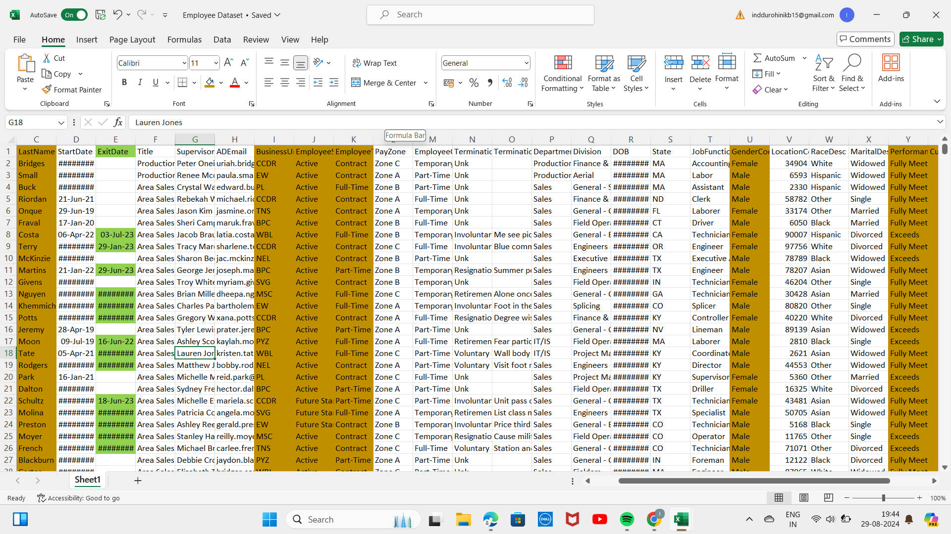
MODELLING
Group employees into clusters based on similar characteristics such as performance ratings, job roles, departments, tenure, etc.
Modelling provides deeper insights into what drives employee performance, helping to focus efforts where they will have the most impact in it.
10

Slide 11
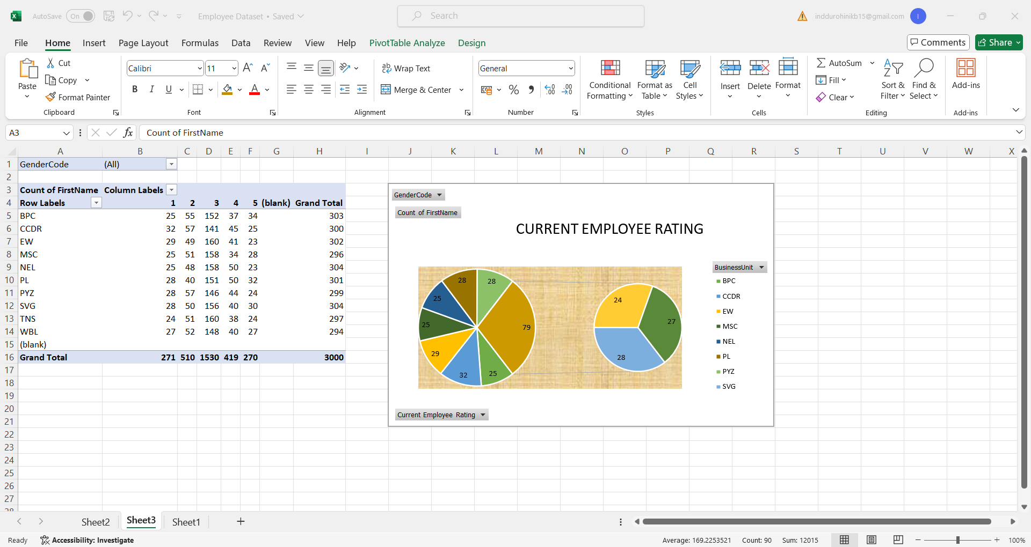
RESULTS
Provided insights into how changes in rating criteria or management practices might affect performance outcomes, guiding strategic decisions.
Continuously monitor performance trends and adjust strategies based on data-driven insights to maintain an effective rating system.
11

Slide 12
conclusion
The analysis of the employee rating system using Excel has yielded significant insights into the effectiveness and fairness of the current performance evaluation process.
Our exploration of key performance drivers through correlation and regression analyses has highlighted critical factors that influence employee performance. This understanding allows the organization to focus on targeted interventions.
The use of dynamic visualizations and interactive dashboards has significantly enhanced our ability to interpret complex data, making it easier for stakeholders to access and understand key performance metrics.

Slide 13
Thank you

