Slide 1

THIAGARAJAR COLLEGE (AUTONOMOUS), MADURAI
Department of Computer Science - M.Sc
PCS20PJ41 - Project – Second Review
PRIVACY PROTECTION BASED
ACCESS CONTROL SCHEME
IN CLOUD BASED SERVICES
GUIDED BY :
SUBMITTED BY :
MANIBALA R - (24SPCS05)
II M.Sc Computer Science
Thiagarajar College, Madurai
Dr. P. MANICKAM., Ph.D
Assistant Professor
Dept. of Computer Science, Thiagarajar College
11/03/2026
PCS24PJ41 Project - Second Review Presentation 2025- 2026
1

Slide 2
OVERVIEW
Abstract
Existing System
Proposed System
Proposed System Architecture
List of Modules
Result Comparison / Analysis
Conclusion
11/03/2026
PCS24PJ41 Project - Second Review Presentation 2025- 2026
2

Slide 3
ABSTRACT
With the rapid development of computer technology, cloud-based services have become a hot topic. They not only provide users with convenience but also bring many security issues such as data sharing and privacy.
In this paper, we present an access control system with privilege separation based on privacy protection (PS-ACS). We divide users into private domain and public domain logically. In the Private Domain, Key-Aggregate Encryption and Improved Attribute-based Signature are adopted for read and write access respectively.
In the Public Domain, we construct a new multi-authority CP-ABE scheme to avoid single point of failure. The analysis and simulation results show that our scheme is feasible and superior in protecting users' privacy in cloud-based services.
11/03/2026
PCS24PJ41 Project - Second Review Presentation 2025- 2026
3

Slide 4
EXISTING SYSTEM
Trust between users and cloud service providers is established using remote attestation techniques.
These protocols verify configuration and security status of the host platform before launching guest virtual machines.
Encryption keys are stored outside the IaaS domain, preventing cloud providers from accessing sensitive data.
The system was tested on a prototype simulating a public electronic health record system.
Results showed that proposed protocols can effectively establish trust between clients and cloud hosts.
Uses a scalable key management mechanism with graph-based access rights representation.
Limitation: Complex key distribution, risk of single point of failure, and limited scalability across domains.
11/03/2026
PCS24PJ41 Project - Second Review Presentation 2025- 2026
4

Slide 5
PROPOSED SYSTEM
The proposed system introduces the PS-ACS scheme — Privilege Separation based Access Control in Cloud Services.
Users are logically divided into Private Domain and Public Domain.
Private Domain uses Key-Aggregate Encryption (read access) and Improved Attribute-Based Signature (write access).
Public Domain uses a multi-authority CP-ABE scheme to avoid single point of failure in key distribution.
Files are automatically split into encrypted partitions upon upload, increasing data security.
Each file is protected with an OTP key sent to the user's registered email for authenticated access.
A Trusted Third Party Auditor (TPA) verifies cloud file integrity using digital certificates.
The administrator manages user requests, monitors file access, and controls system security.
11/03/2026
PCS24PJ41 Project - Second Review Presentation 2025- 2026
5

Slide 6
PROPOSED SYSTEM ARCHITECTURE
User
Application Server
TPA
Admin Module
Database Server
Cloud Storage
11/03/2026
PCS24PJ41 Project - Second Review Presentation 2025- 2026
6

Slide 7
LIST OF MODULES
Admin Module
Only valid administrators can access the system based on assigned access rights.
Admin monitors user activities, manages file permissions, and controls the entire workflow.
User Details Module
Includes self-registration and login forms for user account creation.
After logging in, users can send file access requests to the administrator.
Users can view their uploaded files and check the status of their access requests.
11/03/2026
PCS24PJ41 Project - Second Review Presentation 2025- 2026
7

Slide 8
LIST OF MODULES
Partition Split Module
Users upload files; the system automatically splits the file into encrypted partitions.
Each uploaded file is associated with an OTP key for additional access protection.
Third parties cannot access the file without proper admin authorization.
Send Request Module
Allows users to request access to files stored in the system.
If approved, administrator sends an OTP key to the user's registered email address.
User uses the OTP to securely access or download the requested file.
11/03/2026
PCS24PJ41 Project - Second Review Presentation 2025- 2026
8

Slide 9
LIST OF MODULES
Storage Module
Uses Trusted Computing Base (TCB) isolated by hypervisor from grid services.
Protocols ensure data integrity protection, confidentiality, and job attestation.
Clients verify the host, then interact with the security manager for file access.
TPA Module (Third Party Auditor)
Every entity obtains a digital certificate from a trusted authority during initialization.
TPA verifies system integrity and ensures secure communication within the cloud.
Each domain manager and secure component is assigned a public and private key pair.
11/03/2026
PCS24PJ41 Project - Second Review Presentation 2025- 2026
9

Slide 10
RESULT COMPARISON / ANALYSIS
System Testing — All Test Cases Passed
Test Case | Expected Result | Status
Login with valid credentials | Redirect to user dashboard | PASS
Login with invalid password | Error message displayed | PASS
Register with existing email | Duplicate email warning shown | PASS
Upload file to cloud server | File split & stored in Uploadfile folder | PASS
File partition split process | File divided into encrypted partitions | PASS
Send file access request | Request stored in database | PASS
Enter valid OTP for file access | File download allowed | PASS
TPA verify file integrity | Verification completed successfully | PASS
Unauthorized access attempt | Security alert generated | PASS
11/03/2026
PCS24PJ41 Project - Second Review Presentation 2025- 2026
10

Slide 11
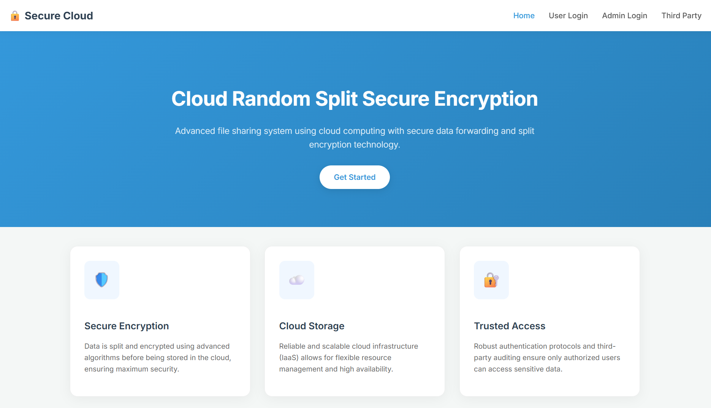
SAMPLE SCREENSHOTS
Homepage:
The homepage provides entry points for User Login, Admin Login, and Third Party (TPA) login. The hero section displays the system title 'Cloud Random Split Secure Encryption' along with a brief description of the platform. Three feature sections are shown: Secure Encryption, Cloud Storage, and Trusted Access, highlighting the key capabilities of the system.
11/03/2026
PCS24PJ41 Project - Second Review Presentation 2025- 2026
11

Slide 12
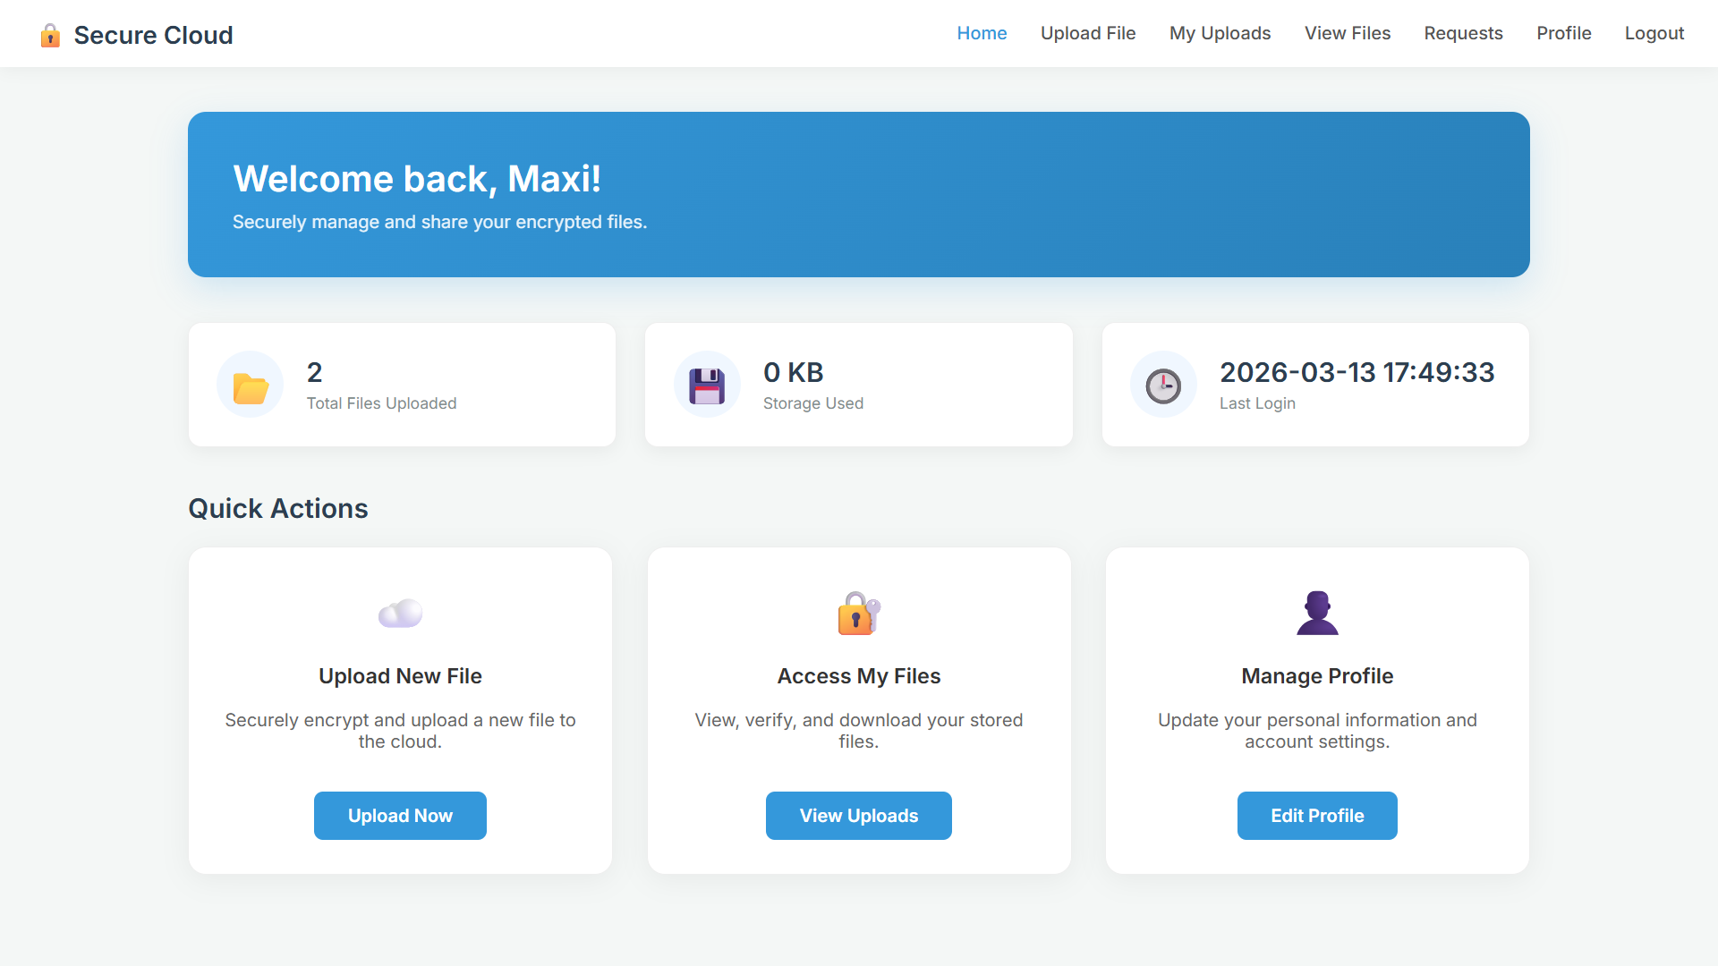
SAMPLE SCREENSHOTS
User Home Page:
After login, the user dashboard shows total files uploaded, storage used, and last login information. Quick action buttons allow users to Upload New File, Access My Files, and Manage Profile. The navigation bar provides links to Upload File, My Uploads, View Files, Requests, and Profile sections for full control over file management.
11/03/2026
PCS24PJ41 Project - Second Review Presentation 2025- 2026
12

Slide 13
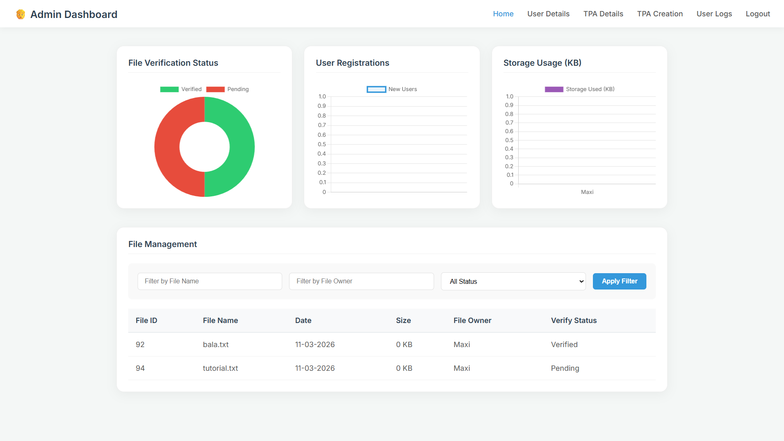
SAMPLE SCREENSHOTS
Admin Home Page:
The Admin Dashboard provides a centralized interface to monitor user registrations, verify uploaded files, manage storage, and control system activities. The dashboard displays File Verification Status, User Registration counts, and Storage Usage (KB). A file management table lists File ID, File Name, Upload Date, Size, File Owner, and Verify Status for every uploaded file in the system.
11/03/2026
PCS24PJ41 Project - Second Review Presentation 2025- 2026
13

Slide 14
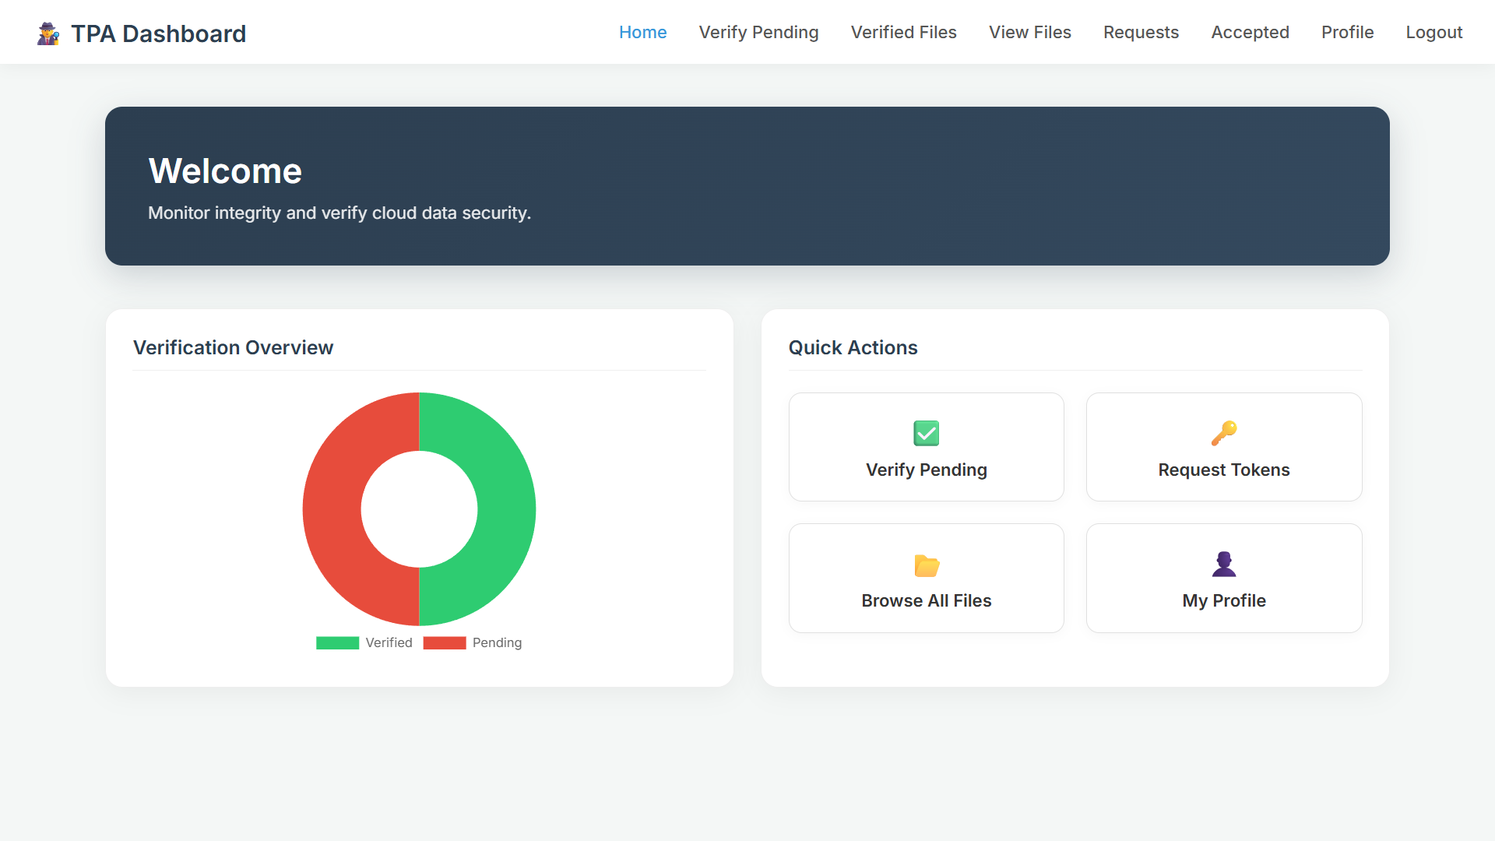
SAMPLE SCREENSHOTS
TPA Home Page:
The TPA (Third Party Auditor) dashboard allows the auditor to monitor and verify cloud file integrity. It shows a Verification Overview with counts of Verified and Pending files. Quick Action buttons include Verify Pending, Request Tokens, Browse All Files, and My Profile, enabling efficient and secure auditing of all cloud-stored files.
11/03/2026
PCS24PJ41 Project - Second Review Presentation 2025- 2026
14

Slide 15
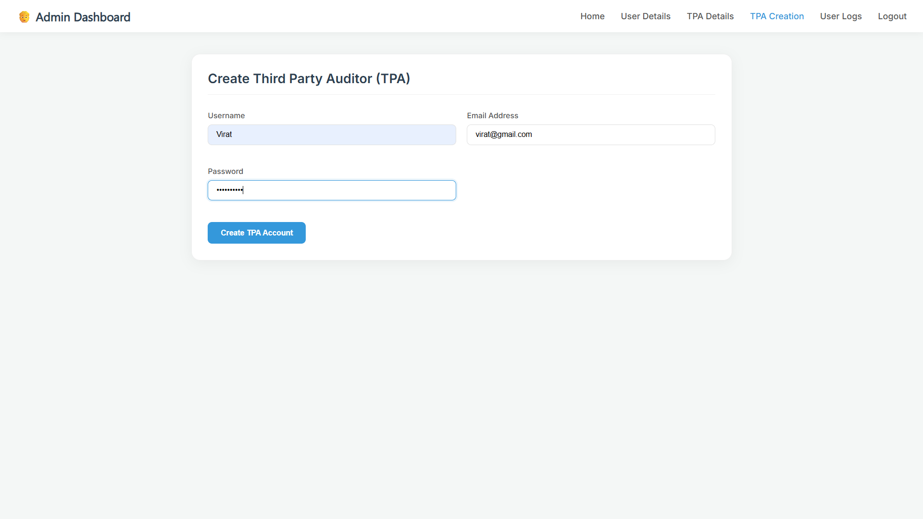
SAMPLE SCREENSHOTS
Create Third Party Auditor:
This image shows an Admin Dashboard page used to create a Third Party Auditor (TPA) account. The form contains fields for Username, Email Address, and Password. The admin enters the details and clicks the “Create TPA Account” button to register a new auditor.
11/03/2026
PCS24PJ41 Project - Second Review Presentation 2025- 2026
14

Slide 16
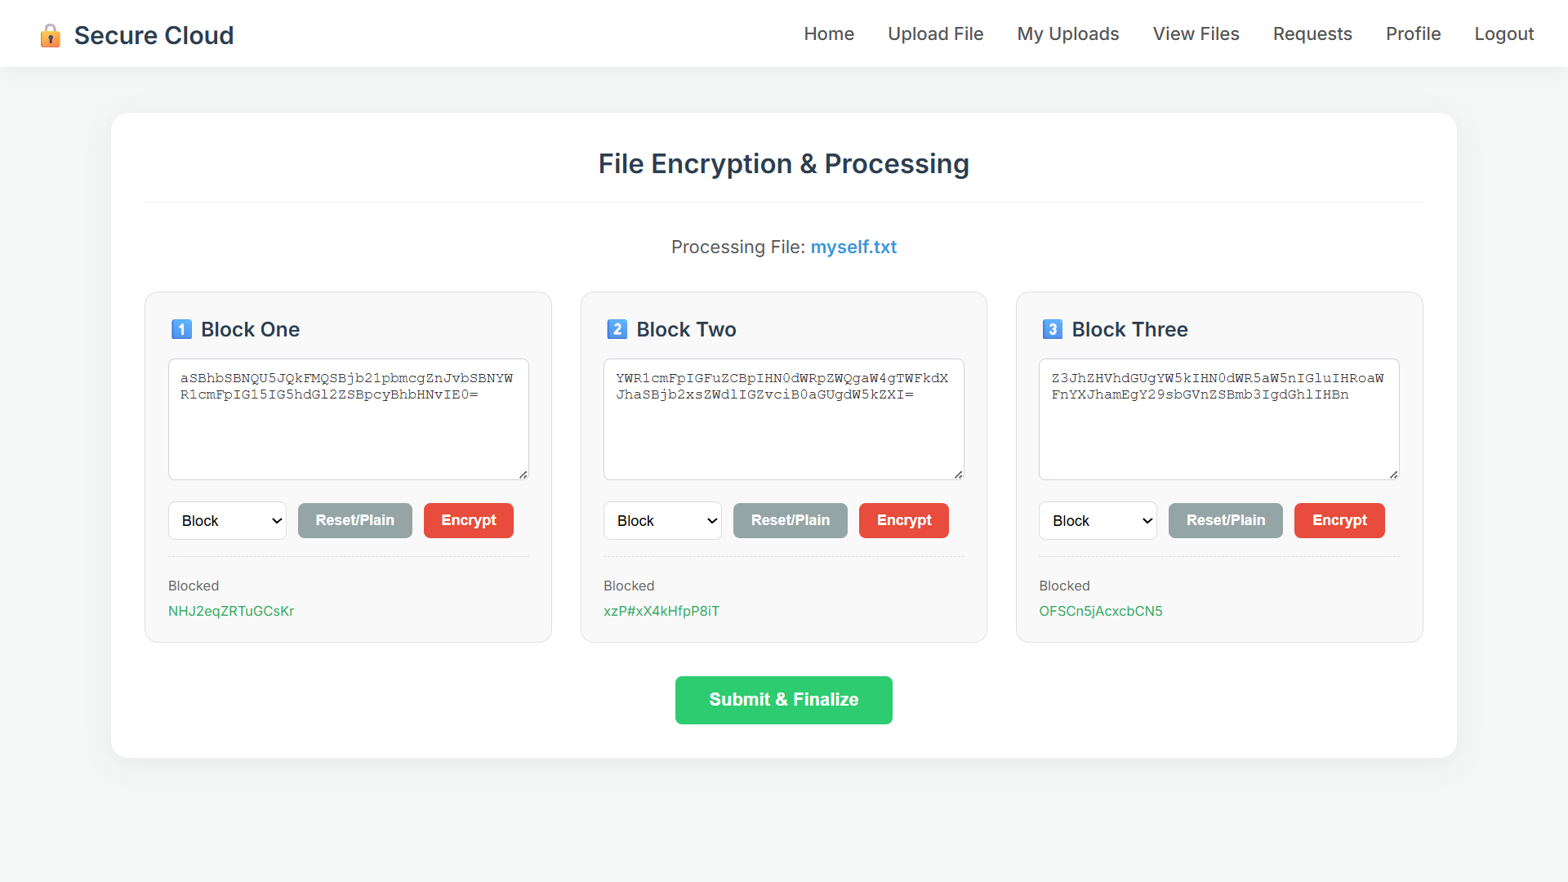
SAMPLE SCREENSHOTS
File Encryption and Processing:
This interface shows a secure cloud system where a file is divided into blocks and each block is encrypted before being submitted and stored securely in the cloud.
11/03/2026
PCS24PJ41 Project - Second Review Presentation 2025- 2026
14

Slide 17
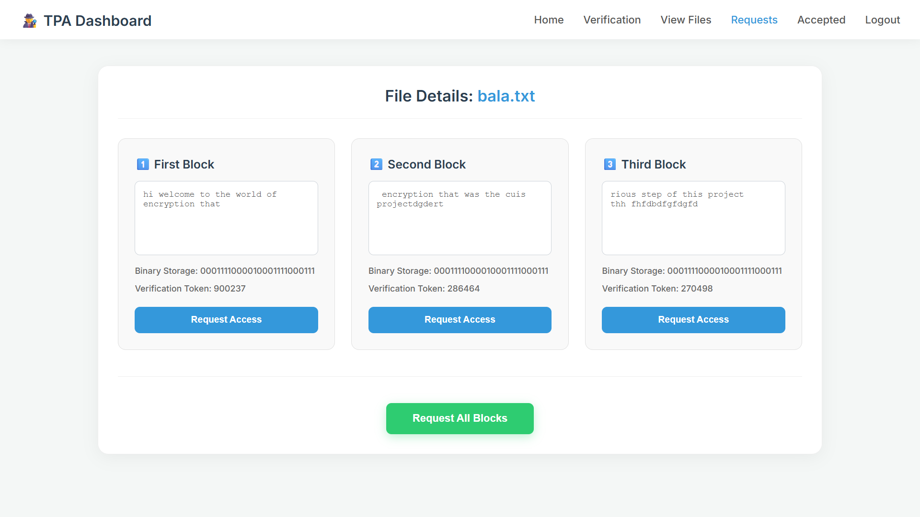
SAMPLE SCREENSHOTS
File Block Access Request:
TPA dashboard where encrypted file blocks are displayed with binary storage and verification tokens, allowing the auditor to request access for verification.
11/03/2026
PCS24PJ41 Project - Second Review Presentation 2025- 2026
14

Slide 18
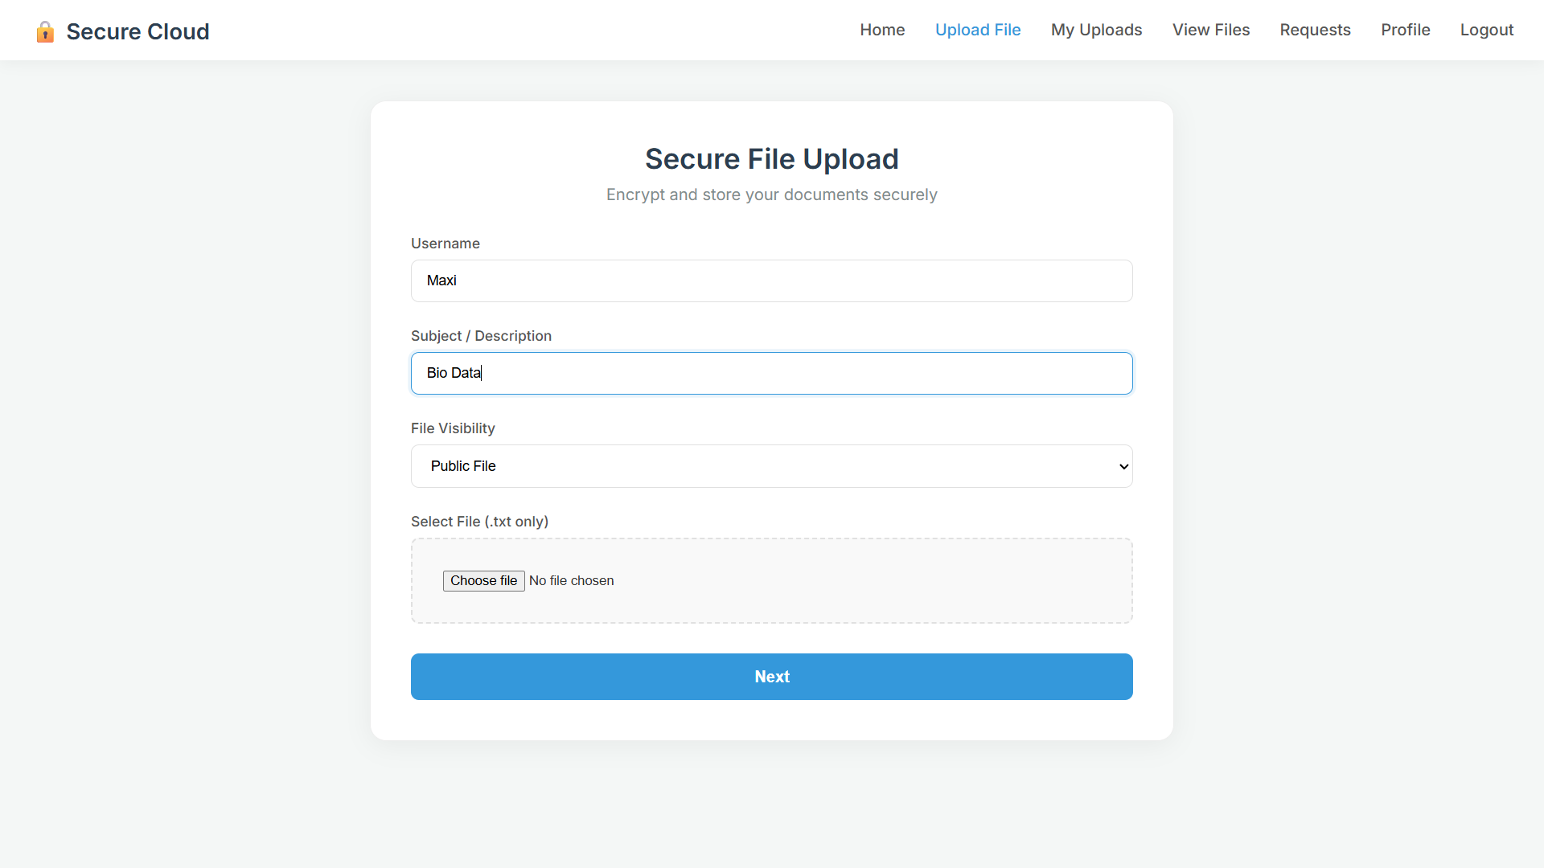
SAMPLE SCREENSHOTS
Secure File Upload:
This page allows users to upload a text file with a description and visibility option so the document can be encrypted and securely stored in the cloud.
11/03/2026
PCS24PJ41 Project - Second Review Presentation 2025- 2026
14

Slide 19
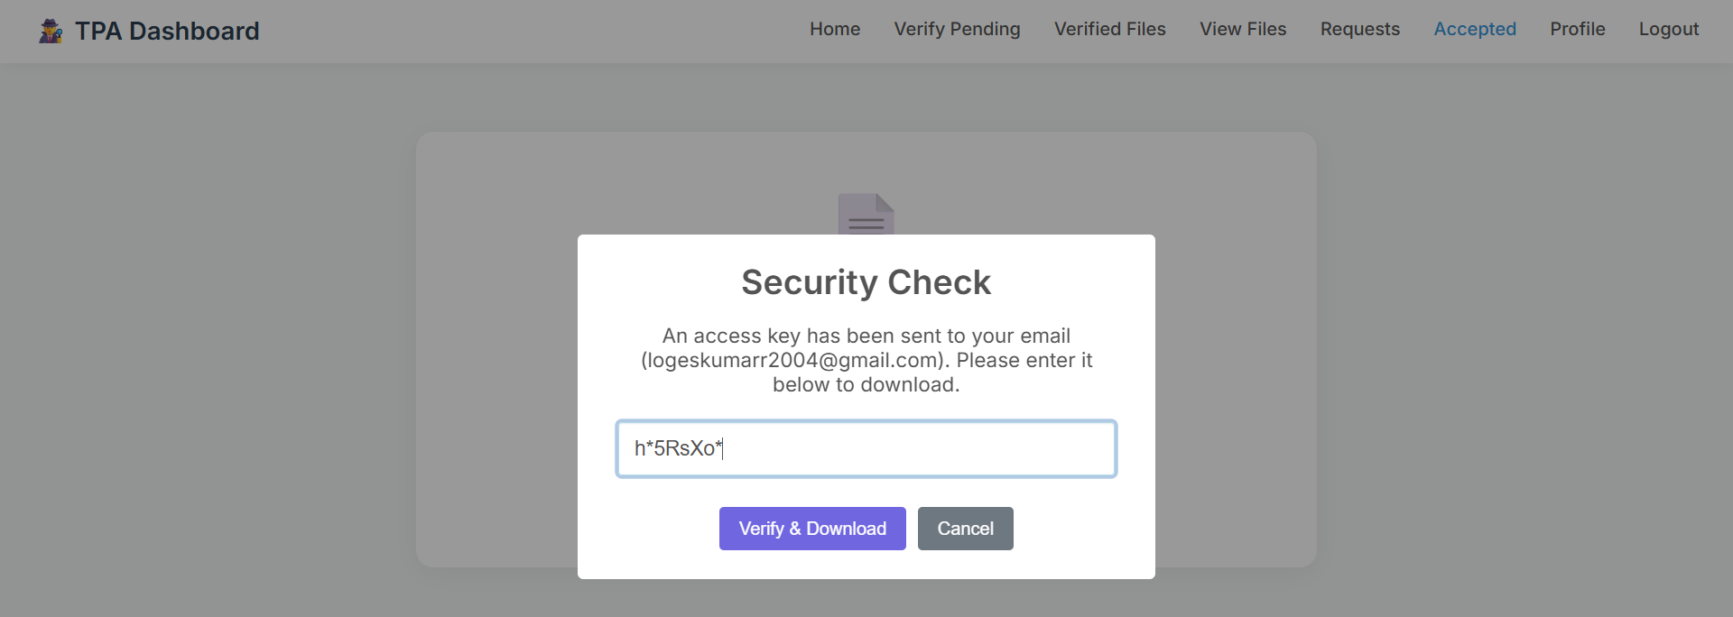
SAMPLE SCREENSHOTS
Security Check for File Download:
This screen shows a security verification step where the user enters an email access key to verify identity before downloading the file securely.
11/03/2026
PCS24PJ41 Project - Second Review Presentation 2025- 2026
14

Slide 20
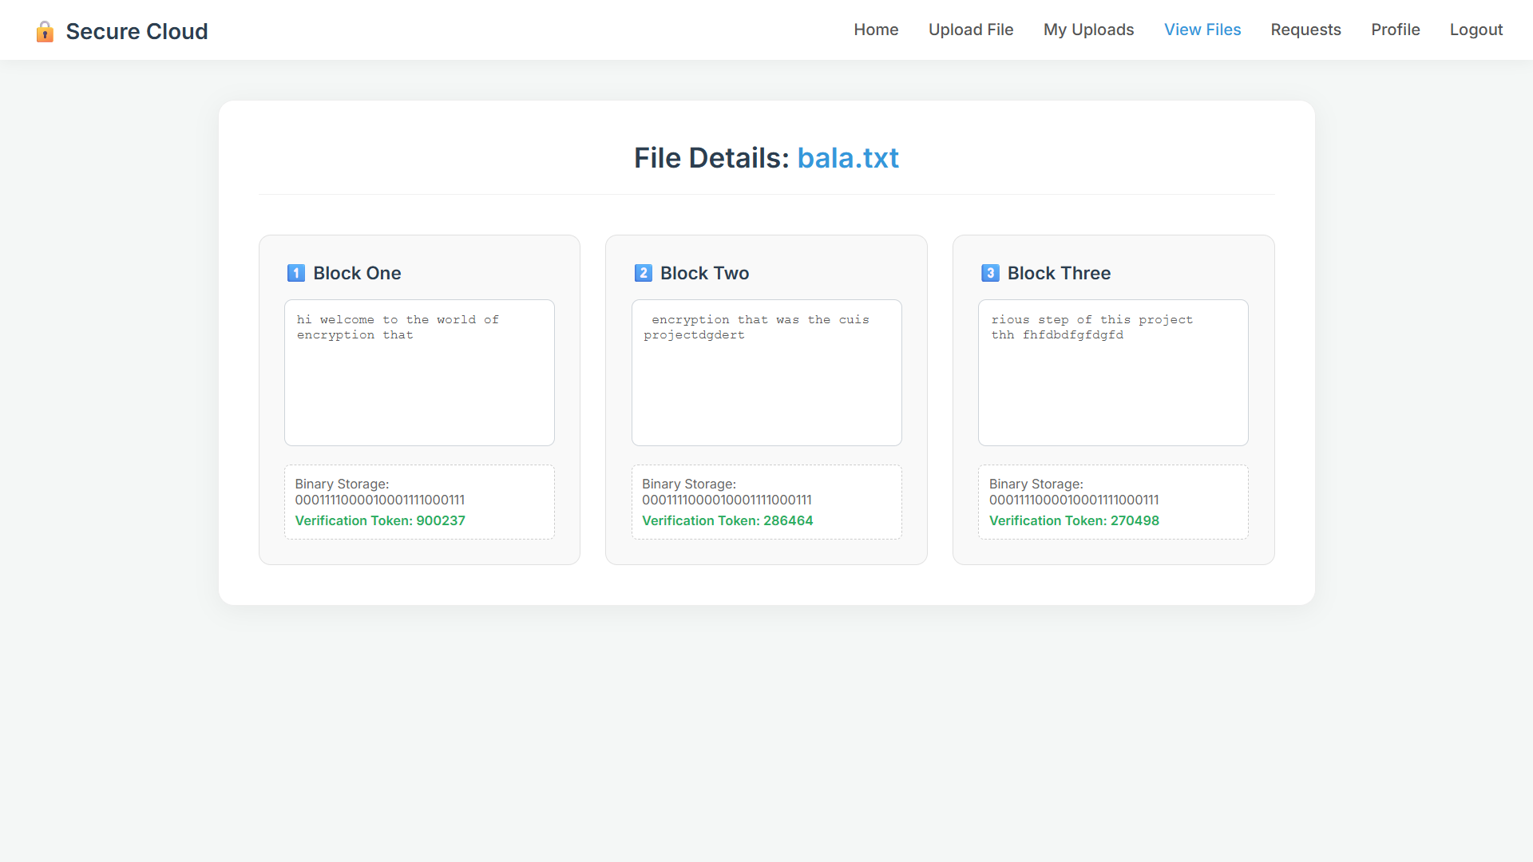
SAMPLE SCREENSHOTS
File Block Details View:
This page displays a file divided into multiple blocks with their binary storage and verification tokens to ensure data integrity in the secure cloud system.
11/03/2026
PCS24PJ41 Project - Second Review Presentation 2025- 2026
14

Slide 21
CONCLUSION
Cloud computing provides scalable storage but introduces security challenges for data privacy and access control.
The proposed PS-ACS framework achieves trusted virtual machine deployment and domain-based data protection.
File partitioning, encryption, OTP-based authentication, and third-party auditing ensure only authorized users access data.
System design demonstrates secure cloud storage can be achieved without significantly affecting performance.
Proposed protocols showed strong resistance to unauthorized access and data manipulation in all test cases.
Performance analysis shows that security mechanisms introduce only minimal overhead to the overall system.
The framework provides an effective solution for privacy protection and secure access control in cloud-based services.
11/03/2026
PCS24PJ41 Project - Second Review Presentation 2025- 2026
15

Slide 22
FUTURE ENHANCEMENT
Improve trust mechanisms used in cloud network communications for secure data transmission.
Implement data geolocation and regulatory compliance to store sensitive data in specific geographic regions.
Searchable encryption will allow users to query encrypted cloud data without decrypting it.
Blockchain technology can be integrated for transaction transparency and immutable audit trails.
AI-based anomaly detection can identify suspicious access patterns and prevent security threats.
Mobile application support for secure file upload, access requests, and OTP verification on mobile devices.
With further improvements, the framework can be integrated into real-world cloud platforms.
11/03/2026
PCS24PJ41 Project - Second Review Presentation 2025- 2026
16

Slide 23
Thank You !
THIAGARAJAR COLLEGE (AUTONOMOUS), MADURAI
Department of Computer Science | PCS20PJ41 – Second Review 2025-2026
11/03/2026
PCS24PJ41 Project - Second Review Presentation 2025- 2026
17

