Slide 1
Call Center Trends Dashboard using Power BI! 🚀
Sales Dashboard in PowerBI! 🚀

Slide 2
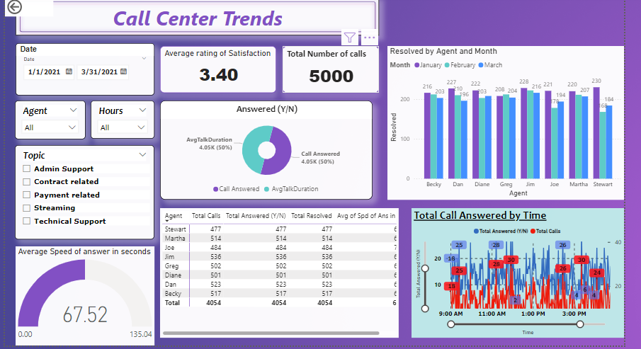
Call Center Trends
This dynamic dashboard offers a bird's-eye view of crucial metrics, providing valuable insights into call center performance. From call volumes and response times to customer satisfaction scores, it's all at your fingertips. 🌐💼 Key Features: ✅ Real-time Data Visualization ✅ Comparative Analysis of Call Metrics ✅ Customer Satisfaction Trends ✅ Agent Performance Metrics KPI Includes (my project): 👍➡️Overall customer satisfaction 👍➡️Overall calls answered and abandoned 👍➡️Calls by time 👍➡️Average speed of answer 👍➡️Agents performance quadrant.

Slide 3
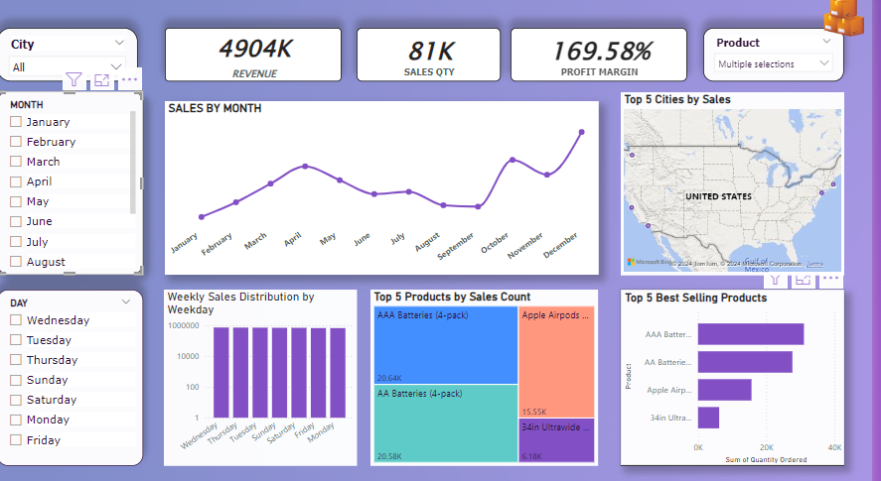
Sales Report
Sales Dashboard in PowerBI, designed to monitor performance, generate reports, and analyze trends. 📊Key Features: 🎯Sales By Category: Visual breakdown of sales across different product categories. 📈Profit Gained Over Time: Insightful graphs showing profit trends over the years. 🚀By State: Geographical representation of sales distribution. 📊Customer Count: Year-over-year comparison of customer numbers. 💰Top 5 Customers selling Products: Highlighting our most profitable customers. 📆Monthly Sales: Monitoring monthly sales performance to spot trends and anomalies.

