Slide 1

Hackathon Presentation

Slide 2
DEMO

Slide 3


Trends
1.6B
illion
Players
over the world
10%
Growth per year

Slide 4
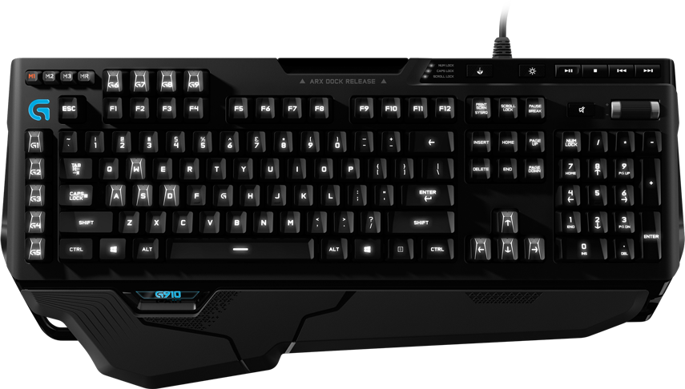

Slide 5
Why it doesn’t work
Difficult to press
Occupy too many space
Too busy

Slide 6

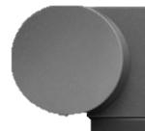
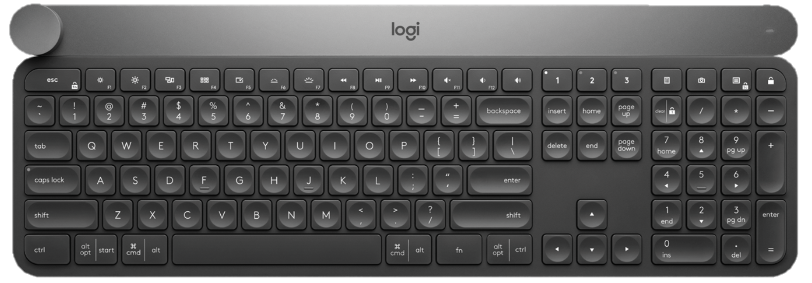

Slide 7

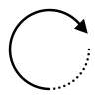

tap
turn
touch

Slide 8
Benefit of Crown
All in one
Instinctive
Portable

Slide 9

Then why not…
G1
G2
G3
we just combine then together ?
Notes:
Then why not we just combine then together?

Slide 10

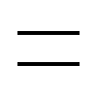




Slightly touch
Select
Game mode
Home
Office mode

Slide 11



Game Mode
Locked key
Special key
Normal key

Slide 12







Office Mode
Just the same as the original Craft settings

Slide 13

Then
We come up with the concept of pedal
Better experience
Better control

Slide 14
The same function as above
And it turns out to be:
step
step+
mouse wheel
touch

Slide 15
Thanks for watching !!

Slide 16
Reference
https://www.bnext.com.tw/article/45491/yahoo-research-on-gaming-industry
https://anntw.com/articles/20140428-w0L4
http://www.gamebase.com.tw/forum/60053/topic/96560355

