Slide 1
連點系統 Auto PRESS KEY
沙包隊

Slide 2
original
Pain point
- too tired to click keys frequently
- you have to leave for a while but don’t want to stop the game
Solution
- roll the crown to replace multiple clicks

Slide 3
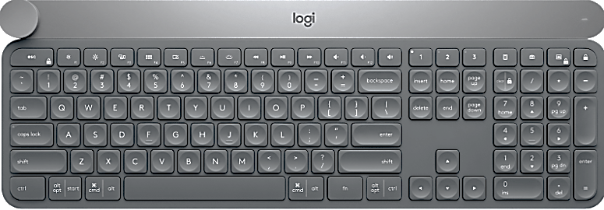
We roll instead of press
- Press the crown to start
- Choose which key we want to press, and then roll the crown.
- The rotation rate represents the times to click

Slide 4
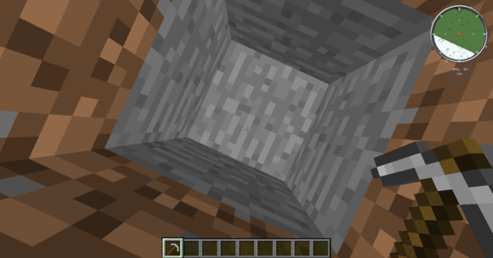
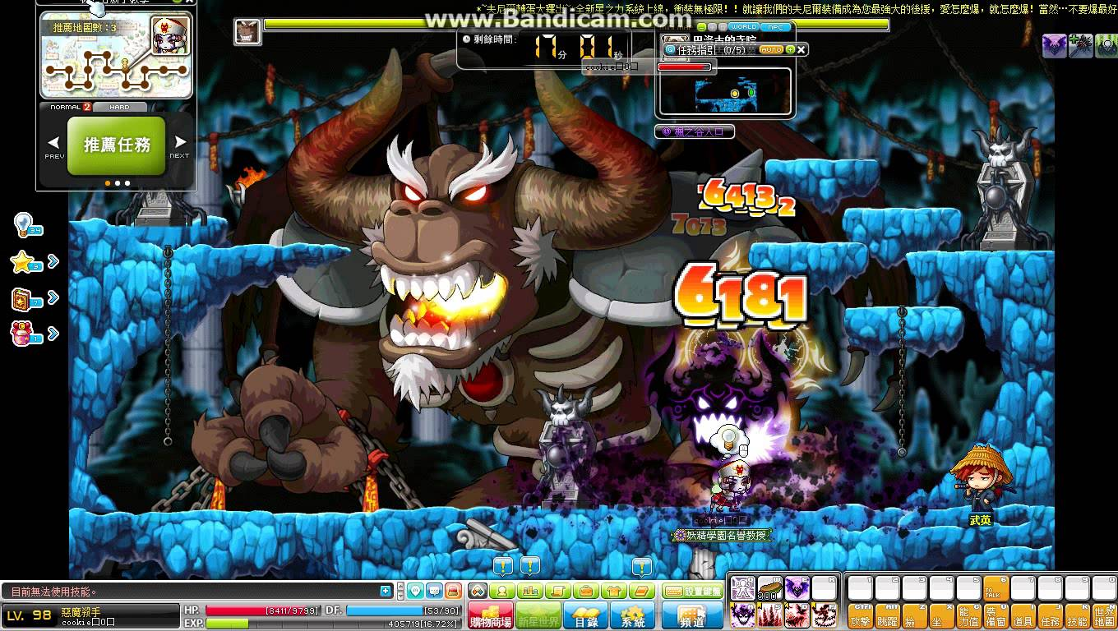
IDEA
Minecraft (mining)
Fighting Boss (Maple Story)

Slide 5
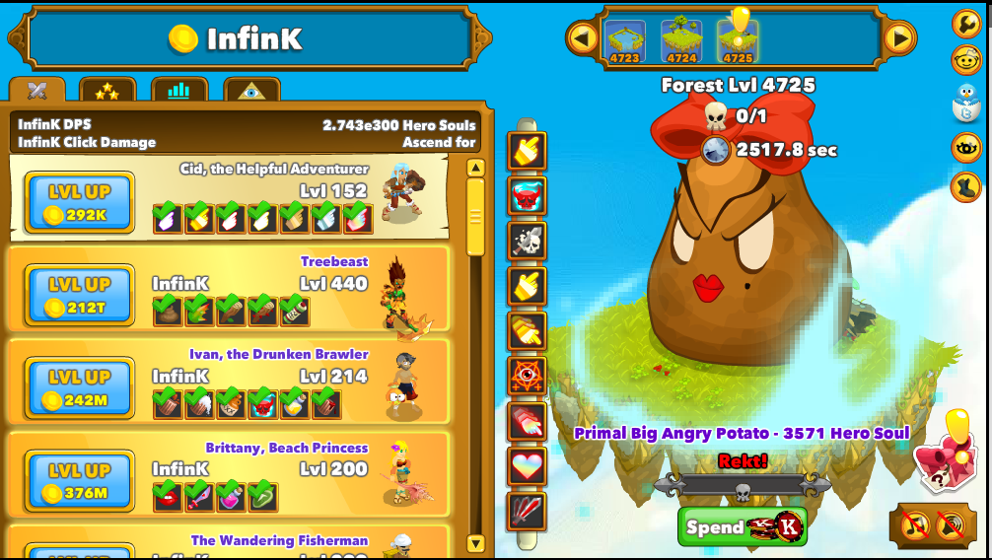
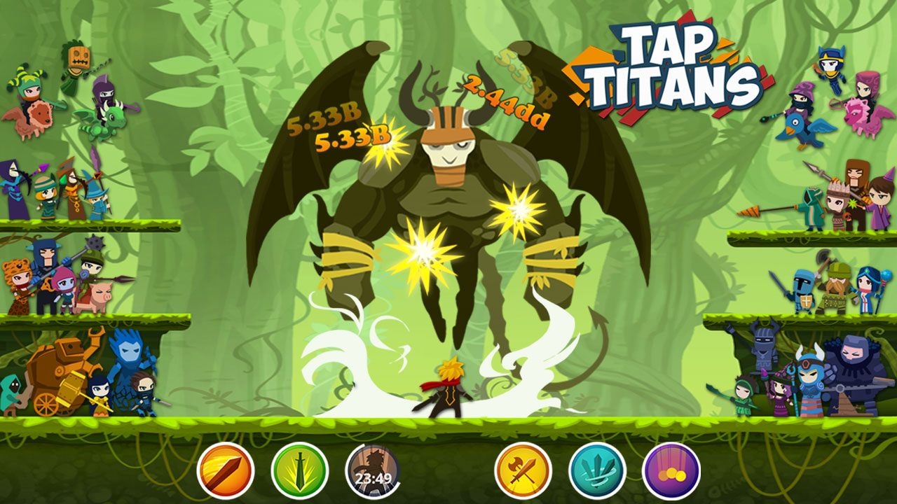
IDEA
Clicker heroes
Tap titan

Slide 6
demo

