Slide 1

$$similarity=\cos{θ}=\frac{b.c}{\left\|b\right\|\left\|c\right\|}$$
$b.c⇒Is the Dot product of the two vectors$
$\left\|b\right\|\left\|c\right\|⇒Is the product of each vector^{′}s magnitude$

Slide 2

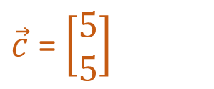

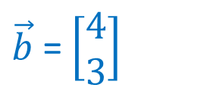

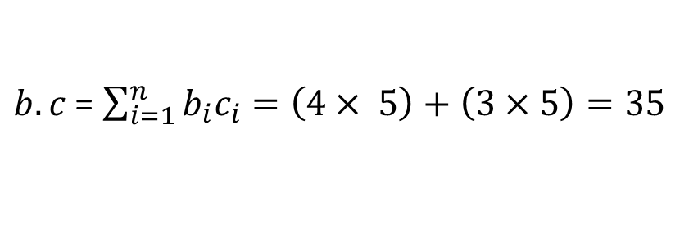



Name | Iron Man | Pride & Prejudice
Bernard | 4 | 3
Clarissa | 5 | 5
$\vec{b}$ = $\left[\begin{aligned}4 \\ 3\end{aligned}\right]$
$\vec{c}$ = $\left[\begin{aligned}5 \\ 5\end{aligned}\right]$
$$similarity=\cos{θ}=\frac{b.c}{\left\|b\right\|\left\|c\right\|}$$
Iron Man
$$Calculating:$$
Clarissa
(5,5)
$b.c$ = $\sum_{i=1}^{n}{b_{i}c_{i}=\left(4× 5\right)+\left(3×5\right)=35 }$
(4,3)
Bernard
$$θ$$
$\left\|b\right\|$ = $\sqrt{4^{2}+3^{2}}=5$
$$\left\|c\right\|=\sqrt{5^{2}+5^{2}}=5\sqrt{2}$$
Pride &
Prejudice
$similarity=\frac{35}{5×5\sqrt{2}}$ $\sim 0.989$

Slide 3
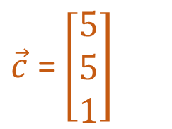

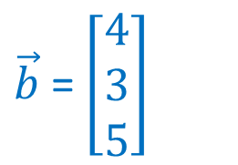


Name | Iron Man | Pride & Prejudice | Ditrict 9
Bernard | 4 | 3 | 5
Clarissa | 5 | 5 | 1
$\vec{b}$ = $\left[\begin{aligned}4 \\ 3 \\ 5\end{aligned}\right]$
$\vec{c}$ = $\left[\begin{aligned}5 \\ 5 \\ 1\end{aligned}\right]$
(4,3,5)
(5,5,1)
Iron Man
$$Calculating:$$
$b.c$ = $\left(4×5\right)+\left(3×5\right)+(5×1)=40$
$\left\|b\right\|$ = $\sqrt{4^{2}+3^{2}+5^{2}}=5\sqrt{2}$
$\left\|c\right\|$ = $\sqrt{5^{2}+5^{2}+1^{2}}=\sqrt{51}$
$similarity=\frac{40}{5\sqrt{2}×\sqrt{51}}$ $\sim 0.792$
Pride &
Prejudice

Slide 4
