Slide 1



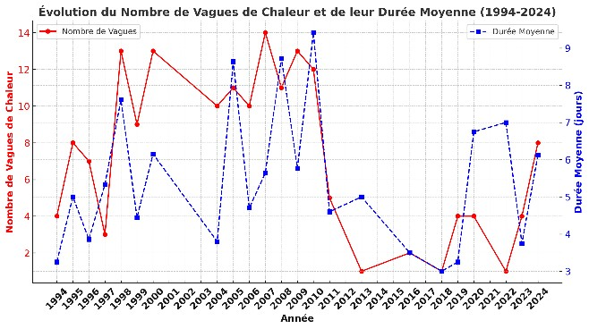
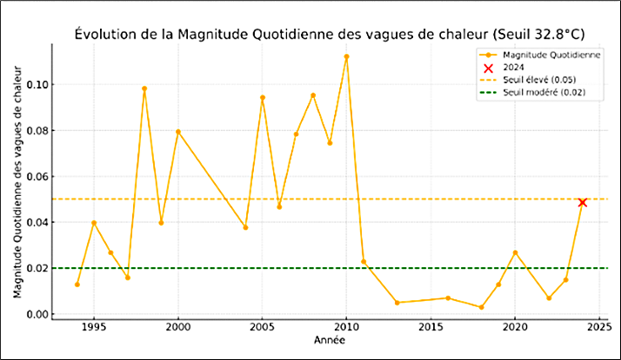
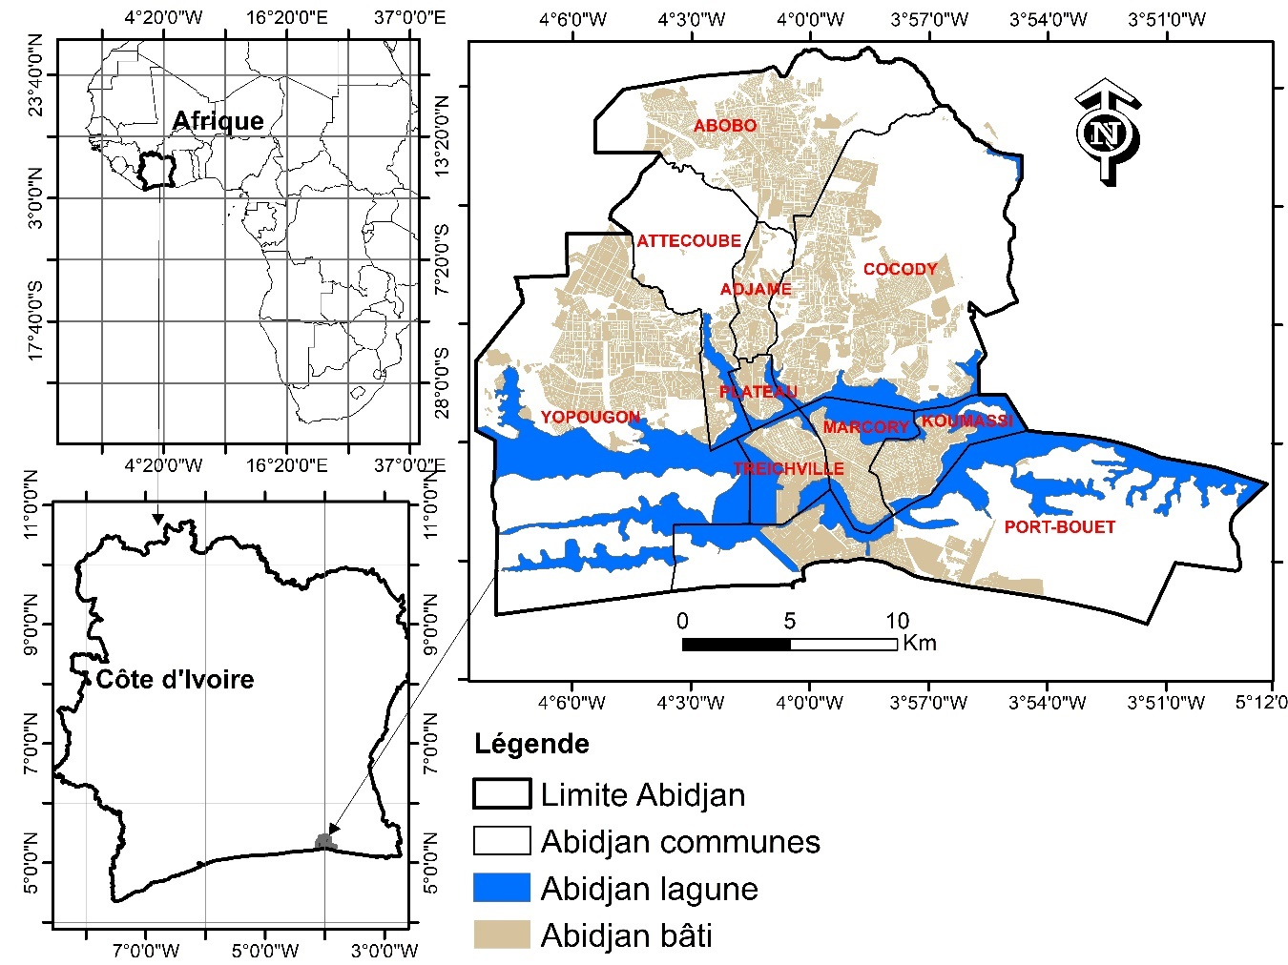
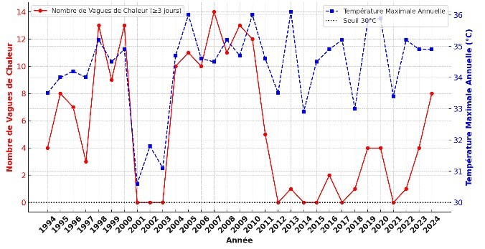








HEAT WAVES AND PUBLIC PERCEPTION IN THE CITY OF ABIDJAN (CÔTE D’IVOIRE)
Authors: Iba Dieudonne DELY^{1,2*} ; Etienne KOUAKOU^{2,3} ; Madina DOUMBIA^{1,2}; Matthew CHERSICH⁵ ; Stanley LUCHTERS⁶; Brama KONE^{1,2} ; Guéladio CISSE^{1,2,7,8}, on behalf of the HE 2AT Center
^{1.}University Peleforo Gon Coulibaly, Côte d’Ivoire ; ^{2.}Centre Suisse de Recherches Scientifiques en Côte d’Ivoire ; ³ University Nangui Abrogoua, Côte d’Ivoire ; ⁴ University Felix Houphouët Boigny, Abidjan, Côte d’Ivoire; ^{5.} Witwatersrand University, Johannesburg, South Africa ; ^{6.}Center for Sexual Health and HIV/AIDS Research, Harare, Zimbabwe ; ^{7.}Swiss Tropical and Public Health Institute, Allschwil, Switzerland ; ^{8.}University of Basel, Basel, Switzerland ; *.Presenting author
Background
Results
The IPCC (2021) projects global temperatures to rise by 1.5°C as early as 2030, exacerbating extreme events such as heatwaves (Gamet, 2020). Africa, particularly vulnerable (IPCC, 2021), is experiencing more intense heatwaves (Russo et al., 2016; Sow et al., 2024). In Abidjan, high surface temperatures (Ymba, 2022) amplify this health risk (Cissé et al., 2022). While heat impacts and perceptions are well-documented in developed countries (e.g., Europe 2003, Diouf, 2018), they remain understudied in Africa. This research examines heatwave perceptions by residents and adaptation strategies in Abidjan.
Combined analysis of heatwave frequency and mean duration trends (1994–2024)
A notable increase in the average duration of heatwaves after 2004 in Abidjan.
Recent heatwaves are generally longer but less frequent, indicating increasing persistence despite a reduced number of events.
Methods
. Figure 3: Trend in heatwave frequency and mean duration (1994–2024)
The study analyzes the evolution of maximum temperatures over 30 years using the Pettitt, Buishand, and SNHT tests to identify reliable trends.
Heat waves (≥ 3 consecutive days above the 90th percentile of Tmax) are assessed based on their mean duration (Dm) and intensity (Mq).
A survey was conducted among 1,120 households proportionally distributed across the five most heat-affected municipalities of Abidjan: Adjamé, Cocody, Treichville, Port-Bouët, and Yopougon.
Data, collected through a questionnaire administered to household heads, were coded and statistically analyzed (Excel) to understand their perceptions and adaptation strategies.
Analysis of heatwave intensity: Daily thermal magnitude
The intensity of heatwaves in Abidjan varies every year.
These fluctuations suggest warming trends, requiring long-term monitoring to confirm climate patterns and societal impacts.
Figure 7: Daily magnitude of heat waves (threshold 32.8°C)
Study area
Public perception of heat in Abidjan
Rising temperatures in Abidjan are a major concern for 98% of the population.
February, March, and April emerge as the hottest months according to household reports.
Figure 5: Perception of the hottest months of the year
Adaptation strategies for heatwaves
Figure 1: Location map of Abidjan
Located in the southeast of Côte d’Ivoire, on the coast of the Atlantic Ocean, in the Gulf of Guinea.
Built around the Ébrié lagoon, which separates several communes of the city.
Includes densely populated communes like Yopougon and Abobo, with an important network of waterways.
Strategic position as the main economic and port center of Côte d’Ivoire and West Africa.
To cope residents primarily use affordable fans while air conditioning remains limited by cost
Green spaces and pools rarely utilized as cooling solutions due to accessibility challenges
Results
Figure 6: Adaptation strategies to heatwaves
Combined analysis of temperature trends and number of heatwaves.
Conclusion/Implications
A general increase in the frequency of heatwaves; a moderate positive
correlation (R = 0.48, p < 0.05) links the annual maximum temperature (Tmax) to the frequency of heatwaves.
This study highlights the increasing heatwaves in Abidjan and the population's negative perception.
Adaptation measures, mainly fans and air conditioners, remain limited.
Enhanced awareness and adapted urban policies are essential to better manage the impacts of climate change.
Figure 2: Combined evolution of heatwave frequency and annual maximum temperatures (threshold: 32.8°C)
References
Diouf, Nouvelle-Écosse (2018). Spatio-temporal evolution of heat waves in West Africa and associated health risks. http://rivieresdusud.uasz.sn/xmlui/handle/123456789/955
Sow, M., Gaye, D., & Diakhate, M.M. (2024). Analysis of the spatio-temporal evolution of hot extreme trends in Senegal. VertigO - the electronic journal in environmental sciences. https://doi.org/10.4000/12jq1
Ymba, M. (December 2022). Analysis of the effects of urban heat islands on the health of the population of Abidjan (Côte d’Ivoire). French Red Cross Foundation. https://hal.science/hal-04515027
Funding National Institutes of Health (NIH) / Wits Health consortium (Pty); Contact : iba.dely@csrs.ci

