Slide 1










Annual Meeting Presentation Carbomica Modeling Update

Slide 2
WHAT IS CARBOMICA?
CARBOMICA is a resource allocation efficiency tool from the HIGH Horizons initiative for carbon mitigation in healthcare.
It guides decision-makers on resource allocation for mitigation interventions in healthcare.
Designed as a data science tool, it optimizes resource use to reduce carbon emissions in healthcare facilities, especially in LMICs
Notes:
CP

Slide 3
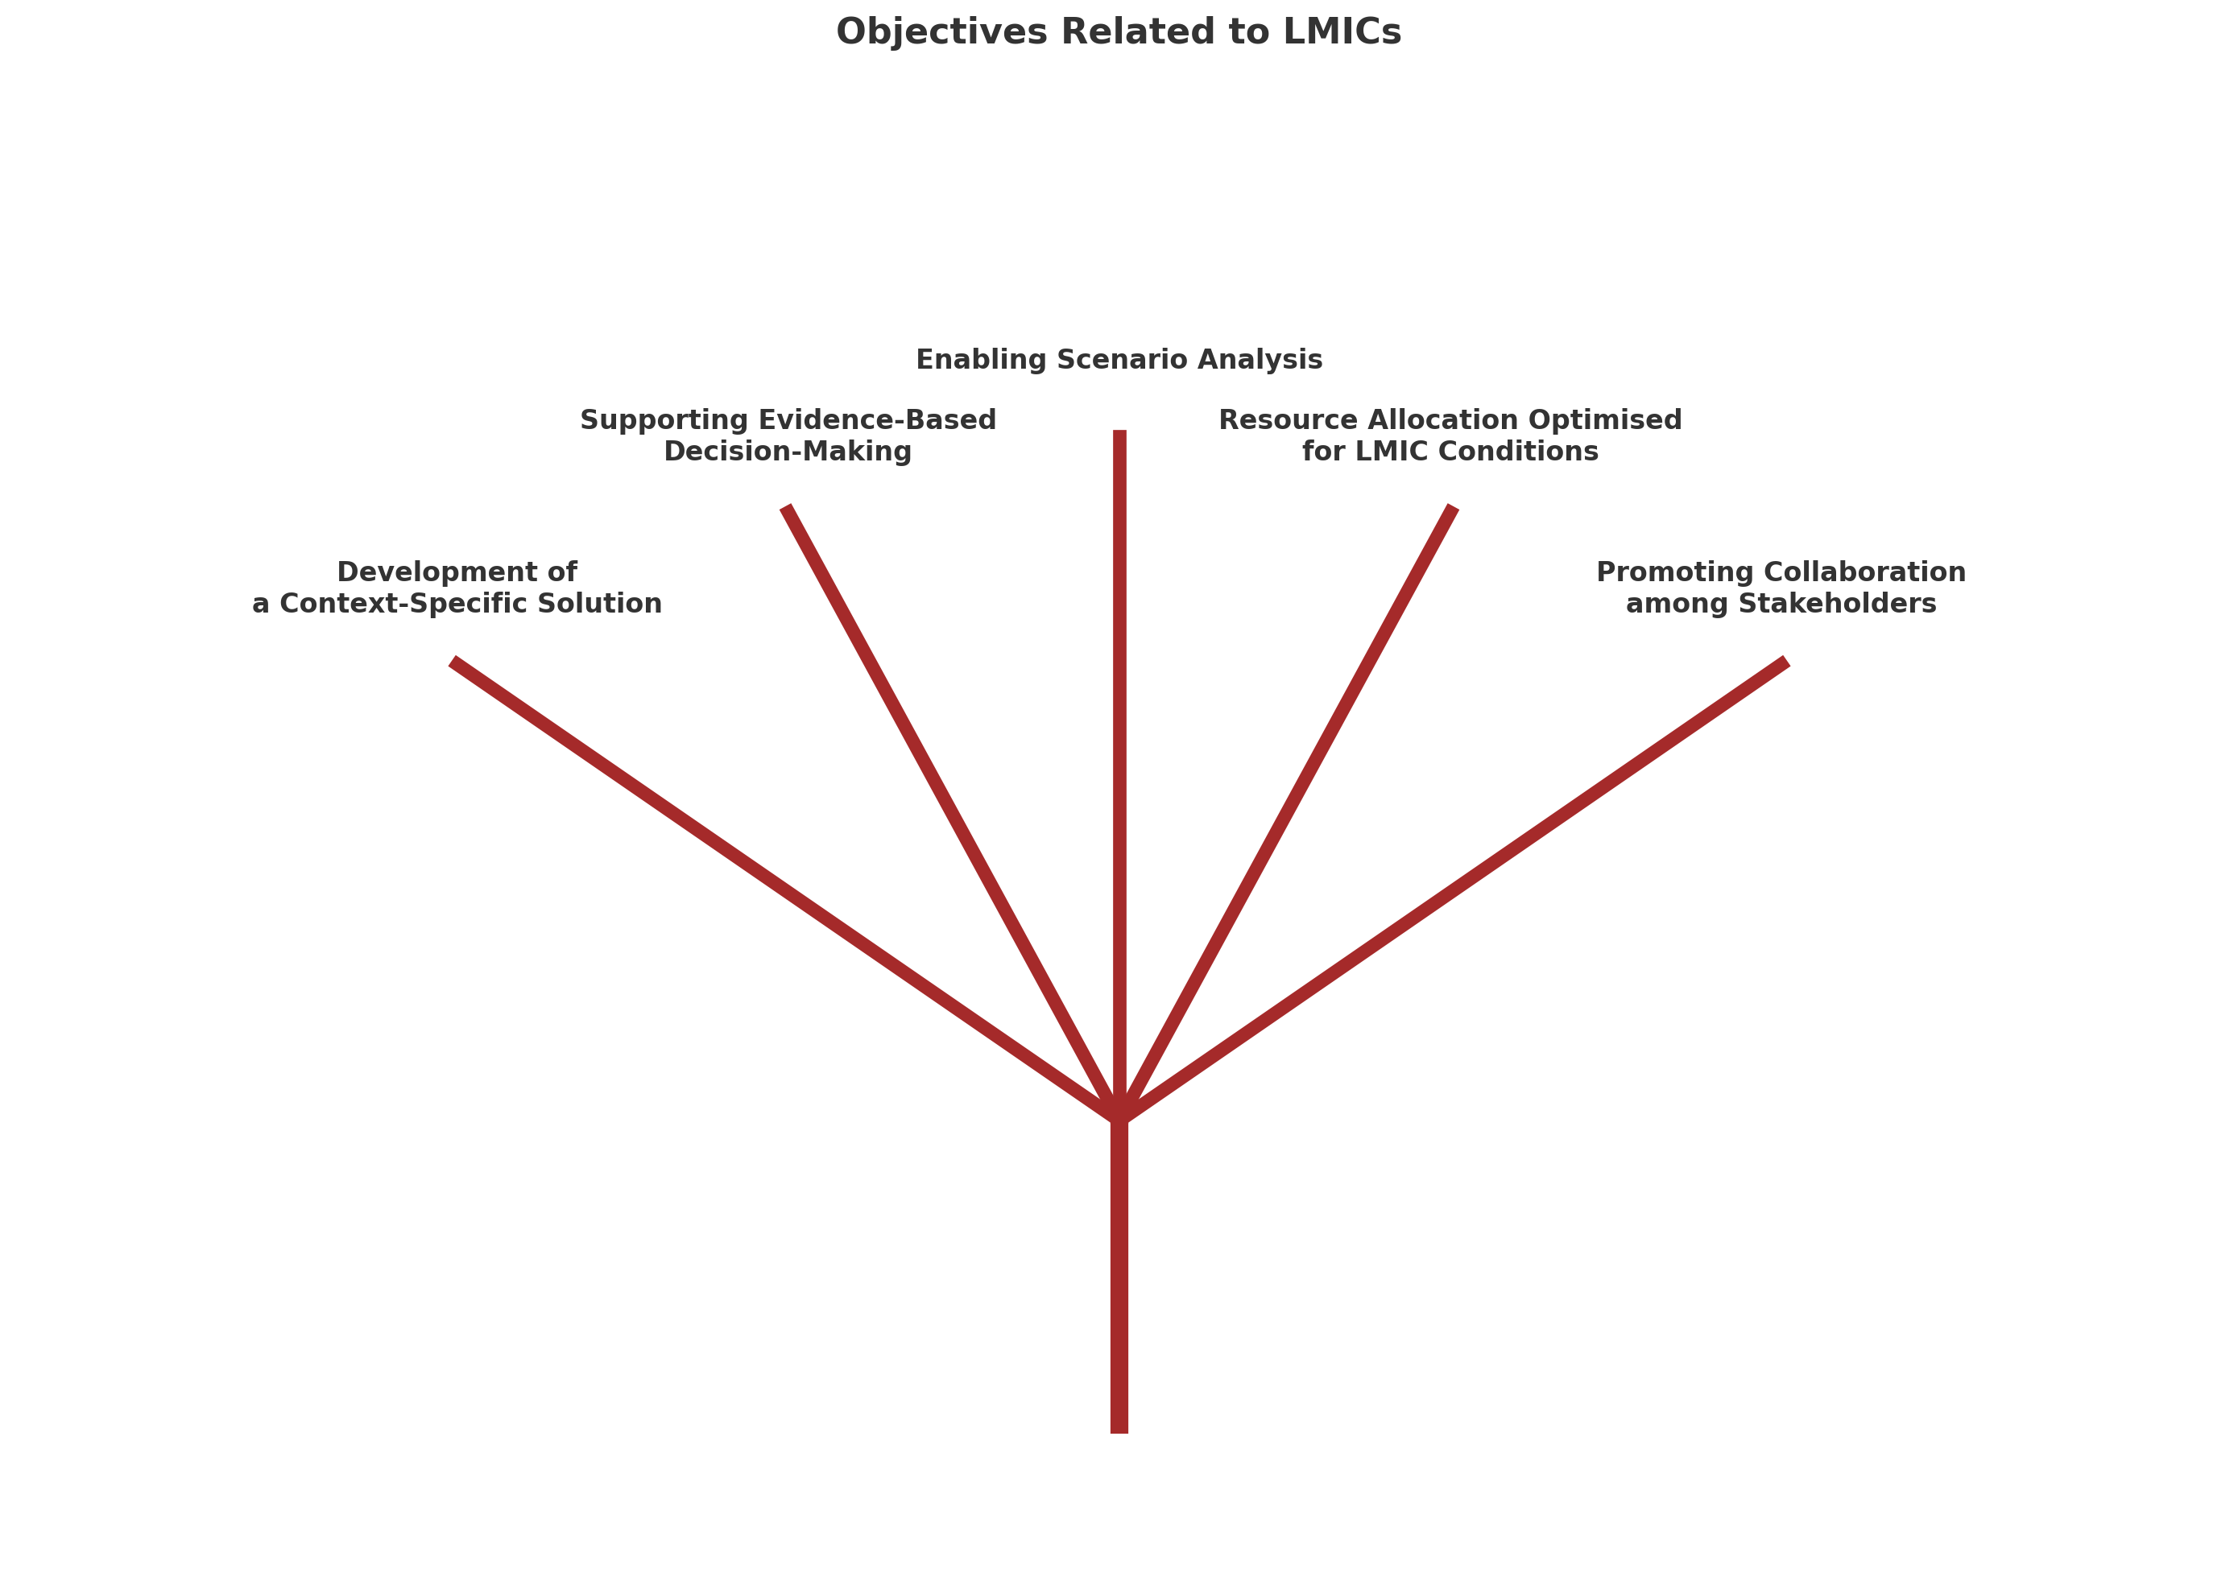
OBJECTIVES
Notes:
Development of a Context-Specific Solution for LMICs
Supporting Evidence-Based Decision-Making in LMICs
Enabling Scenario Analysis Relevant to LMICs
Resource Allocation Optimised for LMIC Conditions
Promoting Collaboration among LMIC Stakeholders

Slide 4
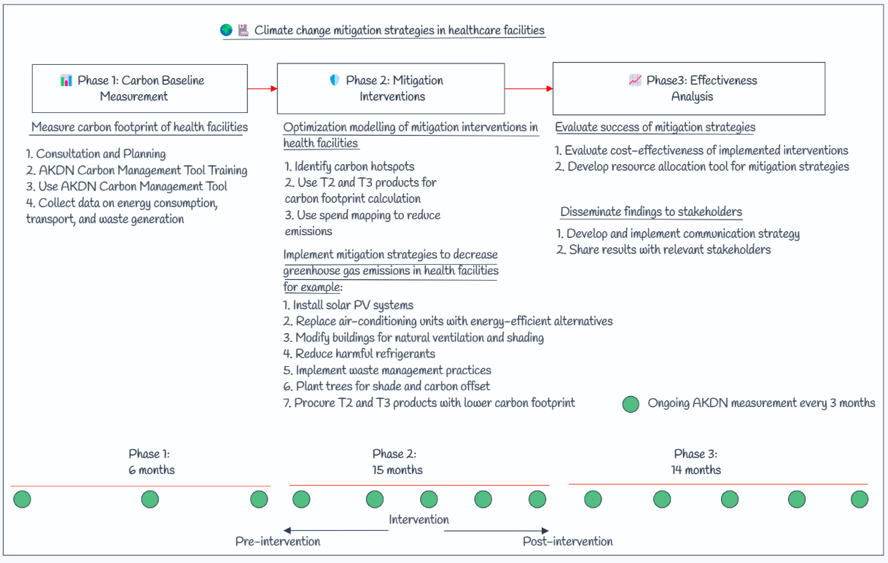

Slide 5
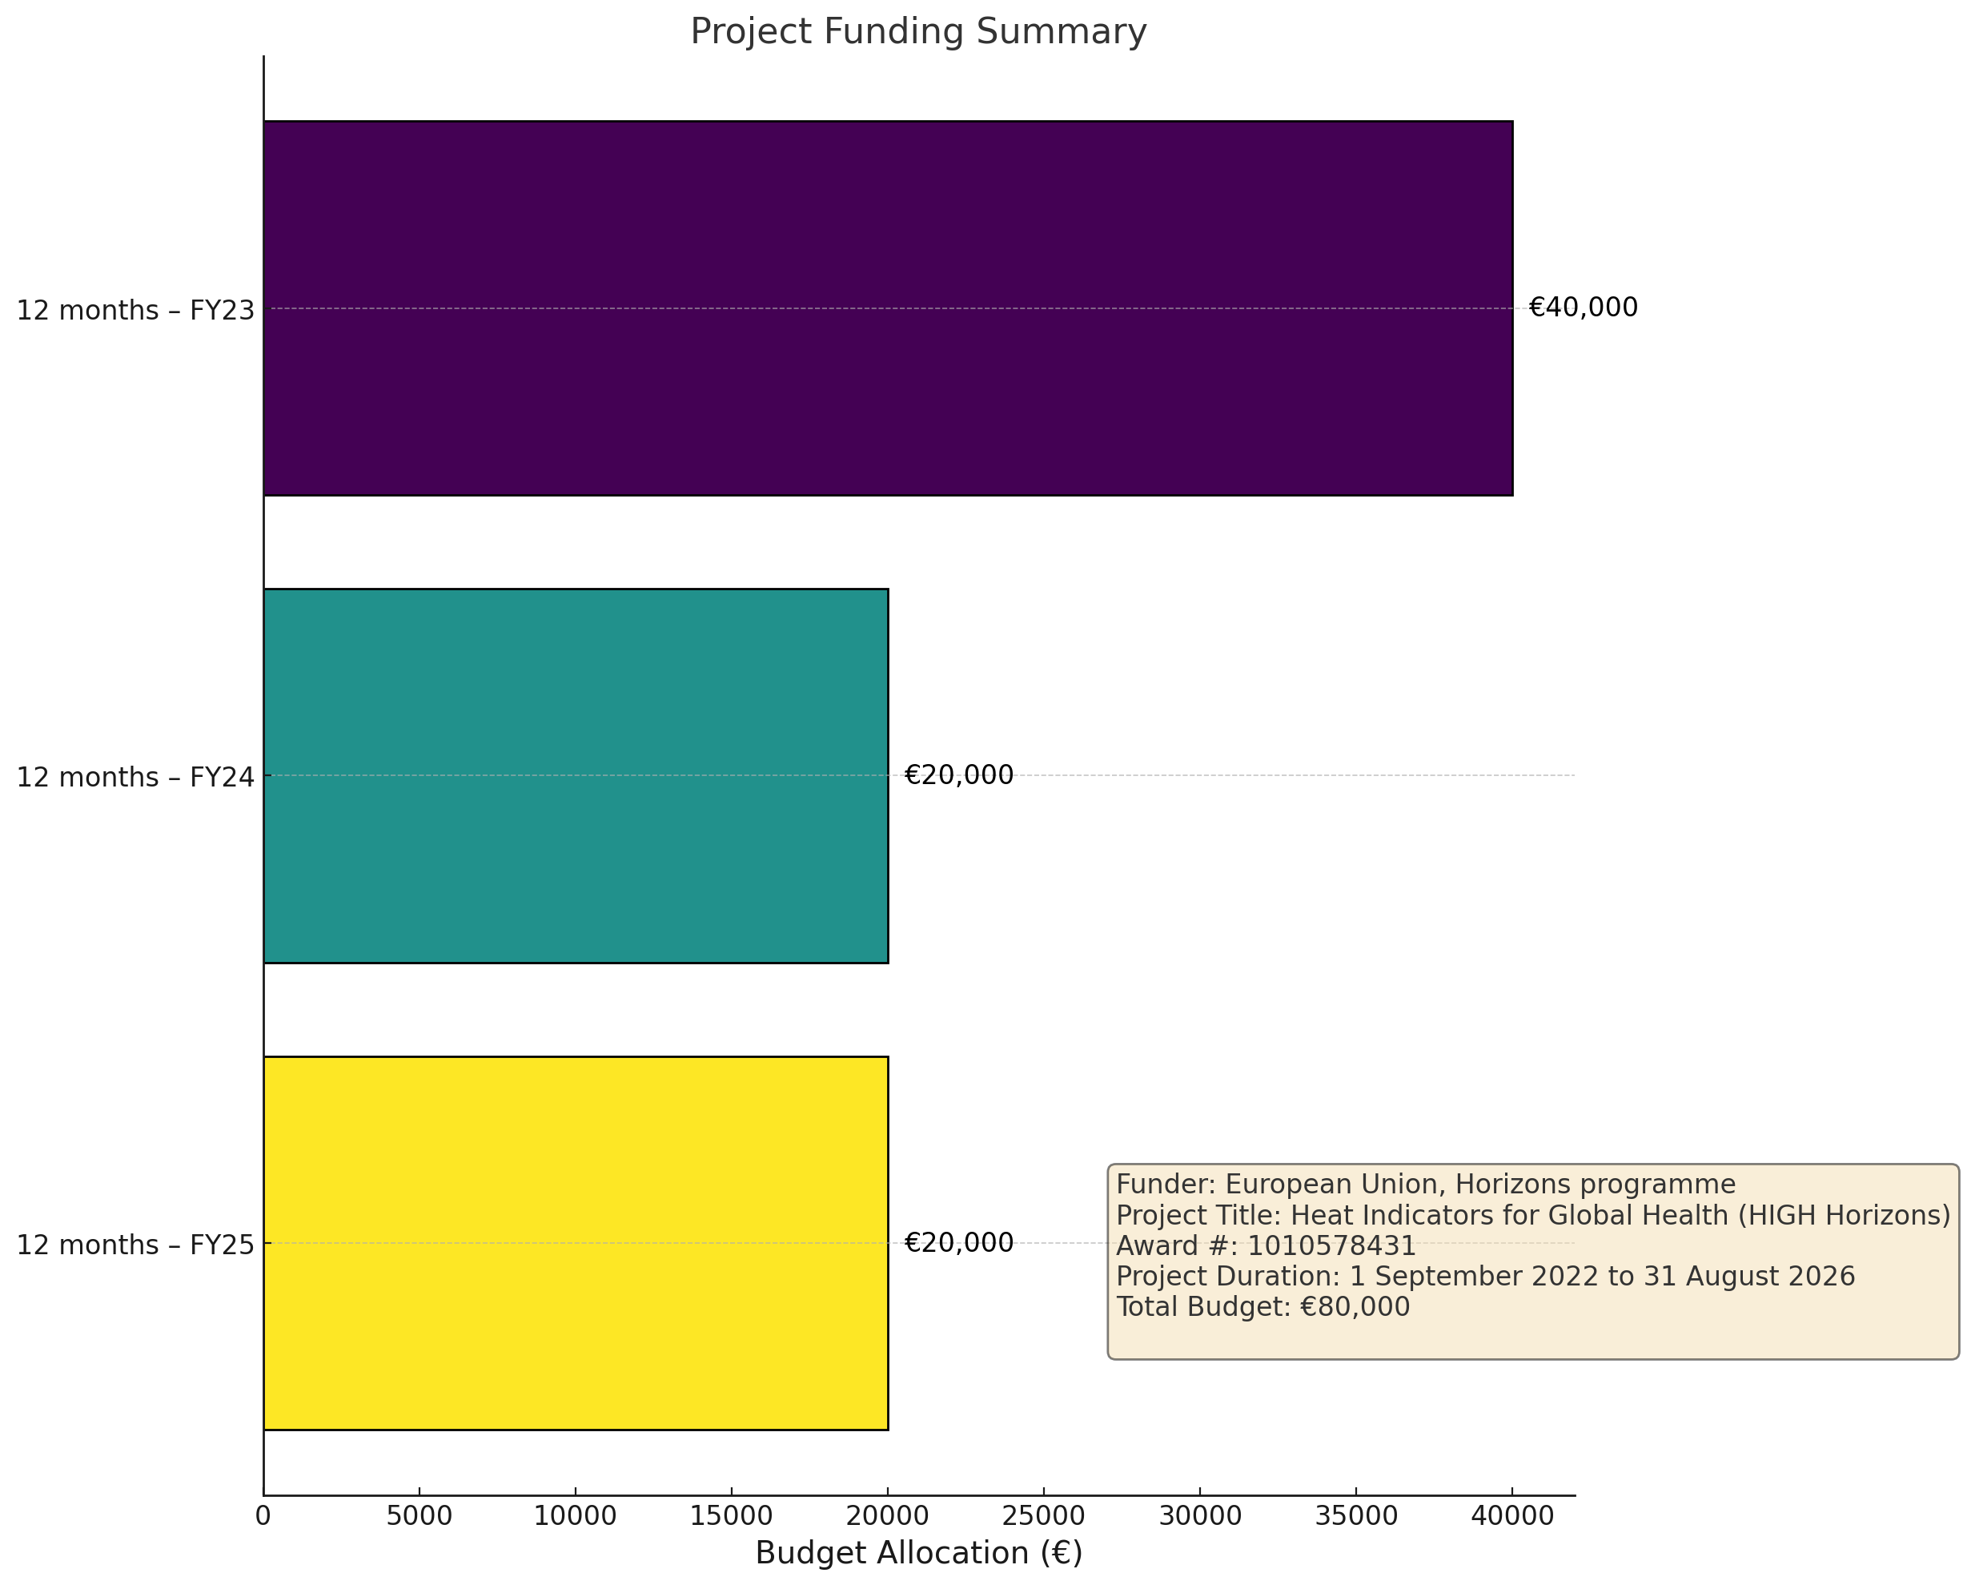

Slide 6
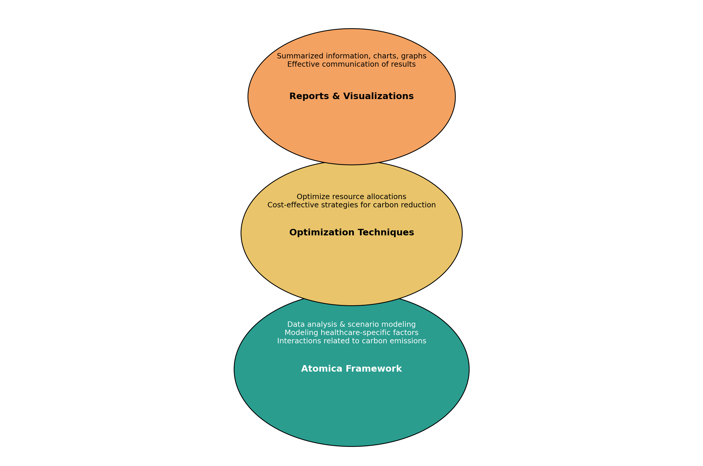
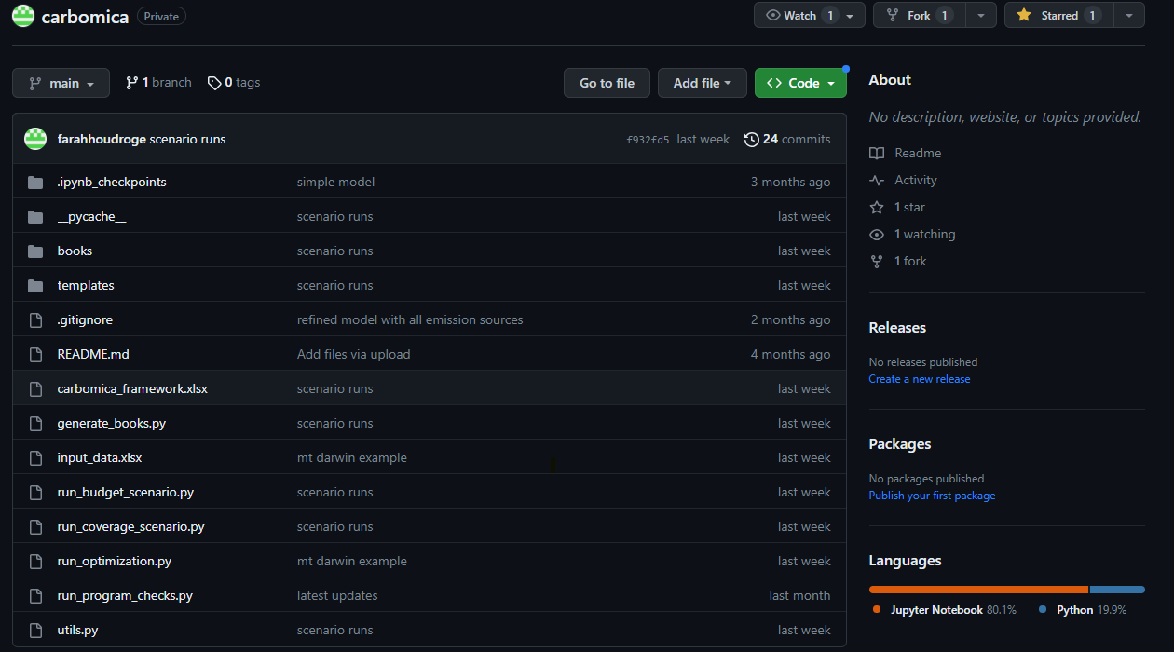
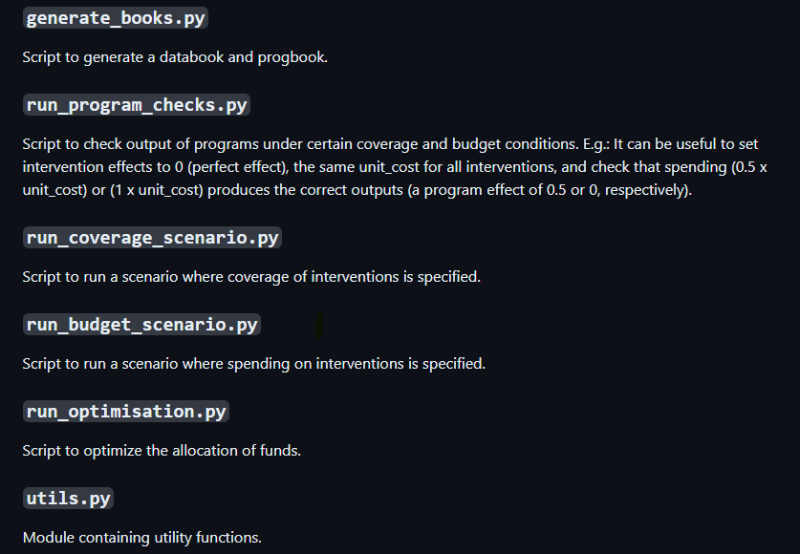
CARBOMICA FRAMEWORK
Notes:
Utilizing the Atomica framework for data analysis and scenario modeling, enabling the modeling of healthcare-specific factors and interactions related to carbon emissions.
Integrating optimization techniques optimize resource allocations and determine cost-effective strategies for carbon reduction in the healthcare sector.
Generating reports and visualizations presenting summarized information, charts, graphs, and other visual representations to effectively communicate the results of scenario analysis and decision-making processes.

Slide 7
Interim Results for Zimbadwe and Kenya

Slide 8
SPECIFYING COVERAGE OF INTERVENTIONS
Scenario Modelling:
Allows users to test the effects of different interventions on emissions.
Budget not considered; any combination of interventions can be tested.
Compare the impact of different intervention packages.
Example:
'Full Coverage' - All interventions applied at maximum potential without considering cost, showing maximum impact.
Notes:
FH or CP

Slide 9
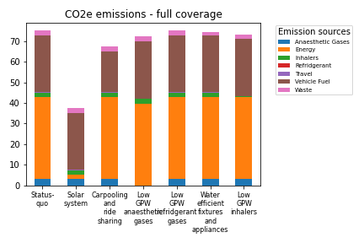
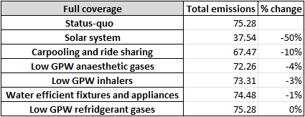
INTERVENTIONS WITH HIGHEST IMPACT AT FULL COVERAGE:
- Solar system
- Carpooling and ride sharing
Notes:
Scenario Modelling:
Allows users to test the effects of different interventions on emissions.
Budget not considered; any combination of interventions can be tested.
Compare the impact of different intervention packages.
Example:
'Full Coverage' - All interventions applied at maximum potential without considering cost, showing maximum impact.

Slide 10
SPECIFYING SPENDING ON INTERVENTIONS
Scenario Modelling:
Users can see effects of spending on specific interventions.
Show potential emissions based on different spending strategies.
Compare optimal vs. non-optimal spending to see benefits of optimisation.
Example:
'Fixed Budget' - Interventions scaled up within a given budget constraint

Slide 11
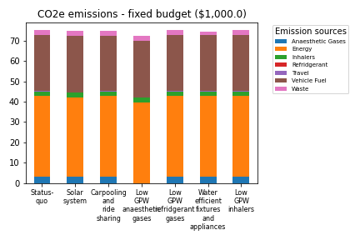
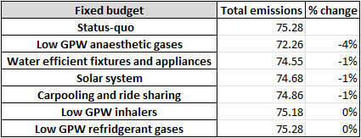
INTERVENTIONS WITH HIGHEST IMPACT AT $1,000:
- Low GPW anaesthetic gases
- Water efficient fixtures and appliances
Notes:
Global Warming Potential

Slide 12
BUDGET OPTIMIZATION FOR EMISSION REDUCTION
Goal: To allocate funds effectively across all interventions in order to achieve the greatest emission reductions at specified budget levels.
Example: “Optimization of total spending”: $20,000.0, $50,000.0 and $100,000.0.

Slide 13
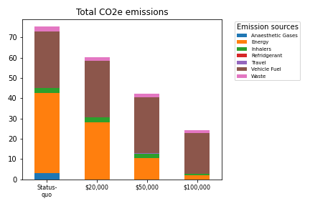
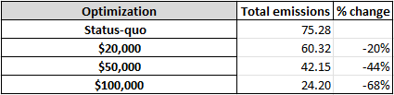
With a dedicated budget allocation ranging from $20,000 to $100,000, the facility can expect to realise a 20% to 68% decrease in its carbon emissions.

Slide 14
