Slide 1
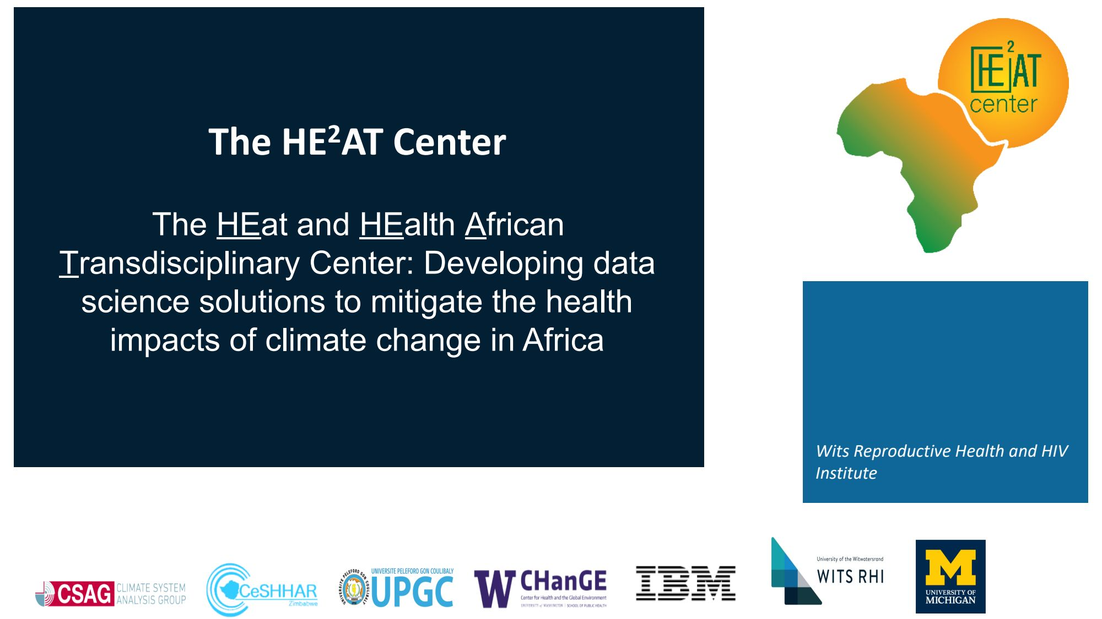

Slide 2


Key Aims of the Research Project
Intra-Urban Heat Vulnerability and Exposure Mapping
Utilizing satellite imagery and geospatial data, map the distribution of heat vulnerability and exposure across urban areas in large African cities, considering factors such as land surface temperature, vegetation cover, and population density.
Spatially and Demographically Stratified Heat-Health Outcome Forecast Model
Develop a predictive model that incorporates spatial and demographic data to estimate the probability of adverse health outcomes, such as heat-related illnesses or mortality, at different temperature thresholds, enabling targeted interventions and resource allocation.
Early Warning System for Geospatial and Individualized Risk Patterns
Implement an early warning system that integrates the heat vulnerability and exposure mapping with the heat-health outcome forecast model, providing localized and personalized risk assessments to facilitate proactive measures and support decision-making for public health interventions.

Slide 3
Progress on RP2
Research Article Accepted
The journal article on RP2 research protocol has been accepted with minor comments by BMJ Open, awaiting final approval after addressing reviewer feedback.
Ethical Approval Obtained
Research authorization and ethical approval obtained from partner in Cote d'Ivoire, documents translated to French for Francophone countries.
Data Harmonization Tools Developed
Codebook with key health variables developed, embeddings-models used for mapping variables, web-based mapping tool implemented for cross-collaboration.
Study Screening and Data Acquisition
In Johannesburg, 14 datasets received, 5 more at DTA stage after screening 3,168 studies. In Abidjan, 20 potential studies identified, 17 with DTA signed/in progress.
Data Acquisition Procedures Refined
Data acquisition procedure refined based on insights from Johannesburg, now implemented in Abidjan. New review process established with Ethics Committee.
Datasets Being Processed
14 datasets received in Johannesburg, including ACTG5221, PEARLS, OCTANE A5208, PROMISE1077BF, HPTN075, HPTN082, VIDA studies, and Ezintsha studies.
Vulnerability Mapping Initiatives
Earth Observation project for urban heat island detection using satellite data, socio-economic and environmental vulnerability assessments being enhanced.
Stakeholder Engagement
Stakeholder workshops conducted in Abidjan and Johannesburg, advancing understanding of early warning systems and disaster response planning.
Postdoctoral Student Advancement
Postdoc in Abidjan secured funding for developing heat vulnerability index for the city, contributing to overall vulnerability mapping efforts.

Slide 4
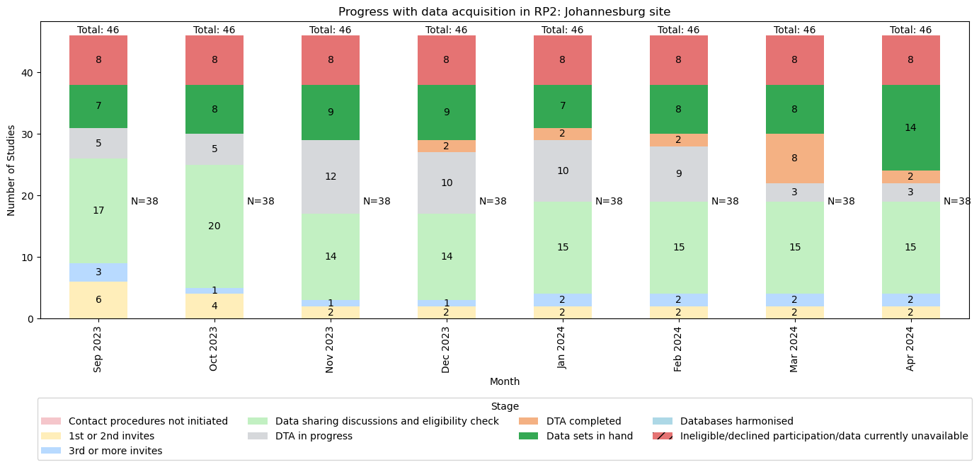

Slide 5
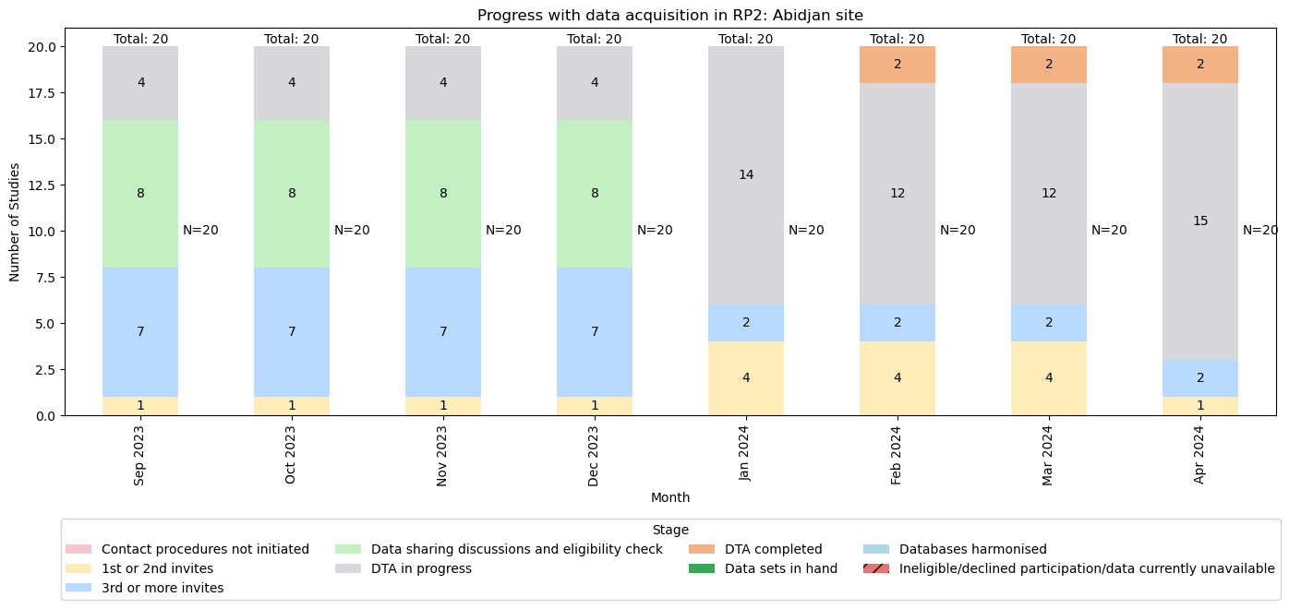

Slide 6



Challenges
Data integration challenges
Data procurment bottlenecks
Complex modeling requirements
Combining diverse data formats like health, geographic, demographic, and climate data for comprehensive analysis.
Delays in acquiring and processing large volumes of data, impacting the timeline for system testing and deployment.
Developing accurate heat vulnerability models that account for multiple factors and their interdependencies.
Overcoming these challenges is crucial for timely and effective deployment of heat vulnerability assessment systems, enabling proactive measures to mitigate heat-related risks.

Slide 7
Year 4 Plans and Objectives
Finalize data sharing requests
Obtain remaining data from principal investigators of adult trials and cohort studies.
Complete Data Transfer Agreements (DTAs)
Secure formal agreements with all data holders in the pipeline.
Advance data harmonization and mapping
Further develop work on harmonizing data, hazard mapping, and vulnerability mapping.
Integrate health and geospatial data
Combine health data with weather and various geospatial data sources.
Disseminate project findings
Focus on developing academic outputs, including journal articles and conference presentations, summarizing the project findings.

