Slide 1
Spares
Reporting Transparency
Promote open access to emissions data to track progress over time.
Skills Development
Provide training on effective carbon management strategies.
Investment Strategy
Encourage ethical investments to reduce institutional carbon footprints.
Policy Engagement
Advocate for policies requiring carbon tracking and reduction across institutions.
Knowledge Exchange
Create platforms for institutions to share best practices on sustainability.
Community Outreach
Conduct campaigns to increase public awareness on environmental issues.
Incentivizing Carbon Mitigation
Provide funding incentives for organisations to conduct carbon reduction research projects.
Foster Collaboration
Partner with diverse entities on carbon mitigation studies to encourage knowledge sharing.
Recognition & Awards
Develop a certification program and give awards to recognise sustainability.

Slide 2

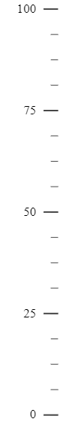
Energy Efficiency
Implement energy-efficient HVAC and lighting technologies across all facilities.
Sustainable Research
Carbon Reduction Strategies
Prioritize and incentivize sustainability-focused research projects.
Investment and divestment
We must reduce carbon emissions through a broad range of strategies.
Align endowment investment strategies with low-carbon initiatives

Slide 3




Systematic review included 13 studies focusing on environmental impact of health services
15-50% of emissions from energy use and electricity (scopes 1 and 2)
Majority of emissions from scope 3 sources
Healthcare systems contribute 4%-5% of global GHG emissions, with scope 3 emissions being predominant. Effective interventions are needed throughout health service lifecycles to reduce this footprint.

Slide 4
Emissions Scope | Definition | Example from Research Laboratories | Additional Health Services Examples | Clinical Trials Research Examples
Scope 1 | Direct emissions from the organization’s activity | - Use of combustion equipment for experiments. - Emissions from backup generators. - Use of gases in research released into the atmosphere. | - Direct emissions from health care facility operations, such as from anesthetic gases and emergency generators. - Transport of healthcare waste for disposal. | - Transport of trial samples and supplies. - Direct emissions from trial site operations.
Scope 2 | Indirect emissions from energy consumed by the organization | - Energy consumption of lab equipment. - Electricity used by PCs and servers. | - Energy used for medical imaging and patient care equipment. - Building heating, ventilation, and air conditioning. | - Energy use for data centers managing trial data. - Energy consumption for maintaining specific environmental conditions for clinical trial materials.
Scope 3 | Indirect emissions from products or services used to support the organization’s operations | - Production and disposal of plastics. - Transportation of chemicals and lab samples. - Research-related travel. - Waste generated from research activities. | - Procurement of medical supplies and pharmaceuticals. - Patient and staff commuting. - Business travel for conferences and consultations. - Waste disposal and management of medical waste. | - Production and disposal of single-use medical devices used in trials.- Participant travel to and from trial sites. - Emissions related to the manufacturing and distribution of trial medications. - Outsourced services for data analysis and trial monitoring.

Slide 5
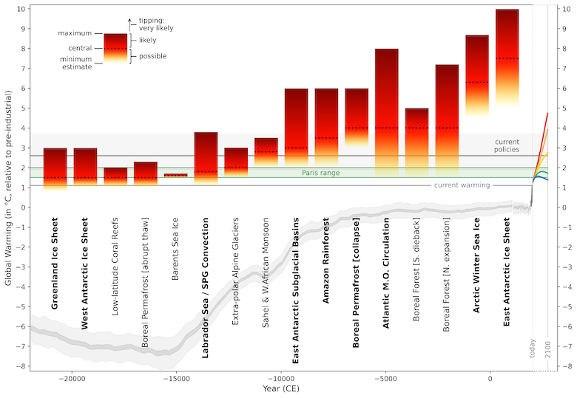

Slide 6


