Slide 1
Machine Learning for Climate-Health Research
A Comprehensive Training Session

Slide 2
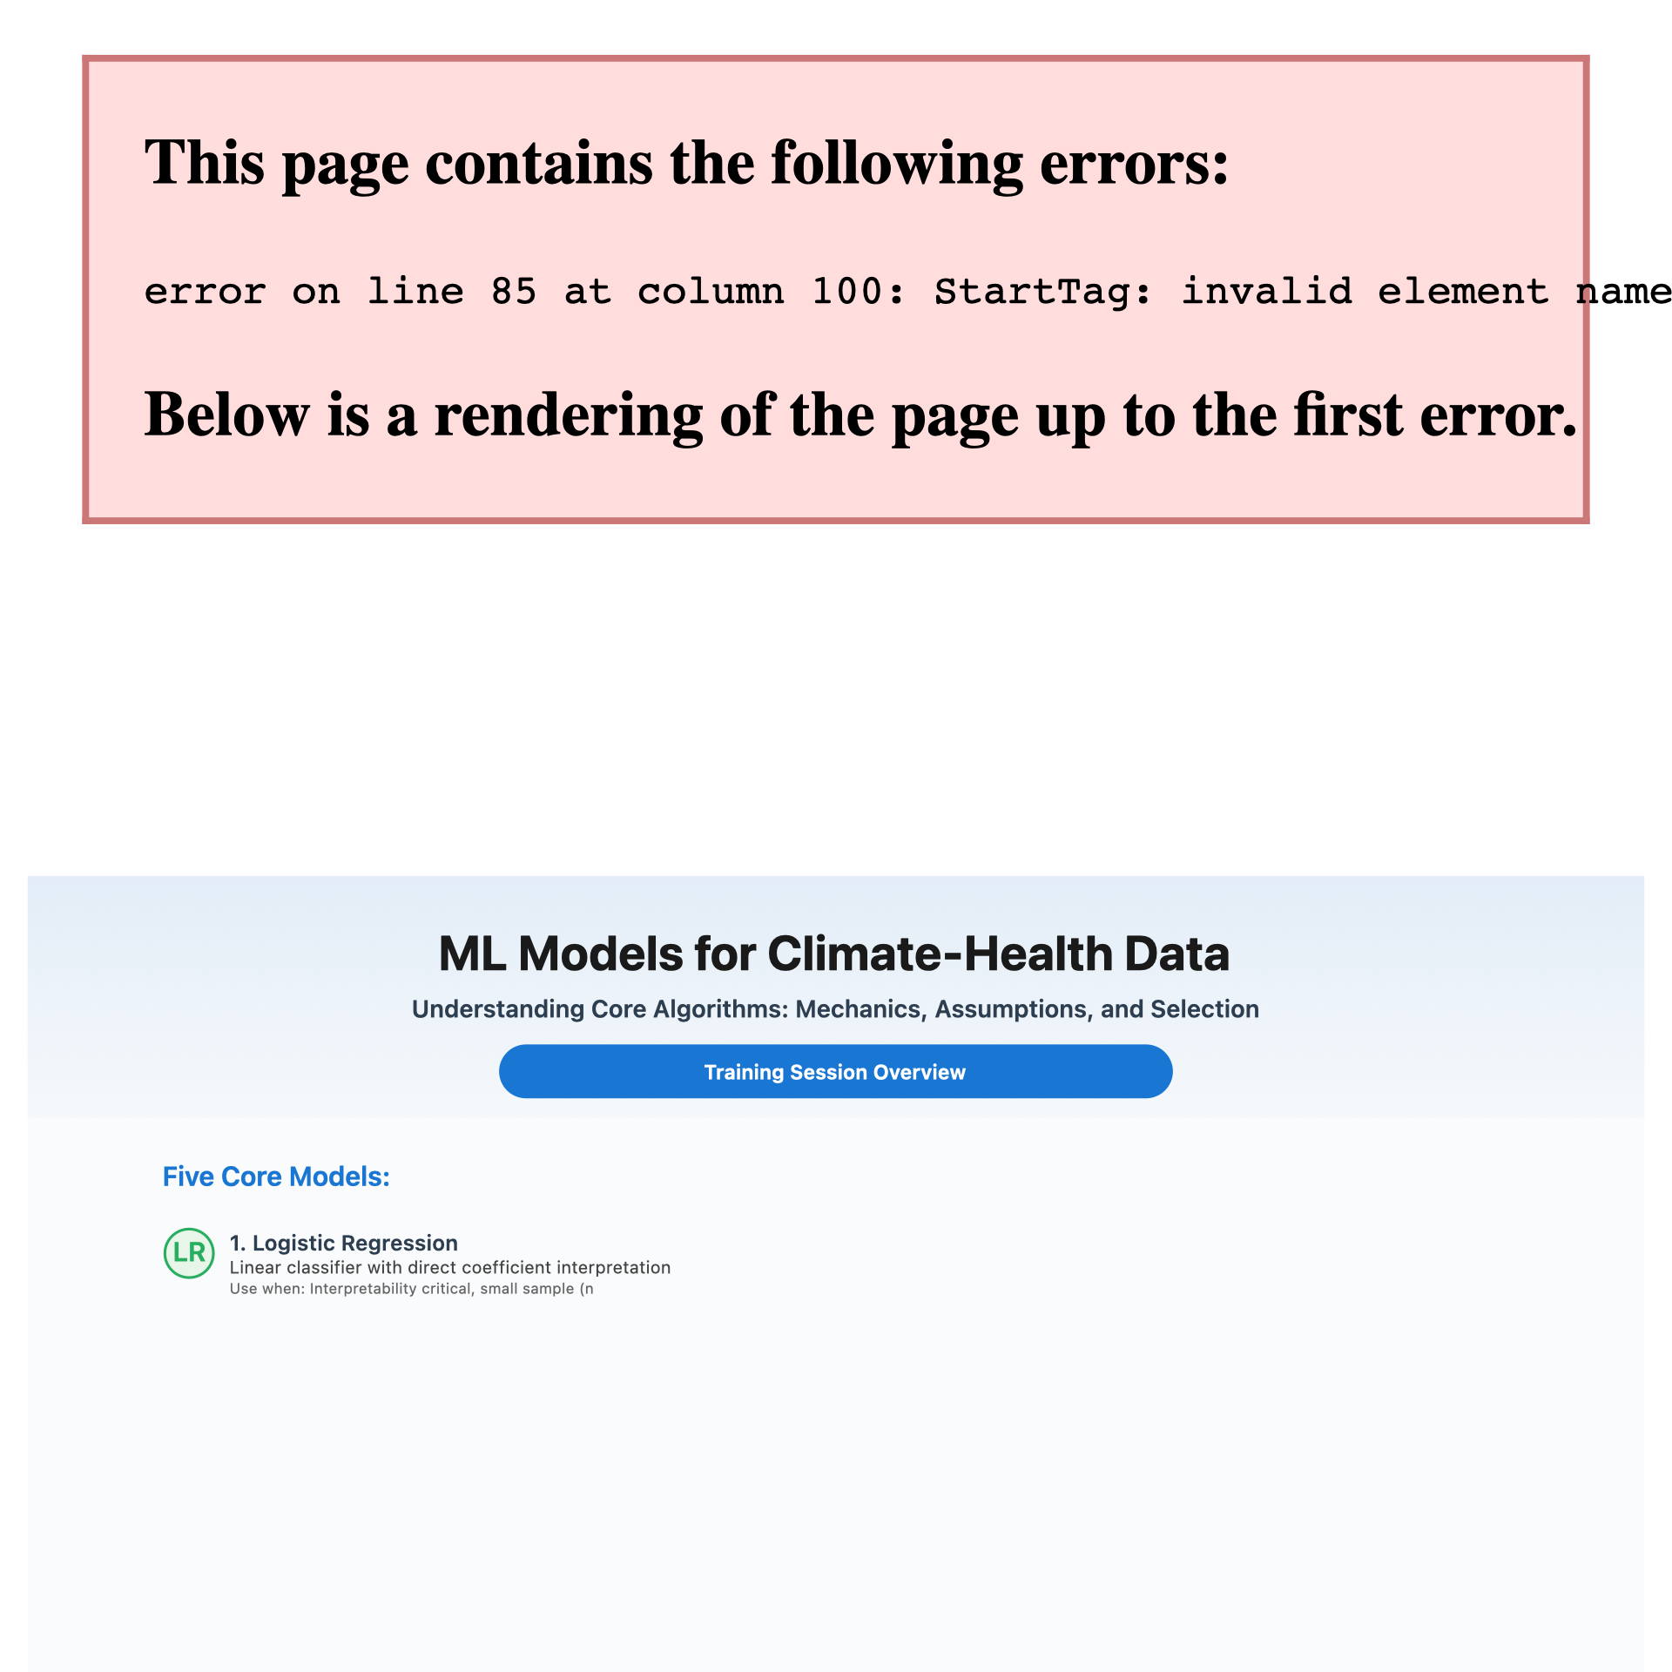
Session Overview

Slide 3

Use Case: Climate & Health Data

Slide 4
Understanding Our Data

Slide 5

Dataset Structure

Slide 6
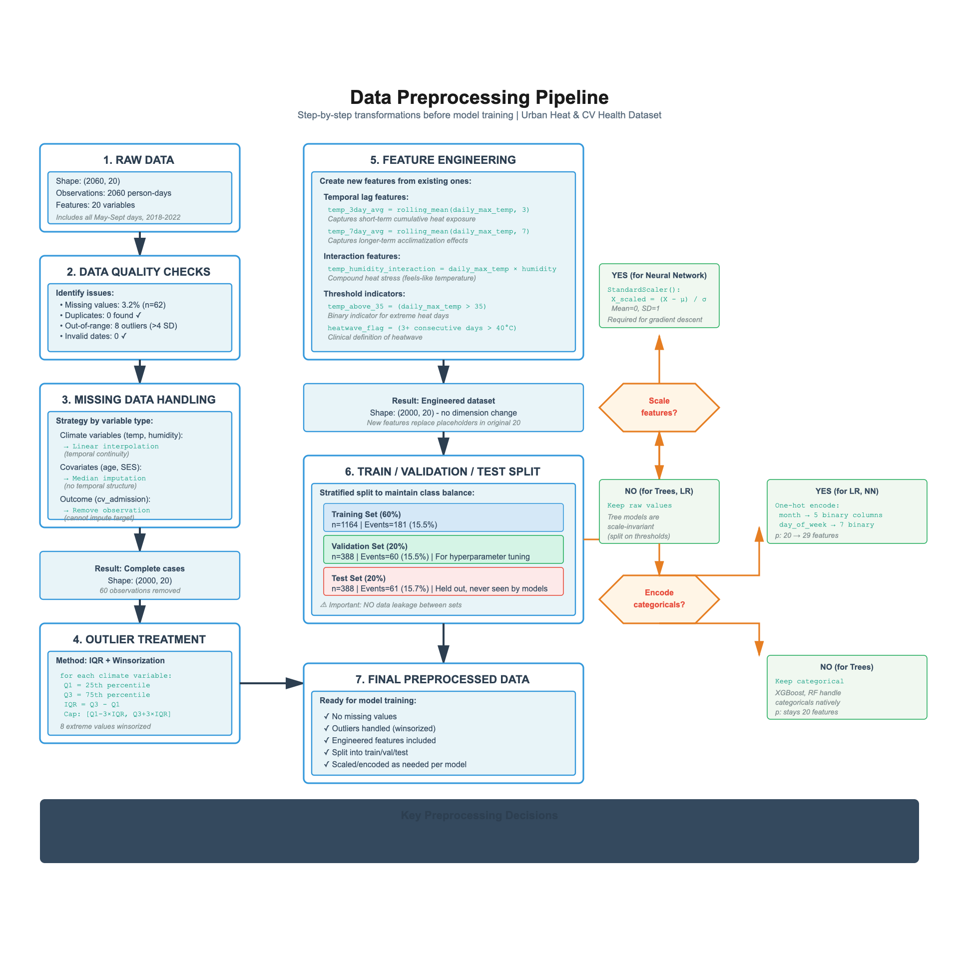
Data Preprocessing Pipeline

Slide 7
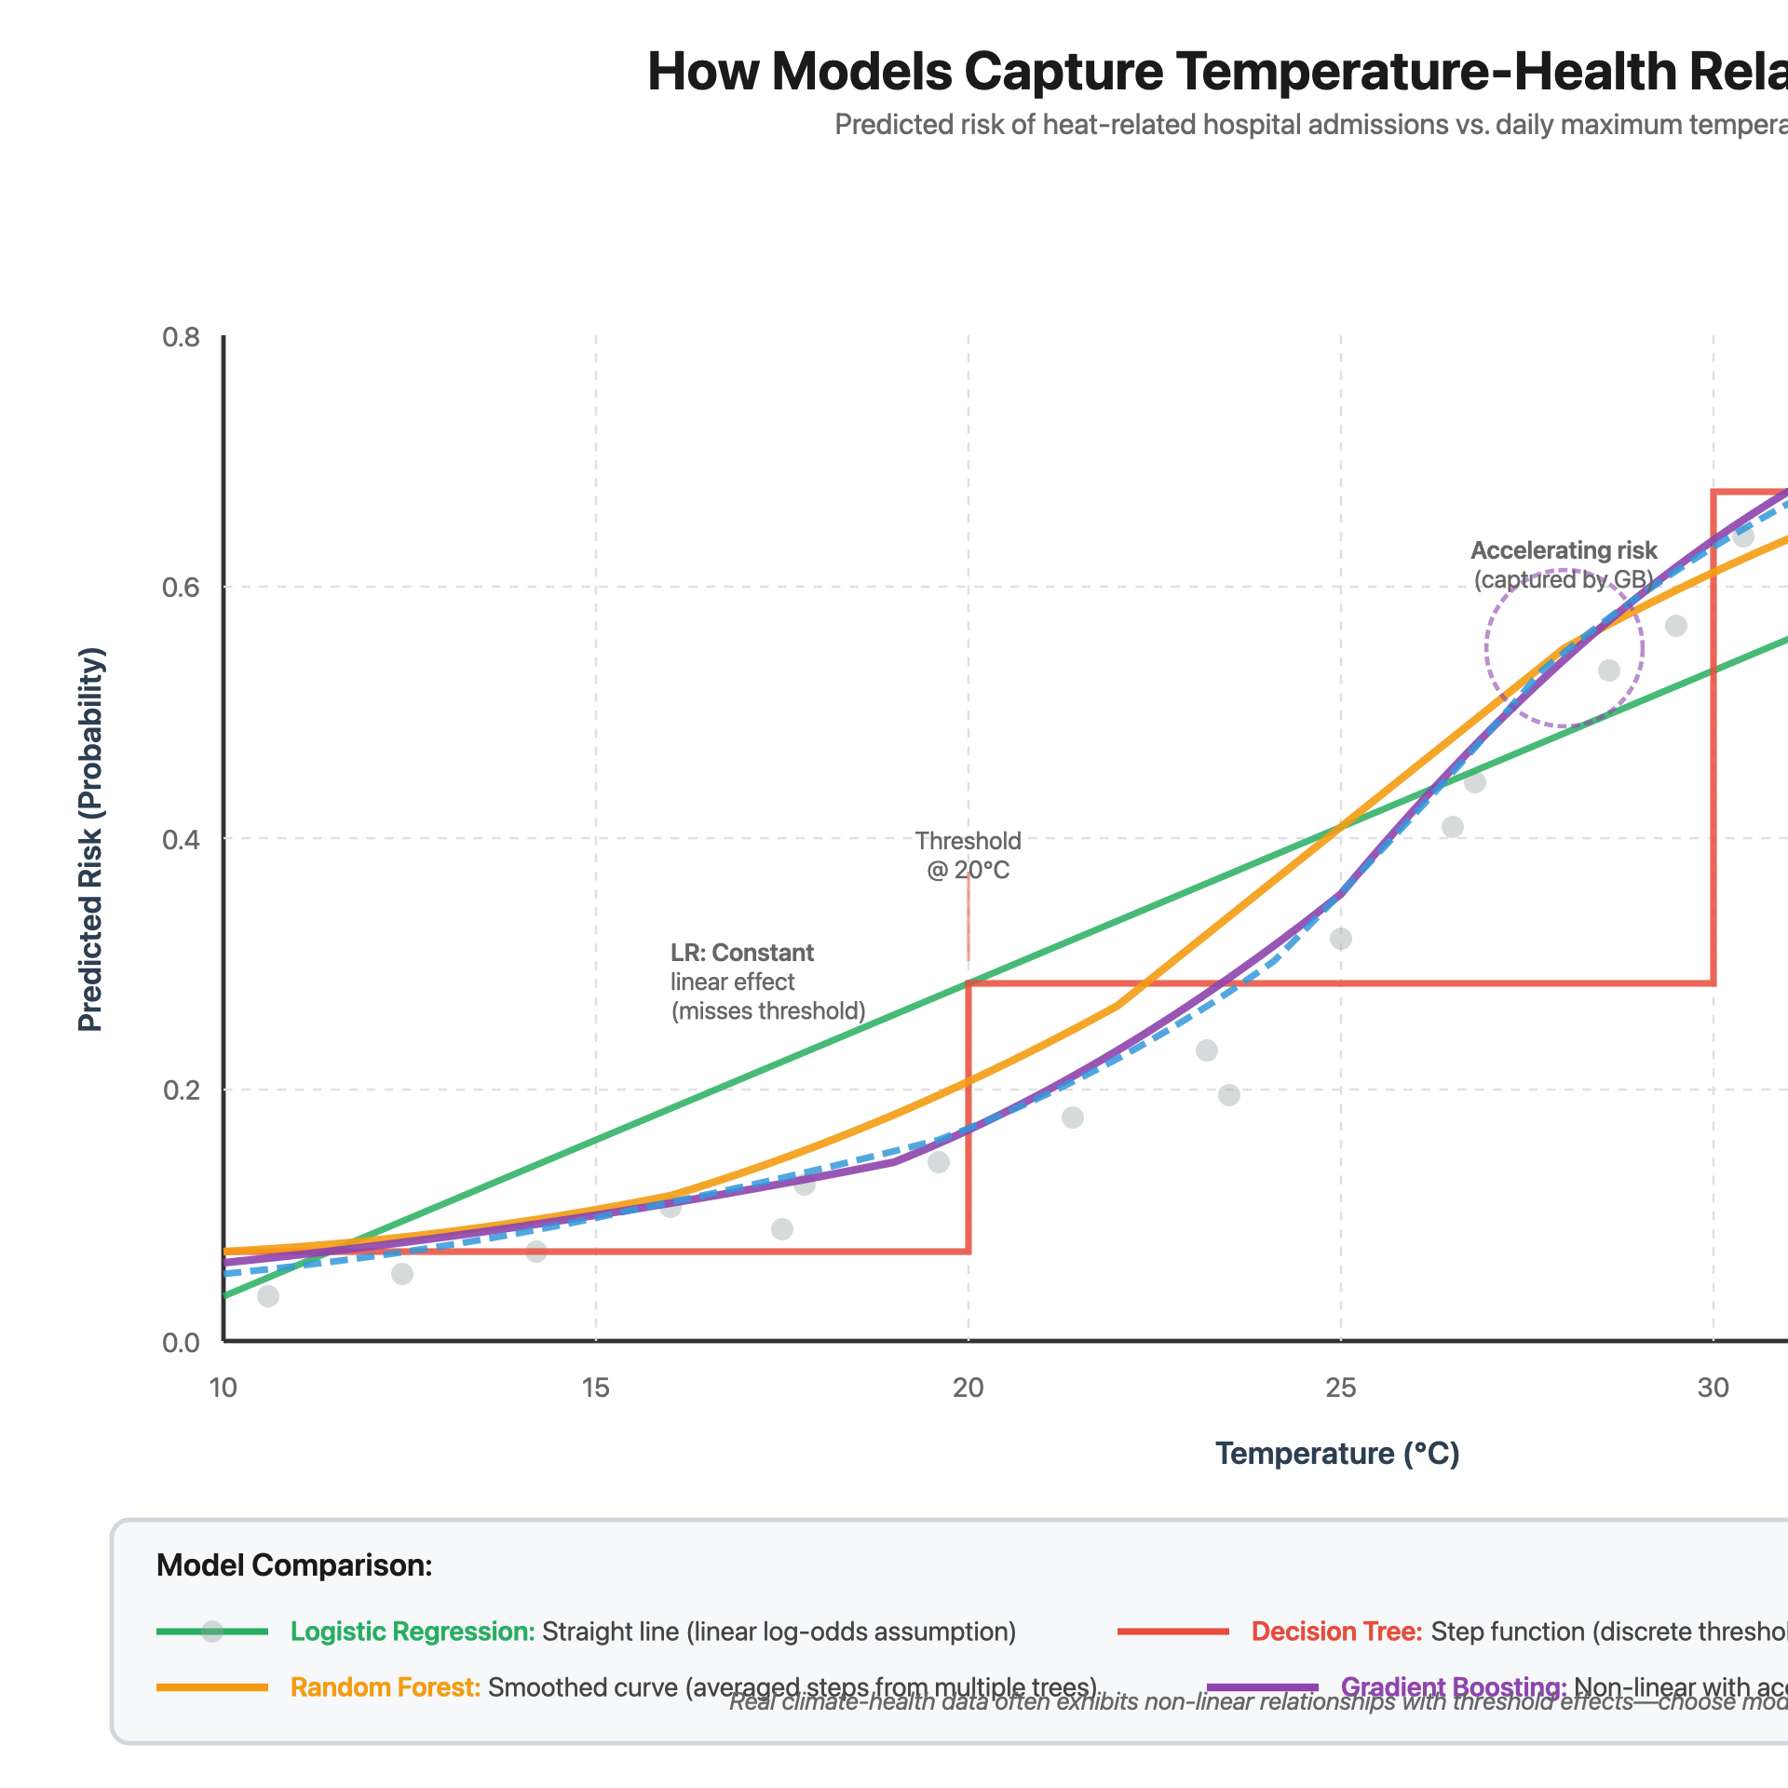
Feature Patterns in the Data

Slide 8
How Machine Learning Models Learn

Slide 9
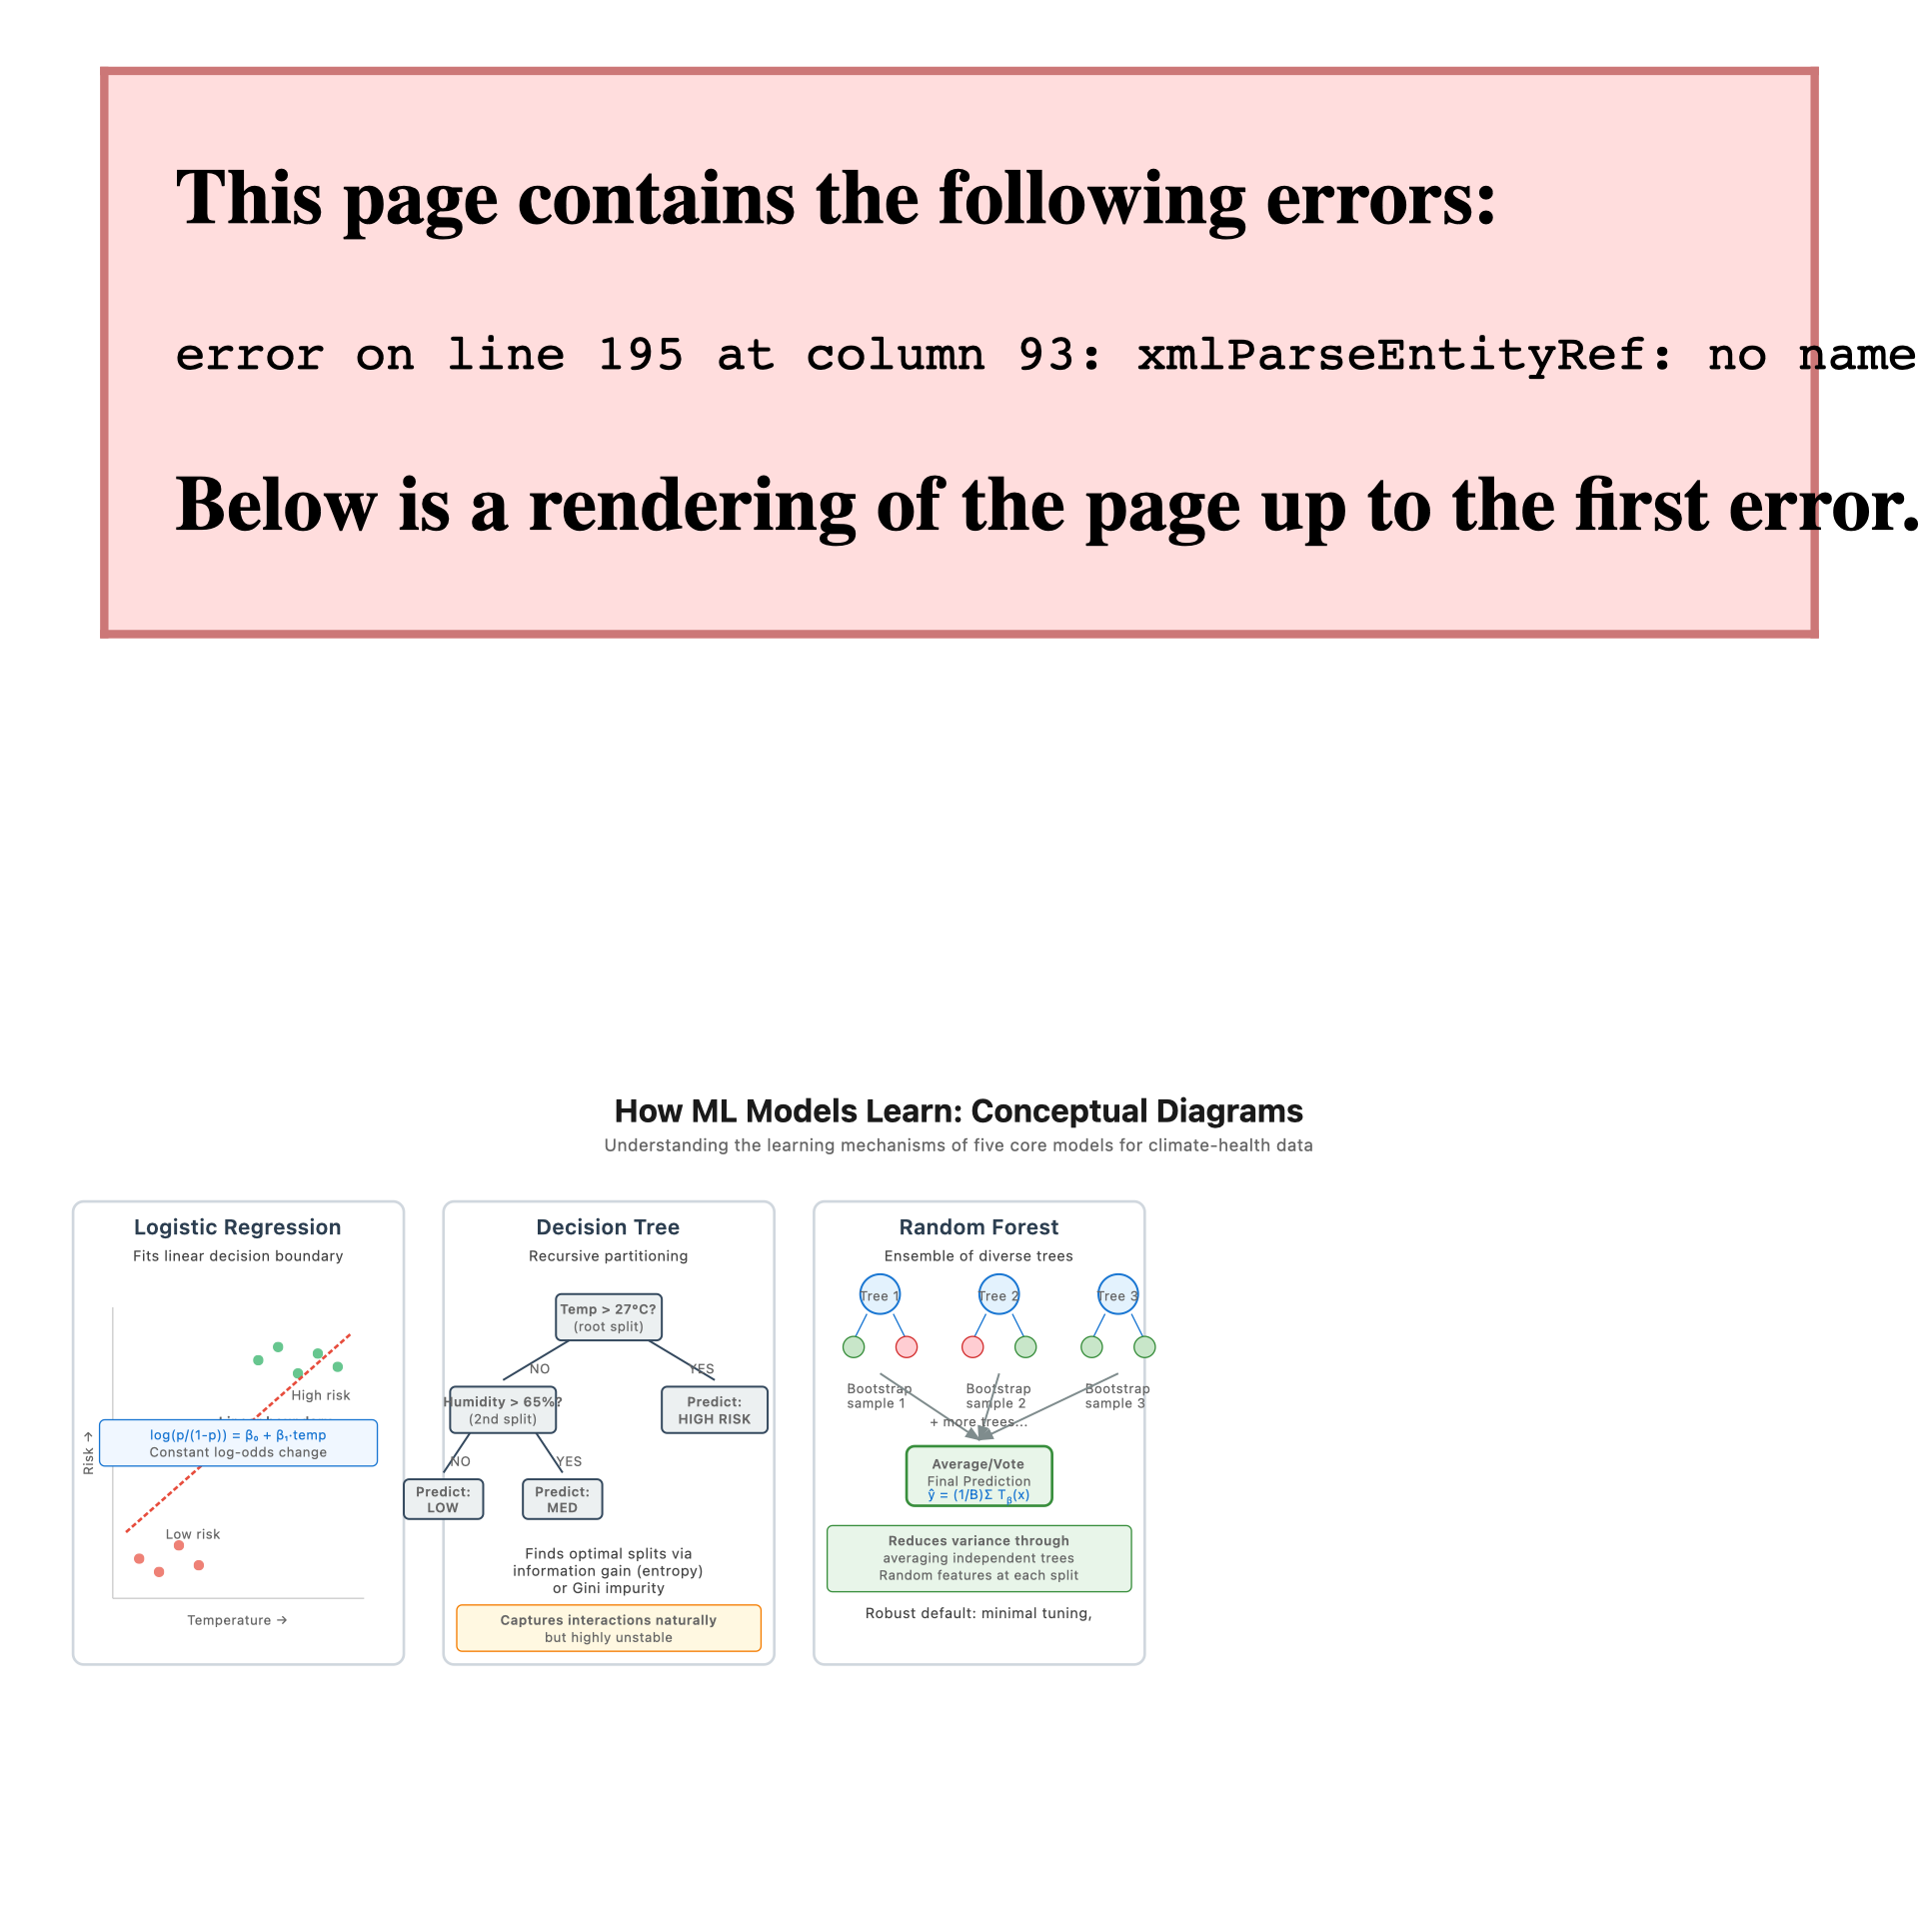
Learning Mechanisms Across Models

Slide 10

Gradient Descent in Action

Slide 11
Decision Trees & Ensembles

Slide 12
How Decision Trees Build

Slide 13
Random Forest: Ensemble Power

Slide 14
Gradient Boosting: Sequential Learning

Slide 15
Neural Networks

Slide 16
Backpropagation Flow

Slide 17
Critical Concepts in ML

Slide 18
Bias-Variance Tradeoff

Slide 19
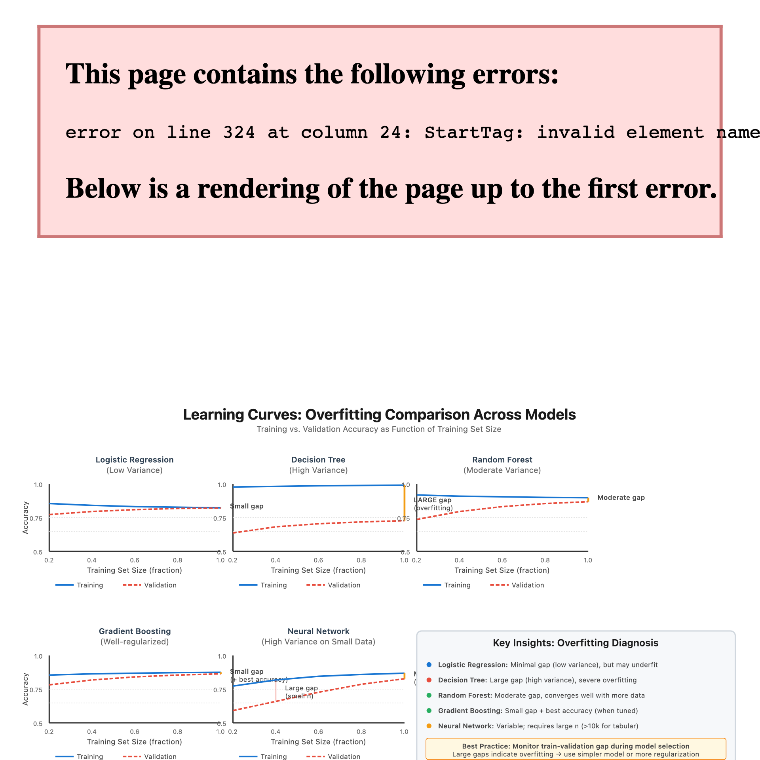
Overfitting Behavior Across Models

Slide 20
The Double Descent Phenomenon

Slide 21
Learning Rate Effects

Slide 22
Optimizing Model Performance

Slide 23
Tree Depth Impact

Slide 24
Regularization Effects

Slide 25
Choosing the Right Model

Slide 26
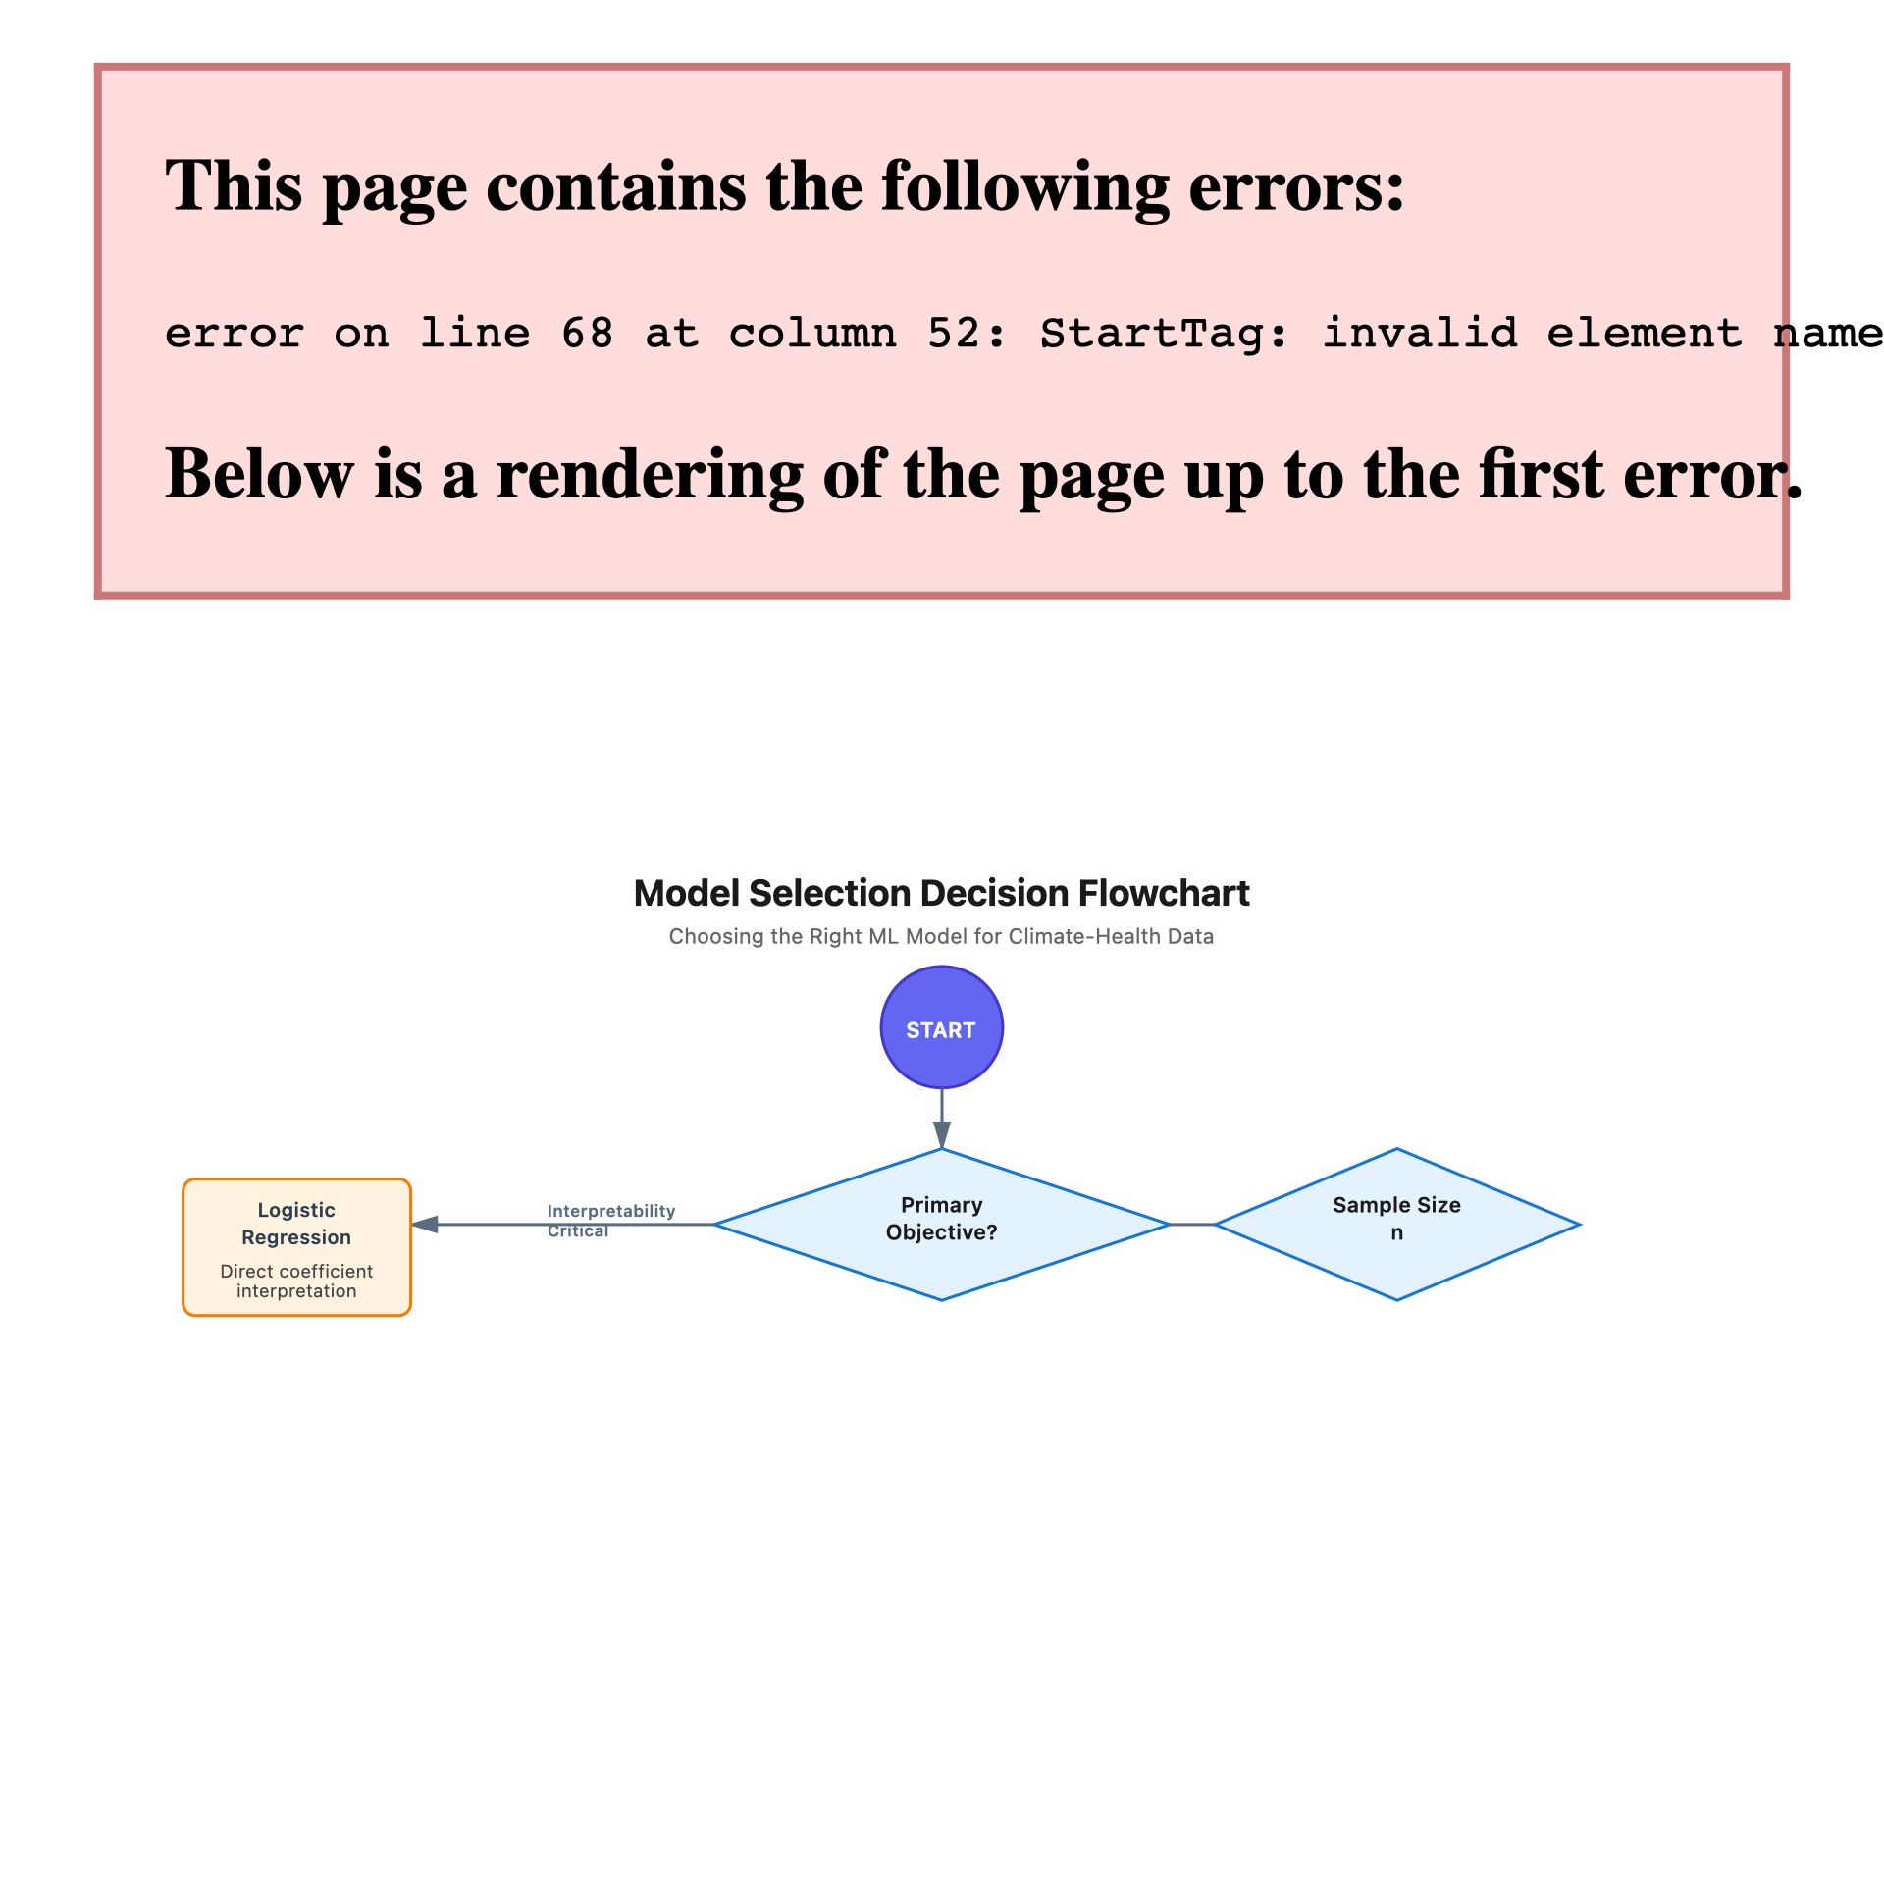
Model Selection Flowchart

Slide 27
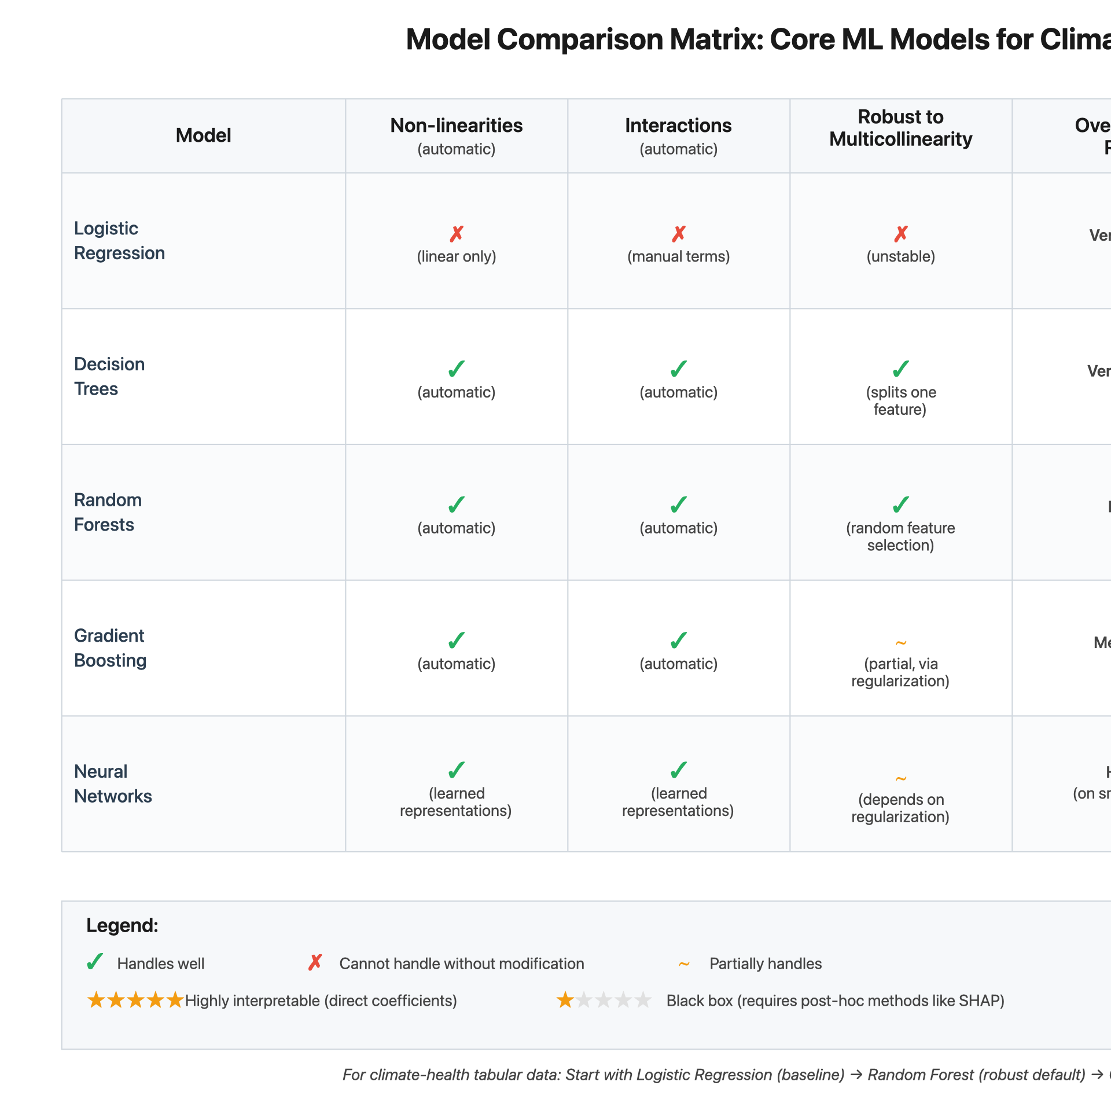
Comprehensive Model Comparison

Slide 28
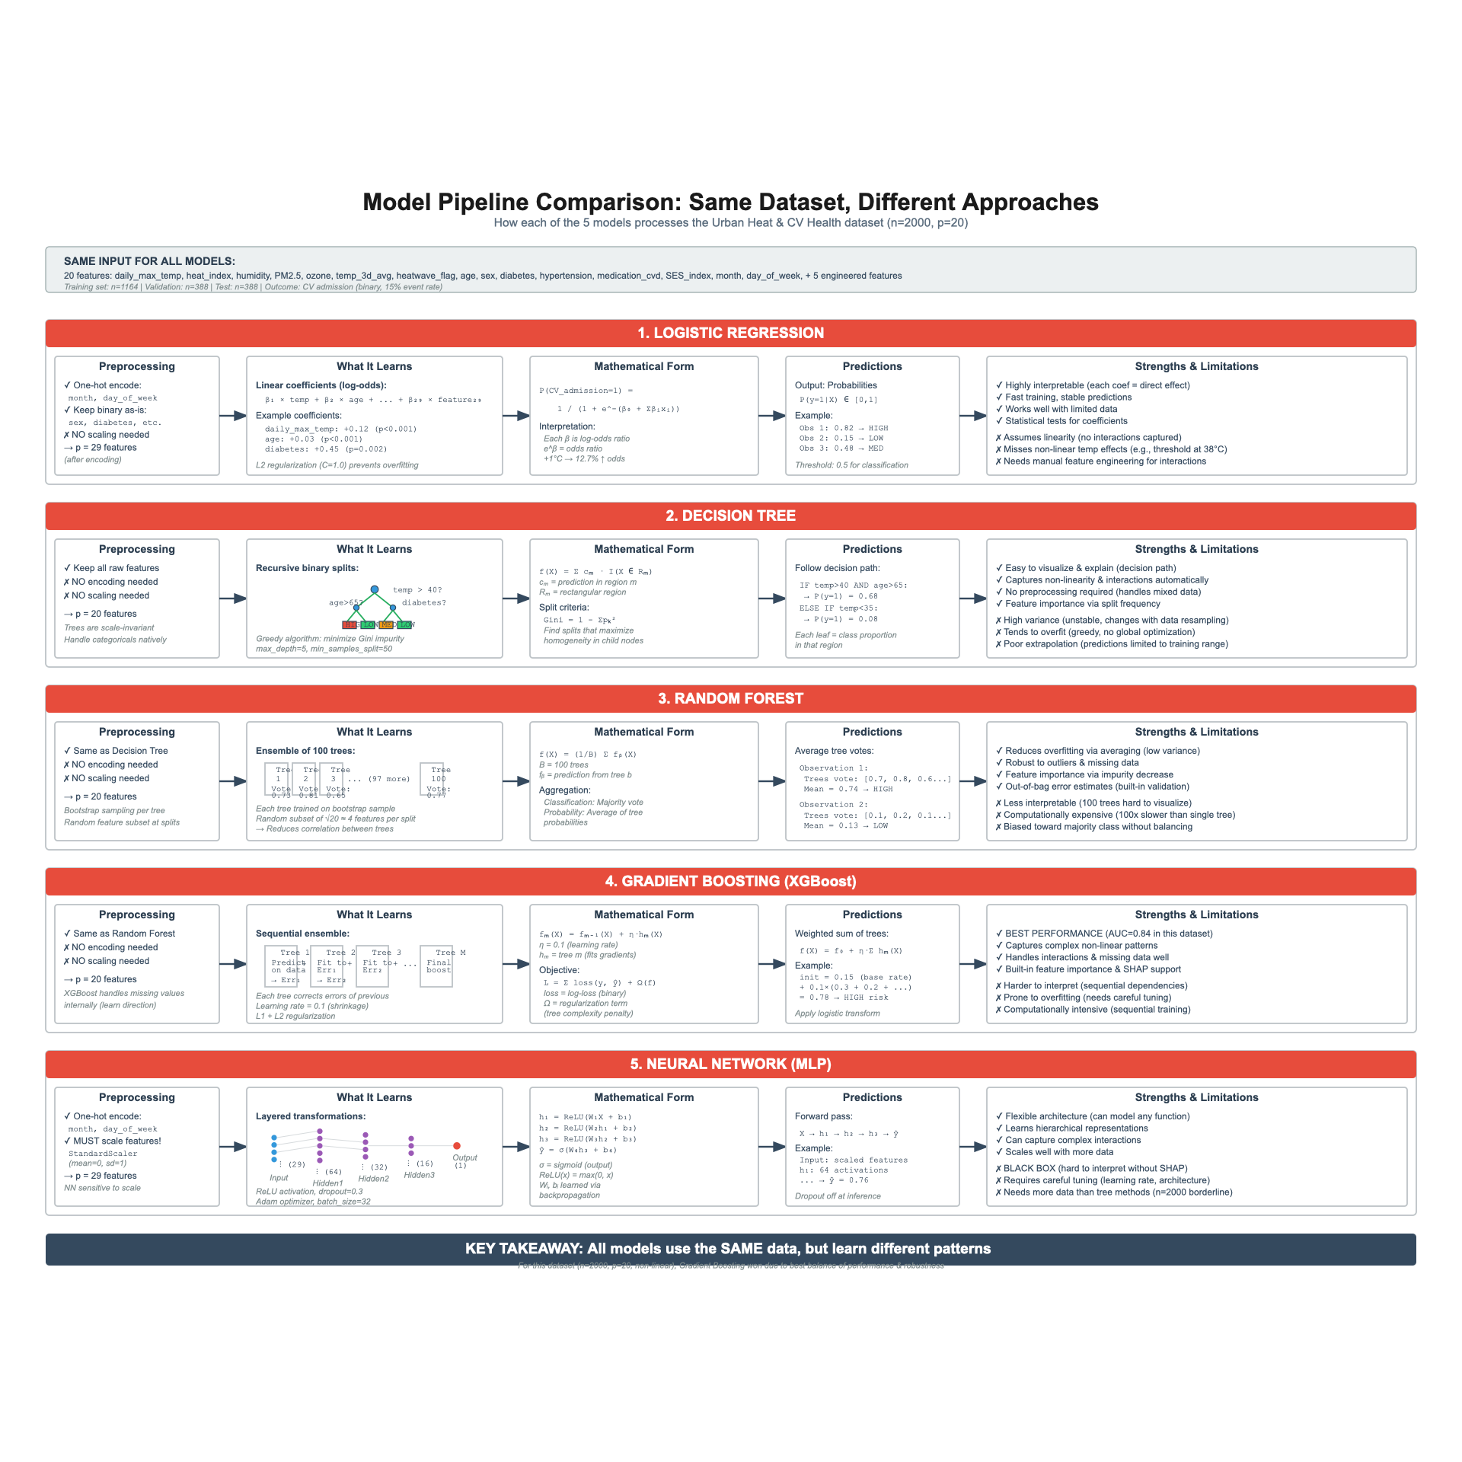
Model Pipeline Comparison

Slide 29
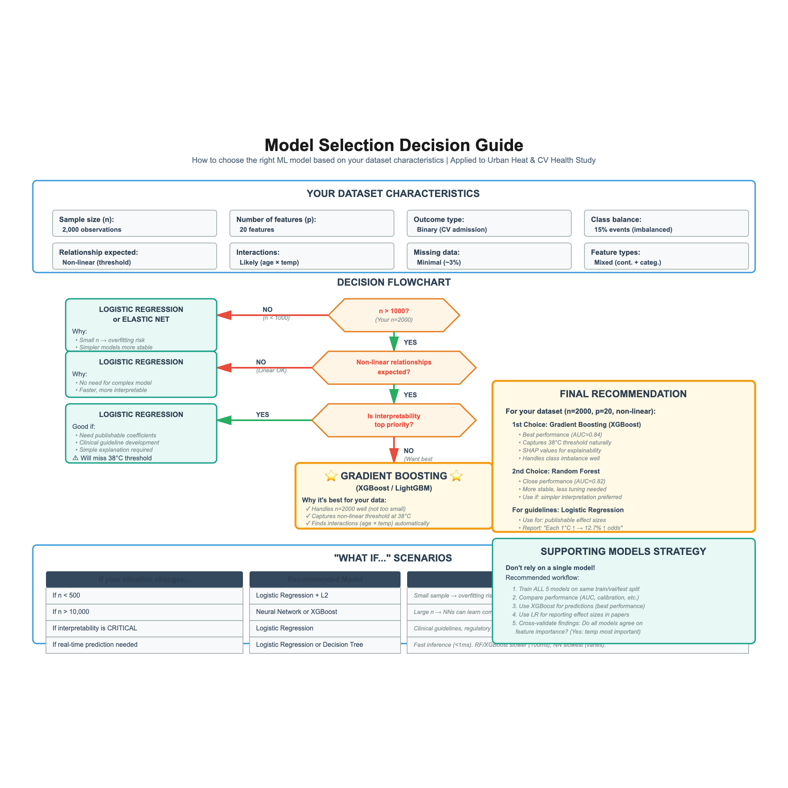
Model Selection for This Dataset

Slide 30
Understanding Model Predictions

Slide 31
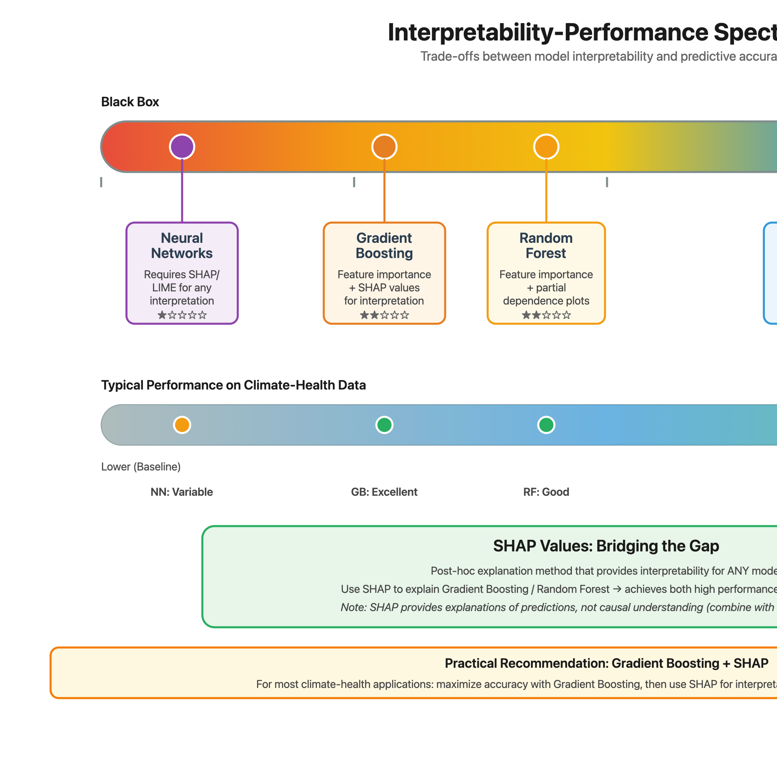
The Interpretability Spectrum

Slide 32
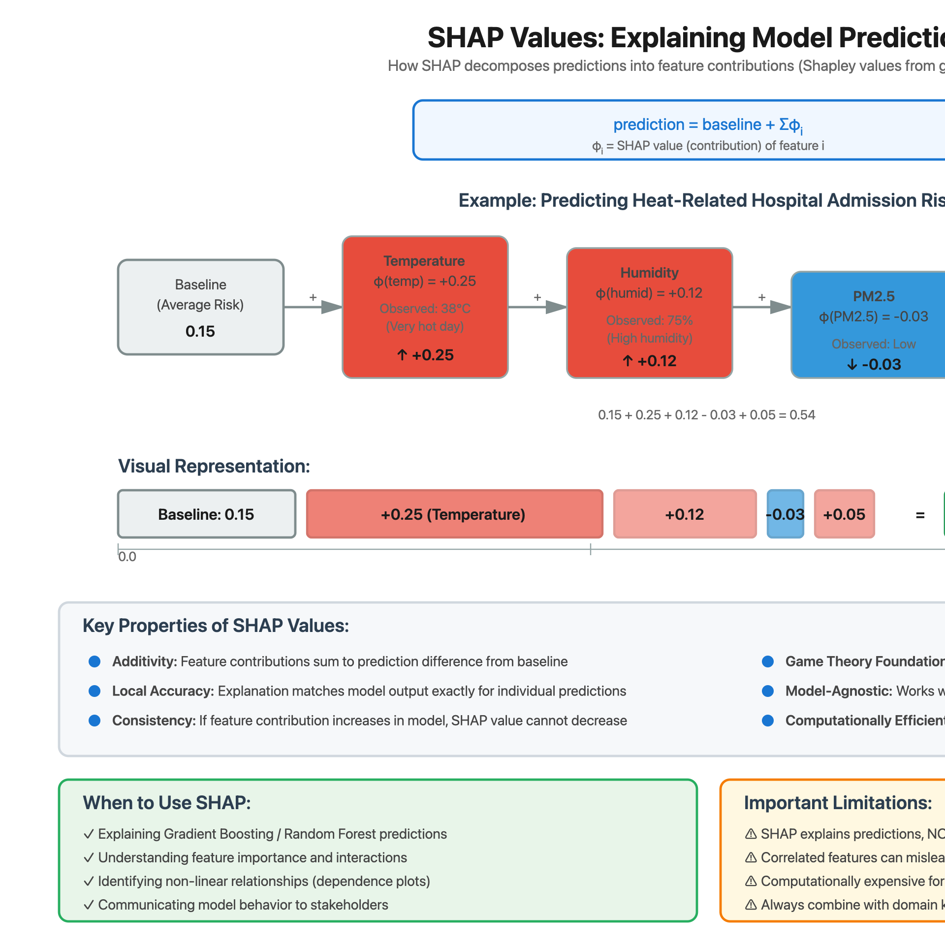
SHAP: Bridging the Gap

Slide 33
Feature Importance Evolution

Slide 34
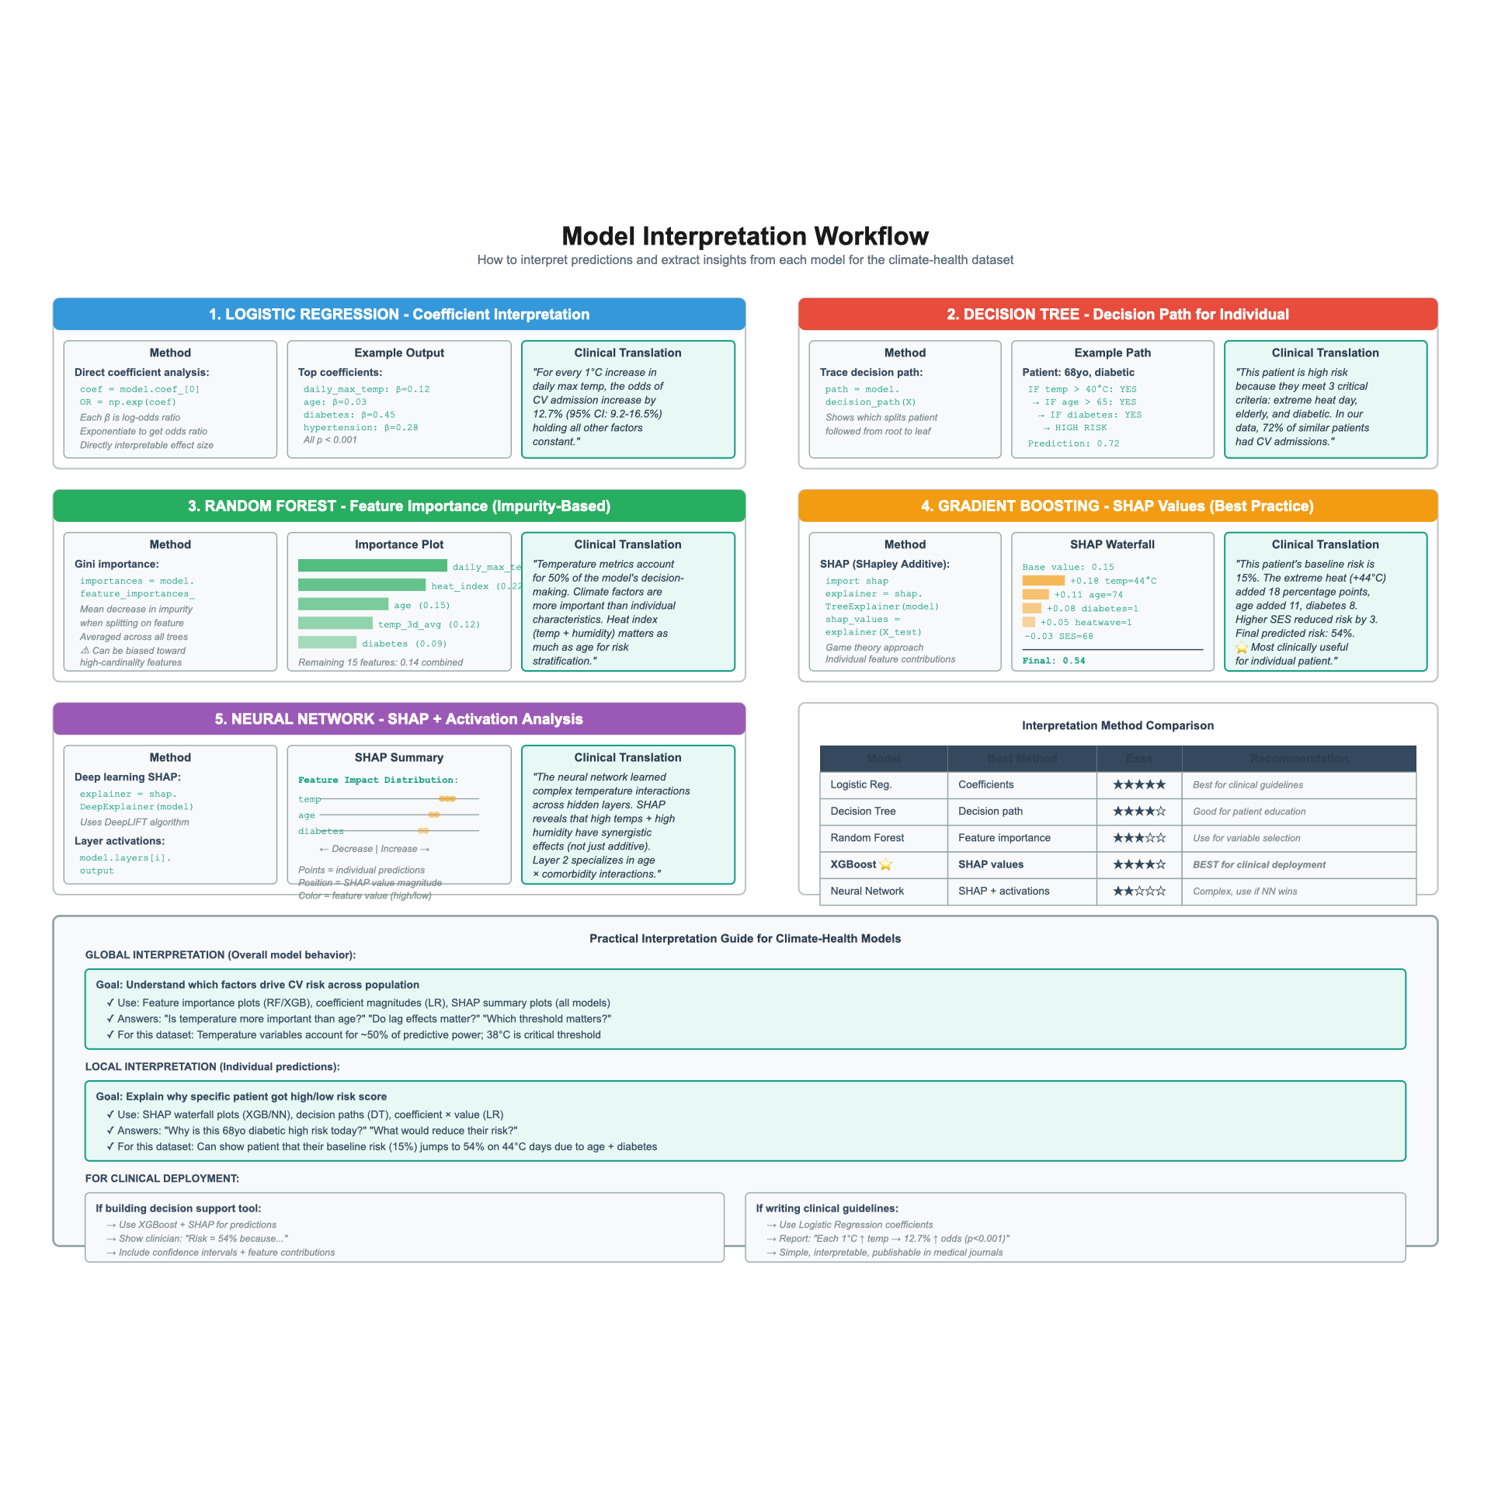
SHAP Interpretation Workflow

Slide 35
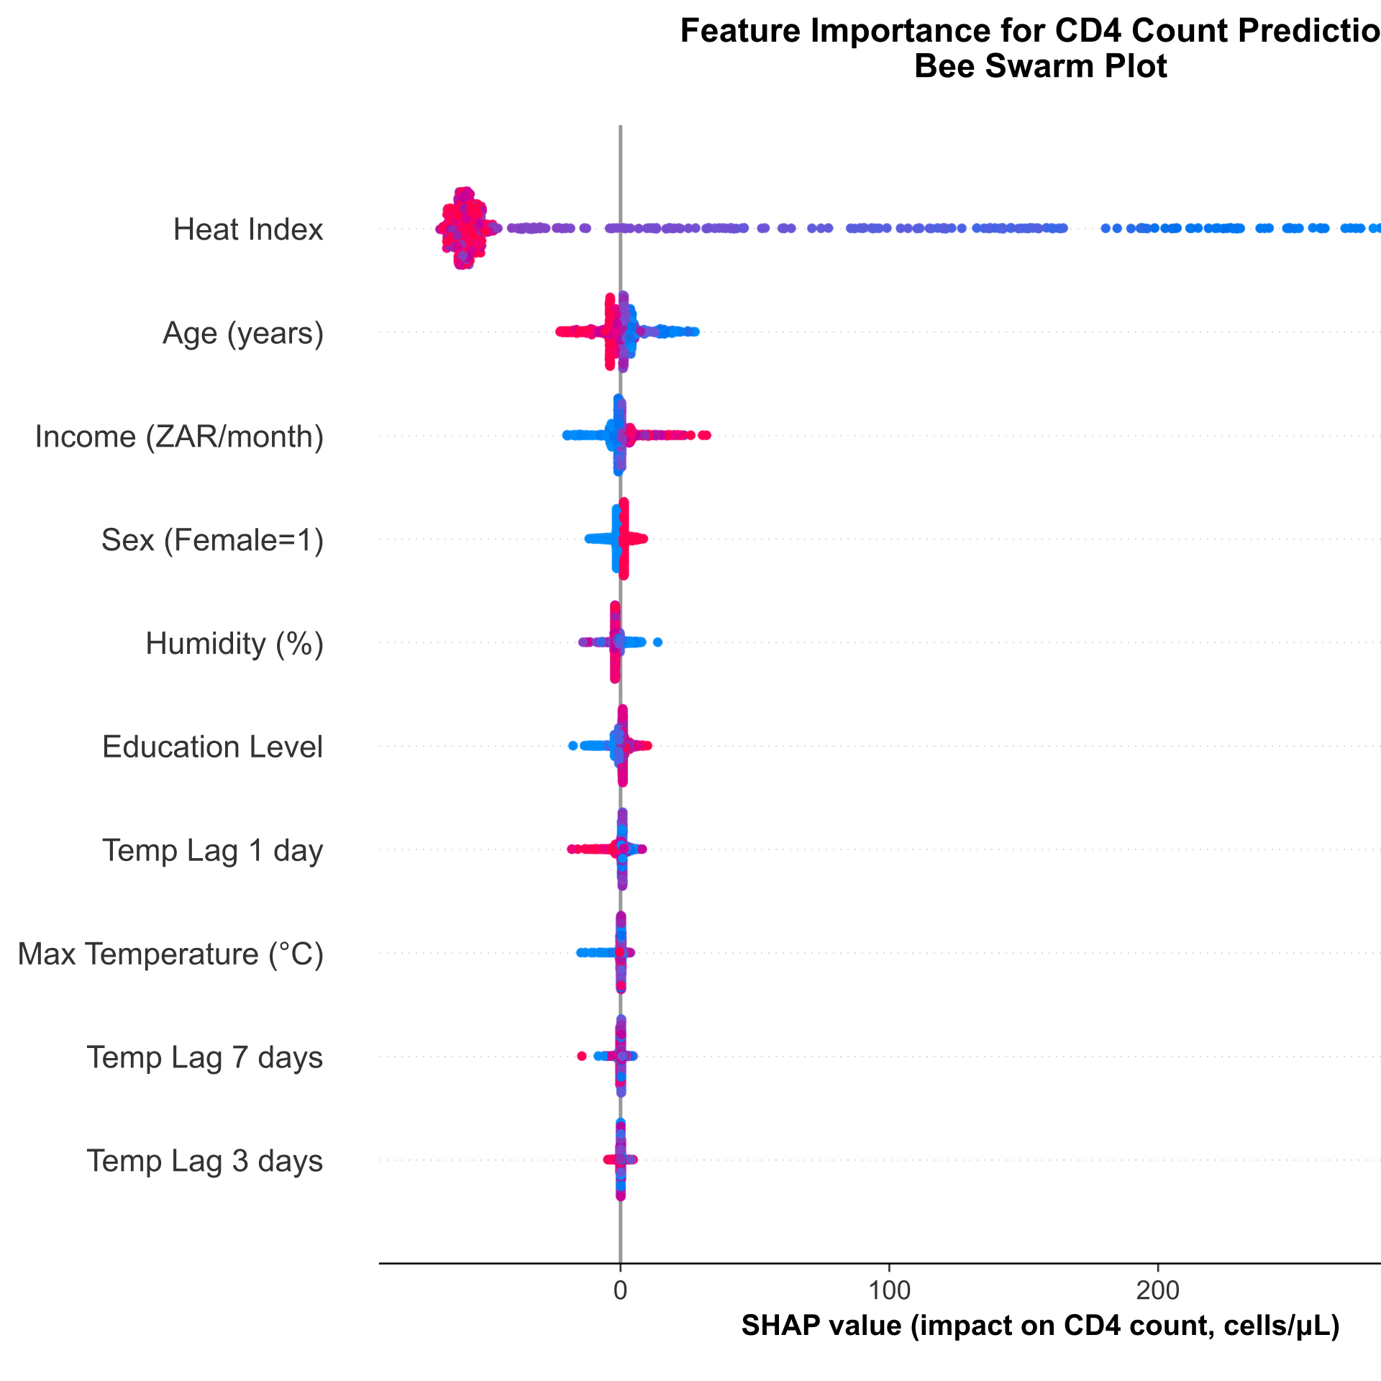
SHAP Beeswarm Plot

Slide 36
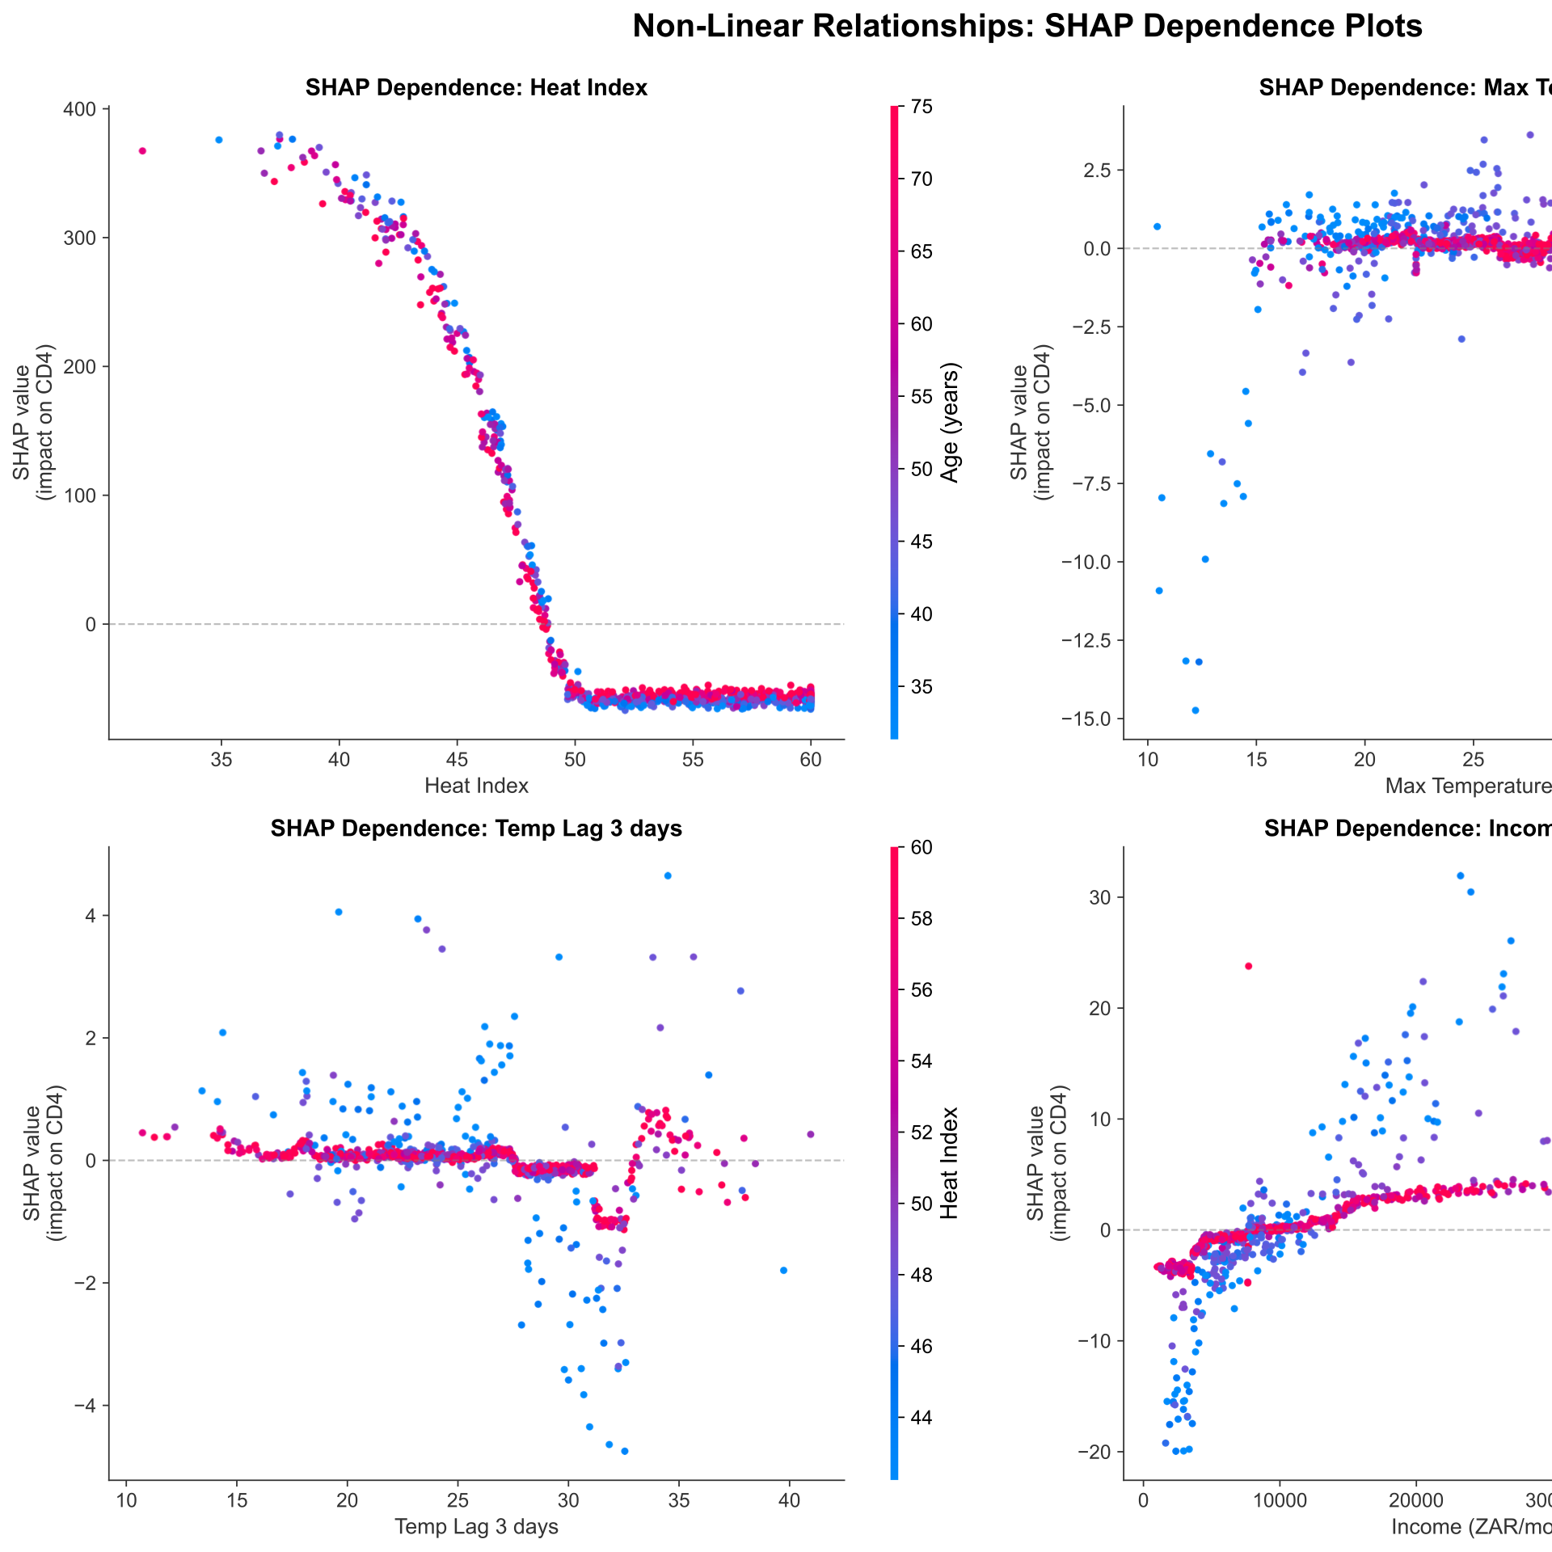
SHAP Dependence Analysis

Slide 37
Results & Recommendations

Slide 38
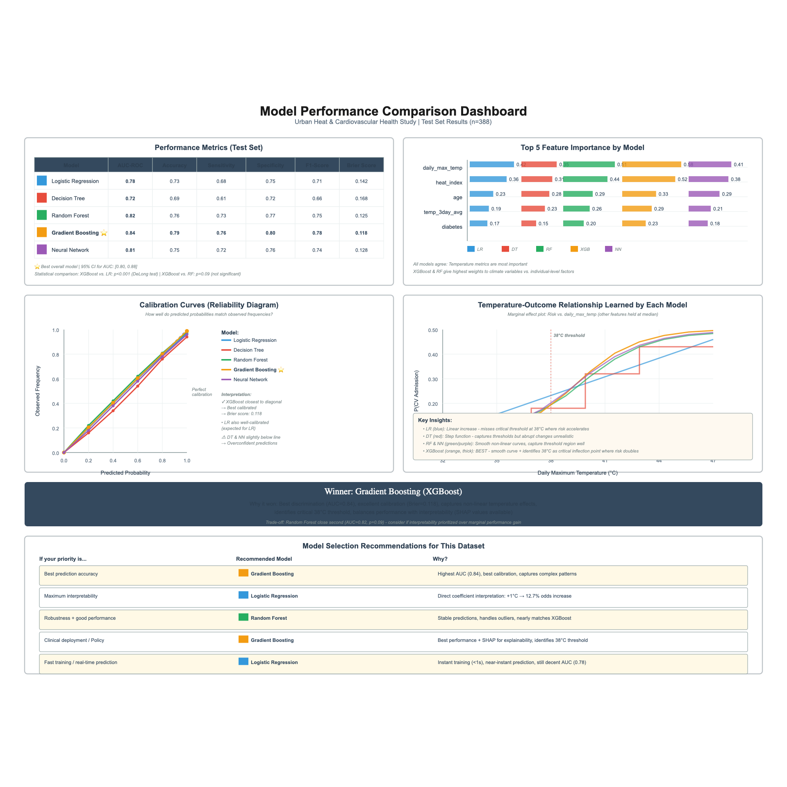
Results Comparison Dashboard

Slide 39
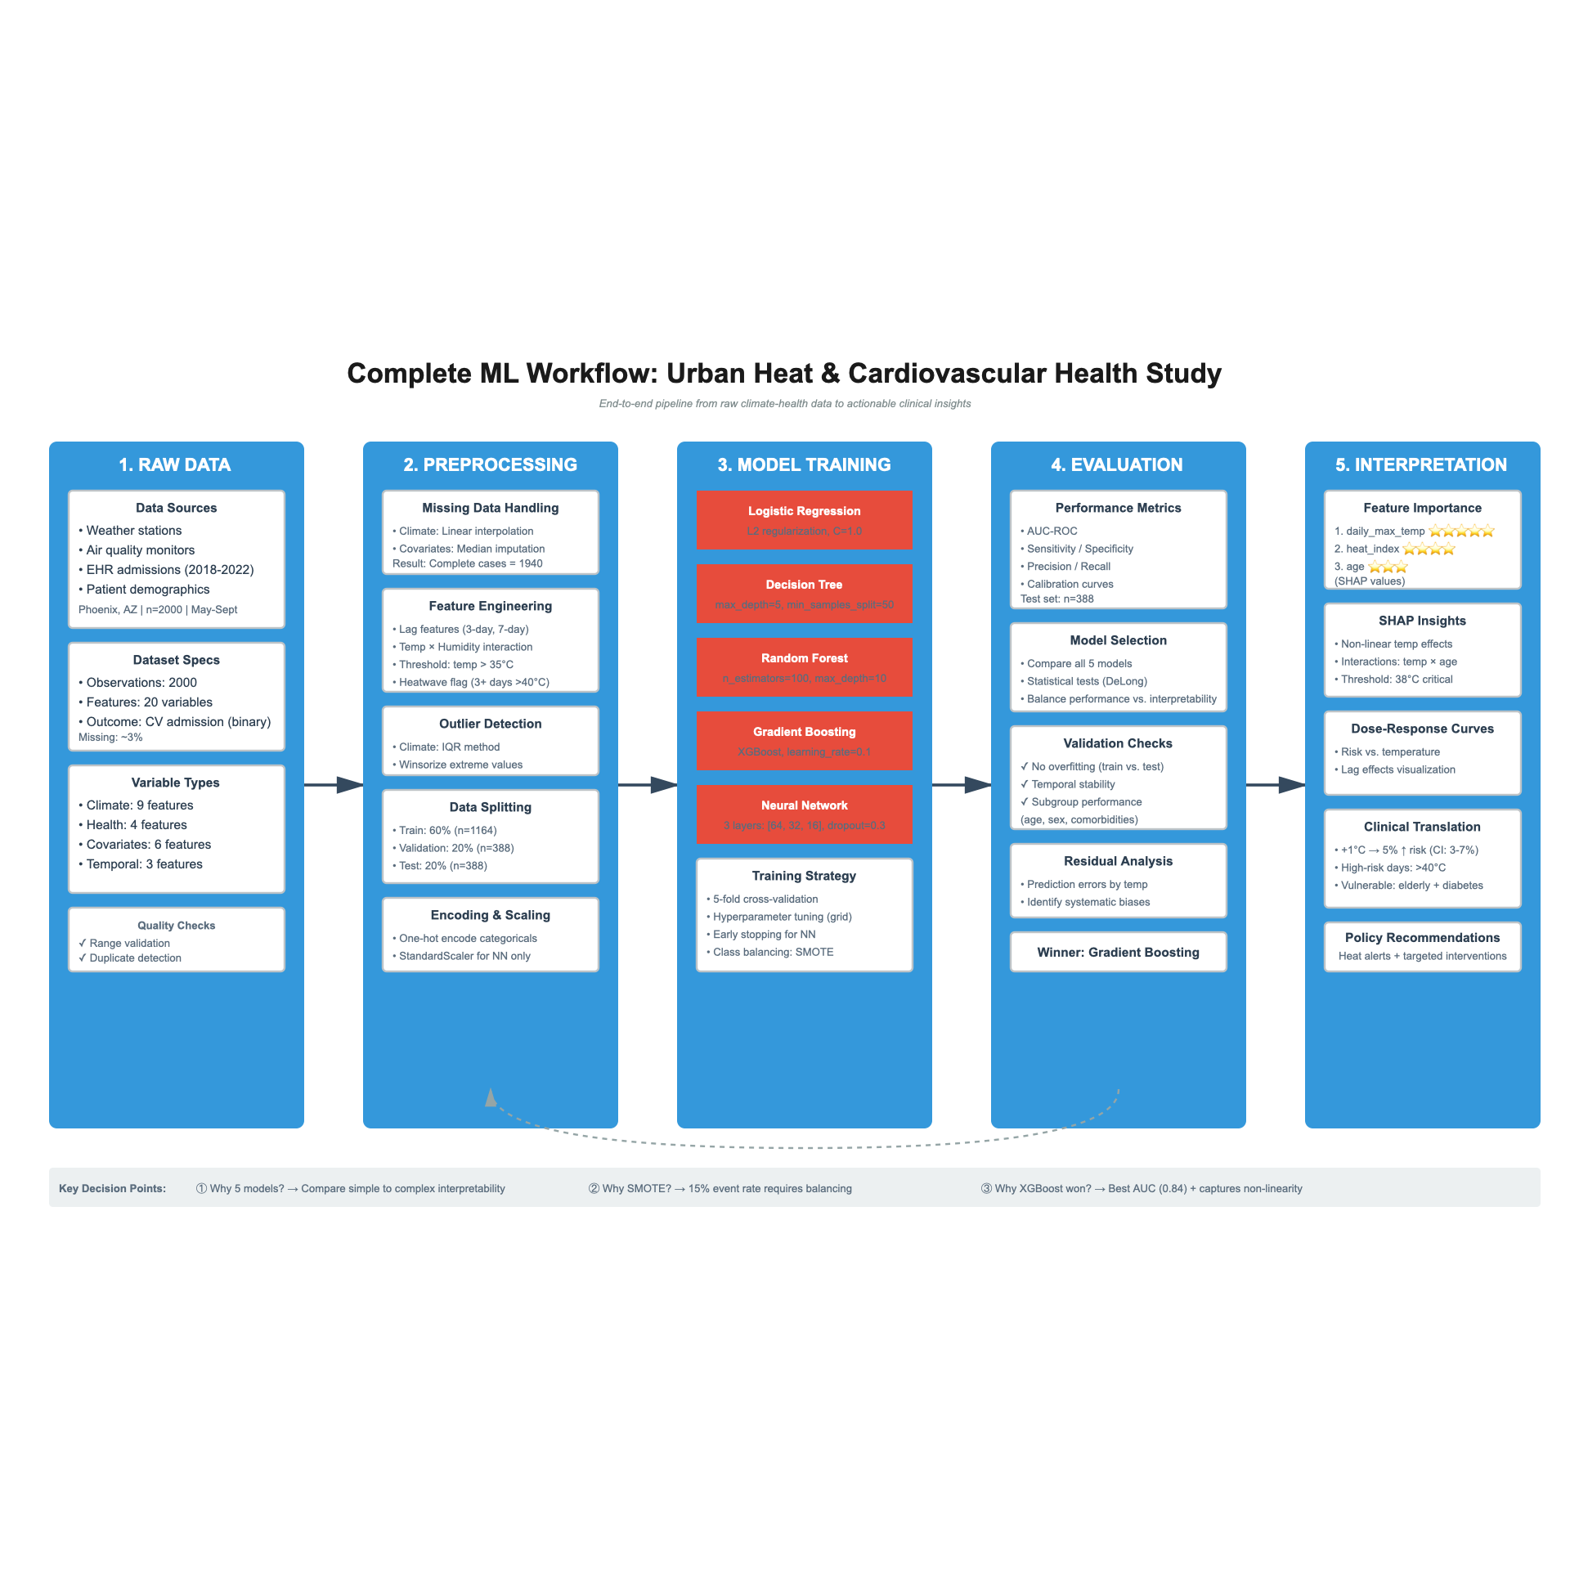
Complete Workflow

Slide 40
Thank You!
Questions?

