Slide 1
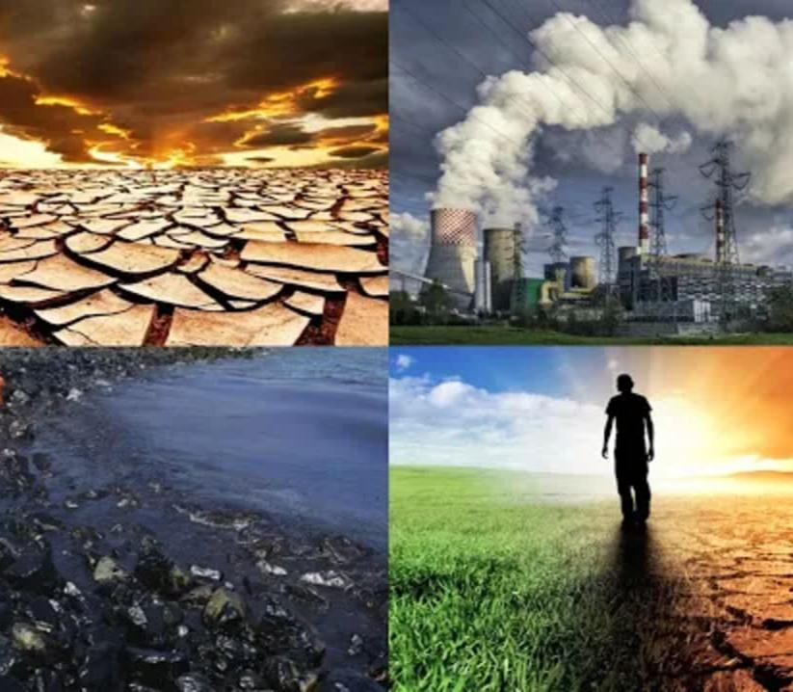
Introduction to Environmental Pollution Definition: The contamination of the environment by harmful substances or activities. Types: Air Pollution Water Pollution Soil Pollution Noise Pollution Why it matters: It affects human health, ecosystems, and the climate.

Slide 2
Causes of Environmental Pollution Air Pollution: Emissions from industries, vehicles, and burning fossil fuels. Water Pollution: Dumping industrial waste, plastic, and sewage into water bodies. Soil Pollution: Overuse of pesticides, chemical fertilizers, and improper waste disposal. Noise Pollution: Urbanization, traffic, and industrial noise.

Slide 3
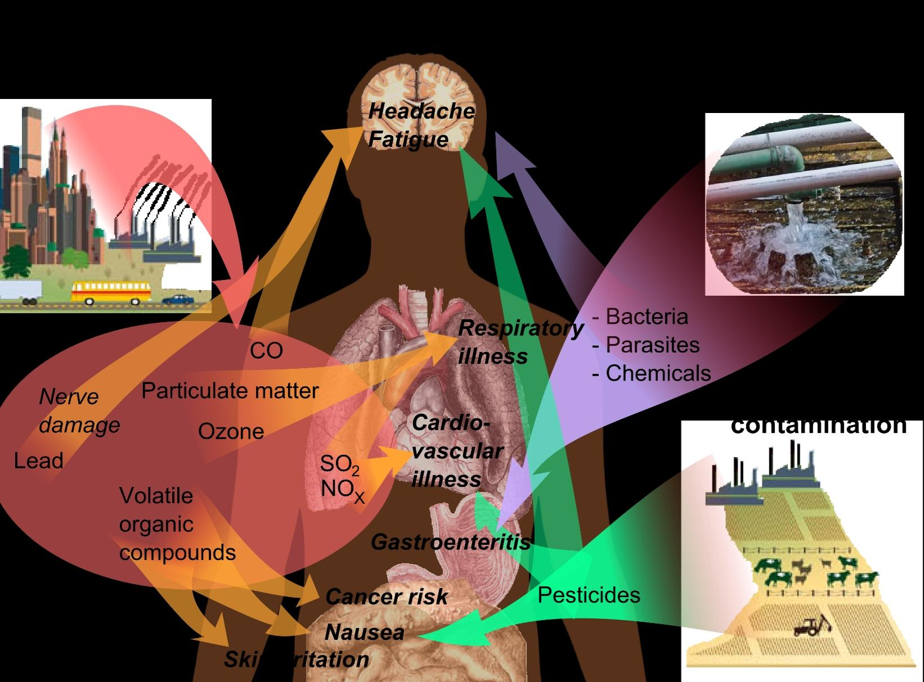
Effects of Environmental Pollution On Health: Respiratory issues, cardiovascular diseases, and waterborne illnesses. On Environment: Loss of biodiversity. Soil infertility. Contaminated water bodies. On Climate: Contribution to global warming and extreme weather patterns.

Slide 4
Solutions to Combat Pollution Air Pollution: Use of renewable energy. Planting trees. Reducing vehicle emissions. Water Pollution: Proper waste management. Cleaning water bodies. Promoting water conservation.
Soil Pollution: Organic farming. Recycling waste. Proper disposal of hazardous substances. Noise Pollution: Implementing soundproofing measures. Regulating industrial noise.

Slide 5
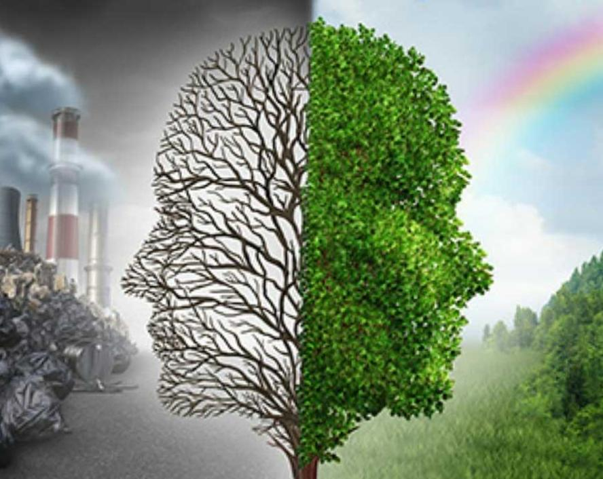
Call to Action Individual Responsibility: Reduce, reuse, recycle; avoid single-use plastics; conserve energy and water. Community Role: Organize clean-up drives and awareness campaigns. Global Efforts: Support policies and international agreements to reduce pollution. Remember: Protecting the environment ensures a sustainable future for everyone.

Slide 6


