Slide 1
Mux2_1 Walkthrough – PYNQ & SoC Builder Basics
Component Symbol
Target Language: Verilog
Truth Table
dIn0 | dIn1 | sel | dOut
X | Y | 0 | X
X | Y | 1 | Y
dIn1
dOut
Test Plan
dIn0
dIn0 | dIn1 | sel | dOut
0 | 1 | 0 | 0
0 | 1 | 1 | 1
1 | 0 | 0 | 1
1 | 0 | 1 | 0
sel

Slide 2
2-bit Full Adder Walkthrough
Target Language: VHDL
Component Symbol
Truth Table & Test plan
cOut
addIn1 | addIn0 | cIn | dOut | cOut
0 | 0 | 0 | 0 | 0
0 | 0 | 1 | 1 | 0
0 | 1 | 0 | 1 | 0
0 | 1 | 1 | 0 | 1
1 | 0 | 0 | 1 | 0
1 | 0 | 1 | 0 | 1
1 | 1 | 0 | 0 | 1
1 | 1 | 1 | 1 | 1
addIn1
dOut
addIn0
cIn

Slide 3
RISC-V ALU Walkthrough
Target Language: VHDL
Component Symbol
32
A
32
ALUOut
branch
32
B
selALUOp
4

Slide 4
RISC-V ALU Walkthrough
Test plan
Signals | selALUOp | A | B | ALUOut | branch | Delay | TestNo | Note
Mode | in | in | in | out | out | None | None | None
Radix | 4'b | 32'h | 32'h | 32'h | 1'b | None | None | None
= | = | = | = | = | = | = | = | =
 | 0000 | 5a5a5a5a | 15a5a5a6 | 70000000 | 0 | 1 | 1 | sgnA + sgnB
 | 0000 | 15a5a5a6 | 5a5a5a5a | 70000000 | 0 | 1 | 2 | sgnA + sgnB
 | 0000 | ffffffff | 40000000 | 3fffffff | 0 | 1 | 3
 | 0001 | ffffffff | fffffffe | 00000001 | 0 | 1 | 4 | sgnA - sgnB
 | 0010 | f0c3a596 | 1f7e8ab4 | 10428094 | 0 | 1 | 5 | A and B
 | 0011 | f0c3a596 | 1f7e8ab4 | ffffafb6 | 0 | 1 | 6 | A or B
 | 0100 | f0c3a596 | 1f7e8ab4 | efbd2f22 | 0 | 1 | 7 | A xor B
 | 0101 | f0c3a596 | 00000008 | c3a59600 | 0 | 1 | 8 | A << B(4:0) shift left logical
 | 0110 | f0c3a596 | 00000008 | 00f0c3a5 | 0 | 1 | 9 | A >> B(4:0) shift right logical
 | 0111 | f0c3a596 | 00000008 | fff0c3a5 | 0 | 1 | 10 | A >>> B(4:0) shift right arithmetic
 | 1000 | f0c3a596 | 1f7e8ab4 | 00000001 | 0 | 1 | 11 | 1 if sgn A < sgn B
 | 1001 | f0c3a596 | 1f7e8ab4 | 00000000 | 0 | 1 | 12 | 1 if uns A < uns B
 | 1010 | f0c3a596 | 1f7e8ab4 | 00000001 | 0 | 1 | 13 | branch = 1 if A = B
 | 1010 | f0c3a596 | f0c3a596 | 00000002 | 1 | 1 | 14 | branch = 1 if A = B
 | 1011 | f0c3a596 | 1f7e8ab4 | 00000003 | 1 | 1 | 15 | branch = 1 if A != B
 | 1011 | f0c3a596 | f0c3a596 | 00000004 | 0 | 1 | 16
 | 1100 | f0c3a596 | 1f7e8ab4 | 00000005 | 1 | 1 | 17 | branch = 1 if sgn A < sgnB
 | 1100 | f0c3a596 | f0c3a596 | 00000006 | 0 | 1 | 18
 | 1101 | f0c3a596 | 1f7e8ab4 | 00000007 | 0 | 1 | 19 | branch = 1 if sgn A >= sgnB
 | 1101 | f0c3a596 | f0c3a596 | 00000008 | 1 | 1 | 20
 | 1110 | f0c3a596 | 1f7e8ab4 | 00000009 | 0 | 1 | 21 | branch = 1 if uns A < uns B
 | 1110 | f0c3a593 | f0c3a596 | 00000010 | 1 | 1 | 22
 | 1111 | f0c3a596 | 1f7e8ab4 | 00000011 | 1 | 1 | 23 | branch = 1 if uns A >= uns B
 | 1111 | f0c3a596 | f0c3a596 | 00000012 | 1 | 1 | 24

Slide 5
CB4CLED Walkthrough
4-bit Cascadable, Chip-Enabled, Up/Down Synchronous Counter
with Asynchronous reset
Target Language: VHDL
Component Symbol
Test plan
load | loadDat | ce | up | count | TC | ceo | Delay
1 | d | 0 | 0 | D | 0 | 0 | 1
0 | d | 1 | 1 | F | 1 | 1 | 2
0 | d | 0 | 1 | F | 1 | 0 | 1
0 | d | 1 | 1 | 1 | 0 | 0 | 2
0 | d | 1 | 0 | 0 | 1 | 1 | 1
0 | d | 0 | 0 | 0 | 1 | 0 | 1
0 | d | 1 | 0 | F | 0 | 0 | 1
0 | d | 1 | 0 | 0 | 1 | 1 | 15
dataIn(3:0)
load
count(3:0)
up
ceo
ce
TC
clk
rst

Slide 6
CB4CLED Walkthrough
4-bit Cascadable, Chip-Enabled, Up/Down Synchronous Counter
with Asynchronous reset
Signals load loadDat ce up count TC ceo Delay TestNo Note
Mode in in in in out out out None None None
Radix 1'b 4'h 1'b 1'b 4'h 1'b 1'b None None None
= = = = = = = = = = =
1 d 0 0 d 0 0 1 1 load 0xd
0 d 1 1 f 1 1 2 2 0xf, TC and ceo asserted
0 d 0 1 f 1 0 1 3 0xf, TC asserted, ceo deasserted
0 d 1 1 1 0 0 2 4 count increments to 0, ,then to 1
0 d 1 0 0 1 1 1 5 count down to 0, TC and ceo asserted
0 d 0 0 0 1 0 1 6 0, TC asserted, ceo deasserted
0 d 1 0 f 0 0 1 7 count own to 0xf
0 d 1 0 0 1 1 15 8 0, TC and ceo asserted
# Example of a comment - comments are ignored by the testplan generator
# HDLGen-ChatGPT Test Specification
# Title: 4-bit cascadable, loadable, up/down counter, with asynchronpous rst
# Created by: Fearghal Morgan
# Date: 20/02/2024
# Component type: Register-Transfer Logic

Slide 7
Single Shot Walkthrough
Target Language: VHDL
Component Symbol
Timing Diagram
sw
aShot
clk
rst

Slide 8
Single Shot Walkthrough
Target Language: VHDL
Component Symbol
Timing Diagram
sw
aShot
clk
rst

Slide 9
RISC-V Register Bank Walkthrough
Target Language: VHDL
Component Symbol
RWr
rd(4:0)
rs1(4:0)
rs2(4:0)
clk
rs1D(4:0)
WBDat(31:0)
rs2D(4:0)
ce
RBOut(31:0)
rst
host_datToMem(31:0)
host_memAdd(15:0)
RBWe
WBDat(31:0)

Slide 10
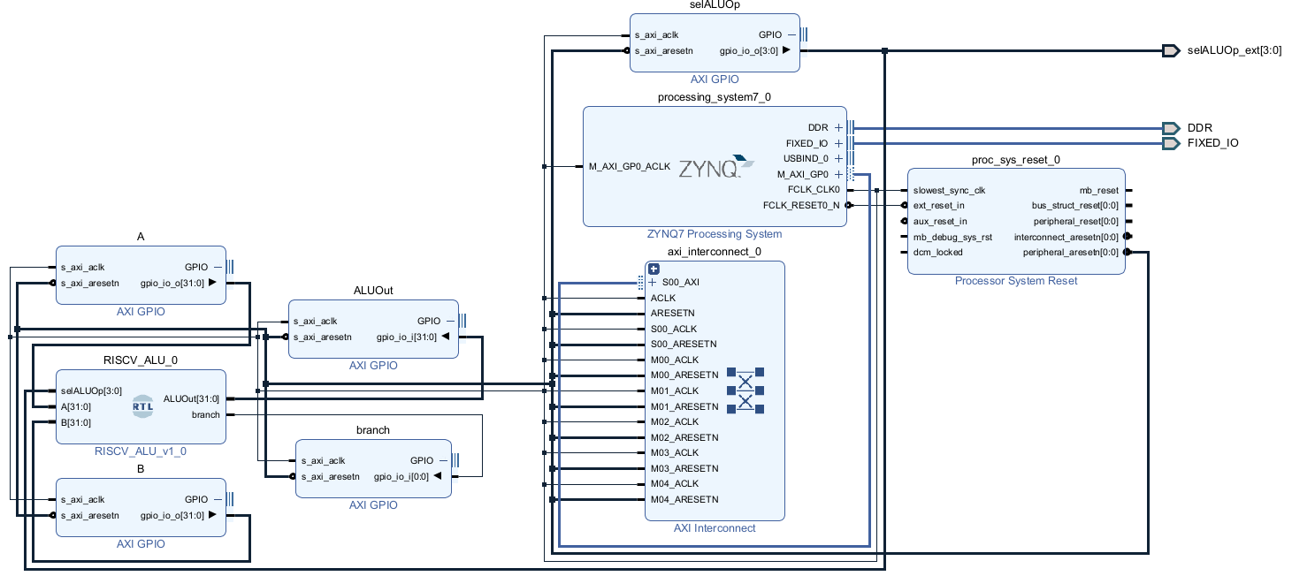
External Ports
ZYNQ Processing System
AXI GPIO
IP Blocks
Processor System Reset
RISC-V ALU
AXI Interconnect

Slide 11
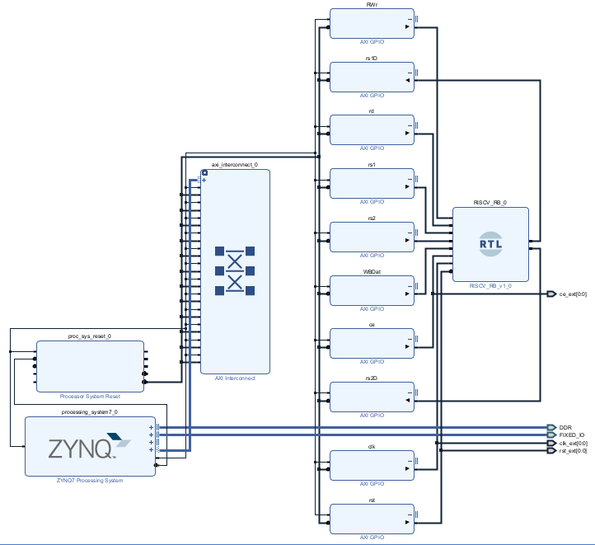
AXI GPIO
IP Blocks
AXI Interconnect
RISC-V
Register Bank
Processor System Reset
External Ports
ZYNQ Processing System

Slide 12
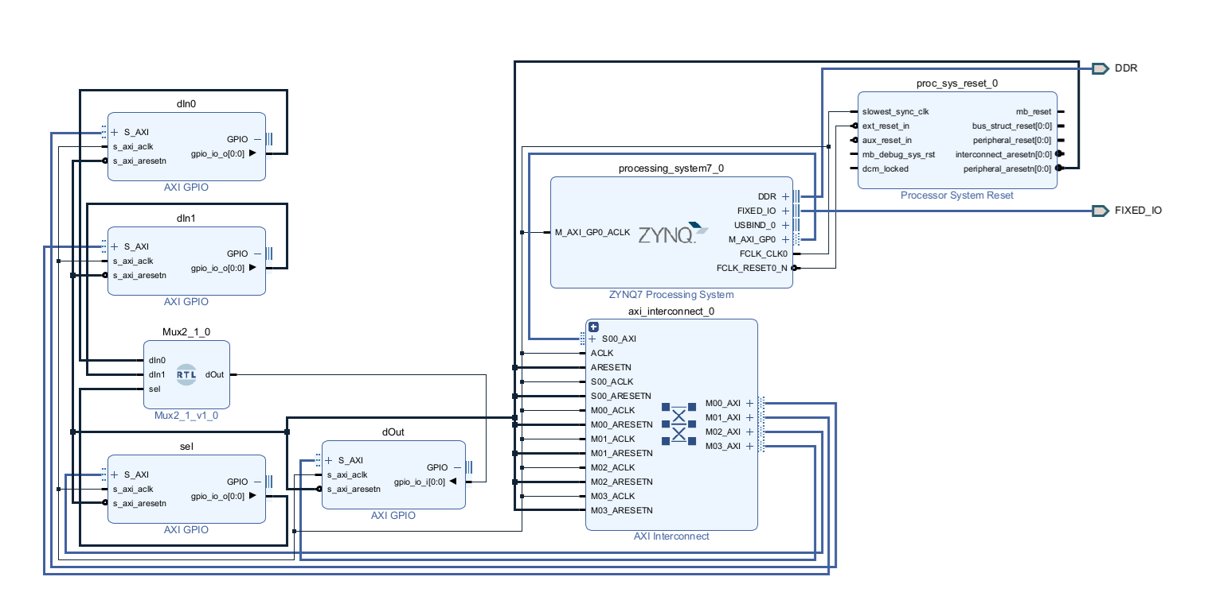
Input AXI GPIO IP Blocks
ZYNQ Processing System
Processor System Reset
Mux2_1
Output AXI GPIO IP Blocks
AXI Interconnect

Slide 13
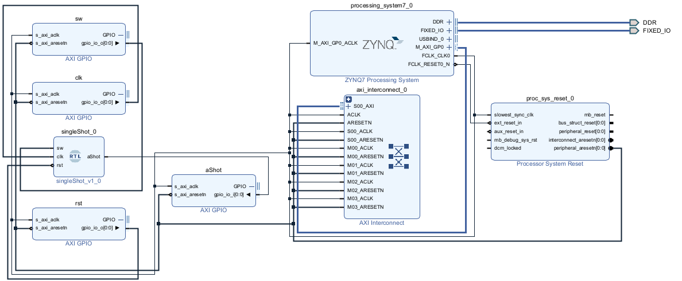
ZYNQ Processing System
AXI GPIO IP Blocks
Mux2_1
Processor System Reset
AXI Interconnect

Slide 14
Path to Vivado Bat File
Instructs Vivado to operate in Tcl Console Mode
Source command in Tcl is used to execute Tcl scripts
Path to Tcl script with build instructions

