Slide 1
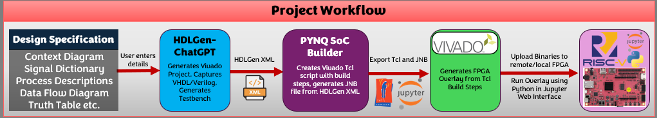
Launch Application
Select HDLGen File
Set SoC Builder Configuration (I/O, Vivado Settings)
Click “Run” in SoC Builder to start build
Vivado will execute all build steps required
Find output files in
<hdlgen-proj>/PYNQBuild/output
Find output files in
<hdlgen-proj>/PYNQBuild/output
Upload all files in output/ to PYNQ
SoC Builder reads all the required information from the HDLGen Project XML file
SoC Builder creates a script with all instructions and Vivado executes the build instructions to produce binary files.
Vivado is launched from the terminal using Python
(Python opens a shell session, it opens Vivado by calling vivado.bat in the installation directory)
Vivado sources (executes) a Tcl (Tool control language) script with the build instructions which was prepared by the SoC builder in the previous step.
Upon a successful build, SoC builder finds the bitstream output and dependencies and moves them to PYNQBuild/output directory
Upon a successful build, SoC builder finds the bitstream output and dependencies and moves them to PYNQBuild/output directory
Remote: Open remote Jupyter Notebook environment in your browser, select the upload button and select all files in PYNQBuild/output
Local (LAN or Direct Connection): You may upload files manually or choose to upload automatically, supplying IP address of the PYNQ board.
Using information read from the XML, instructions are generated in Tcl language to execute the following steps:
Launch Vivado
(Optional) Make the Vivado GUI visible
Change target board configuration to PYNQ Z2
Import FPGA’s Physical Constraints
Create and populate a block design connecting PYNQ Processing System to the VHDL Logic Component by AXI IP.
Run Synthesis
Run Implementation
Generate and Export Bitstream
Export Block Diagram
An XDC Master Physical Constraints File is also generated automatically depending on the I/O configuration specified by the user in the GUI. The XDC file maps board I/O to external ports in the block diagram.
Whilst Vivado is executing the steps, the SoC builder will run multiple threads used to track the main application log, the synthesis log and the implementation log files.
The SoC Builder checks continuously to determine what stage in the build process Vivado is in, and relay this to the user through the GUI. The logs will also inform the SoC builder if there is any errors or critical warnings, handling errors and relaying info to user.
Using information read from the XML, instructions are generated in Tcl language to execute the following steps:
Launch Vivado
(Optional) Make the Vivado GUI visible
Set target board configuration to PYNQ Z-2
If the board config does not exist in the user’s installation of Vivado, install it automatically.
Import FPGA’s Physical Constraints
Physical constraints are generated depending on I/O config. This file maps external pins in block design to board I/O pins.
Create and populate a block design connecting PYNQ Processing System to the VHDL Logic Component by AXI IP.
Import Component
(Optional) An SVG image of component may be exported at this point. It will be used later and presented in the Jupyter Notebook fiel
Import Zynq Processing Unit
For each signal in the component:
Import AXI GPIO Component
Configure AXI GPIO
Connect user component port to GPIO
Import AXI Interconnect IP
Connect each AXI GPIO to the Interconnect IP
Import System Reset IP
Connect System Reset to the Interconnect IP
Run Connection Automation on Block Design
Run Block Automation on Block Design
Auto assign memory addresses
Validate Block Design
A HDL Wrapper is generated automatically by Vivado
Run Synthesis
Run Implementation
Generate and Export Bitstream
Export Block Diagram
(Optional) The user may set Vivado not to close automatically allowing them inspect the project for their own purposes.
Close project, close GUI and exit Vivado

Slide 2
Launch Application
Select HDLGen File
Set SoC Builder Configuration (I/O, Vivado Settings)
Click “Run” in SoC Builder to start build
Vivado will execute all build steps required
Find output files in
<hdlgen-proj>/PYNQBuild/output
Find output files in
<hdlgen-proj>/PYNQBuild/output
Upload all files in output/ to PYNQ
SoC Builder reads all the required information from the HDLGen Project XML file
SoC Builder creates a script with all instructions and Vivado executes the build instructions to produce binary files.
Vivado is launched from the terminal using Python
(Python opens a shell session, it opens Vivado by calling vivado.bat in the installation directory)
Vivado sources (executes) a Tcl (Tool control language) script with the build instructions which was prepared by the SoC builder in the previous step.
Upon a successful build, SoC builder finds the bitstream output and dependencies and moves them to PYNQBuild/output directory
Upon a successful build, SoC builder finds the bitstream output and dependencies and moves them to PYNQBuild/output directory
Remote: Open remote Jupyter Notebook environment in your browser, select the upload button and select all files in PYNQBuild/output
Local (LAN or Direct Connection): You may upload files manually or choose to upload automatically, supplying IP address of the PYNQ board.
Using information read from the XML, instructions are generated in Tcl language to execute the following steps:
Launch Vivado
(Optional) Make the Vivado GUI visible
Change target board configuration to PYNQ Z2
Import FPGA’s Physical Constraints
Create and populate a block design connecting PYNQ Processing System to the VHDL Logic Component by AXI IP.
Run Synthesis
Run Implementation
Generate and Export Bitstream
Export Block Diagram
An XDC Master Physical Constraints File is also generated automatically depending on the I/O configuration specified by the user in the GUI. The XDC file maps board I/O to external ports in the block diagram.
Whilst Vivado is executing the steps, the SoC builder will run multiple threads used to track the main application log, the synthesis log and the implementation log files.
The SoC Builder checks continuously to determine what stage in the build process Vivado is in, and relay this to the user through the GUI. The logs will also inform the SoC builder if there is any errors or critical warnings, handling errors and relaying info to user.
Using information read from the XML, instructions are generated in Tcl language to execute the following steps:
Launch Vivado
(Optional) Make the Vivado GUI visible
Set target board configuration to PYNQ Z-2
If the board config does not exist in the user’s installation of Vivado, install it automatically.
Import FPGA’s Physical Constraints
Physical constraints are generated depending on I/O config. This file maps external pins in block design to board I/O pins.
Create and populate a block design connecting PYNQ Processing System to the VHDL Logic Component by AXI IP.
Import Component
(Optional) An SVG image of component may be exported at this point. It will be used later and presented in the Jupyter Notebook fiel
Import Zynq Processing Unit
For each signal in the component:
Import AXI GPIO Component
Configure AXI GPIO
Connect user component port to GPIO
Import AXI Interconnect IP
Connect each AXI GPIO to the Interconnect IP
Import System Reset IP
Connect System Reset to the Interconnect IP
Run Connection Automation on Block Design
Run Block Automation on Block Design
Auto assign memory addresses
Validate Block Design
A HDL Wrapper is generated automatically by Vivado
Run Synthesis
Run Implementation
Generate and Export Bitstream
Export Block Diagram
(Optional) The user may set Vivado not to close automatically allowing them inspect the project for their own purposes.
Close project, close GUI and exit Vivado

Slide 3



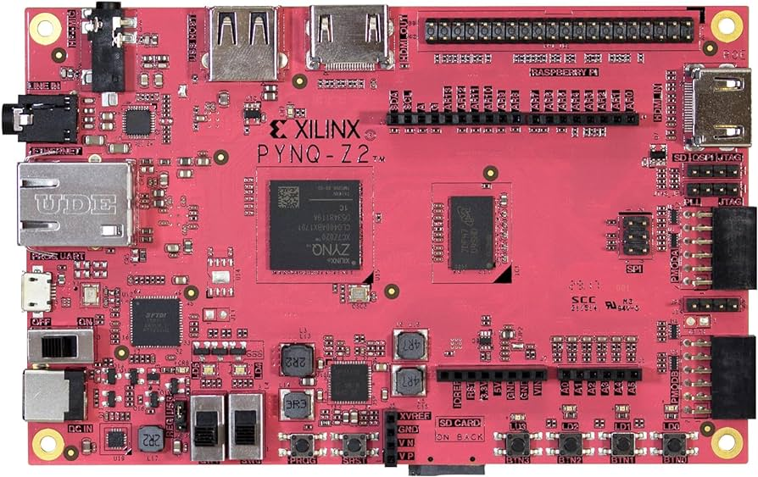
User uploads binaries to the PYNQ Z2 over the Jupyter Notebook Interface
Bitstream files are used to program the PL (programmable logic) slices in the FPGA core
Ngrok tunnels data from one network to the next
Zynq 7000 SoC consisting of a dual-core ARM processor and 13,300 logic slice programmable logic
PYNQ hosts a Jupyter Notebook session in web interface accessible in the computer’s web browser
PYNQ (Unix-based) OS and user-uploaded files are stored in on-board MicroSD
Bitstream files are used to program the PL (programmable logic) slices in the FPGA core
Computer directly connected to FPGA using Ethernet connection
Zynq 7000 SoC consisting of a dual-core ARM processor and 13,300 logic slice programmable logic
PYNQ hosts a Jupyter Notebook session in web interface accessible in the computer’s web browser
PYNQ (Unix-based) OS and user-uploaded files are stored in on-board MicroSD
Bitstream files are used to program the PL (programmable logic) slices in the FPGA core
Computer directly connected to FPGA using Ethernet connection
Zynq 7000 SoC consisting of a dual-core ARM processor and 13,300 logic slice programmable logic
PYNQ hosts a Jupyter Notebook session in web interface accessible in the computer’s web browser
PYNQ (Unix-based) OS and user-uploaded files are stored in on-board MicroSD

Slide 4
Step 1: Parse HDLGen XML
Step 2: Read Application Configuration
Step 3: Vivado Preparation
Step 4: Execute Tcl in Vivado
Step 5: Generate Jupyter Notebook
Store the following as variables:
Component Ports
Internal Signals
HDL Language
Project Path
Vivado Path
Store the following as variables:
Keep Vivado Open
Open Vivado GUI
Generate Jupyter Notebook File
Connect Signals to IO
Make internal signals as ports
Contains all the build instructions required by Vivado to compile the project (instructions based on data gathered in stage 1 and 2)
Open Project
Create Block Diagram
Export
Synthesis/Implementation and Bitstream Generation
Etc using Tcl language
Create an XDC file (Master Constraints File) required to connect to board I/O on FPGA (if applicable)
Modify the source VHDL/Verilog File (to connect internal signals to ports) if specified
SoC Builder will prompt Vivado to run the build steps (from Tcl file).
Build Steps:
Open Project
Import XDC Constraints File
Delete existing if needed
Create Block Diagram File
Import Component
Export SVG of Block Diagram (Component Only)
Import Processing Unit
Import all the other required IP
Connect IP
Run Block and Connection Automation tools in Vivado
Assign Memory Address Space
Validate Block Design
Export Block Design
Run Synthesis
Run Implementation
Generate Bitstream
Close Project
Once Vivado closes, and no errors or problems have been detected, the SoC Builder will search the project directory and retrieve the output binaries - .bit, .hwh and .tcl file.
In this stage, two files are created, a (ipynb) Notebook file and a supplementary Python file
Using information from Stage 1 and 2, the Overlay (bitstream file) is loaded, and signals are defined.
Code to make the GUI controller and LED GUI is added to the Python file.
Testplan from HDLGen XML is read. It is presented as markdown and each test in the testplan is generated in the Jupyter Notebook if specified.

