Slide 1
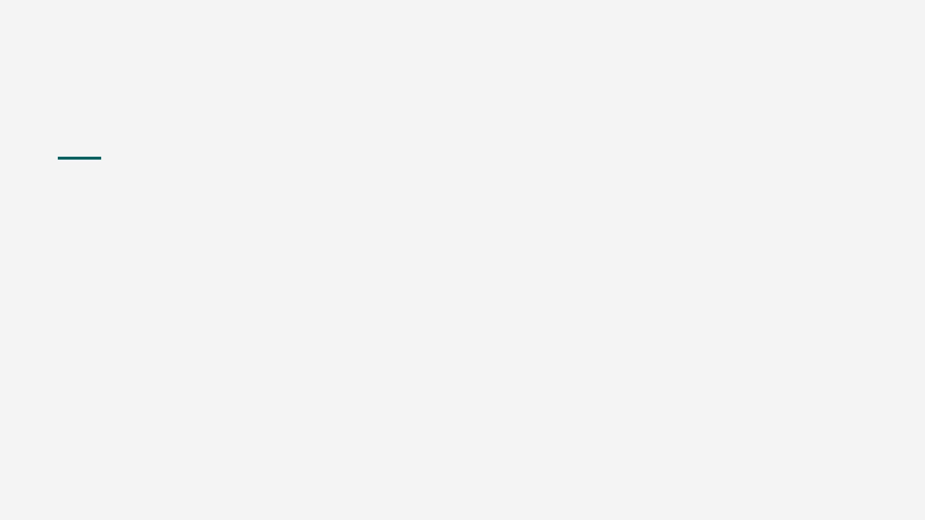
GROUP 3A · 5 MIN
Inventory API
A shop shelf with an address for every question.
Node.js
Express
Map

Slide 2
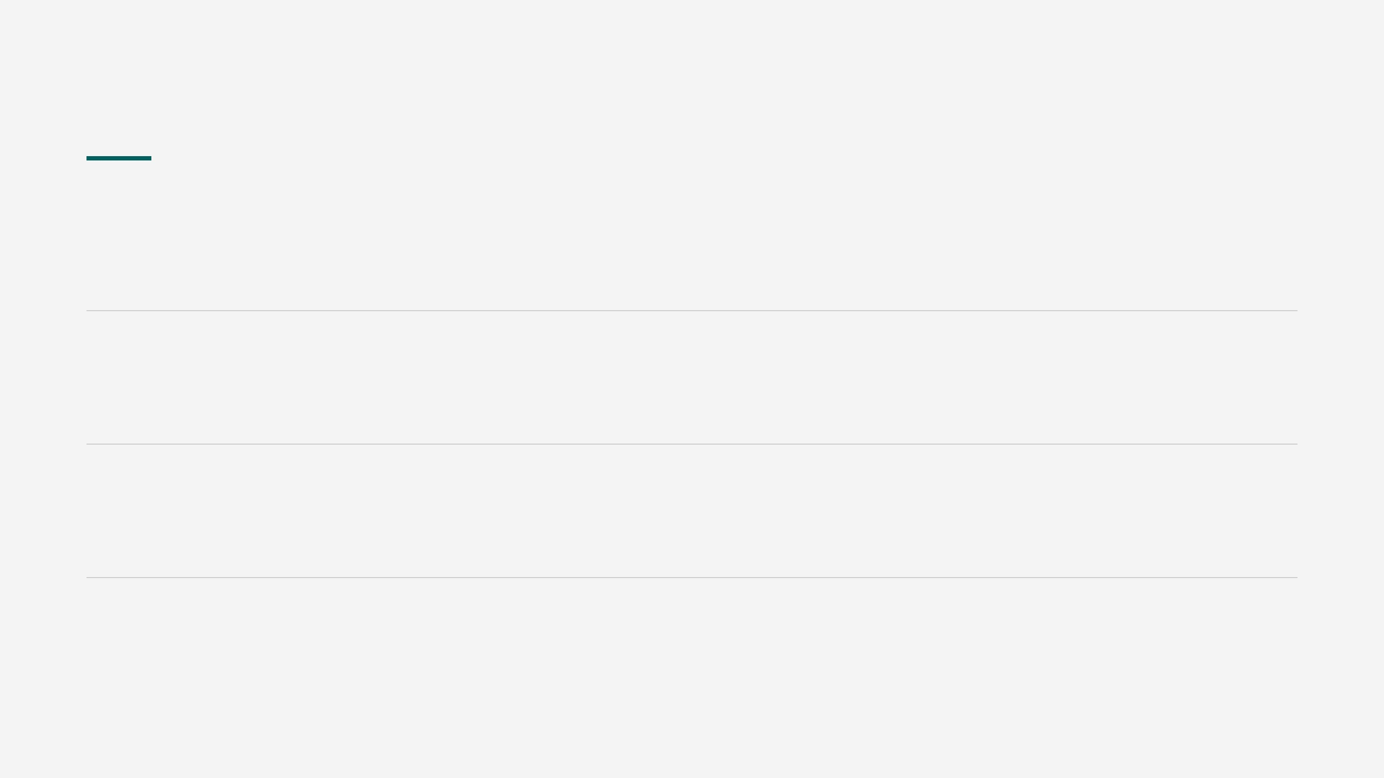
Three questions
01How many are left?
GET /api/products/1
02Biscuits are at 3. Threshold is 5.
"lowStock": true
03Record a sale.
{ "change": -3 }

Slide 3
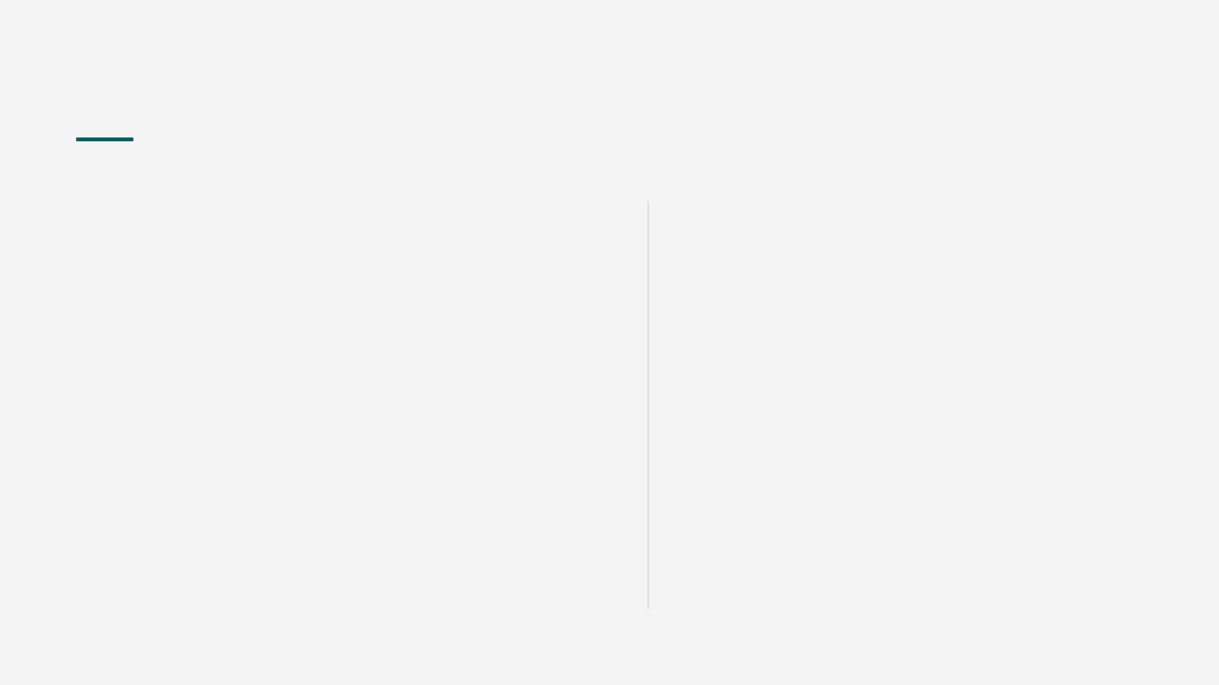
Sell 3 bottles
PATCH /api/products/1/stock
{ "change": -3 }
47
minus is a sale, plus is a delivery, zero is rejected.
was 50 · 200 · lowStock false

Slide 4
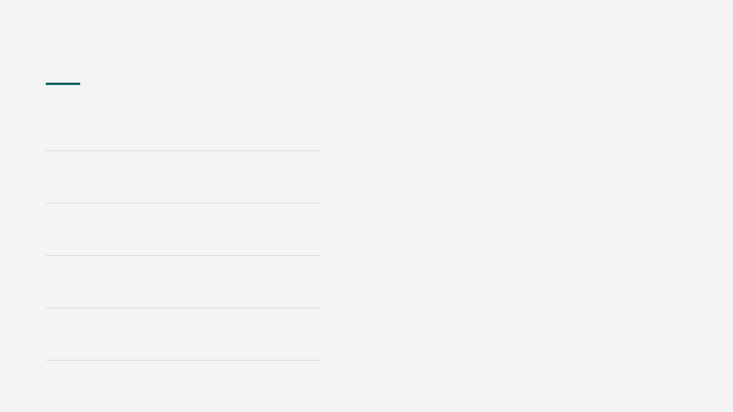
Five layers. One job each.
1 Route
const nextQuantity = product.quantity + change; if (nextQuantity < 0) { throw new AppError( `Not enough stock. Available: ${product.quantity}`, 400 ); }
match PATCH /products/1/stock
2 Check
reject 0, 1.5, and "5"
3 Controller
read the request, send the reply
4 Service
decide if the shelf can spare them
5 Repository
the only write to the Map

Slide 5
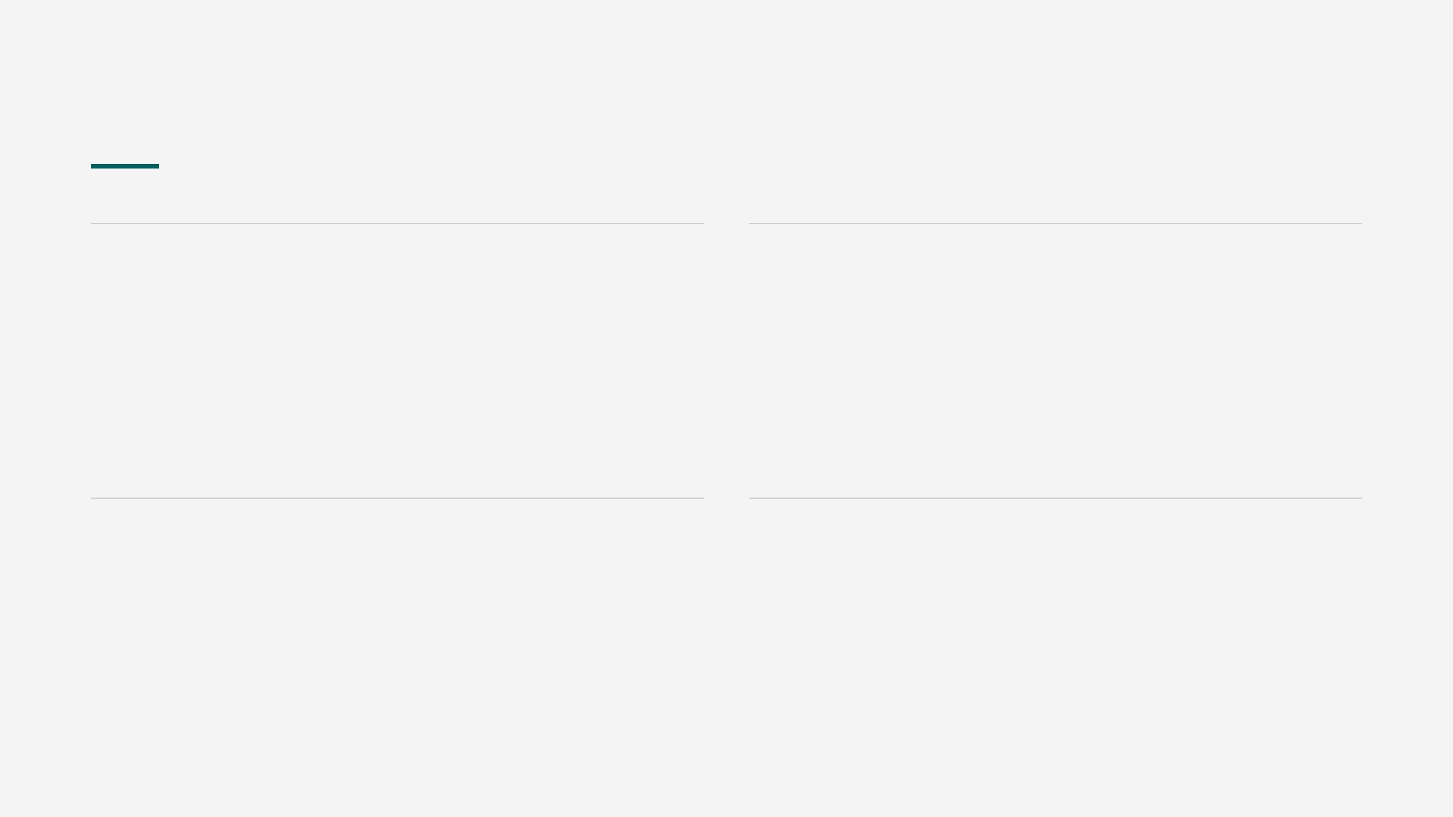
Four refusals
400
200
47 left, someone asks for 500. Quantity stays 47.
Selling the last 3 biscuits is allowed. Zero is valid.
Not enough stock. Available: 47, requested: 500
quantity: 0 lowStock: true
409
409
"drinks" is the same name as Drinks.
Drinks still has water and juice.
Category name "drinks" already exists
it still has 2 product(s)

Slide 6
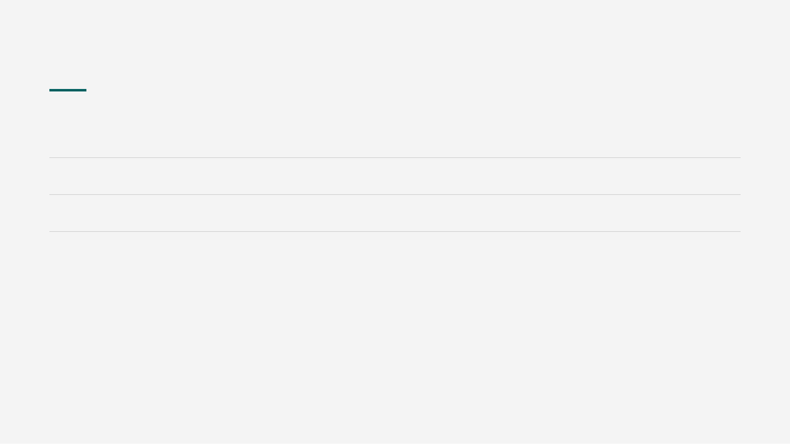
The shelf is a Map
Bottled Water
50
threshold 10
in stock
Orange Juice
8
threshold 10
low
Biscuits
3
threshold 5
low
low stock means quantity <= threshold. Restart reloads this shelf.
const products = new Map();
products.set(1, { name: "Bottled Water", quantity: 50 });
products.get(1);

Slide 7
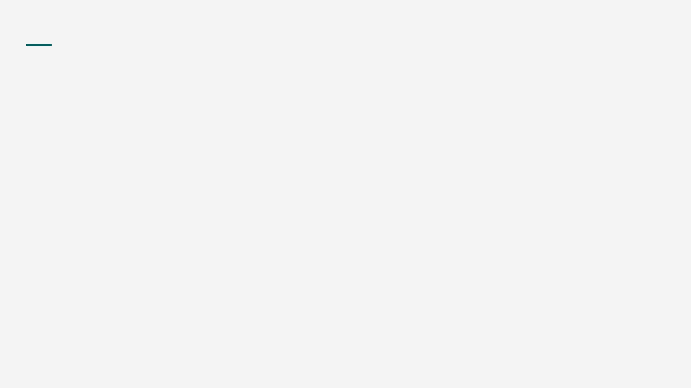
Four calls. Fresh server.
01 GET /api/products/low-stock
juice and biscuits, lowStock true
02 PATCH /api/products/1/stock { "change": -3 }
50 becomes 47
03 PATCH /api/products/1/stock { "change": -500 }
400, quantity stays 47
04 DELETE /api/categories/1
409, category still has products
/low-stock is registered above /:id, or Express treats "low-stock" as an id.

Slide 8
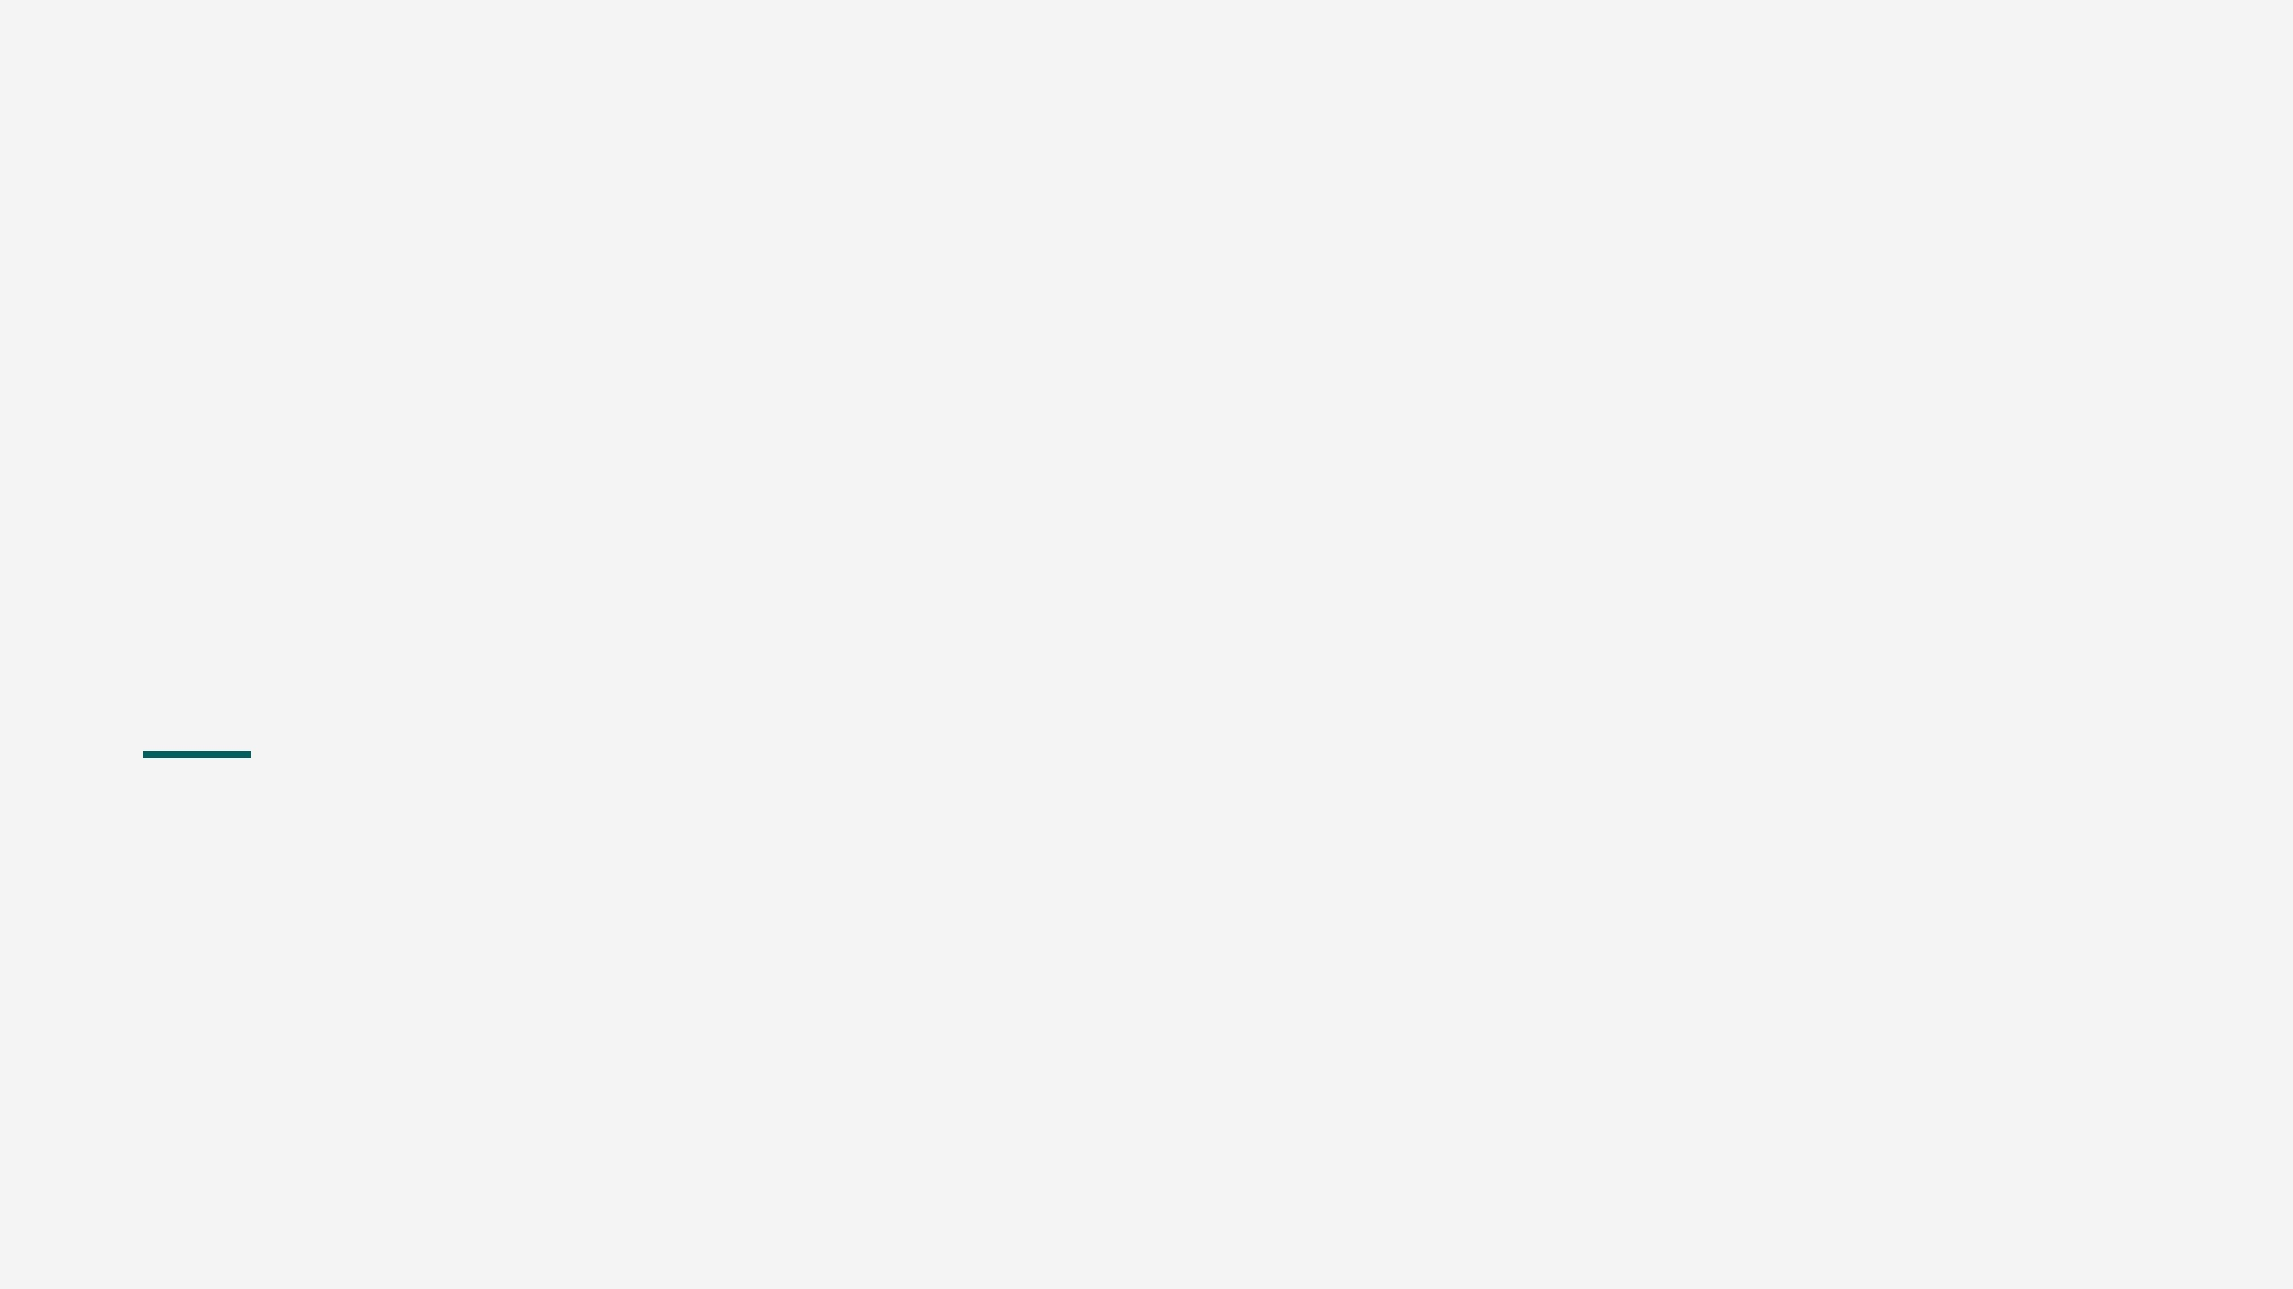
Routes match.
Services decide.
The repository stores.
The shelf can say no, and say why.
Thank you.

