Slide 1
Play Store Analysis
Team Za Warudo

Slide 2
Member Contribution
Maqarios: Data Loading, Data Cleaning, Visualizations
Reda: Data Cleaning, Visualizations, Website
Omar: Exploratory Data Analysis, Feature Engineering, Code Commentary
Ahmed: Feature Engineering, Transformations, Final Pipeline

Slide 3
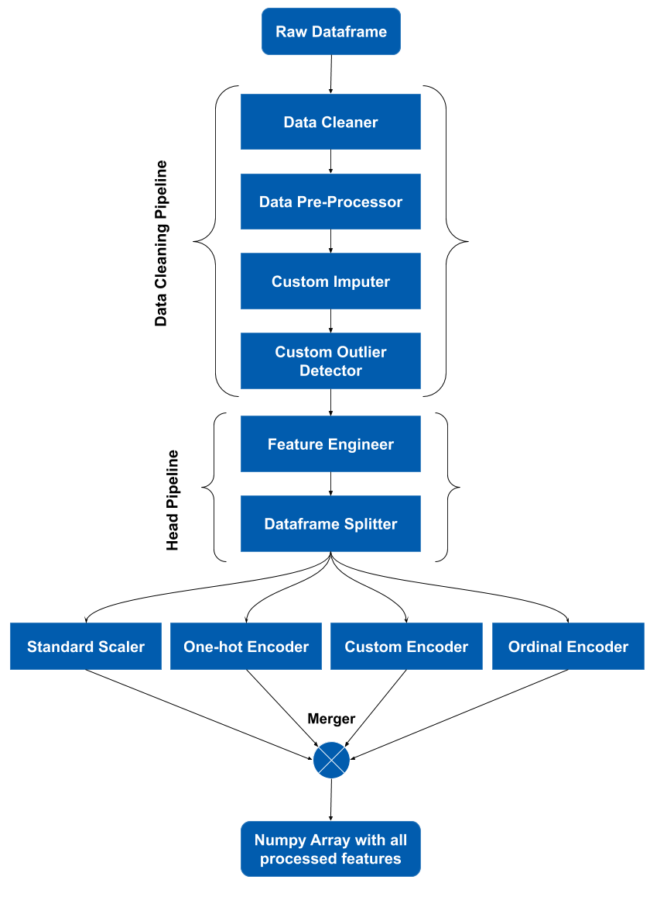
Processing: Data Pipeline
Most Important Processing Steps:
Extracting Numerical Data from Strings.
Made statistical analysis possible.
Removing Duplicate Entries.
Avoided statistical bias.
Outlier Detection and Removal.
Discovered that Tools Category has more installations than Communication.
Stratified Sampling.
Allowed us to represent all categories in both training and test data.
Ordinal Encoding and One-Hot Encoding.
Allowed us to apply ML regression models.

Slide 4
The Most Interesting Questions

Slide 5
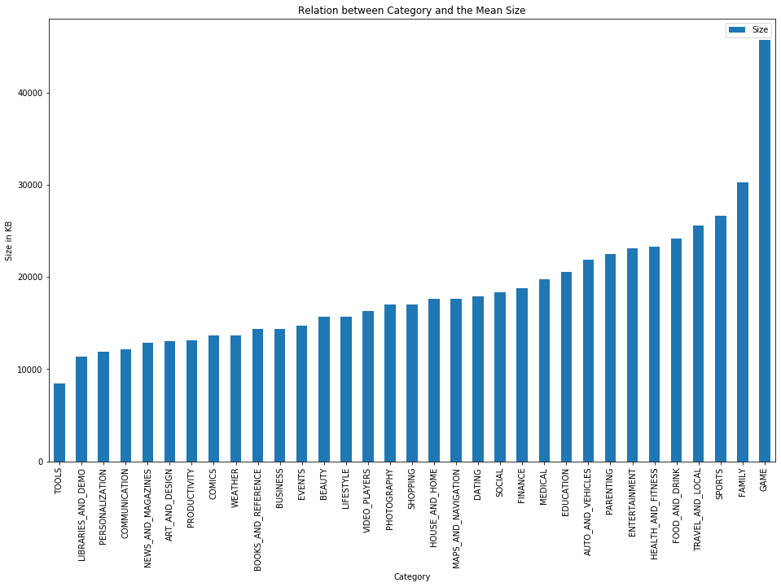
Is there a relationship between the category and size of an app?
Chi-Squared Test.
Strong dependence.

Slide 6
Is there a relationship between the category and number of installs of an app?
We applied the chi-squared test and discovered a strong correlation between the two attributes.
P-Value ≅ 0

Slide 7
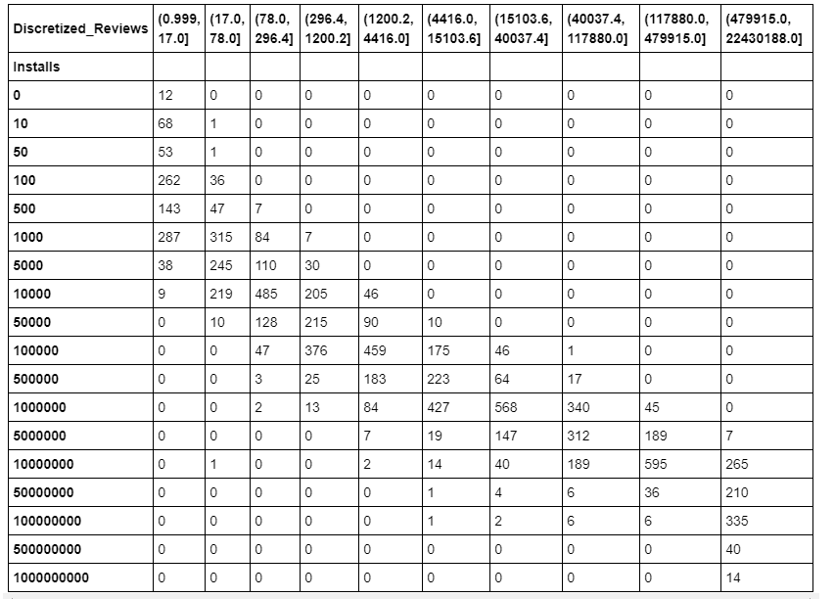
Do more installs mean more reviews?
P-Value = 0.0

Slide 8
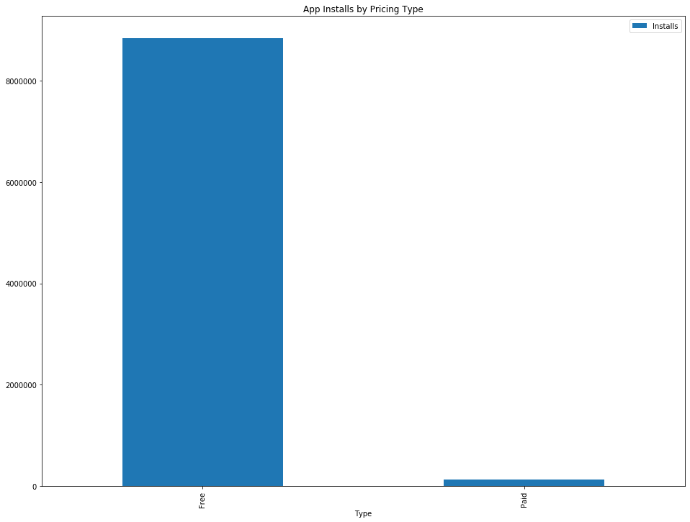
Are there more free or paid apps in the dataset? Which apps are more popular?
Not a simple database query:
Sampling by Category.
Avoiding Representational Bias.

Slide 9
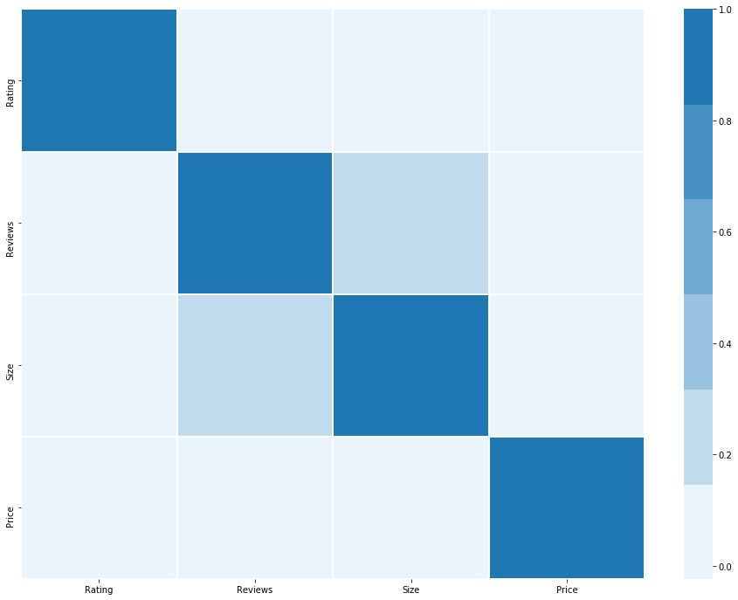
Can we successfully predict the rating of an app using the other numerical attributes of the app?
Pearson’s Coefficient.
With Rating:
All in the range of ~0.01 and less.
Unexpected weak correlation between Size and Reviews.
Heatmap as a better visualization.

Slide 10
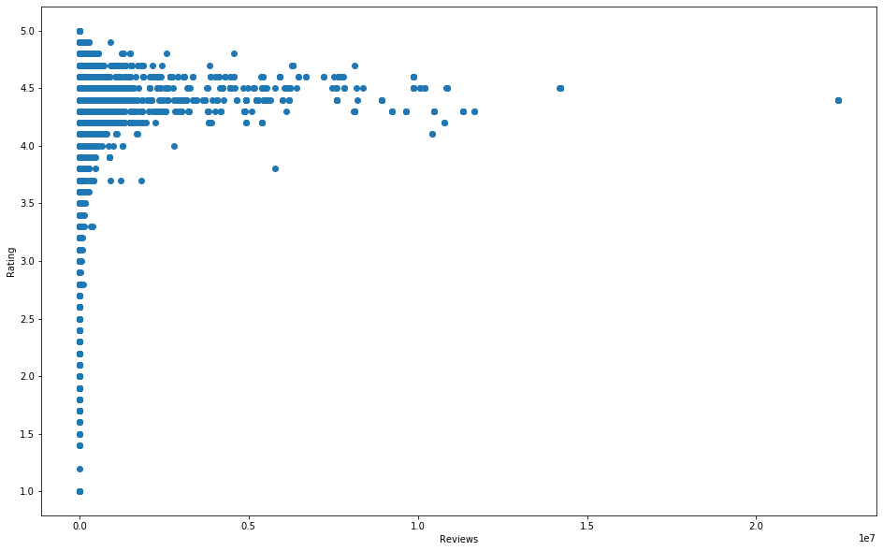
Does the number of reviews an app receives affect its rating?
Bell-shape.
Convergence pattern:
Toward 4.5
Weak linear correlation.

Slide 11
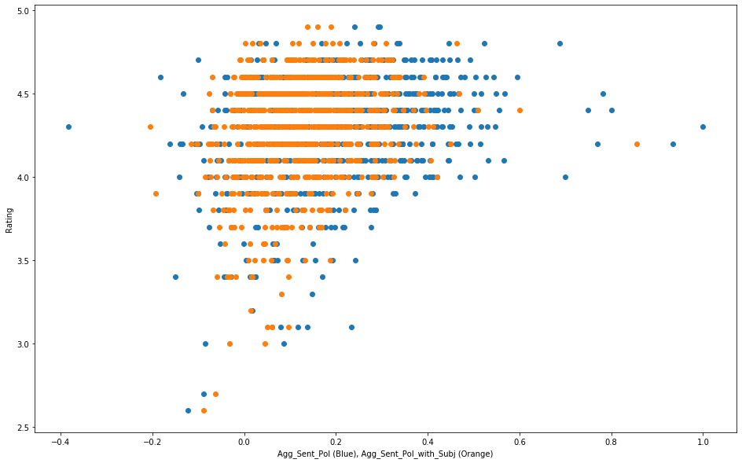
Can the sentiment analysis dataset be useful for the prediction of app ratings?
Engineered 2 new columns:
Sum of Review Sentiments.
Review Sentiments Weighted by Subjectivity.
Stronger linear correlations than any original attribute:
0.269
0.251

Slide 12
Thank you

