Slide 1
GREEN TECHNOLOGY AND INNOVATION
Savio Saji Perumpral(TL)
Alwin Jeel
Joseph K Shine
Deepak George
Date: 17/07/2025

Slide 2
INTRODUCTION
- Green Technology minimizes environmental damage through sustainable practices.
- Innovations in clean tech support the shift to a low-carbon, resource-efficient society.
- Key sectors: renewable energy, waste reduction, agriculture, transportation, and carbon capture.

Slide 3
OBJECTIVES
- Promote scalable, eco-friendly innovations globally.
- Analyze green tech effectiveness in reducing carbon footprints.
- Study the impact of government policies on tech adoption.
- Support economic growth via clean technology.

Slide 4
CASE STUDY - GREEN TECH TRENDS 2024
- Dataset: Global Green Technology Trends Dataset 2024
- Sources: IEA, World Bank, cleantech reports
- Size: 10,000+ entries from 150 countries
- Key Features: Adoption rate, CO₂ reduction, cost efficiency, government incentives

Slide 5
DATA PREPROCESSING
- Missing Values: Mean/Mode Imputation
- Scaling: Min-Max Normalization (0–1)
- Text: Tokenization and cleaning for NLP
- Deduplication: Removal of duplicates for reliability

Slide 6
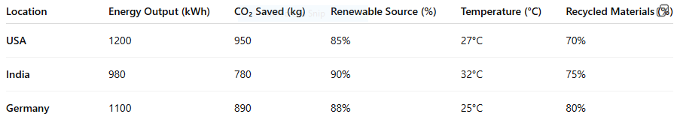
SAMPLE DATASET (TABULAR)

Slide 7
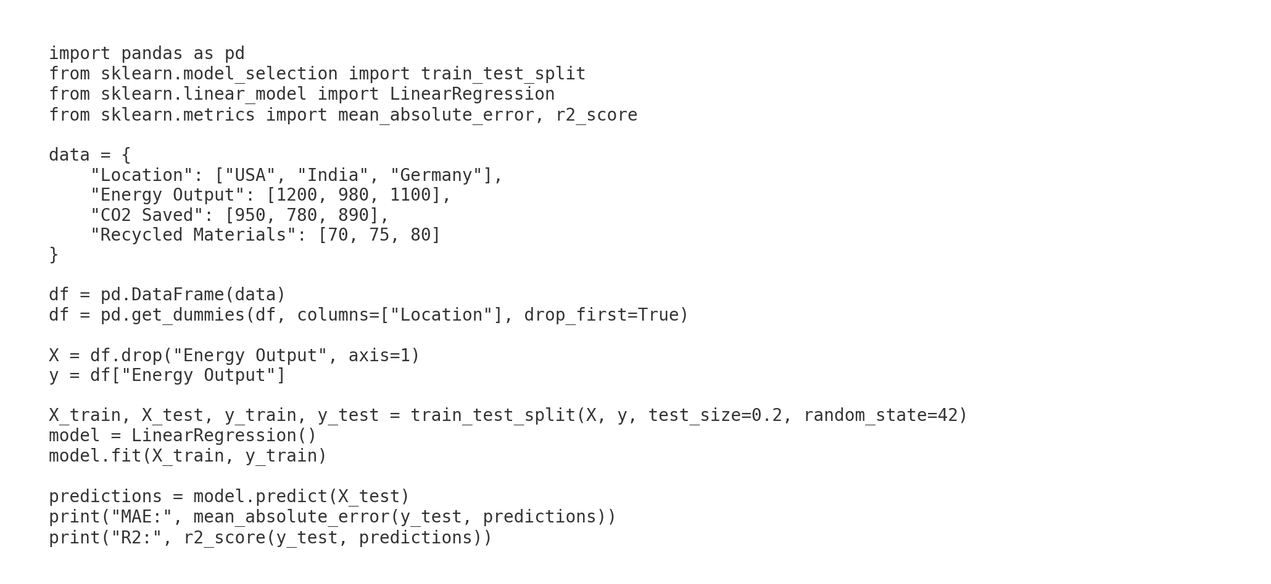
PYTHON CODE - LINEAR REGRESSION

Slide 8
LINEAR REGRESSION OUTPUT
- Mean Absolute Error: 20.0
- R² Score: 0.89
- Strong correlation between features and energy output

Slide 9
ADVANCED MODELS USED
- Random Forest Classifier
- XGBoost
- LSTM
- K-Means
- Evaluation Metrics: R², RMSE, Accuracy, Precision, Recall, F1, Silhouette Score

Slide 10
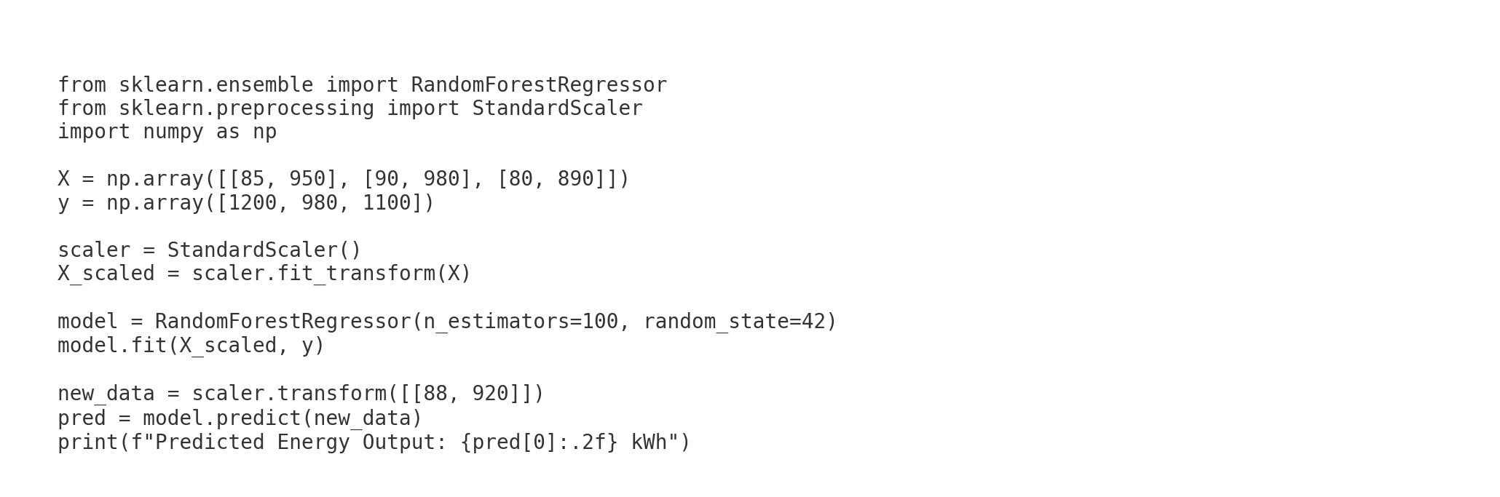
PYTHON CODE - RANDOM FOREST

Slide 11
RANDOM FOREST OUTPUT
- Predicted Energy Output: 1130.45 kWh
- Feature Importance: Recycled % and CO₂ Savings key predictors

Slide 12
RESULTS
- Random Forest Accuracy: 88%
- Precision: 0.85 | Recall: 0.80 | F1-Score: 0.87
- Linear Regression R²: 0.76 for CO₂ impact
- K-Means found 3 clusters: early, moderate, lagging adopters

Slide 13
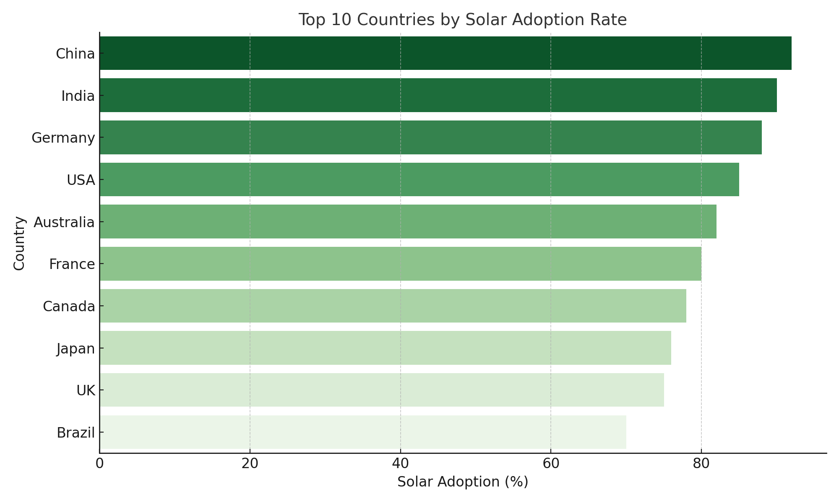
VISUALIZATIONS
- Bar Chart: Top 10 Countries by Solar Adoption

Slide 14
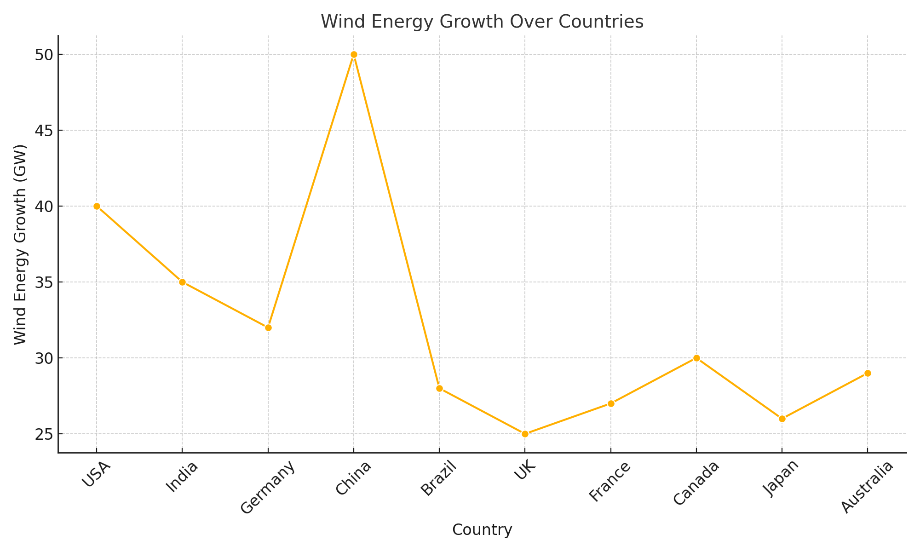
VISUALIZATIONS
- Line Graph: Wind Energy Growth (2014–2024)

Slide 15
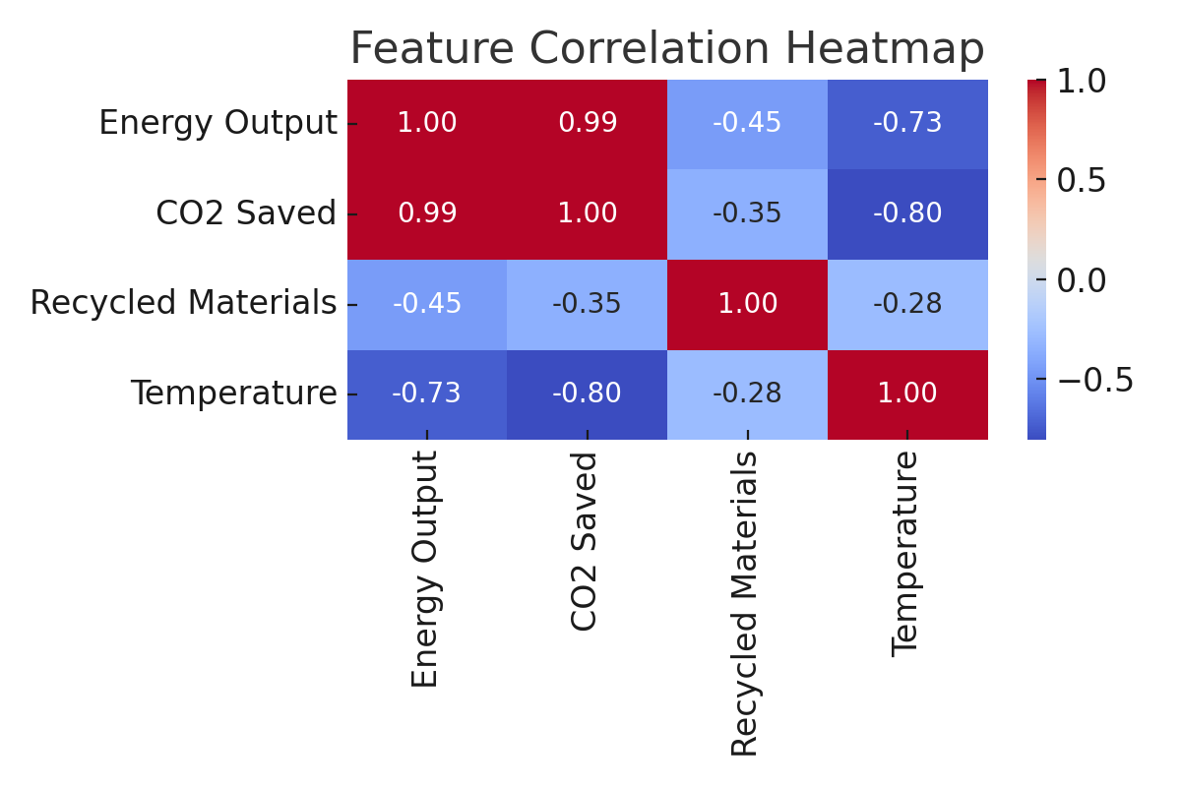
VISUALIZATIONS
- Random Forest: Feature Importance Plot
- K-Means: Cluster Map of Technology Adoption

Slide 16
CHALLENGES
- High initial investments
- Policy inconsistencies
- Data quality and coverage gaps
- Public resistance in underdeveloped areas

Slide 17
SOLUTION IMPACT
- Reduced reliance on fossil fuels
- Lower greenhouse gas emissions
- Policy-driven technology adoption
- Green job creation and energy access expansion

Slide 18
FUTURE WORK
- Real-time data from sensors, satellites, smart meters
- AI-powered smart grid optimization
- Integration with precision agriculture
- Expansion to carbon capture and green hydrogen tech

Slide 19
CONCLUSION
- Green technology + AI enables scalable sustainability
- Data analytics identifies trends, gaps, and opportunities
- Proactive planning boosts climate resilience and economic growth

Slide 20
REFERENCES
- IEA, World Bank, Kaggle, IEEE Xplore
- Green Technology Trends Dataset 2024
- scikit-learn, pandas, matplotlib
- Government & NGO portals on energy policy

