Slide 1


AQUAGUARD
AI-BASED MULTI-SOURCE WATER QUALITY PREDICTION & MONITORING SYSTEM
DEVIKA S
DATASCIENCE AND AI

Slide 2


1.INTRODUCTION
2.OBJECTIVES
3.TECHNOLOGY STACK
4.SYSTEM MODULES
5.AI/ML TECHNOLOGY
6.DATASET AND MODEL PERFORMANCE
TABLE OF
CONTENTS
7.PREDICTION WORKFLOW
8.INSPECTION WORKFLOW
9.ADVANTAGES
10.FUTURE SCOPE

Slide 3



INTRODUCTION
  AquaGuard AI is an intelligent water quality prediction and monitoring system that uses Machine Learning to analyze water from multiple sources, calculate Water Quality Index (WQI), and determine whether the water is safe or unsafe for use.
60-70% water
  The System aims to simplify water quality assessment by providing a smart, reliable, and user-friendly platform for monitoring and managing water safety.

Slide 4


OBJECTIVES
  To predict water quality using Machine Learning techniques.
  To analyze water from multiple sources such as wells, rivers, lakes, taps, and industrial sources.
  To calculate and evaluate the Water Quality Index (WQI).
  To classify water as safe or unsafe based on the prediction results.
  To provide an effective monitoring and reporting system for users, inspectors, and administrators.

Slide 5


TECHNOLOGY STACK
  HTML
  CSS
  JAVASCRIPT
  PYTHON
  FLASK
  MACHINE LEARNING
  MYSQL

Slide 6


SYSTEM MODULES
  ADMIN
  USER
  INSPECTOR
User: Accesses water quality prediction, appointments, and reports.
Admin: Manages users, inspectors, assignments, and system monitoring.
Inspector: Conducts inspections, records observations, and submits reports.

Slide 7


AI/ML TECHNOLOGY
Data Preprocessing: Cleaning the dataset and handling missing values using imputation techniques.
Feature Preparation: Selecting and preparing relevant water-quality parameters for model training.
Model Training: Training machine-learning models to identify relationships between water parameters and WQI.
Ensemble Approach: Combining Random Forest and Extra Trees Regressors for improved prediction.
WQI Prediction: Predicting the Water Quality Index for new water-quality inputs.

Slide 8


DATASET & MODEL PERFORMANCE
  Dataset: Water Quality Index (WQI) Dataset
  Input Features: Temperature, Dissolved Oxygen, pH, BOD, Faecal Streptococci, Nitrate, Faecal Coliform, Total Coliform, and Conductivity.
  Data Processing: Missing values are handled through appropriate preprocessing before model training.
  Model Used: Ensemble approach using Random Forest and Extra Trees Regressors.
  Performance Evaluation: Model performance is evaluated using R² Score, MAE, and RMSE.

Slide 9


PREDICTION & MONITORING WORKFLOW
Input: User enters water-quality parameters and selects the water source.
Preprocessing: The submitted data is cleaned and prepared for prediction.
ML Prediction: The trained model predicts the WQI.
Quality Assessment: The predicted WQI is used to determine the water-quality status.
Result: The system displays the water quality as Safe or Unsafe.
Monitoring: For unsafe water, the system supports further appointment and inspection.
Action: Inspector records observations and provides appropriate recommendations.

Slide 10


INSPECTION & APPOINTMENT WORKFLOW
  Unsafe Result: User can request an inspection when unsafe water is detected.
  Appointment: User schedules an appointment with an inspector.
  Assignment: Admin assigns the inspection to an available inspector.
  Inspection: Inspector examines the water quality and records observations.
  Report: Inspection findings are documented for further action.

Slide 11
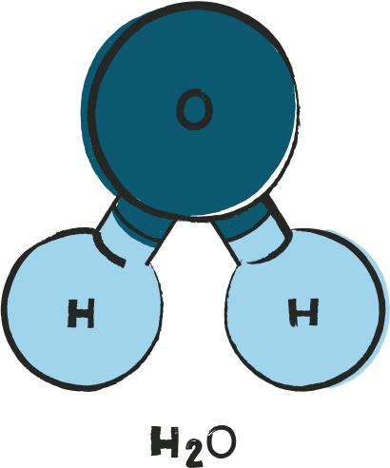
ADVANTAGES
  AI-based water quality prediction and WQI assessment
  Supports inspection, monitoring, and report generation
  Centralized management of water-quality records
  Enhances decision-making through reliable prediction
COHESION
  pH Neutrality
  Scalable for handling larger water-quality datasets and monitoring activities

Slide 12
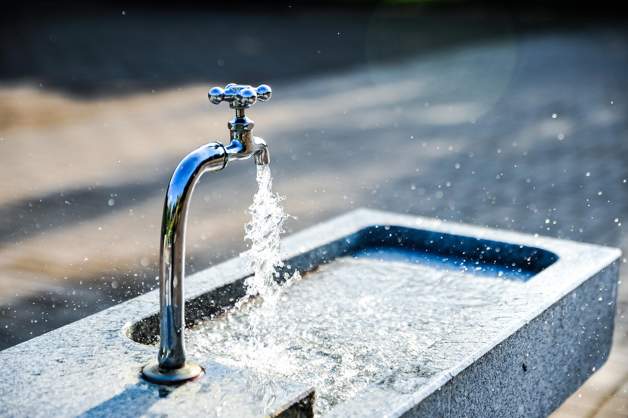
FUTURE SCOPE
  Real-Time Monitoring: Integration of continuous water-quality monitoring capabilities.
  Parameter Expansion: Inclusion of additional water-quality parameters for comprehensive assessment.
  Dataset Enhancement: Utilization of larger and more diverse datasets to improve prediction reliability.
  Advanced Inspection: Further enhancement of digital inspection and monitoring functionalities.
  System Scalability: Extension of AquaGuard to support broader water-quality assessment and management requirements.

Slide 13

THANK YOU FOR YOUR ATTENTION
“AQUAGUARD — SMARTER WATER, SAFER FUTURE.”
ANY QUESTIONS??

