Slide 1
Agile Development
Bringing Estimation To Life

Slide 2

Estimation
Challenges
How do you estimate when you don’t know the exact nature of the task?
How do you estimate for something you’ve never done before?
How do you estimate for a team?
How can you have confidence in your estimates?
How do you improve your ability to estimate?

Slide 3
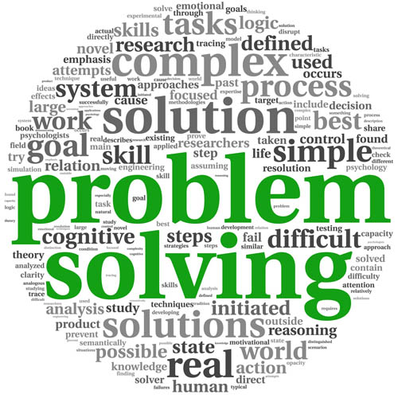
Solving Problems
Software engineers and data analysts constantly draw upon their problem solving skills
Whilst working on a problem you won’t always know what challenges you may encounter
To solve a complex problem you need to break it down into smaller pieces
Past experiences will help you to solve “similar” problems using the skills you’ve acquired
You will get better with practice but even better if you take the time to review + reflect

Slide 4
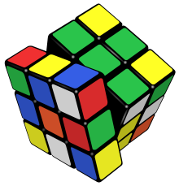
The World’s Most Famous Puzzle
Invented in 1974 by Ernő Rubik and originally called the “Magic Cube”
Debuted at the toy fairs in London, Paris, Nuremberg and New York in Jan + Feb 1980
350 million sold worldwide by January 2009
There are many permutations - 43,252,003,274,489,856,000 to be precise!

Slide 5

Analogy with Agile
Estimation challenge
How many moves will it take me to solve a Rubik’s cube?
Bear in mind that every “solve” will be slightly different…
Possible approaches
Just estimate the total number of moves
Split the task up, estimate the number of moves for each part then add them up

Slide 6

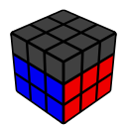

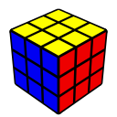
Method / Framework - CFOP
Cross - Four “edges”
First Two layers (F2L)
Four “corner + edge” pairs
Orientation of the Last Layer (OLL)
Permutation of the Last Layer (PLL)

Slide 7

Actuals VS Estimates
Cross - Typically ~6 moves
F2L - Typically ~30 moves
OLL - Typically ~11 moves but can be as high as 14 moves
PLL - Typically ~13 moves but can be as high as 21 moves
TOTAL ~60 moves

Slide 8
Relationship to Agile
This is a relatively simple task / problem but there are similarities with agile methodologies
Breaking larger tasks into smaller tasks even though you won’t know exactly what challenges will be encountered
Your ability to handle different scenarios improves with experience. Figuring out your own solutions is great but you can often learn from others
Common patterns / scenarios become familiar and the ability to identify / apply an appropriate solution improves with practice
You’ll spend less time considering inappropriate solutions and quickly settle upon an suitable solution
You’ll become more accurate with practice, reducing mistakes and minimising the amount of rework / unnecessary effort
When you start out, estimates may be little more than guesswork but experience and learning from others will improve your estimation skills
Estimating on behalf of other people (or teams) is likely to pose a challenge until you know their skill level and their delivery record
Hard figures can be recorded and analysed to see how the outcomes vary from your expectations (e.g. actuals VS estimates)
As skill levels increase, estimates will change accordingly (e.g. tasks require less effort) and estimates become more accurate
However… there will always be some variation even for similar tasks. How can we be confident about delivering by the end of the sprint?
Ensure that you include some contingency. e.g. Consider allocating 85% of the available resources to sprint related tasks and 15% for Kanban tasks

