Slide 1
Quickstart – DE4L Sensing App

Slide 2
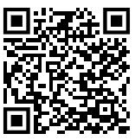
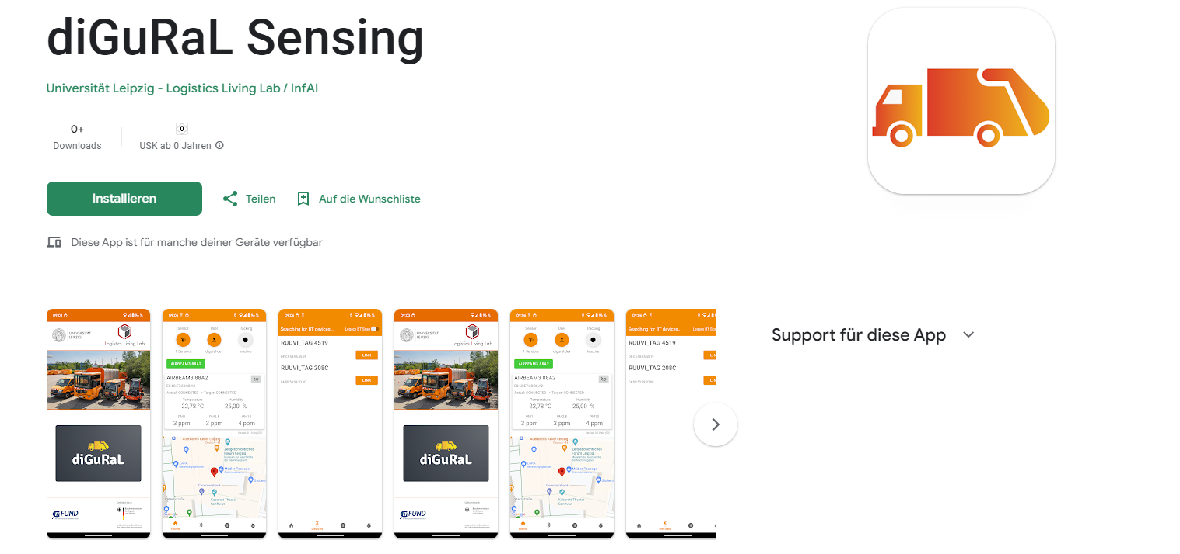
diGuRaL Sensing App
Google Play Store
https://play.google.com/store/apps/details?id=de.lll.digural.senseapp

Slide 3
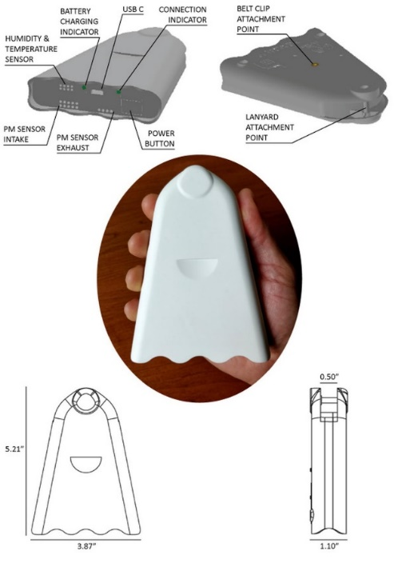
AirBeam 2
https://www.habitatmap.org/airbeam
Bluetooth Classic
PM1, PM2.5, PM10

Slide 4
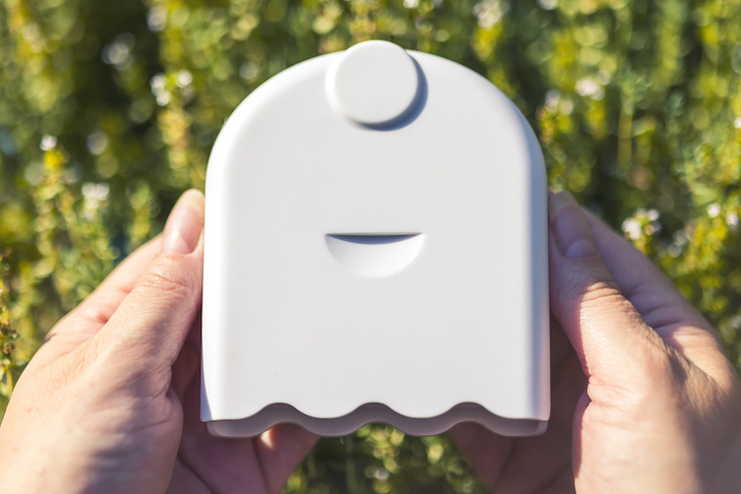
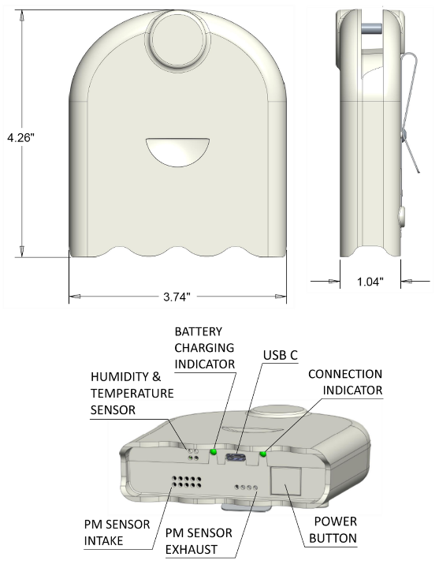
AirBeam 3
https://www.habitatmap.org/airbeam
Bluetooth LE
PM1, PM2.5, PM10

Slide 5
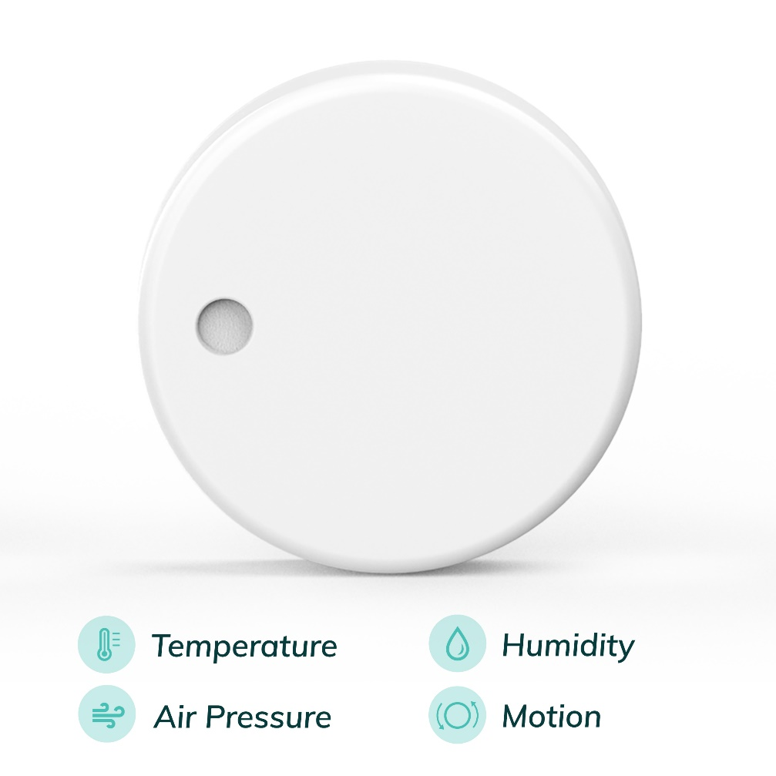
Ruuvi Tag
https://ruuvi.com/
BLE Beacon
Temperature, Humidity, Air Pressure

Slide 6
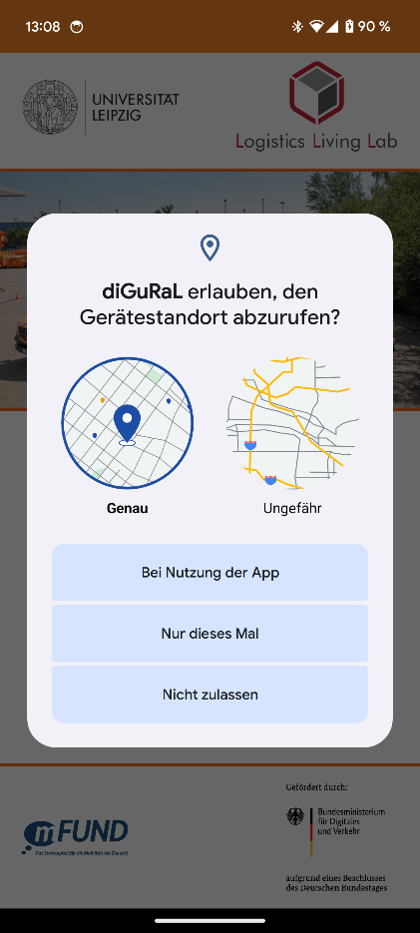
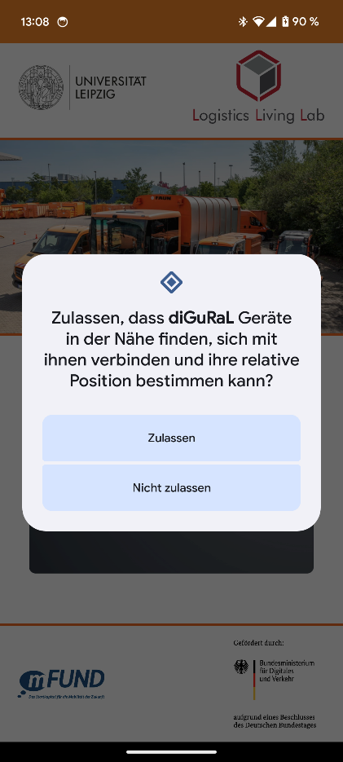
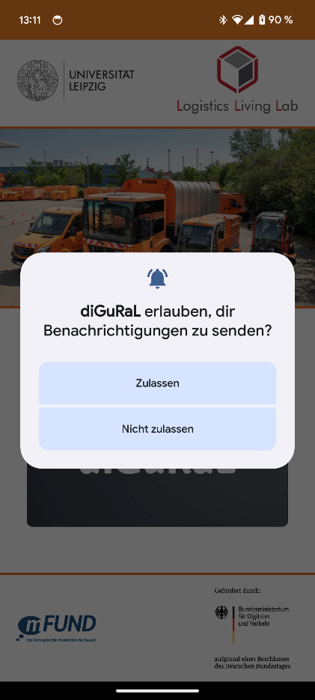
App – Permissions – Location / Bluetooth
App uses location services and within a foreground service when active - no hidden location tracking
Select “Allowed only while in use” when asked for permission
App uses Bluetooth device discovery for sensor connection
Select “Allow” when asked for permission
App needs to display a notification, so tracking is possible while app is in background
Select “Allow” when asked for permission

Slide 7
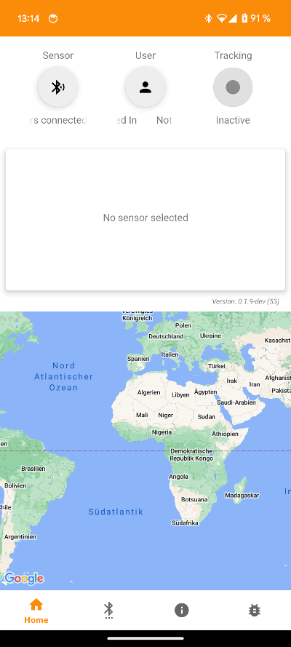
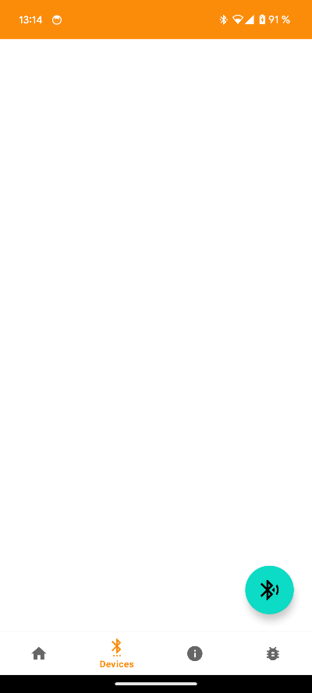
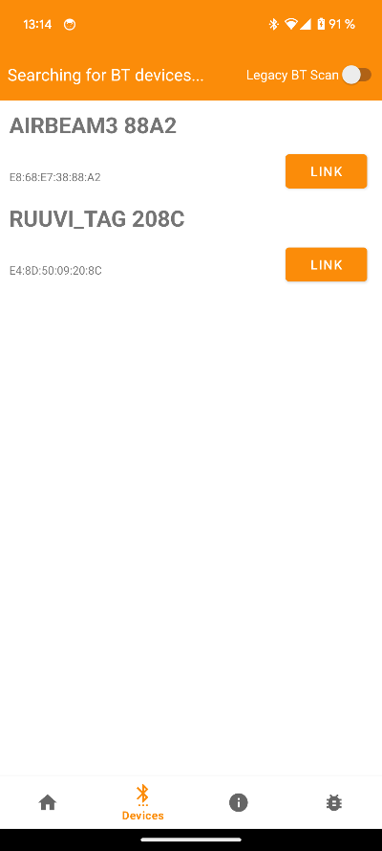
App – Link Sensor (only once)
Option 1
Link Sensor sensor with app
Default scan is for BLE devices only
Enable Legacy Scan to scan for BT classic devices. Currently only needed for AirBeam2
Option 2

Slide 8
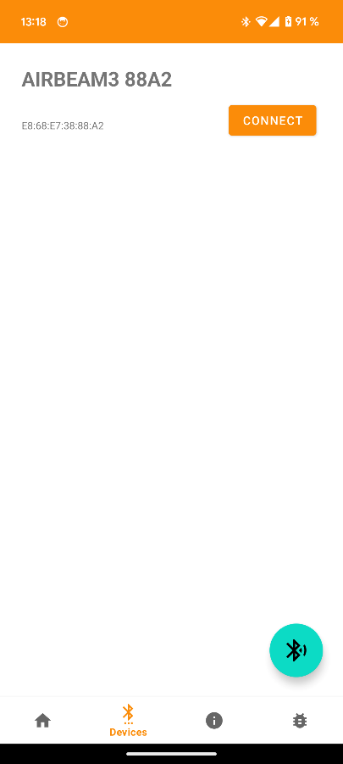
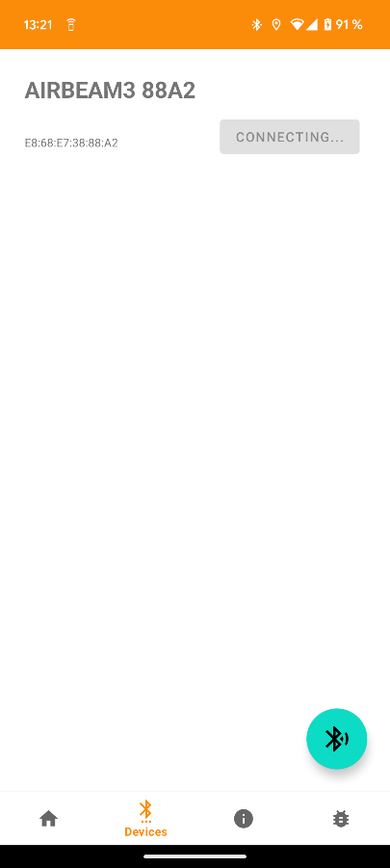
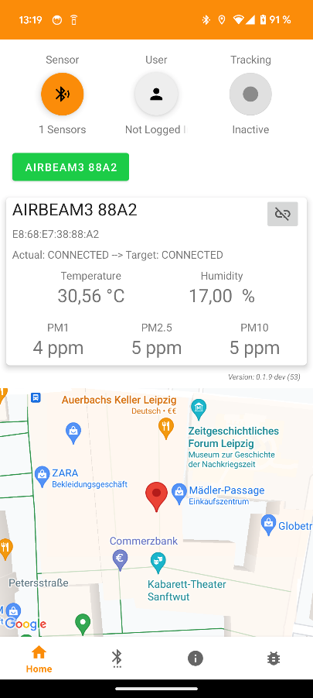
App – Connect Sensor
Press „Connect“ in „Devices“ screen
Connection process can last up to 60 seconds
When the sensor is connected the first time, a pairing notification might be shown by Android
On success, the app automatically switches to the „Home“ screen

Slide 9

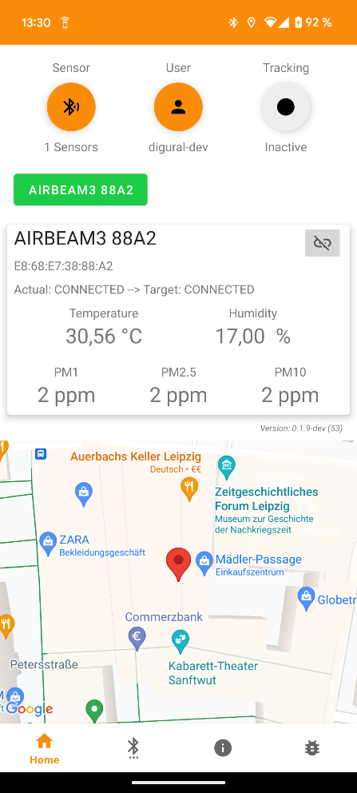
App – Login
Use diGuRaL account to login

Slide 10

App – Start Tracking
Tracking can only be started when at least one sensor is connected and a user logged in

Slide 11
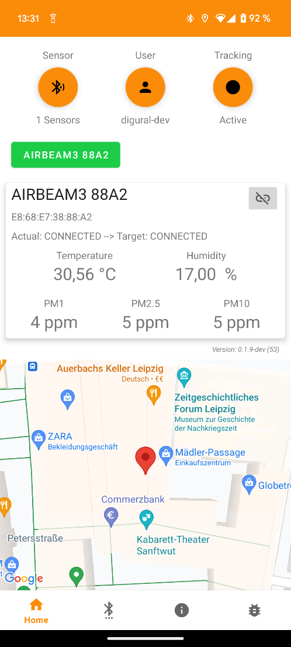
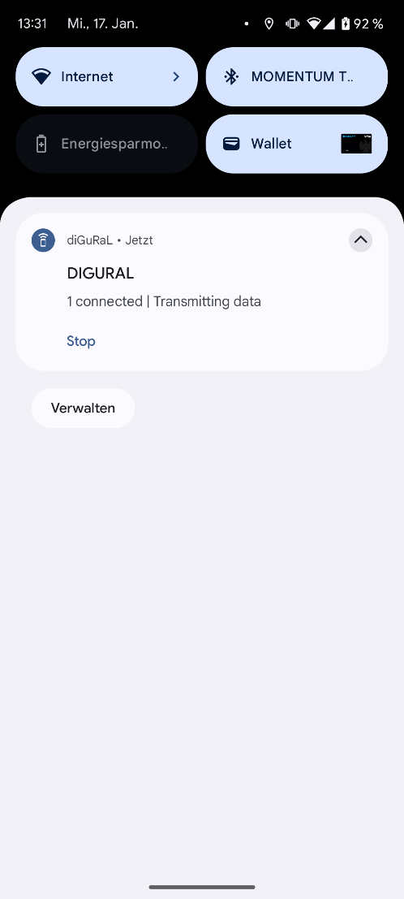
1.
2.
3.
App – Start Tracking
1. Disconnect Sensor
(Data transmission and tracking is stopped automatically)
2. Log out
(Data transmission and tracking is stopped automatically)
3. Stop Tracking
Notification in status bar
4. Stop Tracking and disconnect sensor
4.
4.

Slide 12
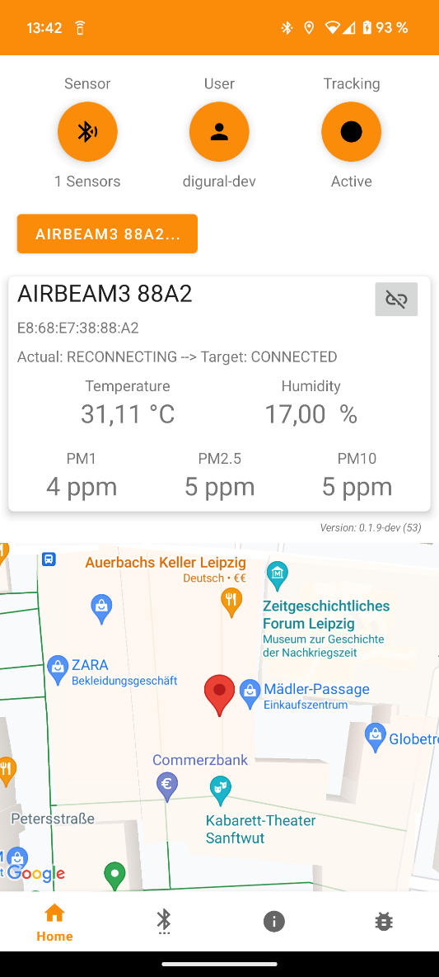
App – Features – Reconnect
In case the connection to the sensor is lost unexpectedly, the app tries to reconnect
To cancel the reconnect trials, press the sensor „button“

Slide 13
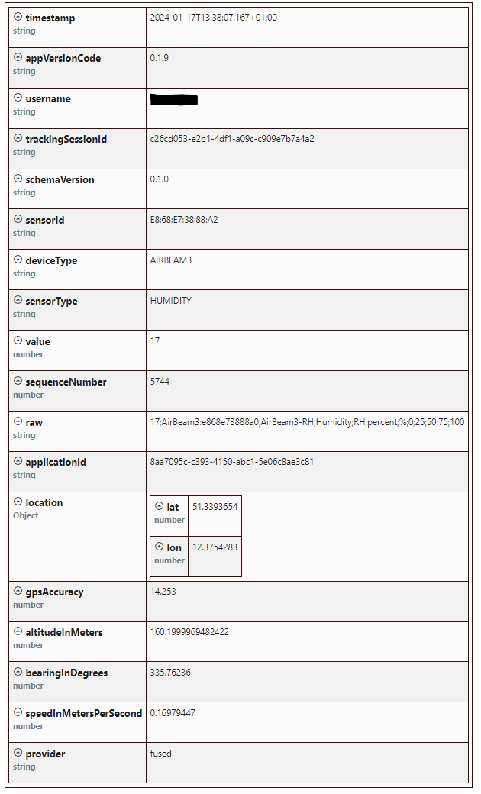
Data transmission
The app transmits data to an MQTT Endpoint in real-time
Transmitted data includes sensor measurements, timestamp, location, username and the current app version.

