Slide 1
LOGITH VL
2021503710
CT Dept. MIT, Anna University
TNSDC-Gen AI Project
3/21/2024 Annual Review

Slide 2
PROJECT TITLE
IMDB Movies Dataset - Recommendation Engine

Slide 3


AGENDA
Introduction to Content-Based
Data Collection and Preprocessing
Feature Extraction and Representation
Similarity Computation
Recommendation Generation and Evaluation
3/21/2024 Annual Review

Slide 4

PROBLEM STATEMENT
Objective: The objective of this project is to develop a content-based recommendation system that addresses the challenge of content overload on platforms like IMDb by providing personalized recommendations based on users' preferences and the intrinsic features of the content.
Dataset: The dataset used in this project comprises movie and television show data sourced from IMDb and other relevant sources.
Goal: The goal of the recommendation system is to alleviate the problem of content overload by offering users tailored recommendations based on their preferences and the intrinsic characteristics of the content.
Applications: The recommendation system can be applied to various platforms such as IMDb, Netflix, and Amazon Prime Video to provide personalized movie and television show recommendations.
Scope: The scope of the project includes collecting and preprocessing movie and television show data, extracting relevant features and metadata, building a content-based recommendation system using machine learning techniques, evaluating its performance using appropriate metrics, and implementing it in a user-friendly interface for practical use.
Key Metrics: Key metrics for evaluating the recommendation system include precision, recall, F1 score, coverage, and mean average precision (MAP).

Slide 5

PROJECT OVERVIEW
Data Collection and Preparation:
Gathering movie and television show data from IMDb and other relevant sources.
Preprocessing the dataset to handle missing values, clean the data, and extract relevant features and metadata necessary for building the recommendation system.
Exploratory Data Analysis (EDA):
Analyzing the dataset to gain insights into the distribution of features such as genre, cast, director, and ratings.
Visualizing patterns and trends in the data to understand the characteristics of popular movies and television shows.
3/21/2024 Annual Review

Slide 6
PROJECT OVERVIEW
Model Selection and Training:
Selecting appropriate machine learning techniques for building the content-based recommendation system.
Training the model using the preprocessed dataset and tuning hyperparameters to optimize performance.
Results and Deployment:
Evaluating the performance of the recommendation system using relevant metrics such as precision, recall, and F1 score.
Deploying the trained model into a user-friendly interface for practical use, enabling users to receive personalized recommendations based on their preferences.
Conclusion and Future Work:
Summarizing the findings and insights gained from the analysis and implementation of the recommendation system.
Discussing potential areas for improvement and future work, such as incorporating user feedback, enhancing the recommendation algorithm, and scaling the system for larger datasets and user bases.

Slide 7

WHO ARE THE END USERS?
The end users for this project are individuals who consume content on platforms like IMDb, Netflix, Amazon Prime Video, and other similar streaming services.
These end users include:
Movie and Television Show Enthusiasts
Casual Viewers
Families
Platform Subscribers
Content Creators and Producers
3/21/2024 Annual Review

Slide 8

MY SOLUTION AND ITS VALUE PROPOSITION
SOLUTION:
My solution is a content-based recommendation system tailored to address the challenge of content overload on platforms like IMDb. Leveraging machine learning techniques and the intrinsic features of movies and television shows, the recommendation system provides personalized recommendations to users based on their preferences and interests.

Slide 9
MY SOLUTION AND ITS VALUE PROPOSITION
VALUE PROPOSITION:
The value proposition of my solution lies in its ability to enhance the content discovery experience for users on platforms like IMDb, Netflix, and Amazon Prime Video. By providing personalized recommendations tailored to users' preferences and interests.

Slide 10

THE WOW IN MY SOLUTION
The "WOW" factor in my solution lies in its ability to revolutionize how businesses approach marketing and customer engagement. By harnessing the power of artificial neural networks, your solution offers:
Data Collection and Preparation:
Gathering movie and television show data from IMDb and other relevant sources, and preprocessing the dataset to extract relevant features and metadata necessary for building the recommendation system.
Exploratory Data Analysis (EDA):
Analyzing the dataset to gain insights into the distribution of features such as genre, cast, director, and ratings. Visualizing patterns and trends in the data to understand the characteristics of popular movies and television shows.
3/21/2024 Annual Review

Slide 11
THE WOW IN MY SOLUTION
Improved User Engagement:
By offering relevant and personalized recommendations, the recommendation system increases user engagement and encourages users to explore new content they may not have discovered otherwise.
Enhanced User Satisfaction:
Users are more likely to find content that aligns with their tastes and preferences, leading to higher satisfaction levels and a more enjoyable viewing experience.
Efficient Content Discovery:
With the vast amount of content available on streaming platforms, the recommendation system streamlines the content discovery process by presenting users with curated recommendations tailored to their individual preferences.
3/21/2024 Annual Review

Slide 12
MODELLING
Feature Extraction and Representation:
TF-IDF (Term Frequency-Inverse Document Frequency)
Word Embeddings (e.g., Word2Vec, GloVe)
Similarity Computation
Cosine Similarity:
After representing items as feature vectors using techniques like TF-IDF or word embeddings, cosine similarity can be used to measure the similarity between items. Cosine similarity calculates the cosine of the angle between two vectors, with higher values indicating greater similarity.
Model Training:
Nearest Neighbors
Machine Learning Classifiers

Slide 13
MODELLING
Deep Learning Models:
Deep Neural Networks: Deep learning models, such as multi-layer perceptrons (MLPs) or convolutional neural networks (CNNs), can be trained to learn complex feature representations directly from raw data, such as images or text. These models can capture intricate patterns and relationships in the data, leading to more accurate recommendations.
Hybrid Approaches:
Content-Boosted Collaborative Filtering: Hybrid approaches combine content-based and collaborative filtering techniques to leverage both item features and user interactions. Content-boosted collaborative filtering combines predictions from content-based and collaborative filtering models to provide more accurate and diverse recommendations.
Ensemble Methods:
Ensemble Learning: Ensemble methods combine predictions from multiple models to improve recommendation accuracy and robustness. Techniques like bagging (e.g., Random Forest) or boosting (e.g., Gradient Boosting Machines) can be used to build ensemble models that leverage the strengths of individual base models.

Slide 14
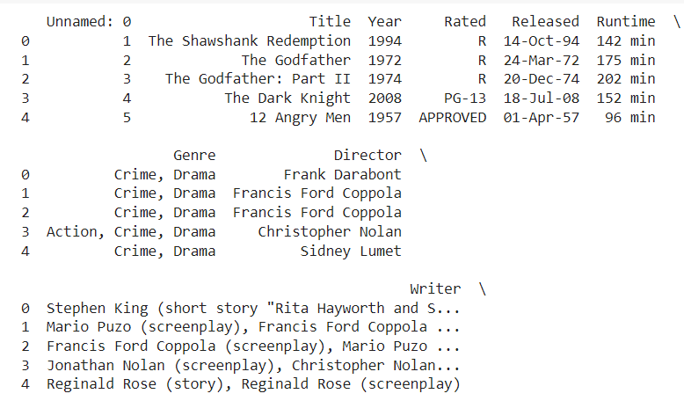
RESULTS
# Predicting Test Set

Slide 15
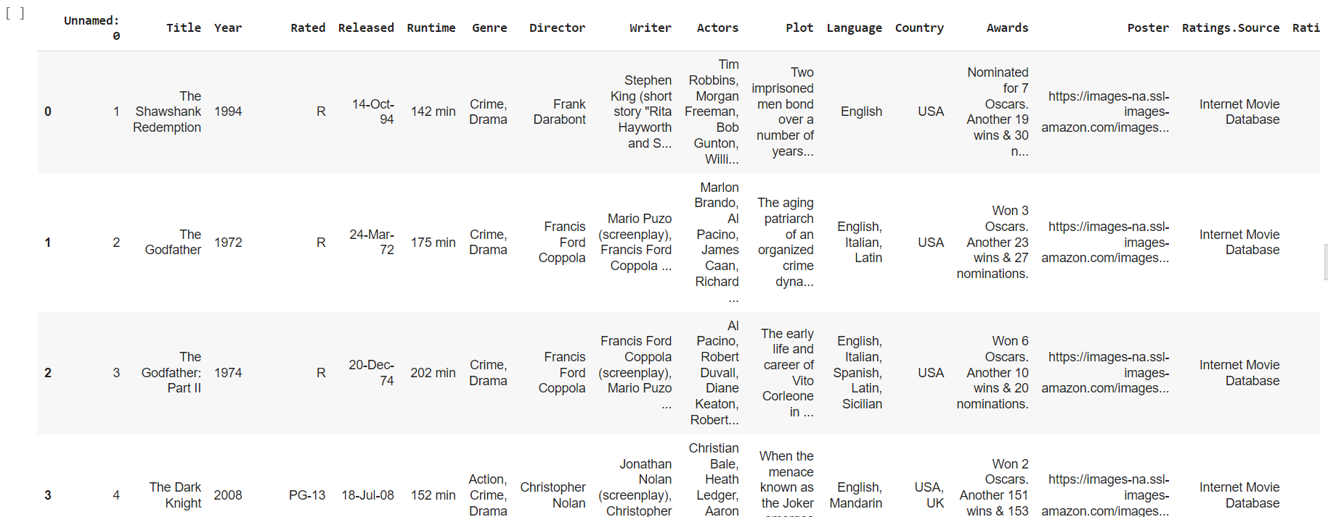
RESULTS

Slide 16
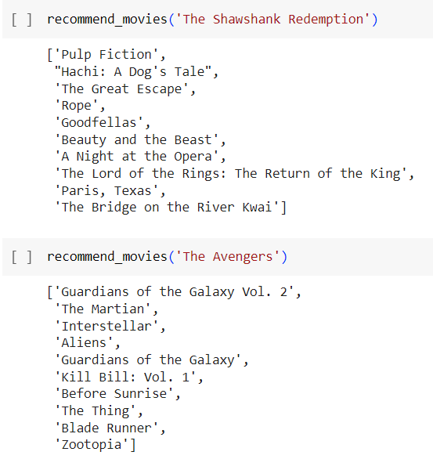
RESULT

