Slide 1
C++11 lambdas
Alex Sinyakov,
Software Engineer at AMC Bridge
Twitter: @innochenti
E-mail: innochenti@gmail.com
PDF Slides: http://j.mp/cpp11ref

Slide 2
lambdas
Terminology clash: “The Great Functor Debate”
https://www.reddit.com/r/cpp/comments/5qcvt0/stop_calling_function_objects_functors/

Slide 3
lambdas
C++03
struct equals { int &a; equals(int& _a) : a(_a) { } bool operator()(int x) const { return a == x; } }; int a = 42; count_if(v.begin(), v.end(), equals(a));

Slide 4
lambdas
C++03 | C++11 lambda
struct equals { int &a; equals(int& _a) : a(_a) { } bool operator()(int x) const { return a == x; } }; int a = 42; count_if(v.begin(), v.end(), equals(a)); | int a = 42; count_if(begin(v), end(v), [&a](int x){ return x == a;});
 | C++14 generic lambda
 | count_if(begin(v), end(v),[&a](auto x) { return x == a; });
Notes:
Note: The Functor debate: name clash with the domain of functional programming https://www.reddit.com/r/cpp/comments/5s3wgw/cppchat_the_great_functor_debate_is_saturday/

Slide 5
syntax
Closure definition:
[=, &a, b=f(x)]
Argument list:
(auto x, int y)
(optional) return type: -> int
(optional) mutable
Function body
{ return x * y; }

Slide 6
closures
capture by value
[=x] { return x>1;}
_copies_ x into function object
capture by reference
[&x] { x++; }
references the outside x
introduce new variables
[x = f()] { cout << x; }
‘implicit’ capture all you need: [=] or [&]

Slide 7
lambdas/closures
C++11 | test scope | lambda scope
void test() { int x = 4; int y = 5; [&](){x = 2;y = 2;}(); [=]() mutable{x = 3;y = 5;}(); [=,&x]() mutable{x = 7;y = 9;}(); } | x=4 y=5 x=2 y=2 x=2 y=2 x=7 y=2 | x=2 y=2 x=3 y=5 x=7 y=9

Slide 8
lambdas/closures
C++11 | test scope | lambda scope
void test() { int x = 4; int y = 5; auto foo = [=]() mutable{ x = 3; ++y; int w = x + y; return w; }; foo(); foo(); foo(); } | x=4 y=5 x=4 y=5 x=4 y=5 x=4 y=5 | //closure //x,y lives inside foo x=3 y=6 w=9 x=3 y=7 w=10 x=3 y=8 w=11

Slide 9
recursive lambdas
Not allowed: infinite type.
Workaround: via function wrapper
std::function<int(int)> f = [&f](int n) {
return n <= 1 ? 1 : n * f(n - 1);
};
int x = f(4); //x = 24
Via ‘explicit’ self (link):
auto fac = [](auto&& f, auto n) -> int {
return n < 1 ? 1 : n * f(f, n - 1);
};
EXPECT_EQ(1, fac(fac, 1));

Slide 10
std::function
C++11
auto sum = [](int a, int b){ return a+b; }; auto diff = [](int a, int b){ return a-b; }; decltype(sum) op = s1; op = diff; → no match for ‘operator=’

Slide 11
std::function
C++11
=> “type erasure” int sum(int a, int b) { return a + b; } auto diff = [](int a, int b){ return a-b; }; function<int (int, int)> f; f = sum; auto six_i_think = f(4, 2); f = diff; auto two_i_think = f(4, 2);

Slide 12
std::function
C++11
struct Foo { void f(int i){} void g(int i){} }; function<void(Foo&, int)> fmember = mem_fn(&Foo::f); Foo foo; foo.f(42); fmember(foo, 42);

Slide 13
std::function
C++11
struct Foo { void f(int i){} }; Foo foo; function<void(int)> fmember = bind(&Foo::f, foo, _1); fmember(42);

Slide 14
std::bind
C++11 | output
float div(float a, float b){ return a/b; } cout << “6/1” << div(6,1); cout << “6/2” << div(6,2); cout << “6/3” << div(6,3); function<float(float, float)> inv_div = bind(div, _2, _1); cout << “1/6” << inv_div(6,1); cout << “2/6” << inv_div(6,2); cout << “3/6” << inv_div(6,3); function<float(float)> div_by_6 = bind(div, _1, 6); cout << “1/6” << div_by_6 (1); cout << “2/6” << div_by_6 (2); cout << “3/6” << div_by_6 (3); | 6/1 = 6 6/2 = 3 6/3 = 2 1/6 = 0.166 2/6 = 0.333 3/6 = 0.5 1/6 = 0.166 2/6 = 0.333 3/6 = 0.5

Slide 15
std::bind
C++11
//Practical usage linear_congruential_engine<uint64_t, 1103545, 123, 21478> generator(1127590); uniform_int_distribution<int> distribution(1,6); int rnd = distribution(generator); //Let’s make things a little bit easier: auto die = bind( distribution, generator ); int rnd = die()+die()+die();

Slide 16
function objects
C++11(deprecated binders and adaptors) | C++11
unary_function, binary_function, ptr_fun, pointer_to_unary_function, pointer_to_binary_function, mem_fun, mem_fun_t, mem_fun1_t const_mem_fun_t const_mem_fun1_t mem_fun_ref mem_fun_ref_t mem_fun1_ref_t const_mem_fun_ref_t const_mem_fun1_ref_t binder1st binder2nd bind1st bind2nd | Function wrappers function mem_fn bad_function_call Bind bind is_bind_expression is_placeholder _1, _2, _3, ... Reference wrappers reference_wrapper ref cref

Slide 17
Pitfalls
Closure: careful with references!
struct X { void foo() {} };
std::function<void()> foo;
{
X x;
foo =[&] { x.foo(); };
}
foo();

Slide 18
Pitfalls
Ownership… since c++14
auto x = make_unique<int>(5); foo = [auto x = move(x)] { *x=5 };

Slide 19
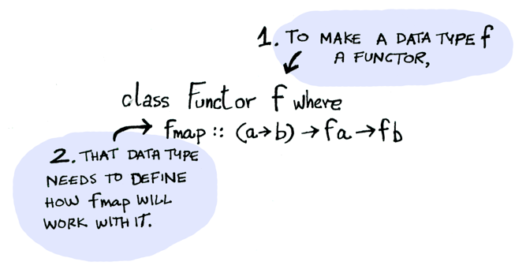
Reminder: “Callable Objects”
std::vector is a Functor (it has std::transform)
std::function is a Callable Object

Slide 20
Where to go from here
Functional programming paradigm
Libraries for
function composition
lifting
… the monad pattern (std::future)
…
“higher order functions for ordinary devs”

