Slide 1
Logols Learning
Weekend web Development Boot Camp
Training: CSS

Slide 2
What is CSS?
HTML provides the definition of the page
CSS provides the styling for the page
It’s best to keep these separate
Cascading Style Sheets
If multiple styles applied, styles will override based on the hierarchy
Notes:
CSS provides the styling for the page.
It stands for cascading style sheets

Slide 3
Inline Styling
Can style inside an element using the style attribute
This overrides all other styling
Style Attribute is a global attribute
Can be used on any html element
style=“[Style Name1]: [Value]; [Style Name2]: [Value];”
Example:
<img src=“/images/logo.gif” style=“height:100px; width:100px;” alt=“logo” />
Notes:
The styles can be specified in multiple places.
First you can specify them in the style attribute of an element.
The style element is global and can be used on any html element.
The CSS styles are specified by using the style name followed by : followed by the value.

Slide 4
In Page Styling
It’s best to separate your elements from the style
You can also style in the page
Use style element within the head element
Surround styles in a comment
Example:
<head>
<style>
<!—
.logo {
height:100px;
width:100px;
}
-->
</style>
</head>
…
<img src=“/images/logo.gif” class=“logo” alt=“logo” />
Notes:
You can also specify styling within the page.
Add the style element within the head element
Then styles can be specified.

Slide 5
Linking a CSS File
It’s best to style outside of the html file altogether in a .css file
To link use the link element inside the head
Attributes:
rel - stylesheet
href – location of css file
type – text/css
Example:
<head>
<link rel=“stylesheet” href=“/styles/site.css” type=“text/css” />
</head>
Notes:
Finally you can also specify styles in another file.
This is the recommended approach.
Link the css file by adding a link element to the head element
Specify rel as stylesheet
Specify type as text/css
Then specify the href as the location of the css file.

Slide 6
Selectors
Used to select elements for styling
Sample below
Name | Syntax | Example
ID | #[Element ID] | #PersonTable
Class | .[Class Name] | .highlightTable
All Elements | * | *
Element | [Element] | p
Element in Element | [Element] [Element] | div p
Multiple Elements | [Element], [Element] | div, p
Element direct child | [Element] > [Element] | div > p
Notes:
These are different selectors that can be used to set a style for
The most obvious ones are ID, class, and element
To specify an id, put a # in front of it.
To specify a class, put a . In front of it.
To specify an element, just write it.
With these selectors it could apply to many elements throughout the site
All of these elements are updated with the style.

Slide 7
Comments
Comments should be surrounded by /* */
Single line Example:
/* this is a comment*/
Multiple Line Example:
/*
This is also
a comment
*/
Notes:
Comments are provided with the /* */ syntax.
Single and multi line comments are the same.

Slide 8
Colors
Uses: font, background, border
color: red;
background-color: red;
border-color: red;
Multiple ways to specify colors:
Color Name
RGB
Hex
Example:
color: red;
color: #00ff00;
color: rgb(0,0,255);
Notes:
You can set the font color, background color, or border color.
The font color is specified using the color style
The background color is specified using the background-color style
The border color is specified using the border-color style
Colors can be specified in multiple ways.
There are many colors that are named.
In this way you can set the color by its name
You can also use RGB, which is specifying the values for red, green, and blue.
Finally, you can use the hex value.

Slide 9
Text
color - Example: color: red;
text-align – Example: text-align: center;
text-decoration – Example: text-decoration: underline;
text-transform – Example: text-transform: lowercase;
letter-spacing – Example: letter-spacing: 5px;
text-indentation – Example: text-indent: 25px;
line-height – Example: line-height: 1;
word-spacing – Example: word-spacing: 10px;
text-shadow – Example: 5px 5px red;
Direction – Example: direction: rtl;
Notes:
There are many styles for text.
As just mentioned there is color for the text color.
There is text-align to specify the horizontal alignment.
And much more

Slide 10
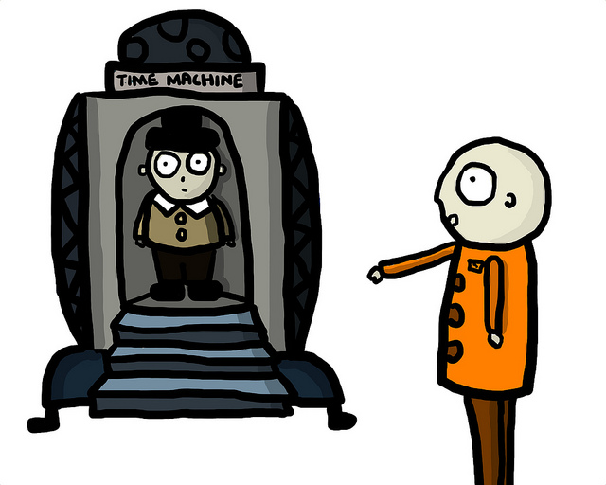
EXAMPLE
Linking, Selectors, Colors, Text, Comments

Slide 11

ASSESSMENT
Linking, Selectors, Colors, Text, Comments
Notes:
What is CSS used for?
What does CSS stand for?
What tag is used to reference a separate CSS file?
Write on the board the css to make the font color red for an element with an id of header.

Slide 12

Assignment
Style the Status Report Interface.
Center the header text using an id selector.
Modify the paragraph text to be dark grey using a class selector.
Modify the table header to be light grey using the element selector.

Slide 13
Box Model
Margin
Border
Padding
Content
Notes:
The box model is an important part of laying out parts of a page.
The content is surrounded by the padding. The padding is surrounded by the border. The border is surrounded by the margin.
All of these need to be considered when figuring out the total size of the content.

Slide 14
CSS Length Unit of Measures
Absolute Lengths
Relative Lengths
px (pixels 1px = 1/96th of 1in)
cm (centimeters 1cm = 37.8px)
mm (millimeters 1mm = 3.78px)
in (inches 1in = 96px = 2.54cm)
pt ( points 1pt = 1/72 of 1 in)
pc (picas 1pc = 12pt)
em (font-size of element)
rem (font-size of root)
% (parent element)
vw (1% width of viewport)
vh (1% height of viewport)
*viewport – visible area of a web page
Notes:
Absolute Lengths
px (pixels 1px = 1/96th of 1in)
cm (centimeters)
mm (millimeters)
in (inches 1in = 96px = 2.54cm)
pt ( points 1pt = 1/72 of 1 in)
Pc (picas 1pc = 12pt)
Relative Lengths
em (font-size of element)
rem (font-size of root)
% (parent element)
vw (1% width of viewport)
vh (1% height of viewport)
*viewport – visible area of a web page

Slide 15
EXAMPLE
Box model

Slide 16
Display
Options:
inline
block
flex
inline-block
infline-flex
table
none
etc...
Display:none vs. Visibility
Display Examples: https://css-tricks.com/almanac/properties/d/display/
Flexbox Examples: https://css-tricks.com/snippets/css/a-guide-to-flexbox/
Notes:
Display has a number of options.
One of those is display none.
Display none means the element will not appear on the page
This is different than visibility which will make it not show on the page, but still show in the DOM.
Let’s review examples of display and flexbox.

Slide 17
Position
Options:
static
relative
fixed
absolute
Examples: http://learnlayout.com/position.html
Notes:
Position is another style to change how an element is positioned on a page.
Let’s review some examples.

Slide 18
Float
float
none
left
right
initial
inherit
clear
Same +both
Example: https://css-tricks.com/all-about-floats/
overflow
visible
hidden
scroll
auto
initial
Inherit
Example: https://css-tricks.com/almanac/properties/o/overflow/
Notes:
Here are some other styles that effect the position of elements.
It’s easier to see these in action again, so let’s look through the examples.

Slide 19
EXAMPLE
Display, Position, Float

Slide 20
EXAMPLE
Flexbox - https://flexboxfroggy.com/

Slide 21
Assignment
Style the report so the image is to the right of the data table using floats.
Then do it using flexbox

Slide 22
Pseudo-Class
Allow to set style of element in certain states.
Examples of Pseudo-Classes:
a:active
a:hover
a:link
a:visited
input:checked
input:disabled
input:enabled
input:focus
input:invalid
input:valid
Notes:
CSS also has pseudo-classes.
These allow different styles for different states of an element.
Here are some examples of pseudo-classes
For example pseudo-classes for a
a:active
a:hover
a:link
a:visited

Slide 23
Where is my style?
Importance
Add !important to the end of a property
Wins over all other rules (not recommended)
Specificity
Measured using 4 values
Thousands – inside style element or style attribute
Hundreds – one for each ID selector
Tens – one for each class selector, attribute selector, or pseudo-class
Ones – one for each element selector or pseudo-element
Source Order
Later rule wins if everything else is the same
Notes:
This refers to the hierarchy of styles.
Every property figures out what styles should be used, since conflicts will come up.
The first check is based upon whether it is specified with !important at the end of the property.
This wins over all other properties unless both are specified as !important
After that specificity is used to determine the styles used.
Specificity is determined by a score with 4 digits.
The thousands place gets a value if its inside the style element or style attribute
The hundreds place gets a value for each id selector
The tens place gets a value for each class selector, attribute selector, or pseudo-class used.
The ones place get a value for each element selector or pseudo-element
Finally if the specificity is the same the later style wins.

Slide 24
Page Layouts
Options:
Tables
Float
CSS Framework
Flexbox
CSS Grid
Example: https://www.codementor.io/codementorteam/4-different-html-css-layout-techniques-to-create-a-site-85i9t1x34
Bootstrap Templates: https://www.w3schools.com/bootstrap/bootstrap_templates.asp
Scroll Template: https://www.w3schools.com/bootstrap/bootstrap_theme_company.asp
Notes:
Page layouts are created using the same styles we’ve talked about so far.
Tables can be used and was really popular for a while, but is not currently recommended.
Floats can also be used to style the page layout.
A framework can also be used to aid the creation of a layout
Flexbox is newer and can be used, but a lot of browsers still in use do not support it
Let’s go through some examples.

Slide 25
Responsive
Designing to work on any monitor size or device
Use a Grid System – Bootstrap / CSS Grid
Use Media Queries
Use Vector Graphics or Alternate Images
Use a Framework like Bootstrap
Notes:
Pages need to be designed to work on different devices and screen sizes.
These are some things that you can use to help.
We are going to focus on using the bootstrap framework.

Slide 26
ASSESSMENT
Box Model, Display, Position, Float, Responsive
Notes:
What makes up the box model?
Write on the board the css to set the display to inline for a class named inlineText.
Write on the board the css to fix the footer element to the bottom of the page.
What are some options for page layout?
What can be done to make a page responsive?

Slide 27
Assignment
Center everything under the header using flexbox;
Play around with width, margins, and padding to change the looks.

Slide 28
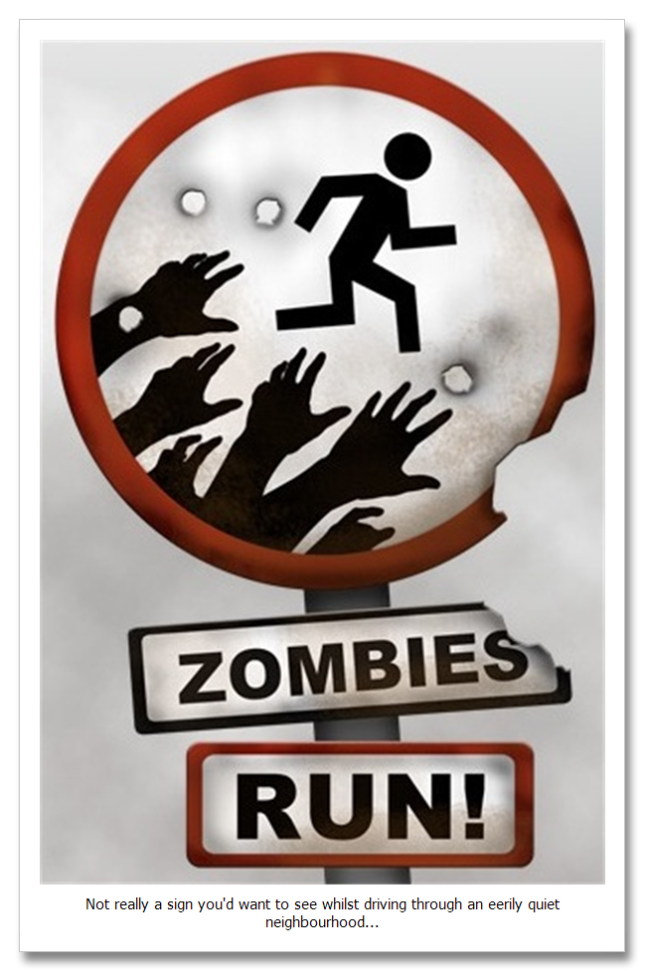
QUICK REVIEW
CSS
Notes:
What tag is used to reference a separate CSS file?
Write on the board the css to make the font color red for an element with an id of header.
What makes up the box model?
Write on the board the css to set the display to inline for a class named inlineText.
Write on the board the css to fix the footer element to the bottom of the page.

Slide 29
Additional Resources
JSFiddle
https://jsfiddle.net/
free Code Camp
https://www.freecodecamp.org/
Can I Use
https://caniuse.com/

