Slide 1
Logols Learning
Weekend web Development Boot Camp
Training: HTML

Slide 2
Elements
Elements are the objects in a page
Have a start and an end tag
Can be nested if the definition allows it
Can have a value between the tags
Empty elements can have / instead of ending tag
Use lowercase even though not case sensitive
Example:
<html>
<body>
Welcome to the page.
<br />
</body>
</html>
Notes:
Elements define the objects on a page.
They have a start and an end tag.
Values and other elements can be nested inside the element
Empty elements, those that don’t have anything between the begin and end tag can have a / at the end and not use an end tag.
Lowercase is the standard for elements.

Slide 3
Attributes
Attributes are properties associated with an element
Located in the start tag
Have the syntax name=“value”
Example:
<p title=“My Header”>
Welcome to the page.
</p>
Notes:
Attributes are properties associated with an element.
They go in the start tag and are written with the attribute name = to the value.
This is an example of the title attribute being set on the p element.

Slide 4
Comments
Syntax: <!-- … -->
Example:
<!– Comments here, everything commented until end comment
<p>
Some text that won’t show up
</p>
-->
Notes:
Comments in html are represented with this syntax <!-- comment -->
Here is an example.

Slide 5
DocType
First in the HMTL file
Instructs the browser the version of HTML that is used
Types:
HTML 5
HTML 4.01 Transitional
HTML 4.01 Frameset
Etc…
Example:
<!DOCTYPE html>
Notes:
The DocType is that first part of the HTML page.
It tells the browser which version of HTML it is.
Let’s see the examples..
For HTML 5 you just specify html.
More info: http://html.com/tags/doctype/

Slide 6
Basic Structure
DocType
Html
Head
Body
Example:
<!DOCTYPE html>
<html>
<head>
<title>
My title
</title>
</head>
<body>
Welcome to the page.
</body>
</html>
Notes:
This is the structure of a basic html page.
The DocType element is specified first.
Then you have the html element.
Inside the html element is the head element.
The head element is for metadata purposes only. It is not shown on the page.
After the head element is the body element inside of the html element.
The other page elements will go in the body.

Slide 7
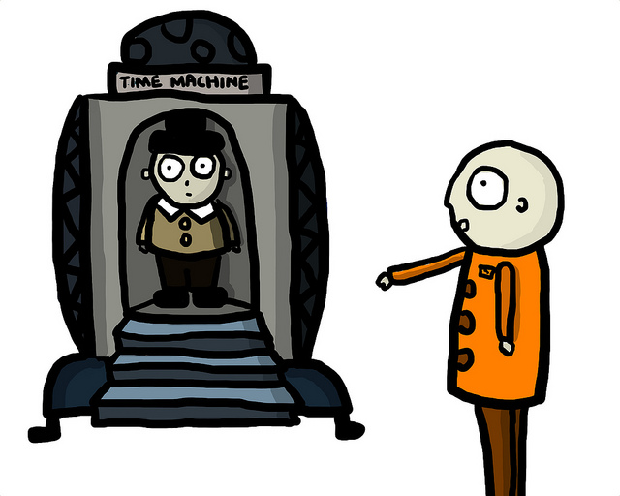
EXAMPLE
BASIC html STRUCTURE

Slide 8

ASSESSMENT
BASIC html STRUCTURE
Notes:
What is the name of objects on the page?
What are properties associated with an element called?

Slide 9
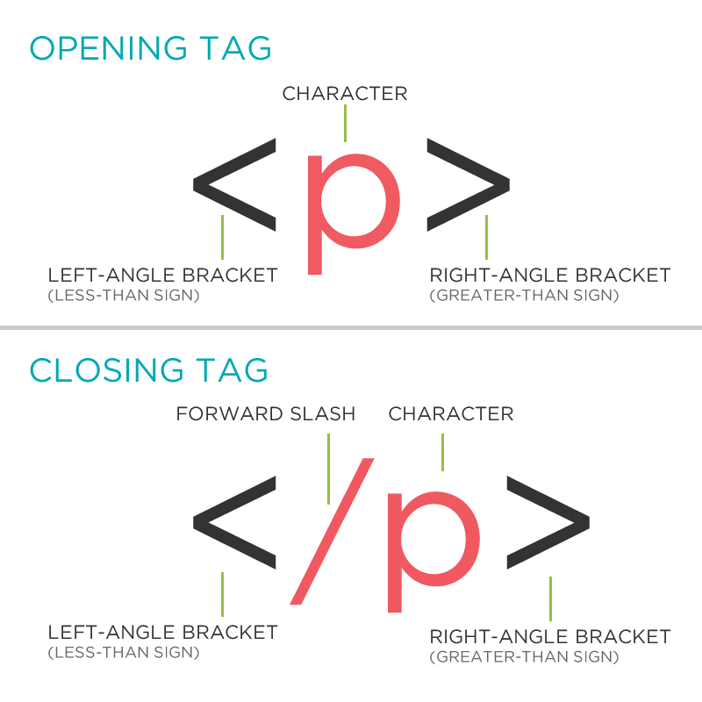
Common Elements
div
span
p
h1, h2, h3, h4, h5, h6
hr
Notes:
Here are some common elements that you will see over and over again.
Div provides an empty container to be styled.
Span also provides an empty container to be styled, but inline.
p represents a paragraph
h1, h2, h3, h4, h5, and h6 are different sizes of headings.
hr represents a horizontal line

Slide 10
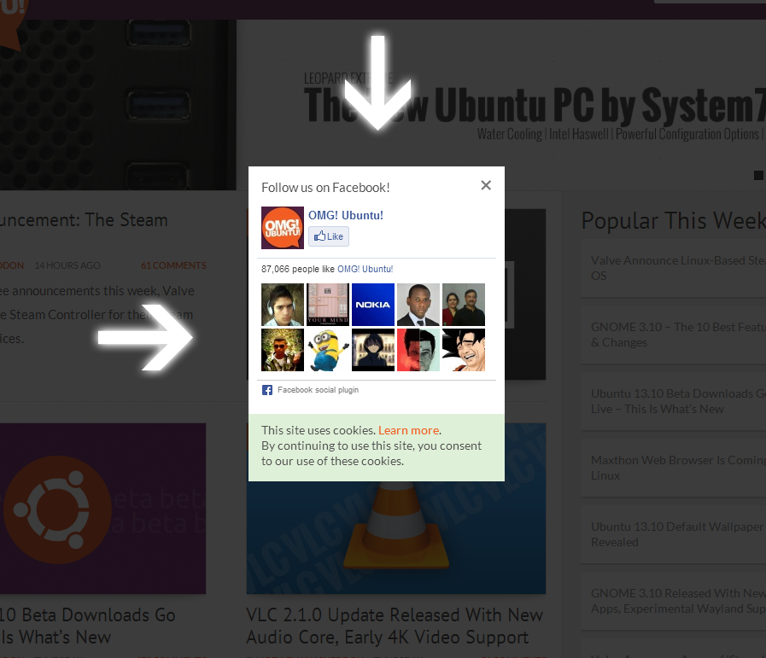
Images
Represented by the img element
Attributes:
src
alt
width
height
style
Usemap
Example:
<img src=“logo.gif” alt=“my logo” style=“width:100px; height:100px;” />
Notes:
The img element represents an image on the page.
Here is an example of the element.
There is a src attribute that defines where the image is in reference to the page.
The alt attribute is text that shows if the image cannot be displayed for some reason.
There is a width and height also, but it is recommended to use the style instead.

Slide 11
Semantic Elements
article
aside
details
figcaption
figure
footer
header
mark
nav
section
summary
Time
main
Notes:
There are a number of elements that just exist to help make the page more semantic.
This means that the elements are describing what is inside the element.
This means that not only does the page work for users to use it in a browser, but it can also be used by other machines to read the page and figure out what to do with the text based upon what semantic element it’s in.

Slide 12
EXAMPLE
iMAGES

Slide 13
ASSESSMENT
Paragraph and Images
Notes:
Write on the board a paragraph with text “this is a paragraph”.
Write on the board an image that exists in the img folder named profile.gif

Slide 14

Assignment
Write an interface for our status report.
Write the basic html structure with header text and title of “Zombie Status Report”.
Under the title, link to an image that you find online or have on your computer.
Under the image add a paragraph tag describing the report.

Slide 15
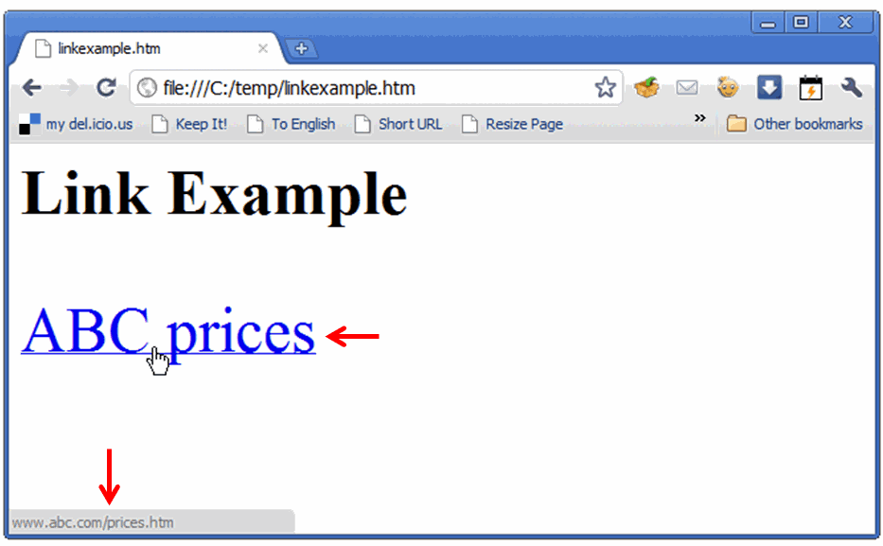
Links (Hyperlinks)
Represented by the a Element
Attributes:
Href
Absolute Path
http://www.google.com
Relative Paths
About.html
../About.html
./Company/About.html
Example:
<a href=“http://www.google.com”>Google Link</a>
Notes:
Links are represented by the a element.
The href attribute specifies the location of the link.
The text of the link goes between the tags.
The paths can be specified in multiple ways.
An absolute path can be specified with the full url.
Or a relative path can be used in reference to the page that the link is displayed on.
The relative path is recommended if the link is hosted within the same site.

Slide 16
EXAMPLE
lINKS

Slide 17
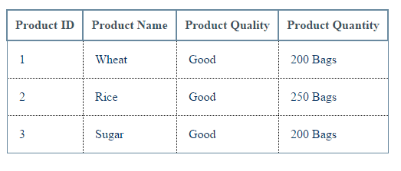
Tables
<table>
<thead>
<tr>
<th>First Name</th>
<th>Last Name</th>
</tr>
</thead>
<tbody>
<tr>
<td>John</td>
<td>Smtih</td>
</tr>
<tr>
<td>Tom</td>
<td>Jones</td>
</tr>
</tbody>
</table>
Notes:
The table element represents a table as you might imagine.
There is a thead element that represent the header and a tbody element that represents the body of the table.
The footer is represented by the tfoot element.
These are optional.
Inside the table the tr element represents a table row.
Each column is represented by th in the header and td in the body.

Slide 18
EXAMPLE
tABLES

Slide 19
Form Elements
form
Attributes: action, method, autocomplete, name, novalidate, target, accept-charset
Methods: get, post
Input
Attributes: type, name, value
Types: text, radio, checkbox, submit, select
fieldset
legend
Notes:
The form is the standard way for the page to submit data to the server.
Everything is surrounded by the form element start and end tags.
Within the form tags are input elements.
Different types can be specified for the input such as text for a textbox, radio for radio buttons, checkbox for checkboxes, and submit for the submit button.
The fieldset can be used to semantically describe where form fields are.

Slide 20
Forms
<form action=“/formAction.html” method=“post”>
First Name:
<input type=“text” name=“firstName” value=“First” />
Last Name:
<input type=“text” name=“lastName” value=“Last” />
Sign Up?
<input type=“checkbox” name=“signUp” value=“SignedUp” />
Gender
<select> <option value=“male">Male</option> <option value=“female">Female</option> </select>
<input type=“submit” value=“Submit” />
</form>
Notes:
Here’s a quick example of a form.

Slide 21
EXAMPLE
fORMS

Slide 22
ASSESSMENT
Links, Tables, and forms
Notes:
Write on the board a link to Google’s site with text “search engine”
Write on the board a table with two columns, a header, and two rows. Put in whatever text you would like.
Write on the board a text box with an id “LastName”

Slide 23
Assignment
Write an interface for our status report.
Under the paragraph add a table with a header that has 4 columns: First Name, Last Name, Status Id, and Status. Fill in some rows with data.
Create a new page with form fields First Name (text), Last Name (text), and Status (drop down).
Under the table add a link to open the new page with text, “Add”.

Slide 24
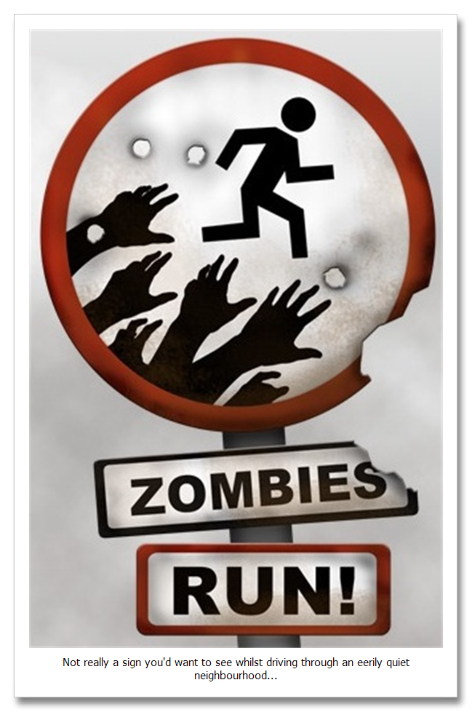
QUICK REVIEW
HTML
Notes:
What is the name of objects on the page?
What are properties associated with an element called?
Write on the board a paragraph with text “this is a paragraph”.
Write on the board an image that exists in the img folder named profile.gif
Write on the board a link to Google’s site with text “search engine”
Write on the board a table with two columns, a header, and two rows. Put in whatever text you would like.
Write on the board a text box with an id “LastName”

Slide 25
Additional Resources
MDN Tutorial
https://developer.mozilla.org/en-US/docs/Learn/HTML
JSFiddle
https://jsfiddle.net/
free Code Camp
https://www.freecodecamp.org/

