Slide 1
Logols Learning
Weekend web Development Boot Camp
Training: Web API

Slide 2
REST
Representational state transfer
REST is protocol independent
Architectural Style
Client-Server Communication
Stateless
Cacheable
Uniform Interface
Addressable Resources
Notes:
REST is an architectural style that is protocol independent.
It requires client server communication similar to how a browser interacts with a server.
It is stateless, meaning that one request doesn’t know anything about another.
It needs to be cacheable meaning the client could cache results if they wanted to.
And it needs to have a uniform interface.
http://carminedimascio.com/2013/09/restful-design-principles/

Slide 3
HTTP
Many REST services now use HTTP
This is Hypertext Transfer Protocol
What web pages use
Request and Response
Stateless
Requests: GET, POST, PUT, DELETE
Notes:
REST is often implemented over HTTP and uses the GET, POST, PUT, DELETE structure for a uniform interface.
HTTP is what all web requests and responses use.
It is stateless
So http works well with REST principles.

Slide 4
ASP.NET Web API
Request / Browser
Request
Server
ASP.NET
Find Controller
Controller
Request to Params
Model Binding
Find Method
Action Method
Action Method
Controller
Action Method
Controller
Response
Return to JSON
Action Method
Notes:
ASP.NET Web API handles routing a request to the server to a given controller class and action method.
It also binds query parameters or the request body to method parameters.
Finally it binds the return of the action method to JSON in the response.

Slide 5
https://www.google.com/Employee?id=1
https://www.google.com/Employee?id=1
Get Request
Google Server
ASP.NET running on Web Server
Find Controller
Employee
Request to Params
Model Binding
Find Method
Get
Id = 1
Post
Customer
Put
Supplier
Response
Return to JSON
Delete
{ Id: 1, FirstName: Tom, LastName: Burns }
Notes:
Here is an example request and response

Slide 6
Controller
The request initially goes to the controller
Based upon the route a method is run.
The JSON body of the request can be bound to a model.
Whatever is returned from the method is returned in JSON.
Notes:
The request initially goes to the controller.
Based upon the route and the request type attribute a method is run.
The JSON body of the request can be bound to a model.
Whatever is returned from the method is returned as JSON in the response body.

Slide 7
Attributes
Allow for declarations on classes, methods, or properties.
Give special behavior or properties.
[HttpGet], [HttpPost], [HttpPut], [HttpDelete]
Example:
[HttpPost]
public void Post([FromBody]Answer answer)
{
_service.Insert(answer);
}
Notes:
Attributes allow for declarations on classes, methods, and properties.
They give special behavior or properties to those classes, methods, or properties.
They are specified above a class, method, or property definition with the name of the attribute between square brackets [].
Parameters can be passed to attributes using parentheses ().
For WebApi we are using attributes to specify the http request type.
The example shows an HttpPost attribute used to designate a post request.

Slide 8
Routing
Tells ASP.Net which controller should receive the request
Based on the pattern of the request
Default Route: “http://domain/api/{controller}/{action}/{id}”
URL | Http | Controller | Method | Parameter
http://www.google.com/Employee/ | Get | Employee | Get | None
http://www.google.com/Employee?id=1 | Get | Employee | Get | id = 1
http://www.google.com/Employee/ | Post | Employee | Post | In Request Body
http://www.google.com/Employee/ | Put | Employee | Put | In Request Body
http://www.google.com/Employee?id=1 | Delete | Employee | Delete | id = 1
Notes:
As I mentioned, every request is routed to a controller.
You can control how the routing works.
There is a default route which is controller/action/id.
This is in reference to how the url looks, the controller is specified and then the action and then the id.
You can create custom routes to change which requests go to which controller.
Example: https://docs.microsoft.com/en-us/aspnet/mvc/overview/getting-started/introduction/adding-a-controller

Slide 9
Class Attribute Route
Controller Names End With “Controller”
This is left off of URL for routing
Class Attribute Route Ex:
[Route("api/[controller]")]
public class TimeTravelerController : Controller
Notes:
You can specify a route attribute for a class or an action method to detail further the route.

Slide 10
JSON
JavaScript Object Notation
How an Object is represented in JavaScript.
Example:
{
‘studentID’: 0
‘firstName’: ‘Kathy’,
‘lastName’: ‘Smith’
}
Notes:
JSON stands for JavaScript Object Notation.
It is how an object can be created on the file and is represented in JavaScript.
Essentially an object is surrounded by curly braces {}
Inside each property or variable is named followed by a colon : followed by the value.
There can be objects within objects or arrays within objects as well.

Slide 11
Response Binding
Return value to JSON Data
Example:
[HttpGet]
public IEnumerable<TimeTraveler> Get()
{
return timeTravelerRepository.GetAll();
}
Notes:
The return value of an action method in a controller is converted to JSON in the response body.
This automatic binding makes it easier to convert between JSON and C#.

Slide 12
Parameter Binding
JSON in Request Body converted to Class
Example:
[HttpPost]
public void Post([FromBody]Answer answer)
{
_service.Insert(answer);
}
Notes:
JSON that exists within the request body can also be converted or bound or serialized into a C# class.
This automatic binding makes it easier to convert between JSON and C#.

Slide 13
CLI Commands
mkdir – Create Directory
cd – Change Directory
Add project:
dotnet new classlib
dotnet new webapi
Add reference:
dotnet add reference [path]/[name.csproj]
dotnet add package Dapper
dotnet add package MySql.Data
Notes:
In order to make projects for our main components we will need to use CLI commands.
mkdir creates a new directory on your computer.
cd changes the directory that you are currently in.
dotnet new classlib – creates a new class library project. This is what we use to create a new .Net project that is code only.
dotnet new webapi – creates a new web api project. This is what we use to create a new .Net project that will contain our web api.
dotnet add reference – allows us to reference code from another project. One project does not know about the other until a reference is added.
dotnet add package – allows us to add a package to our code. A package is created by someone and can be downloaded over the internet for use in your project.
We will be using two packages from the Nuget package manager which are Dapper and MySql.Data.

Slide 14
Postman
Notes:
Let’s take a tour of Postman
Open Postman
Using the correct URL, make a get request to the API to get data back.
Using the correct URL and request body, make a post request to post data.
Using the correct URL and request body, make a put request to update data.
Using the correct URL, make a delete request to the API to delete data.

Slide 15
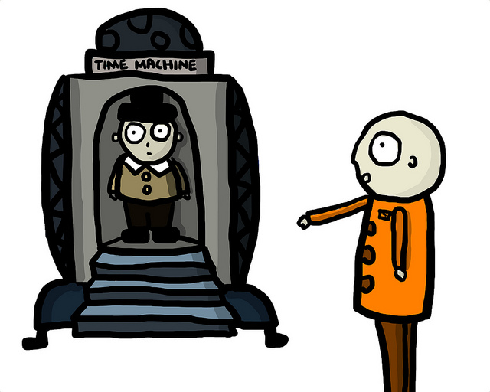
EXAMPLE
ASP.Net Web API

Slide 16

ASSESSMENT
ASP.Net Web API
Notes:
Name four http request types.
Write on the board JSON for a pet object specifying name and pet type.
Write on the board a controller action definition for a post to insert a pet using the JSON definition.
Write on the board a controller action definition for a post to update a pet using the JSON definition.
Write on the board a controller action definition for a get to one pet in the system based upon id.

Slide 17

Assignment
A small internet has been brought back online. Everyone wants your status report.
They also want to be able to insert, update, and delete data.
Add a web api to get, insert, update, and delete person status.

Slide 18
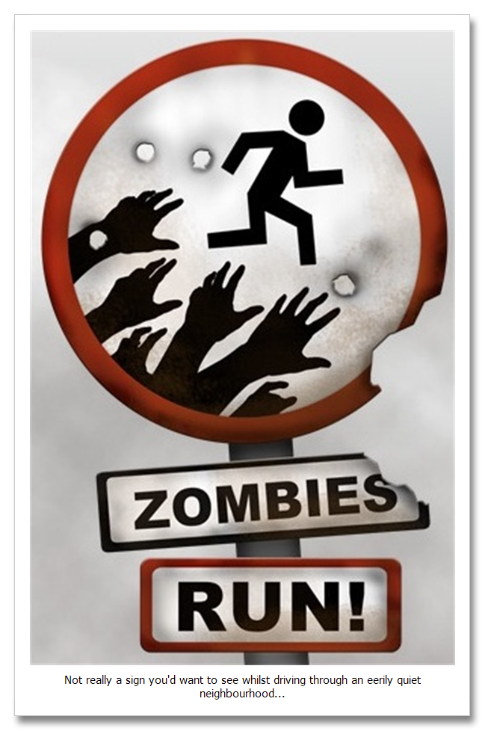
QUICK REVIEW
Web API
Notes:
Name four http request types.
Write on the board JSON for a pet object specifying name and pet type.
Write on the board a controller action definition for a post to insert a pet using the JSON definition.
Write on the board a controller action definition for a post to update a pet using the JSON definition.
Write on the board a controller action definition for a get to one pet in the system based upon id.

Slide 19
Additional Resources
Microsoft Page
https://www.asp.net/web-api
Microsoft Tutorial
https://docs.microsoft.com/en-us/aspnet/web-api/overview/getting-started-with-aspnet-web-api/tutorial-your-first-web-api
PluralSight
https://app.pluralsight.com/player?author=jon-flanders&name=aspnetwebapi-m1-introduction&mode=live&clip=0&course=aspnetwebapi

Slide 20
Keep Practicing!
Try creating different web api’s.
Use the different http actions.
Hook it up to the database.

