Slide 1
Logols Learning
Weekend web Development Boot Camp
Training: Angular

Slide 2

Architecture of Angular?
Modules
Component
Templates
Directives
Services
Notes:
These are all parts of what make up Angular.
Angular is built with TypeScript
It has modules, components, templates, metadata, and services.
We are going to go through each of these.

Slide 3
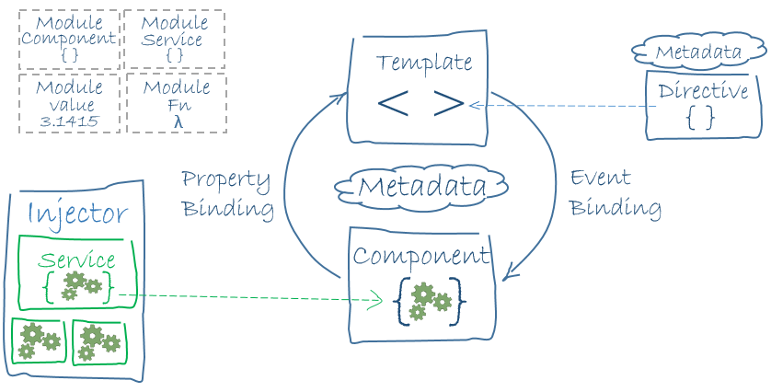
Architecture of Angular

Slide 4
Angular CLI
Install Angular CLI
npm install –g @angular/cli
Create a new Angular App
ng new [app-name]
Change Directory
cd [app-name]
Run the Application
ng serve
Notes:
The Angular CLI is the command line interface for Angular.
To install the Angular CLI enter the following command: npm install –g @angular/cli
To create a new application enter the following command: ng new [app-name]
To change the directory to the new application enter the following command: cd [app-name]
To run the application enter the following command: ng serve

Slide 5
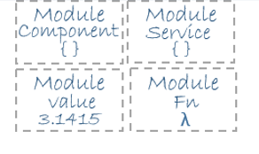
Modules
Define the Components
Root Module
Feature Modules
Notes:
Modules define the components that live within them.
There is a root module and there can also be feature modules to break down and separate the code.

Slide 6
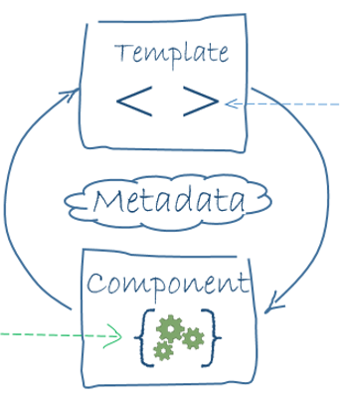
Components
Defines the Template
Defines the Class
Adds Metadata as needed
Uses Export and Import keywords to export and import modules
Notes:
Components define the template or location of the template.
They also define the class and adds any metadata needed.
The Export keyword is used to export a module.
The Import keyword is used to import an exported module.

Slide 7
Component Example
import { Component } from '@angular/core';
@Component({
selector: 'timemachine’,
templateUrl: './timeMachine.component.html’,
styleUrls: ['./timeMachine.component.css']
})
export class TimeMachineComponent {
}

Slide 8
Templates
Defines the html
Can be inline of the component
Or in a separate html file
Notes:
The template defines the html
The template can be fully written in the component.
It is better practice to write the html separately and reference it in the component.

Slide 9
Template Example
<header>
<h1>Time Machine</h1>
</header>
<hr />
<p>
Welcome to the Time Machine. Carefully select your destination.
</p>

Slide 10

Assets Folder
Contains all assets for application.
Non Angular assets
Images
CSS Files not tied to component
Reference files as:
/assets/…/img.jpg
Notes:
The template defines the html
The template can be fully written in the component.
It is better practice to write the html separately and reference it in the component.

Slide 11
app.module – Root Module
declarations
Declare available components
imports
Reference other modules
Providers
Define available services
bootstrap
Define root components to be loaded

Slide 12
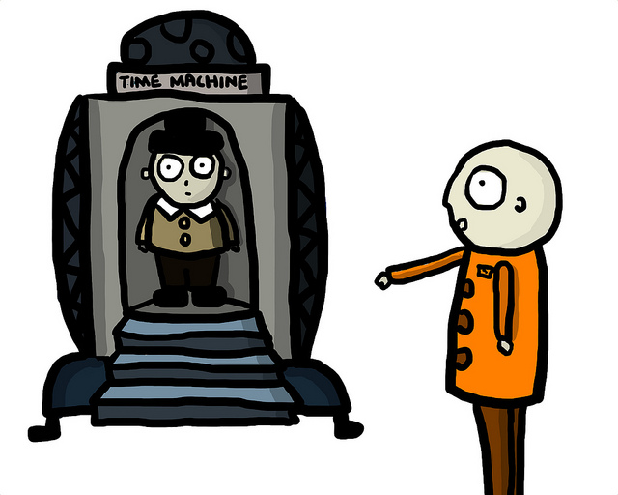
EXAMPLE
Angular Components and Templates

Slide 13

ASSESSMENT
Angular Components and Templates
Notes:
Write on the board the command to create a new angular application.
What are 5 main pieces of the Angular architecture?
Which piece does html go in?
Which piece defines the class and links to the template?
Write on the board a component definition.

Slide 14

Assignment
Add the status report into Angular.
Create a new component and html template for your zombie report.
Add the report html that you created before into the html template.

Slide 15
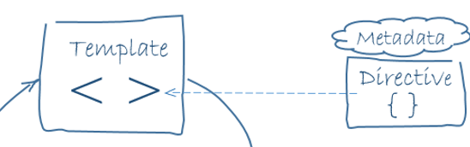
Directives
Custom extended HTML element
ngIf – conditional elements
ngFor – elements created in a loop
ngClass – conditionally add classes
Notes:
Directives are custom extended html elements
They are for things like conditions using ngIf and loops using ngFor

Slide 16
Directive Examples
<tr *ngFor="let log of logs">
<td>{{log.firstName}}</td>
<td>{{log.lastName}}</td>
<td>{{log.travelToYear}}</td>
</tr>
<p *ngIf="!assessments"><em>Loading Assessments...</em></p>
<p [ngClass]=“{‘hidden’:assessments.length > 0}”><em>Loading Assessments...</em></p>

Slide 17
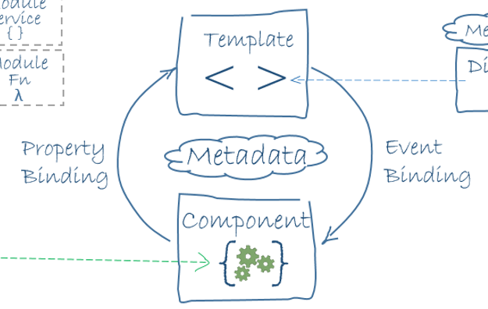
Data Binding
Interpolation
One-way binding (unidirectional)
Two-way binding
Event binding
Notes:
There are different types of data binding.
Let’s look at the examples to understand these better.
Examples: http://www.c-sharpcorner.com/article/data-binding-in-angular-2/

Slide 18
Data Binding Examples
Interpolation
Hello {{ name }}
One-way binding
<input type = 'text' [value]=“firstName" />
Two-way binding
<input [(ngModel)]=“firstName" />
Event binding
<button (click)="onSaveClick()">Save</button>

Slide 19
EXAMPLE
Angular Binding

Slide 20
ASSESSMENT
Angular Binding
Notes:
Which Angular piece extends HTML and makes it dynamic?
What are the four types of binding?
Write on the board interpolation for a property called name.
Write on the board a text field with a two way binding to a property called name.
Write on the board a button with an event binding to an event called onButtonClick.

Slide 21
Assignment
Add a property into the component for the title.
Use interpolation to show the value of the property for the title.
Create a class that defines a status report line named PersonStatus with properties: firstName, lastName, statusId, statusDescription.
Create a property with an array of PersonStatus objects.
Use the ng-for directive to display array data in the table.

Slide 22
Routing/Navigation
Define routes in the module file
Use the following syntax in the template to link to a route:
<a [routerLink] = “[route path]”>Description</a>
Use router-outlet element to specify location of the route in the template
Use * to route all undefined paths
Notes:
Routes allow for navigation through the website.
Routes are setup in the module file and specify the path for a specific router link.
* can be used to route all undefined paths.
Example: https://www.tutorialspoint.com/angular2/angular2_routing.htm

Slide 23
EXAMPLE
Angular Routing

Slide 24
ASSESSMENT
Angular Routing
Notes:
Write on the board a route definition for a route called home.
Write on the board a link that uses a route called home.

Slide 25
Assignment
Create a new component and html template.
Add html for the form into it that you created previously.
Setup up routing and a link so that the add link goes to this new component.

Slide 26
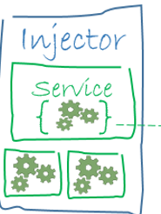
Service
Separate Class
Used to interact with the data
Read and Persist
Called from the component
Notes:
A service class is usally used to interact with the data.
It provides the reading and persisting the data usually calling services from the server.
These are hooked up through the component.

Slide 27
CORS
Cross-Origin Resource Sharing
By default Web API does not allow cross domain requests.
Modify Startup.cs
ConfigureServices Method
services.AddCors(o => o.AddPolicy("AllowSpecificOrigin", builder =>
{
builder.AllowAnyOrigin()
.AllowAnyMethod()
.AllowAnyHeader();
}));
Configure Method
app.UseCors("AllowSpecificOrigin");

Slide 28
EXAMPLE
Angular Service

Slide 29
Assignment
Create a service that calls into your previously created web api.
Return data and loop through it using the ng-for directive for the table instead of using the hard coded array.

Slide 30
Assignment
Add a call into the new service that creates a person status record when using the form component that was created.

Slide 31

QUICK REVIEW
Angular
Notes:
Write on the board the command to create a new angular application.
Which piece does html go in?
Write on the board a div that uses ngif based on a property named headerVisible.
Write on the board a component definition.
What are the four types of binding?
Write on the board interpolation for a property called name.
Write on the board a text field with a two way binding to a property called name.
Write on the board a button with an event binding to an event called onButtonClick.
Write on the board a route definition for a route called home.
Write on the board a link that uses a route called home.
Which Angular piece would be used to read data from an API?

Slide 32
Additional Resources
Cheat Sheet
https://angular.io/guide/cheatsheet
Angular Tutorial
https://angular.io/tutorial
Udemy
https://www.udemy.com/learn-angular-from-scratch/
JSFiddle Template
https://jsfiddle.net/yurzui/1hk7knwq/

