Slide 1
Logols Learning
Weekend web Development Boot Camp
Training: AGILE Development

Slide 2
TEAM PROJECT
TEAM And project selection

Slide 3
Agile
Agile Manifesto:
Individuals and Interactions over Processes and Tools
Working Software over Comprehensive Documentation
Customer Collaboration over Contract Negotiation
Responding to Change over Following a Plan
Notes:
After seeing the results of waterfall and struggling through it, developers met to create what they called the Agile Manifesto
Individuals and Interactions over Processes and Tools
Working Software over Comprehensive Documentation
Customer Collaboration over Contract Negotiation
Responding to Change over Following a Plan
There are many different flavors of agile. Companies often end up implementing some variation of these.
We are going to focus on Scrum.

Slide 4
Scrum
User Stories
Acceptance Criteria
Sprints
Sprint Planning
Stand Ups
Sprint Reviews
Retrospectives
Roles:
Product Owner
Scrum Master
Developer
Notes:
Scrum is a type of Agile development methodology.
For user requirements, the team works together to write user stories.
For each user story, there is acceptance criteria that defines what needs to happen for the stakeholder to be satisfied with development.
The team works in sprints which are usually around 2 weeks.
During a sprint planning meeting, the team decides what work will be done within the sprint. Once agreed, the team works to complete all items for that sprint.
Stand ups occur each day and team members say what they did the previous day and what they plan to do that day. They also mention any road blocks.
Sprint Reviews occur to review all work that was done during the sprint and if there is a release they decide if that work will be released.
Retrospective meetings occur where the team discusses what went well, what didn’t go well, and what improvements are needed.
There are only 3 roles in Scrum:
Product Owner – Works with stakeholders to prioritize work and ensure the team is working on and correctly defining work.
Scrum Master – Ensures Scrum is being followed and ensures road blocks are removed.
Developer – everyone else on the team is considered a developer. This includes programmers, BA’s, and QA’s. The idea is that the team self organizes and helps each other out to complete work.

Slide 5
User Stories
Generally follow the following format:
As a <Who>, I would like <What>, so that <Why>.
Ex. As a development lead, I would like a board, to be able to track user story progress.
Notes:
User stories follow the general format of: As a <Who>, I would like <What>, so that <Why>.
An example is As a development lead, I would like a board, to be able to track user story progress.
User stories should be broken down as far as they can, so that they are not representing too much scope.

Slide 6
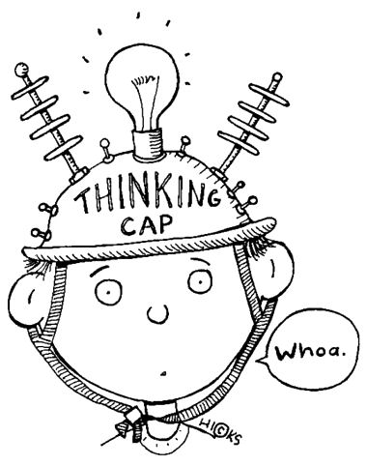
ASSESSMENT
User Stories
Notes:
Agile was started from a document called what?
Name the three roles in Scrum.
The timeframe for one cycle of development is called what in Scrum?
Write on the board the general format of a user story.

Slide 7
User Story Exercises
Outsource your work. Think of 2 tasks that you do on a regular basis. If you were going to outsource these tasks for someone else to do, how would you explain the tasks and ensure they are doing it the way that you want them to. Write user stories.
Write the user stories in the “As a <Who>, I would like <What>, so that <Why>” format to explain the tasks.

Slide 8
TEAM PROJECT
User stories

Slide 9
Acceptance Criteria
Only the What, not the How.
Provide as many as needed.
Ex.
AC1 – The board should show all user stories to be completed in the sprint.
AC2 – All states (To Do, In Progress, Done) should show on the board.
AC3 – User Stories should show associated with the appropriate state.
AC4 – User can move user stories to different states.
AC5 – User Story title should be displayed.
Notes:
The acceptance criteria should only define what should occur. We want the development team to be able to work with the product owner and stakeholders to come up with the best solution (the how).
There is not just one acceptance criteria. There are many and there should be as many as needed to completely define what is needed.
Ex.
AC1 – The board should show all user stories to be completed in the sprint.
AC2 – All states (To Do, In Progress, Done) should show on the board.
AC3 – User Stories should show associated with the appropriate state.
AC4 – User can move user stories to different states.
AC5 – User Story title should be displayed.

Slide 10
ASSESSMENT
Acceptance Criteria
Notes:
What describes what needs to happen for the product owner to be happy with the user story?
How many acceptance criteria should there be?
Acceptance criteria define the who? The what? Or the how?

Slide 11
Acceptance Criteria Exercises
Outsource your work. Think of 2 tasks that you do on a regular basis. If you were going to outsource these tasks for someone else to do, how would you explain the tasks and ensure they are doing it the way that you want them to. Write user stories.
Write the user stories in the “As a <Who>, I would like <What>, so that <Why>” format to explain the tasks.

Slide 12
TEAM PROJECT
Acceptance criteria

Slide 13
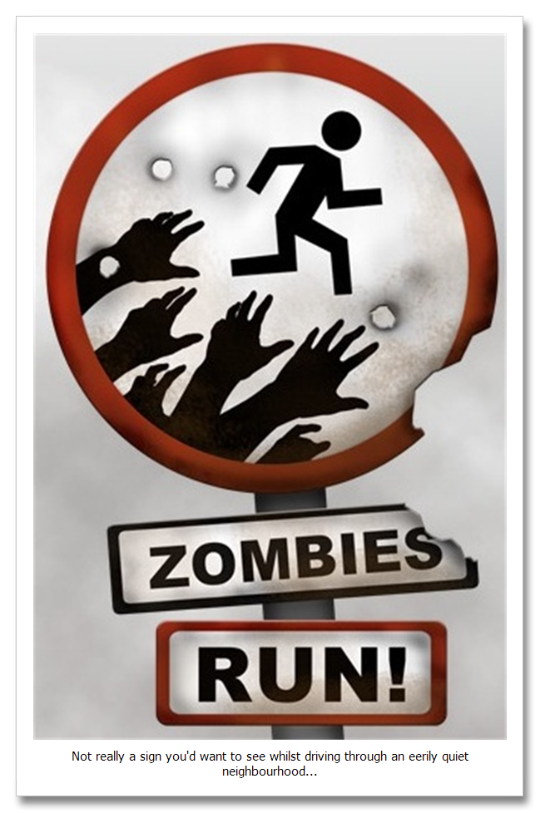
QUICK REVIEW
Agile
Notes:
Agile was started from a document called what?
Name the three roles in Scrum.
The timeframe for one cycle of development is called what in Scrum?
Write on the board the general format of a user story.
What describes what needs to happen for the product owner to be happy with the user story?
How many acceptance criteria should there be?
Acceptance criteria define the who? The what? Or the how?

Slide 14
Additional Resources
Agile Manifesto
http://agilemanifesto.org/principles.html
Scrum
https://www.scrumalliance.org/why-scrum
User Stories
https://www.mountaingoatsoftware.com/agile/user-stories
Acceptance Criteria
https://www.boost.co.nz/blog/2010/09/acceptance-criteria

