Slide 1
Logols Learning
Weekend web Development Boot Camp
Welcome!

Slide 2
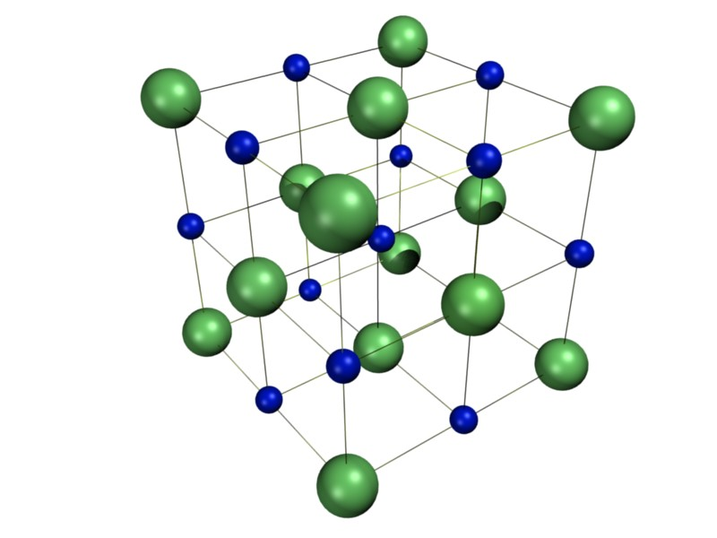
Structure
Instructor Lead
Examples
Individual Exercises
Team Project
Review
Presentations
Notes:
The program is made up of the following:
Instructor lead time, where I do my best to explain things.
Throughout I will be providing examples. All of these examples will be on Github for you to review.
I can stand up here forever and talk and none of it will make sense until you start doing code yourself. Individual Exercises are provided that you will work on to better your understanding of what you are learning.
You will work in teams to create your own web application after we go through the material. There is one full day that we dedicate to coding the team project.
On the last day we will work on a project together to review.
In the afternoon of the last day you will present your team projects.

Slide 3
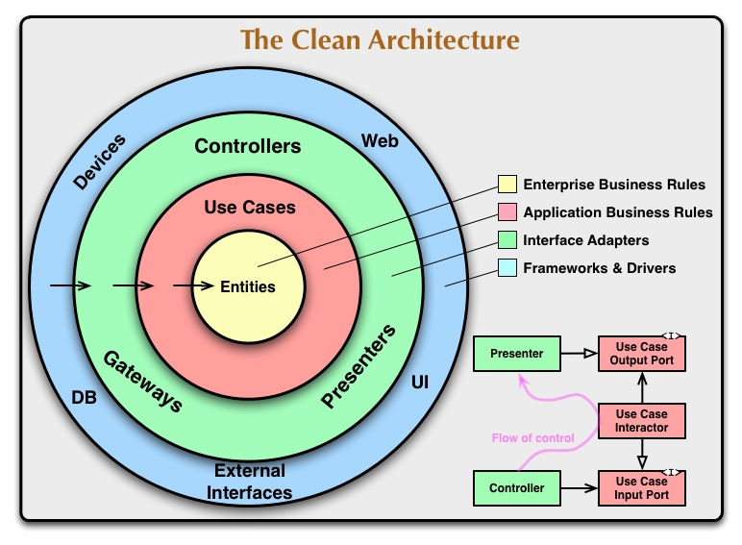
Goals
General Understanding
UI – HTML, CSS, Angular
Server Side – C#, .Net Framework, OOP
Database – MySql
Follow Clean Architecture:
Notes:
The goals of the program are:
To provide a general understanding of a web application development stack and how all the pieces fit together.
To provide a basic understanding and introductory ability to use the technologies of HTML, CSS, Angular, C#, and MySql.
We will follow a clean architecture structure. This may seem a bit excessive for the small applications we are creating, but it provides a good flexible structure to be used for larger scale applications.

Slide 4

Expectations
This is not Easy
Everyone Struggles
It Takes Time and Patience
You will need more Training
Respect Each Other
Help Each Other
Make this a Safe Place
Notes:
Learning programming is not easy.
It’s somewhat like learning a foreign language.
If someone has told you that they just naturally picked it up, it likely means, they forgot their struggle.
Everyone struggles at first.
It takes time and patience to learn.
We have limited time here. You may need to practice more at home during the week.
If you are just starting, you will likely need more training after this to become proficient enough to get a job doing it.
Please respect each other in here. If you have some knowledge coming in to this, please be respectful of those just learning.
Help each other out. Some things may come easier to some people and harder to others. If you get it, help your neighbor.
Let’s make this a safe place for everyone. Be nice, be friendly, we’re all on the same team trying to help each other get better.

Slide 5

Tools
Google Classroom
Github
Slack
Discord
Facebook
Visual Studio Code
.Net Core 2.0
MySql & MySql Workbench
Angular
Notes:
Join the Google Classroom this is where assignments are and where announcements will be made.
A Logols Slack Channel is available for people to join and discuss.
A Logols Discord Channel is available for current and former Logols members to discuss.
A Logols group is available on Facebook to stay in touch after the Bootcamp is over.
Visual Studio Code is the editor we will use for our code.
.Net Core 2.0 is the .Net framework that we will use.
MySql is the database that we will use.
A client for accessing MySql is MySql Workbench
Angular is the JavaScript framework that we will use.

Slide 6
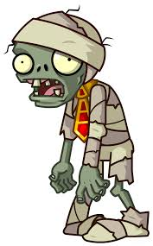
Your Mission - Exercises
It is the zombie apocalypse.
All the programmers are zombies or dead.
The newly formed government has recruited you to learn programming and help save the world!

Slide 7
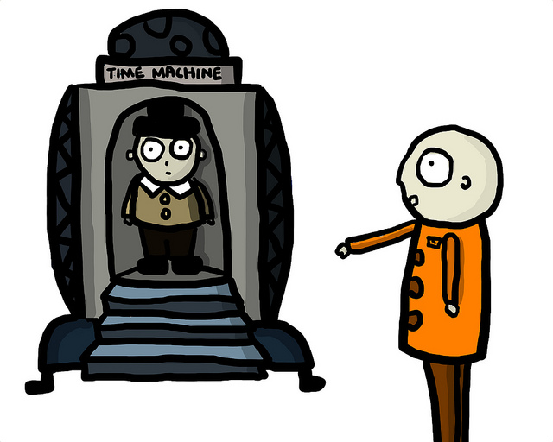
My Mission - Examples
Build a time machine.
Travel back to before the Zombie apocalypse.
Find out how it starts and stop it from occurring.
Notes:
Here are some examples of using new within the CLI to create new projects.
Console project:
dotnet new console
Class Library project:
dotnet new classlib
Web API project:
dotnet new webapi
A full reference is available here: https://docs.microsoft.com/en-us/dotnet/core/tools/dotnet-new?tabs=netcore2x

Slide 8
GET TO KNOW
Notes:
We will now do an exercise that I do with my application development team for us to get to know each other better.
Get to know each other, help each other as you will all be stuck at one point or another.

