Slide 1
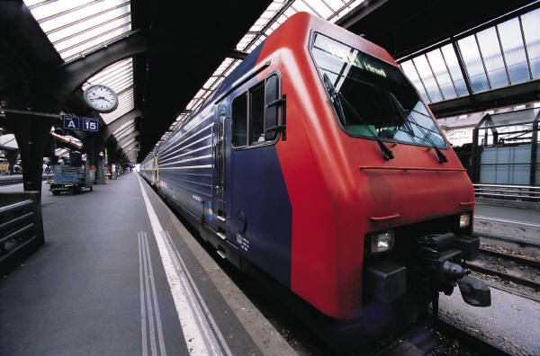


Geoffrey Pouliquen
Mars 2019
Project MyWay

Slide 2
Files reading
Datas written in GTFS (General Transit Feed Specification) format
Only routes.txt, trips.txt, calendar_dates.txt, transfers.txt, stops.txt, stop_times.txt are read
9 Dictionnaries are created and fullfilled with datas from these files
Dictionnaries for algorithm
path_dict
service_dict
platform_dict
trips_dict
Dictionnaries for displaying
display_dict
routes_dict
coordinates_dict
stop_trip
line_direction_dict
Loading time ≈ 1 minute

Slide 3
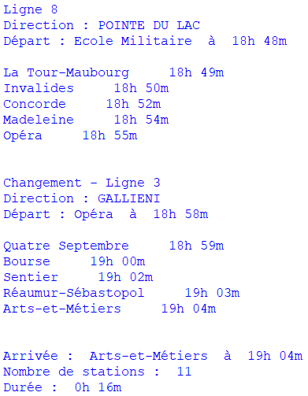
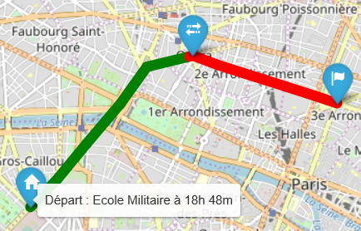
The algorithm
4 Inputs :
  Departure station
  Arrival station
  Departure time
  Departure date
A Dijsktra algorithm finds the shortest itinerary
The itinerary is displayed with text or on map
More tests are available in Test_FindWay

