Slide 1
Batting in Leagues and Home Attendance
By Logan Liddiard and Akhila Akkala

Slide 2
Introduction and Dataset
Major League Baseball from 1871 - 2017
For this analysis we have used files regarding Batting , teams concentrating of players, leagues and parks.

Slide 3
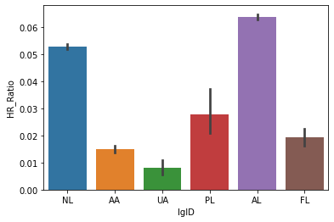
Which League has heavy hitters
Batting data
Home runs to hits ratio
Analysis for each league
We can see AL has heavy hitters

Slide 4
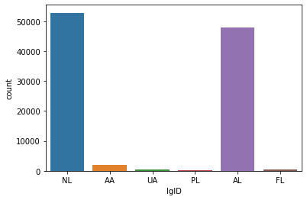
Does AL has more players which leads for more home runs to hits ratio?
Generally assumption is that American League has more players so it have more home runs to hits ratio.
NL has more players than AL.

Slide 5
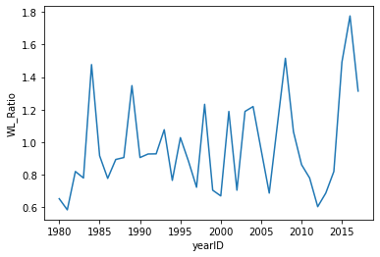
Win loss ratio of Chicago clubs
No steady win loss ratio 1980 - 2017
Major dip in 2012
Highest in 2017

Slide 6
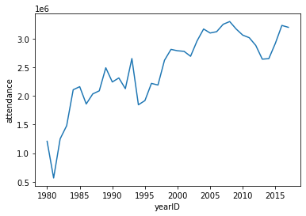
Park Attendance for chicago clubs
Attendance goes up with win loss ratio
It has correlation with win loss ratio

