Slide 1


SMART INDIA HACKATHON 2024
TITLE PAGE
Problem Statement ID – 1609
Problem Statement Title- Implementation of the Alumni Association for the university/institute
Theme- Smart Education
PS Category- Software
Team Name (Registered on portal)- The Hivemind

Slide 2
IDEA TITLE
The Hivemind
Idea/Approach
Since there is no one stop solution to provide the alumni with an environment where they can maintain engagement, facilitate donations and provide valuable services such as job networking, we, with our app ALUMNIFY our providing them with a user-friendly, precise solution.
Features :-
Collecting verified database through direct collaboration with institutions using blockchain algorithms for cross-verification of registrations.
Providing customized interfaces for institutions, students and alumni offering distinct features to cater their needs.
Connecting the user to the respective institute community using the verified data.
Providing access to the user to an alumni directory using a ML-powered filtered search engine.
Creating an expansive networking environment – ALUMNET, which provides the user with various features for enhanced alumni engagement.
Providing a donation portal that allows the user to either invest in an ongoing project or make charitable donations to their Alma Mater , either in monetary terms, or in-kind contributions.
Building a job portal facilitating career opportunities by connecting with potential employers within the network.
Providing a platform where alumni can offer mentorship to current students, sharing their expertise and guidance to help them navigate their careers.
Inspiring the current students by showcasing the success stories and notable contributions.

Slide 3
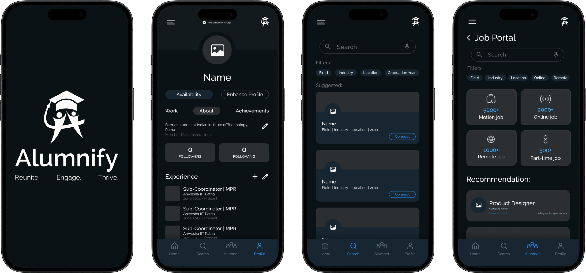
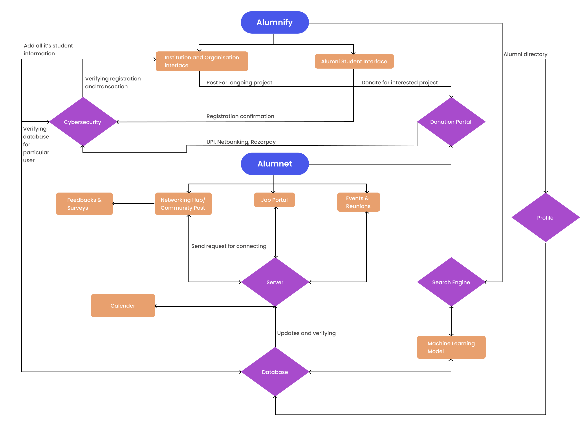












TECHNICAL APPROACH
The Hivemind
Wireframes
Tech Stack
@SIH Idea submission- Template

Slide 4
FEASIBILITY AND VIABILITY
The Hivemind
Technical Feasibility:
Initially, the app will provide services for android devices only and gradually we will extend it to IOS devices.
The app will integrate with other services like payment portals, verified databases and APIs.
As this app targets government institutions only, it is made to handle the load accordingly. Further we will extend it for other organizations also, so the data handling capacity will be changed as per requirements.
Operational Feasibility:
We will collaborate with the institutions and organizations and extract their student and alumni data records.
This project is made by keeping user-experience in mind and it can facilitate quicker adoption and minimize operational disruption.
Market Viability:
The existing alumni connection platforms neither have a better user-experience nor do they have features which fulfil the long-term market demands.
Majority of the organizations lack an efficient alumni relations network.
Sustainability:
We will create a broad network that will gradually span every organization in the country including coaching center and will aim towards propagation overseas.
We will allocate a sufficient amount of money to increase the scalability of the project aspiring to eliminate any disruptions caused to the server to accommodate the wide range of users.
We will regularly keep on updating the app based on surveys and feedbacks form existing users.
Legal Considerations:
All the data will be government verified with low apertures for forgery and scandals.
The donation platforms that we will use are all secure and encrypted.

Slide 5


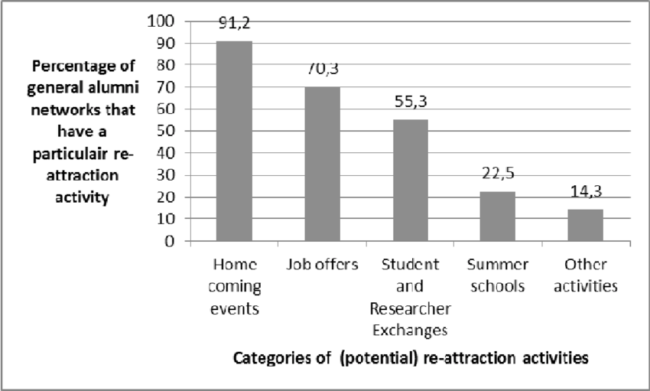

IMPACT AND BENEFITS
The Hivemind
Social Benefits: Fostering better alumni engagement which will lead to holistic and professional growth. Expanding job prospects for the students as well as the alumni.
Economic Benefits: Aiding early startups through donations or investments for hastier growth. Promoting market expansion through provisions and opportunities for the organizations to advance their business ideas.
Long-term Impact: The more robust the alumni network the more is the probability of placements. Improving overall ideation with respect to technology by connecting the old and experienced generation with the new-age tacky generation leading to diverse perspectives in the process thereby resulting in overall long-term sustainable development.
Target Audience
Government Engineering Institutions, alumni and students.
Direct Impact
Engagement through direct communication with alumni
Scalability
Including other organizations and institutions including coaching institutes, schools and private firms.

Slide 6
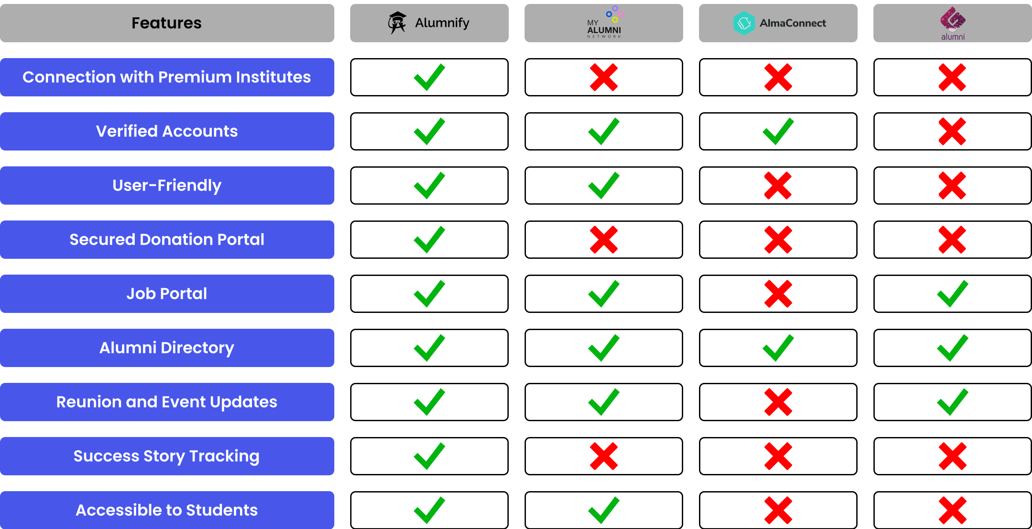
RESEARCH AND REFERENCES
The Hivemind
References
LinkedIn - for networking inspiration, extracting data for Machine Learning model training.
Behance - for profile and success story tracking
Unstop - for UI cards and mentorship portals
My ALUMNI NETWORK - for overall user experience and feedbacks for improvisation
Relationship Building: The Key to Alumni Engagement | EDUCAUSE Review
Percentage of the general alumni network that perform certain... | Download Scientific Diagram (researchgate.net)

