Slide 1
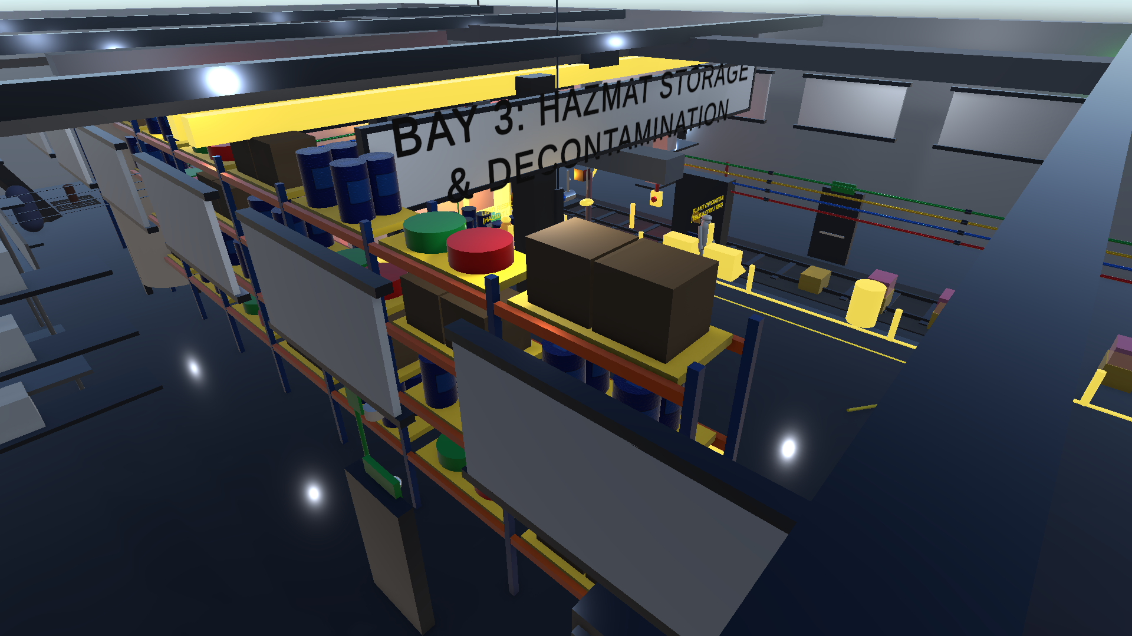

SMART INDIA HACKATHON 2026 // PROBLEM STATEMENT: SIH260088
☣️ CBRS-X : CBRN HAZMAT PROTOCOL & RESPONSE SIMULATOR
Enterprise Tactical VR & WebGL Chemical, Biological & Radiological Emergency Training with Deterministic Audit Engine
📋 MISSION SPECIFICATIONS & TASK FORCE
• Problem Statement ID: SIH260088
• Problem Title: Virtual Reality & WebGL CBRN Emergency Simulator
• Target Ministry: Disaster Management (NDRF / MHA)
• Solution Category: Software & Enterprise Telemetry
• Lead Institution: Kalpataru Institute of Technology (KIT)
• Team Lead: Lohith R C (Unity Physics, Backend & Telemetry)
• Task Force Roster: Monica K S, Chandana M P, Chandana M N, Harshini R B, Pavitra J H
📍 INDUSTRIAL STORAGE BAY 03 // 3D TACTICAL DIGITAL TWIN

Slide 2
CBRS-X Team
[MISSION DOMAIN // SIH260088] PROPOSED SOLUTION & INNOVATION // ZERO-RISK CBRN AUDITING
🚨 The Real-World Crisis
• Lethal Hazard Risks: Live CBRN drills risk fatal toxic vapor & radiation exposure.
• Prohibitive Suit Cost: Single-use Level-A suits cost ₹50,000+ per drill.
• Zero Muscle Memory: Passive classroom lectures fail to build real reflex.
• Subjective Bias: Human evaluations miss microsecond protocol errors.
☣️ The CBRS-X Solution
• Zero-Risk 3D Simulation: Virtual recreation of Storage Bay 03 hot zone.
• Zero-Install WebGL: Runs natively in Chrome/Edge on budget laptops.
• Strict SOP Enforcement: Governs official 5-stage NDRF emergency cycle.
• Deterministic Grading: 100-point audit engine eliminates subjective bias.
🌟 Core Innovation & Edge
• Dual-Screen Sync: WebGL Trainee view synced live with Instructor Radar.
• Sub-50ms Telemetry: STOMP WebSockets streaming responder vitals at 60Hz.
• SHA-256 Certification: Instant tamper-evident official PDF credentialing.
• Multi-Hazard Engine: Hot-swappable Chemical, Bio & Radiological logic.
[STAGE 1]
DETECT
PID Gas Sampling PPM Thresholds
[STAGE 2]
PROTECT
Level-A Hazmat SCBA Air Donning
[STAGE 3]
CONTAIN
Magnetic Patch Torque Leak Seal
[STAGE 4]
EVACUATE
Casualty Triage Warm Zone Transit
[STAGE 5]
DECONTAMINATE
Multi-Stage Arch Washdown Check

Slide 3
CBRS-X Team
[FULL-STACK SPECS] TECHNICAL APPROACH & SYSTEM ARCHITECTURE // MULTI-TIER ENGINE
🛠️ MULTI-TIER TECHNOLOGY STACK
• Frontline Simulation: Unity 2022.3 LTS, WebGL / WASM, OpenXR, Universal Render Pipeline (URP)
• Trainee Web Station: React 18, Three.js 3D viewport, Vite 5
• Instructor Command: React 18 Glassmorphism, Recharts, 2D/3D Spatial Radar Map
• Deterministic Core: Java 17, Spring Boot 3.2.5, REST API Controllers
• Real-Time Telemetry: STOMP WebSockets (/ws-cbrsx) with <50ms dispatch latency
• Data Persistence: PostgreSQL 15 / Supabase relational audit trails
• Security Hardening: LRU Sliding Rate Limiter (10k IP), SHA-256 PDF engine
📡 END-TO-END TELEMETRY & DETERMINISTIC PIPELINE
1. Frontline Event Emission (WebGL / Unity C#): As trainee navigates Bay 03, CbrsEventLogger transmits ISO-8601 UTC timestamped JSON telemetry (gas detection, suit donning, leak containment, decon exit) over HTTP/WS.
2. Real-Time Ingress & State Evaluation (Spring Boot 3.2.5): Ingress security filters validate payloads; ScoringService deterministically computes deductions for PPE breaches, PPM exposure, and containment speed with 0% subjective bias.
3. Tactical Broadcast & Tamper-Evident Certification: Broadcasts live responder radar coordinates to Instructor Command at 60Hz. At mission end, dynamically generates an official PDF certificate with embedded SHA-256 digest.
🏆 VERIFIED PRODUCTION RELIABILITY
✔ 46 / 46 Unit & Integration Tests Passed (JUnit 5 + MockMvc) | ✔ Sub-50ms WebSocket Broadcast | ✔ 60 FPS WebGL Engine

Slide 4
CBRS-X Team
[TACTICAL RESILIENCE] FEASIBILITY, RISK MITIGATION & FIELD DEPLOYMENT
📦 TECHNICAL & OPERATIONAL FEASIBILITY
✔ Zero Hardware Dependency Runs inside standard Google Chrome / Microsoft Edge on budget laptops without dedicated gaming GPUs.
✔ Single-Command Field Setup `docker-compose up` spins up Nginx, Spring Boot backend, and PostgreSQL in under 15 seconds.
✔ Local Hotspot Connectivity Responders connect laptops/tablets to a local router with zero external internet required.
✔ High Concurrency Capacity Handles up to 50 concurrent simulation streams per local base server without frame rate degradation.
✔ Multi-Hazard Polymorphism Hot-swappable JSON state machines for Chemical, Biological, and Radiological disaster scenarios.
⚠️ RISK ANALYSIS & SYSTEMIC MITIGATION
• Heavy 3D WebGL Bundle Size ➔ Mitigation: Brotli compression + WebAssembly reduces initial load by 65%. Service Worker caching enables instant repeat launches.
• No Internet at Field Outposts ➔ Mitigation: Offline 'Field Box' Deployment: Entire ecosystem packaged in Docker Compose running on local offline Wi-Fi router.
• Certificate Forgery / Fraud ➔ Mitigation: Embedded SHA-256 cryptographic digest stamped on all generated PDF certificates allows instant hash verification.
• Cybersecurity & Ingress Risks ➔ Mitigation: Bounded LRU Sliding-Window Rate Limiting (10k IP pool) + DDE / CSV injection sanitization filters.

Slide 5
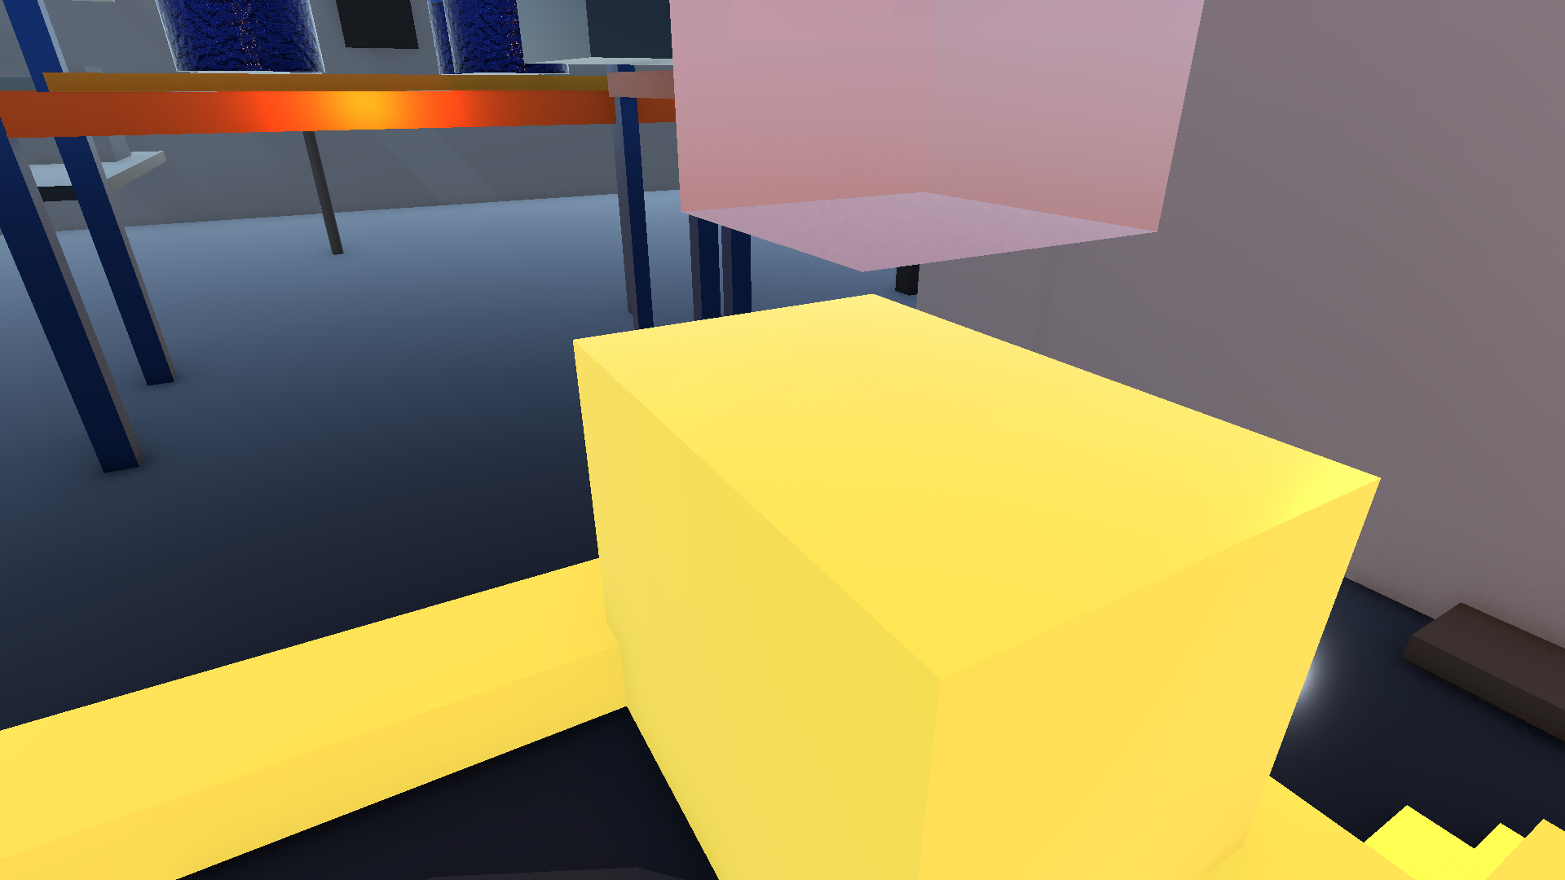
CBRS-X Team
[STRATEGIC OUTCOMES] REAL-WORLD IMPACT, ROI & NATIONWIDE SCALABILITY
100% RISK ELIMINATION
Zero physical injury, chemical burns, or vapor inhalation during emergency drill training.
90%+ COST REDUCTION
Saves ₹50,000–₹1,00,000 per responder per drill by eliminating single-use suit waste.
1,000+ DRILLS / DAY
Infinite virtual repetitions with instantaneous objective grading and replay debriefs.
🎯 TARGET AUDIENCE & INSTITUTIONAL REACH
• National & State Disaster Forces: NDRF battalions, SDRF units across all Indian states & Union Territories.
• Petrochemical & Heavy Energy: Refineries, offshore rigs & chemical depots (IOCL, ONGC, GAIL, NTPC, NPCIL).
• Defense & Paramilitary HAZMAT: CRPF, CISF airport units, Indian Coast Guard, and Municipal Fire Brigades.
• Environmental Sustainability: Zero chemical runoff or hazardous plastic suit waste dumped into landfills.
⚡ FIRST-PERSON TACTICAL CONTAINMENT ACTION

Slide 6
CBRS-X Team
[AUTHORITATIVE FOUNDATIONS] RESEARCH BASE, COMPLIANCE & SCIENTIFIC STANDARDS
📑 OFFICIAL REGULATORY STANDARDS & SCIENTIFIC CITATIONS
✔ 1. NDRF Tactical Standard Operating Procedures (SOP) Official National Disaster Response Force SOP guidelines for Chemical, Biological, Radiological, and Nuclear (CBRN) First-Responder incident lifecycles (MHA, Govt. of India).
✔ 2. National Disaster Management Authority (NDMA) Guidelines Management of Chemical (Terrorism) Disasters & Industrial Hazardous Material Incident Response Guidelines.
✔ 3. OSHA & NIOSH Hazardous Exposure & PID Standards Photoionization Detector (PID) calibration protocols, Permissible Exposure Limits (PEL), and Immediately Dangerous to Life or Health (IDLH) safety caps.
✔ 4. Khronos Group & W3C Web Standards OpenXR 1.0 Cross-Platform VR Standard & High-Performance WebGL 2.0 / WebAssembly (WASM) 3D graphics pipeline.
✔ 5. Enterprise Security & Cryptographic Integrity Spring Security 6 enterprise authentication, STOMP RFC WebSocket specifications, and SHA-256 tamper-evident digest algorithms.

