Slide 1


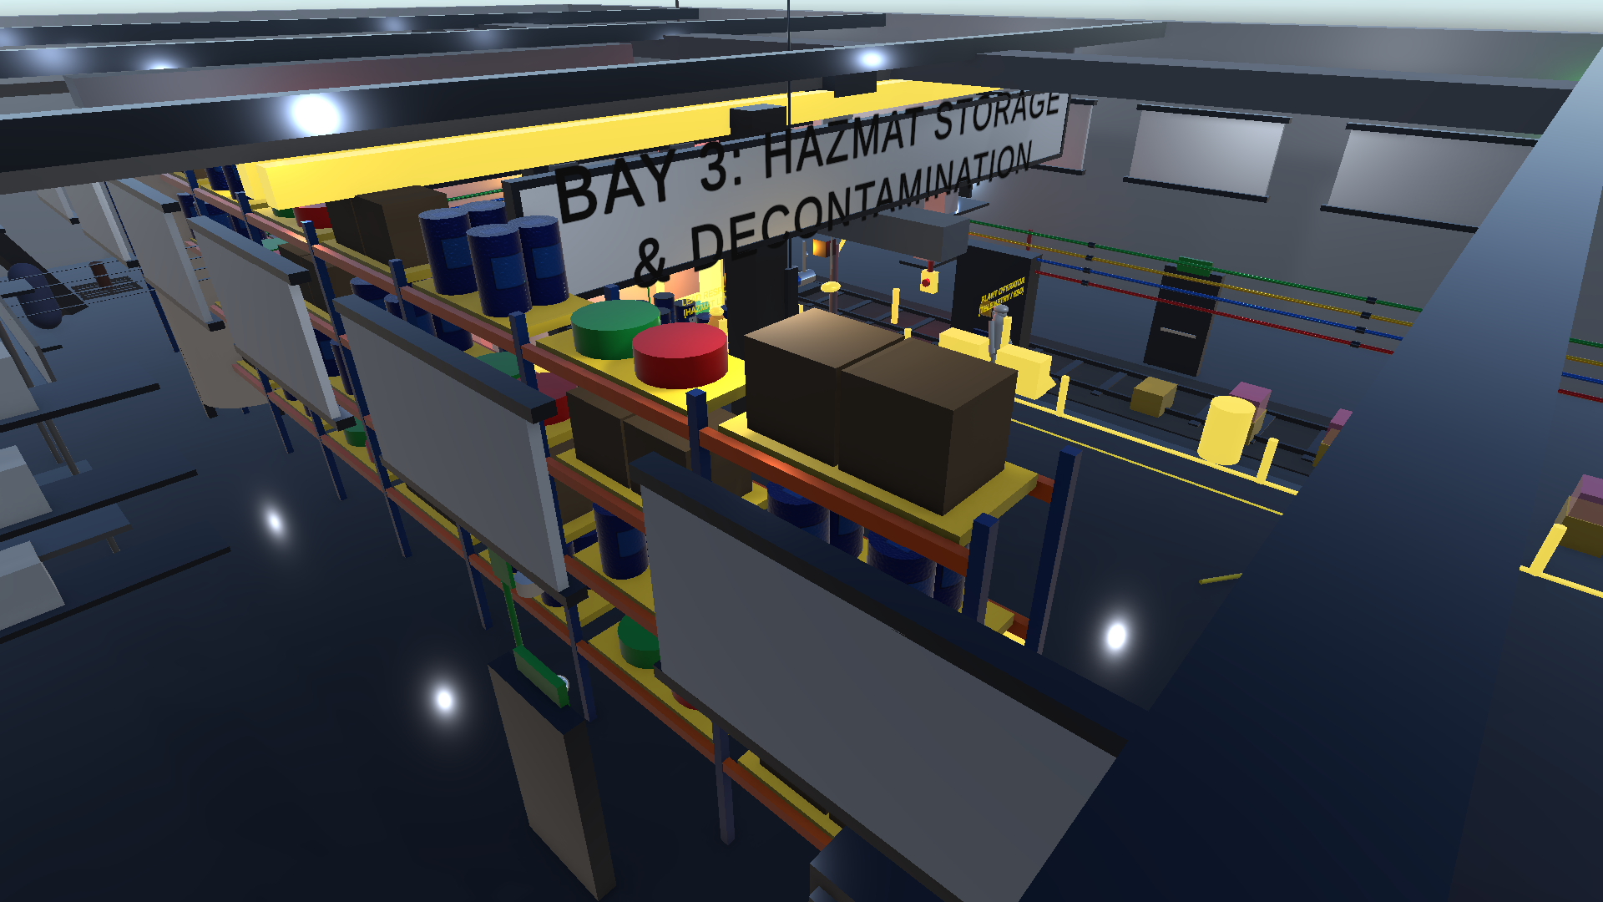
SMART INDIA HACKATHON 2026
TITLE PAGE // CBRS-X
Virtual Reality & WebGL CBRN Hazmat Emergency Simulator
📋 PROBLEM STATEMENT DETAILS
• Problem Statement ID: SIH260088
• Problem Statement Title: Virtual Reality & WebGL CBRN Emergency Simulator
• Theme: Disaster Management (NDRF / MHA)
• PS Category: Software
• Institution: Kalpataru Institute of Technology (KIT)
• Team Name: CBRS-X Team
• Team Lead: Lohith R C

Slide 2
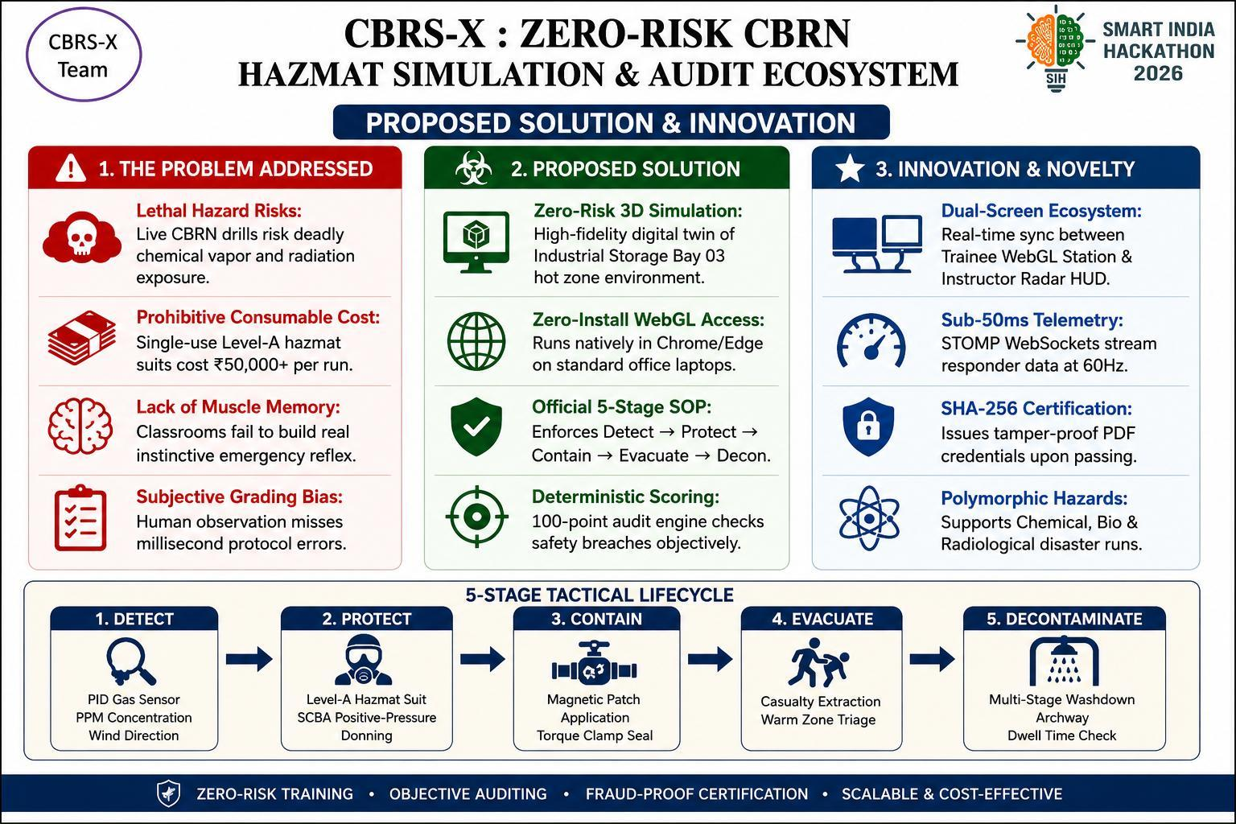
CBRS-X Team
PROPOSED SOLUTION

Slide 3
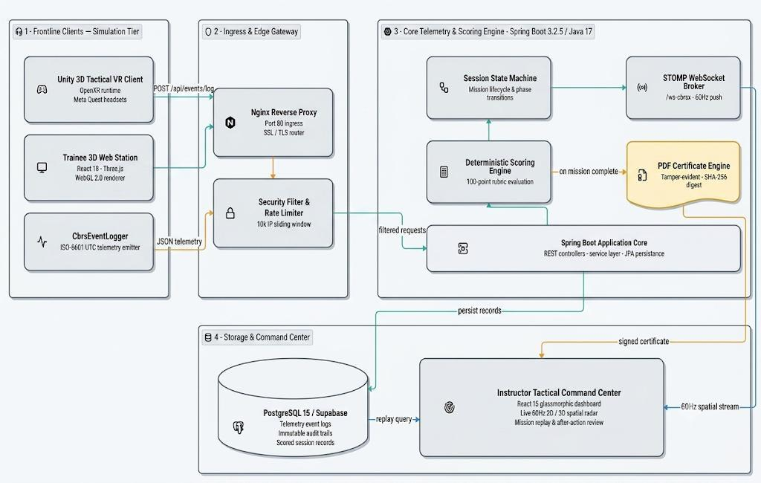
CBRS-X Team
TECHNICAL APPROACH
🛠️ TECHNOLOGY STACK
• Unity + WebGL: VR simulation environment
• React + Three.js: Trainee monitoring interface
• Java + Spring Boot: Backend & real-time telemetry
• PostgreSQL: Secure storage of trainee data
🔄 HOW IT WORKS
• Simulate ➔ Capture ➔ Evaluate ➔ Live Monitor ➔ Certify
• Tracks trainee actions in real time
• Automatically calculates a 100-point score
• Live tactical radar view for instructor
• Generates secure, tamper-proof SHA-256 certificate
📊 PERFORMANCE
✔ 46/46 Tests Passed (JUnit 5 + MockMvc)
✔ Supports up to 10,000 IP requests (LRU Rate Limiter)
✔ Smooth 60 FPS VR/WebGL experience

Slide 4
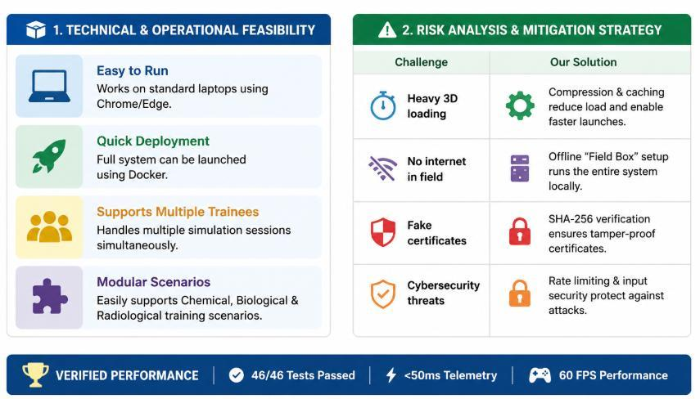
CBRS-X Team
FEASIBILITY AND VIABILITY

Slide 5
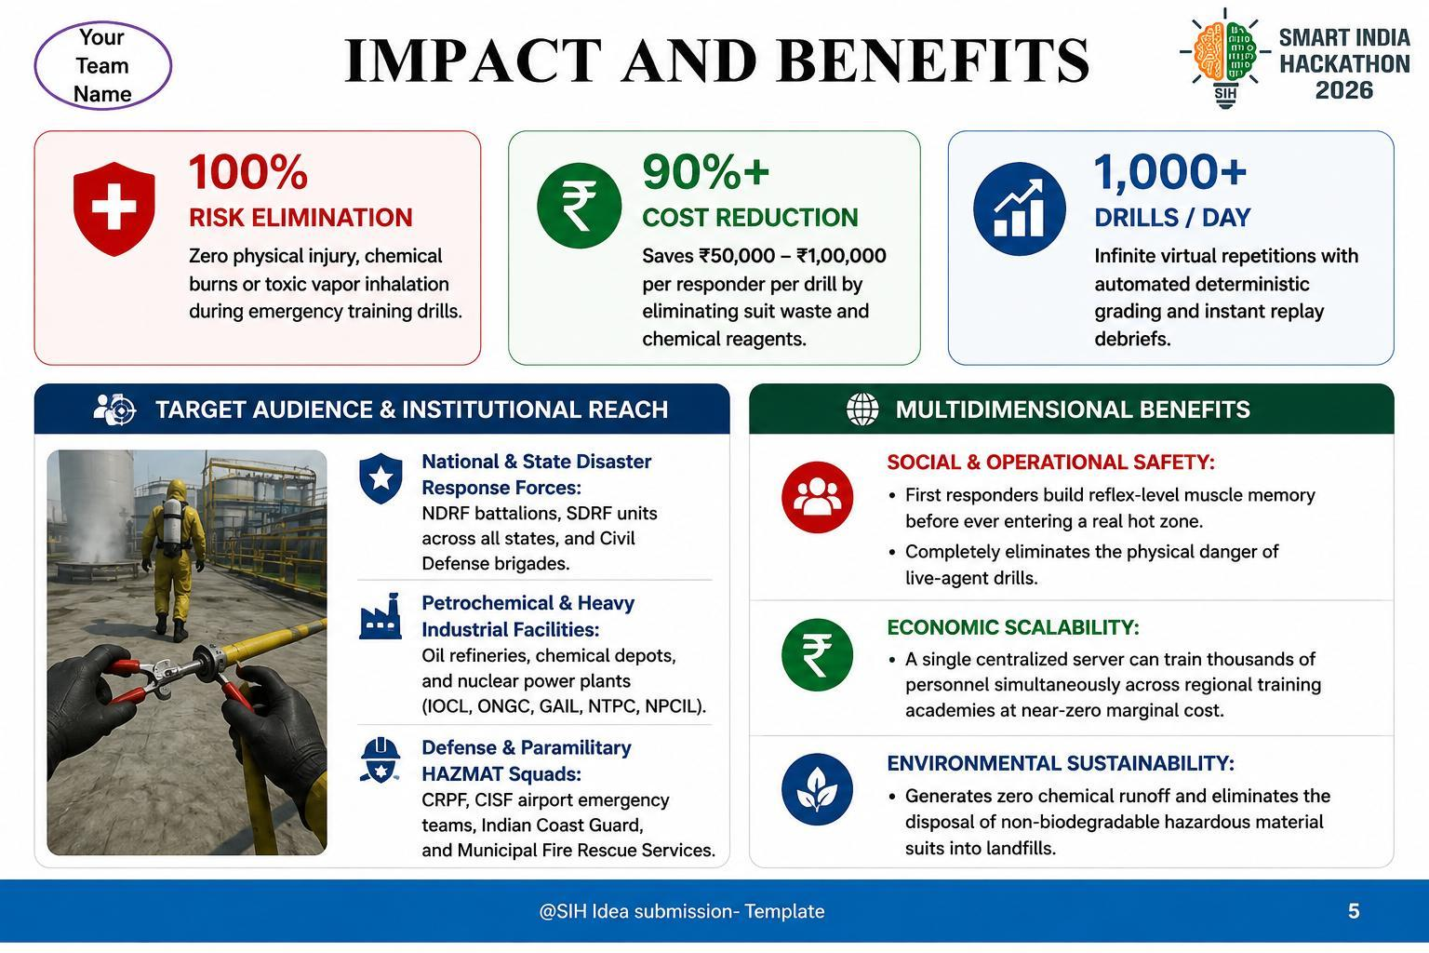
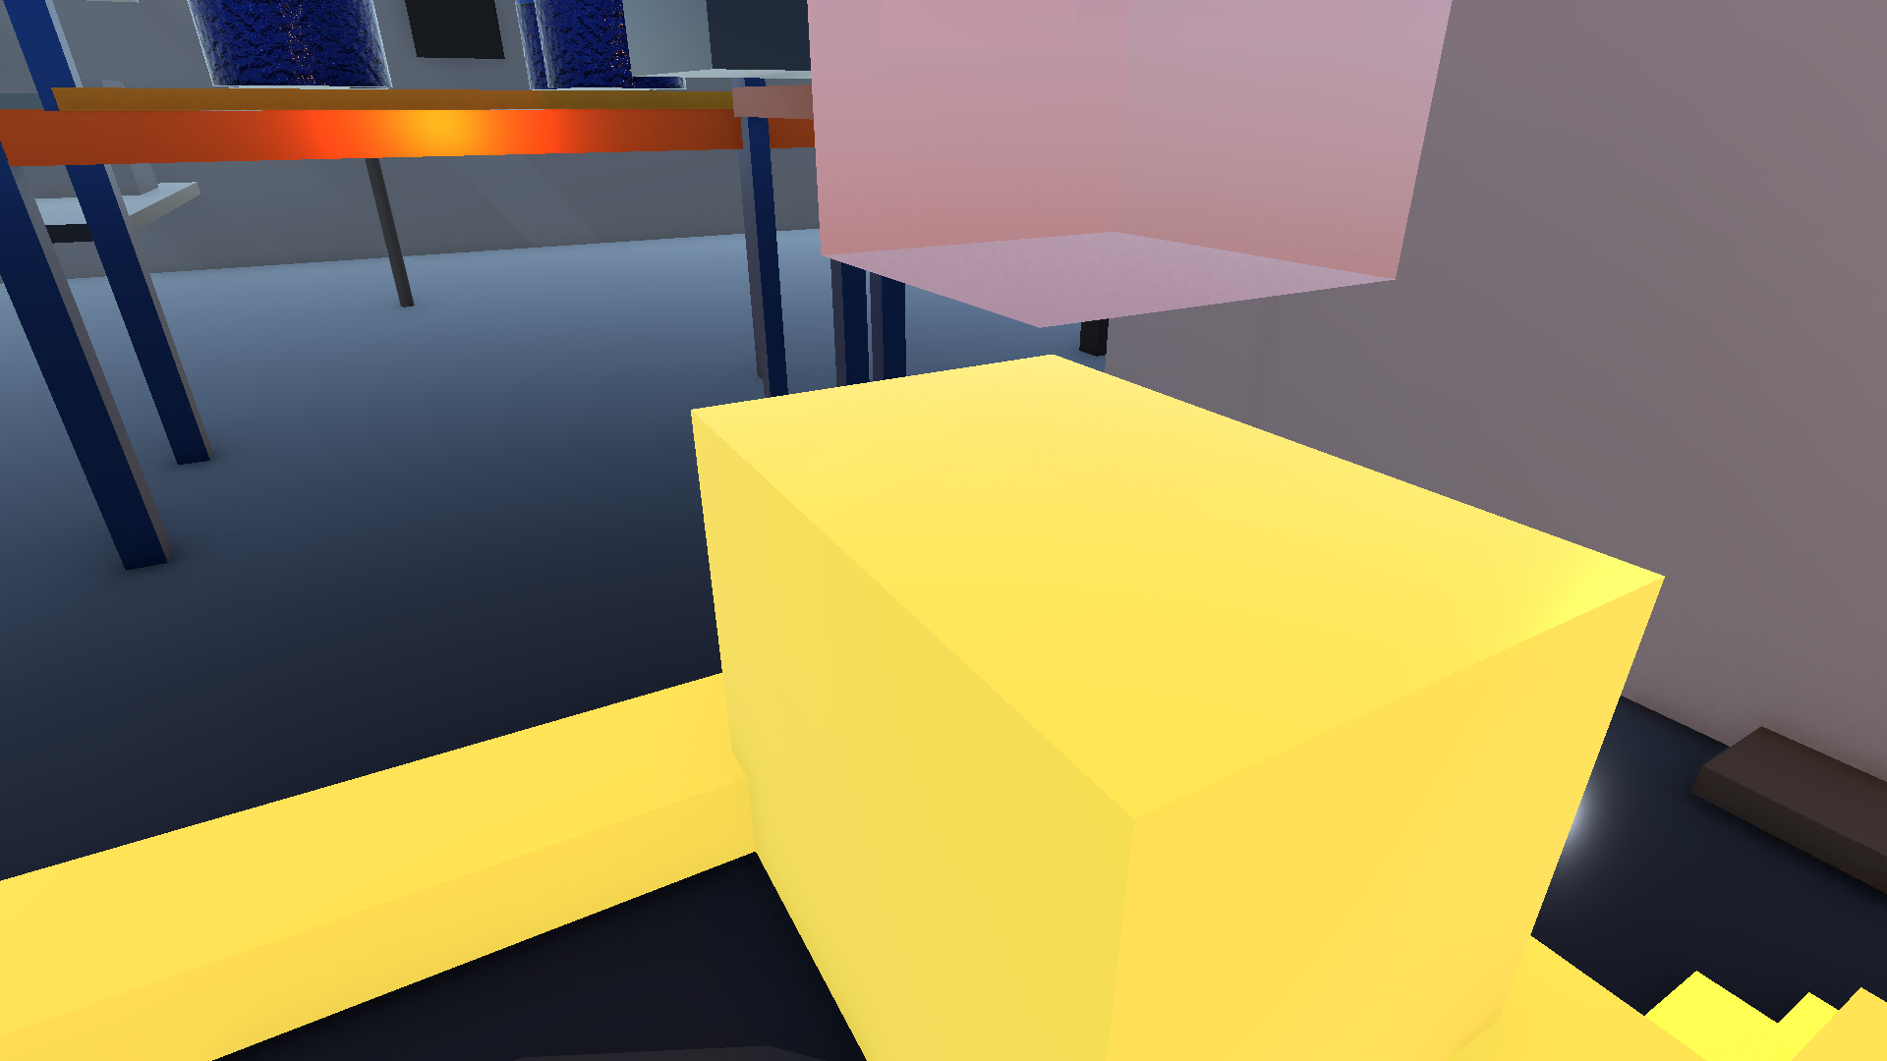
CBRS-X Team
IMPACT AND BENEFITS

Slide 6
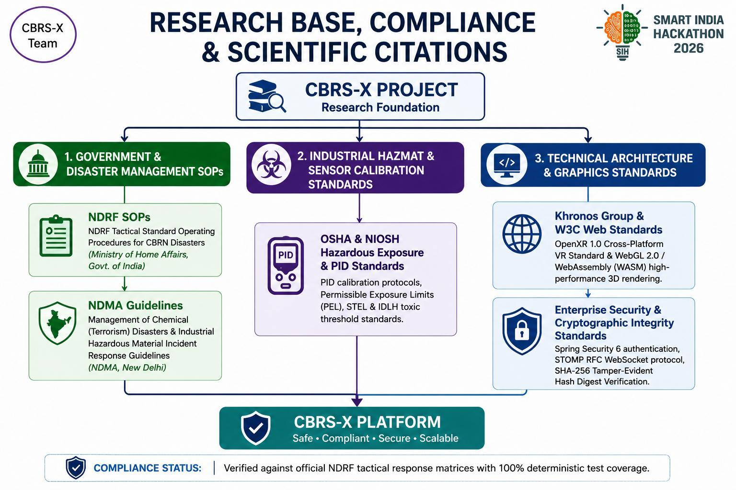
CBRS-X Team
RESEARCH AND REFERENCES

