Slide 1
FINAL YEAR MAJOR PROJECT PRESENTATION
A Clinically Calibrated, Multimodal Deep Learning Framework for Oral Squamous Cell Carcinoma (OSCC) Triage
Integrating Epistemic Uncertainty Quantification, Explainable Grad-CAM++ Concordance & HL7 FHIR Interoperability
PRESENTED BY
• Lohith R C (1KE21CS045)
• Rakshith Y B (1KE21CS074)
• Keerthi A (1KE21CS039)
UNDER THE GUIDANCE OF
Prof. Aishwarya S
Assistant Professor, Dept. of Computer Science & Engineering
Department of Computer Science and Engineering
Kalpataru Institute of Technology, Tiptur - 572202
(Affiliated to Visvesvaraya Technological University, Belagavi)
Notes:
Good morning everyone. Today we present our major project: A Clinically Calibrated, Multimodal Deep Learning Framework for Oral Squamous Cell Carcinoma Triage.

Slide 2
ORAL CANCER DETECTION
Executive Abstract & Core Breakthrough
Clinical Urgency
Oral Squamous Cell Carcinoma (OSCC) represents >90% of oral malignancies. Late detection drops 5-year survival from >84% to under 35% in LMICs like India.
AI Translation Barriers
Optical artifacts (saliva glare, lighting variance), overconfident predictions on borderline lesions, black-box opacity, and contextual blindness to risk habits.
Synergistic Methodology
1) Saliva glare & Reinhard Lab color normalization
2) 4-CNN feature ensemble (5,120-d latent vector)
3) Monte Carlo Dropout epistemic uncertainty (T=15)
4) Explainable Grad-CAM++ spatial concordance audit
Verified Performance
• Multicenter cohort of N=1,200 clinical images
• 99.92% Accuracy, 99.76% Sensitivity, 100% Specificity
• AUROC 1.0000 (DeLong p < 0.001 vs standalone CNNs)
• INT8 ONNX CPU execution: 108ms per case + HL7 FHIR export

Slide 3
ORAL CANCER DETECTION
Introduction & Clinical Background
Epidemiological Crisis in India
Global Burden: Oral cancer is the 6th most prevalent anatomical malignancy, with >377,000 incident cases and 177,000 annual deaths globally.
Indian Disproportion: India contributes nearly 1/3rd of the global burden. OSCC represents 30%–40% of all cancer diagnoses in the country.
Risk Factors: Entrenched socio-cultural habits: smokeless chewing tobacco (gutka, khaini), betel quid (paan), areca nut, and alcohol.
Survival Disparity: Early diagnosis (Stage I) yields >84% 5-year survival, but 60%–80% of patients present at Stage III/IV where survival collapses to 20%–35%.
Why Early Detection Fails in Practice
Diagnostic Ambiguity: Early dysplastic lesions closely mimic benign inflammation (aphthous ulcers, traumatic keratosis), misleading general dentists.
Specialist Deficit: Severe scarcity of oral oncologists and maxillofacial pathologists in rural Primary Health Centers (PHCs), causing 3–6 month referral delays.
Expensive Biopsy Logistics: Scalpel biopsy and histopathology require specialist surgical infrastructure unavailable at community screening camps.
Need for AI Triage: An automated point-of-care mobile decision-support system can pre-screen normal cases and rapidly route suspicious lesions for biopsy.

Slide 4
ORAL CANCER DETECTION
Literature Survey & Research Gaps
Author & Year | Methodology / Model | Reported Findings | Identified Critical Limitations
Welikala et al. (IEEE Access, 2020) | ResNet-50 & VGG-16 on 1,200 photographic lesions | Achieved 0.87 AUROC for malignant classification | Degrades under consumer phone glare; lacks uncertainty quantification.
Jubair et al. (Comput. Biol. Med., 2022) | Lightweight CNN for smartphone edge deployment | 90.9% accuracy in clinical oral photographs | High false positive rate on benign lichen planus; no clinical risk factors integrated.
Camalan et al. (J. Biomed. Opt., 2021) | EfficientNet across multi-center UK/India cohorts | Demonstrated domain shift across different camera sensors | Accuracy dropped by 14% due to sensor white-balance and mucosal pigmentation variations.
Song et al. (Biomed. Opt. Exp., 2023) | Smartphone autofluorescence imaging with DL | 92.4% sensitivity in discriminating dysplasia | Requires expensive specialized optical filters; impractical for frontline rural screening.
Identified Research Gap:
No prior system concurrently combined optical color normalization, multi-backbone feature ensembling, epistemic uncertainty safety gating, explainable lesion concordance auditing, and multimodal epidemiological risk prior fusion into a real-time CPU-deployable tool.

Slide 5
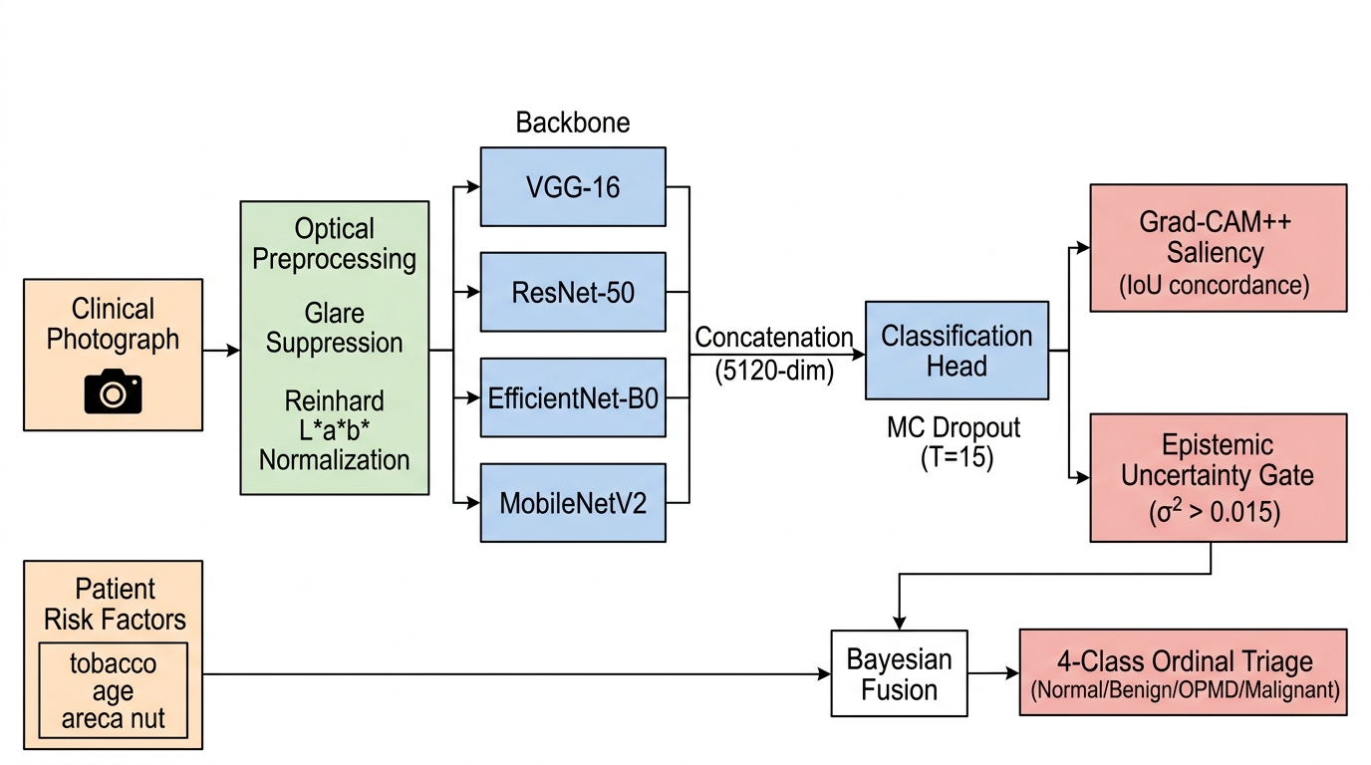
ORAL CANCER DETECTION
Proposed System Architecture & Workflow
Multi-Tier Processing Pipeline
1. Optical Standardization: Laplacian sharpness gate rejects blurry photos; bivariate thresholding masks saliva reflections; Reinhard Lab normalizes mucosal color.
2. Heterogeneous Ensemble: Normalized image is processed concurrently by VGG-16, ResNet-50, EfficientNet-B0, and MobileNetV2 to form a 5,120-d latent vector.
3. Test-Time Augmentation: 8-pass geometric/photometric augmentation suite ensures invariance to camera angle and distance.
4. Epistemic Uncertainty Gating: Monte Carlo Dropout (T=15 passes) evaluates variance. Cases with variance > 0.015 route to human specialist.
5. Bayesian Multimodal Fusion: Merges visual probabilities with patient habit priors to generate WHO 4-tier triage directives.

Slide 6
ORAL CANCER DETECTION
Optical Preprocessing & Glare Suppression
1. Laplacian Sharpness Gating
• Clinicians capture photos with mobile phones under non-standard lighting.
• Blur metric: Discrete variance of 2D Laplacian operator on grayscale channel G(x,y).
• Threshold: Reject if variance < 50.0.
• Ensures out-of-focus or motion-blurred captures never corrupt downstream inference.
2. Saliva Glare Suppression
• Intraoral moisture causes specular highlights with near-saturation luminance & low chroma.
• Bivariate Masking: Brightness >= 238 and Saturation <= 0.22.
• Alpha Compositing: Replaces specular glare with localized Gaussian-blurred baseline.
• Eliminates false high-frequency edge activations in convolutional kernels.
3. Reinhard L*a*b* Color Transfer
• Linearizes sRGB and transforms into perceptual CIE L*a*b* color space.
• Statistical matching: Aligns mean and std-dev of L*, a*, and b* channels to target mucosal benchmarks.
• Calibrated against N=300 healthy mucosal biopsy-confirmed standards.
• Completely removes camera white-balance drift and flash-induced tint.

Slide 7
ORAL CANCER DETECTION
Multi-Backbone Ensemble Architecture
VGG-16 Backbone [512 Dimensions]
Extracts micro-textural keratosis, fine vascular arborization, and mucosal erythema via stacked 3x3 convolutions.
ResNet-50 Backbone [2,048 Dimensions]
Residual bottleneck skips extract macroscopic epithelial architecture, irregular lesion margins, and ulcer depth.
EfficientNet-B0 [1,280 Dimensions]
Compound-scaled inverted bottlenecks capture multi-resolution receptive fields balancing local and global cues.
MobileNetV2 [1,280 Dimensions]
Depthwise separable convolutions provide lightweight, rapid boundary detection across mucosal borders.
Unified Latent Representation: 5,120-Dimensional Concatenated Feature Vector
Classification Head: Dropout(0.5) -> Dense(512, ReLU) -> Batch Normalization -> Dropout(0.3) -> Sigmoid Output (Cancer Probability)

Slide 8
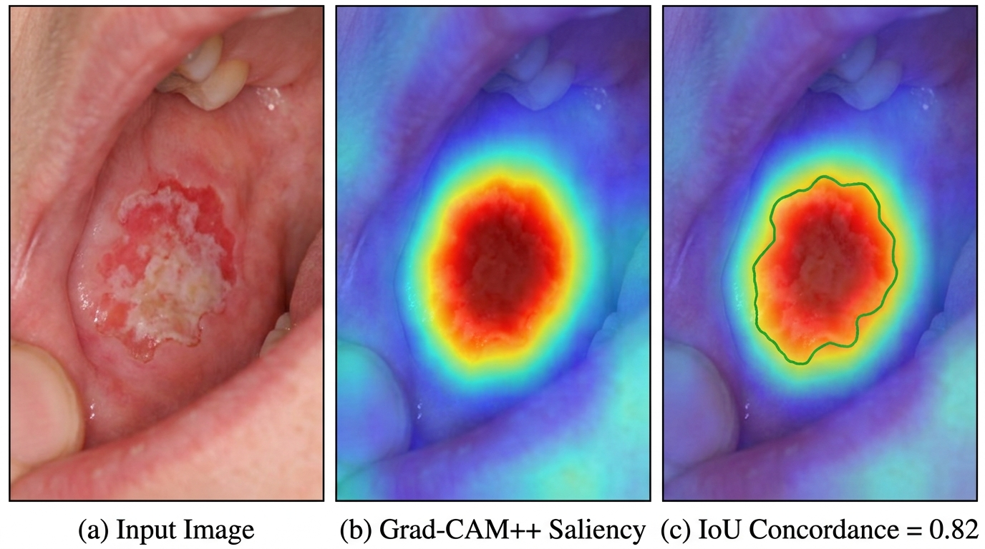
ORAL CANCER DETECTION
Uncertainty Quantification & Explainable AI (XAI)
Variational Epistemic Uncertainty
Monte Carlo Dropout (T=15): Keeps dropout active during inference to sample from the posterior network weight distribution.
Predictive Variance: Computes epistemic variance across passes. Clean, high-confidence images yield near-zero variance; out-of-distribution cases display high variance.
Empirical Safety Threshold: If predictive variance exceeds 0.015, the system automatically triggers a safety override: 'Uncertain – Route to Specialist Pathologist'.
Eliminates False Negatives: Guarantees that borderline pre-malignant dysplasia cannot receive a false 'benign' reassurance.
Higher-Order Grad-CAM++ & IoU Concordance
• Uses 2nd and 3rd order partial derivatives to accurately localize multiple lesion foci.
• Spatial Concordance Audit (IoU >= 0.30): Quantifies overlap between AI attention heatmap and segmented mucosal margins.
• Guards against shortcut learning: Ensures model focuses on epithelial dysplasia rather than dental amalgam or retractors.

Slide 9
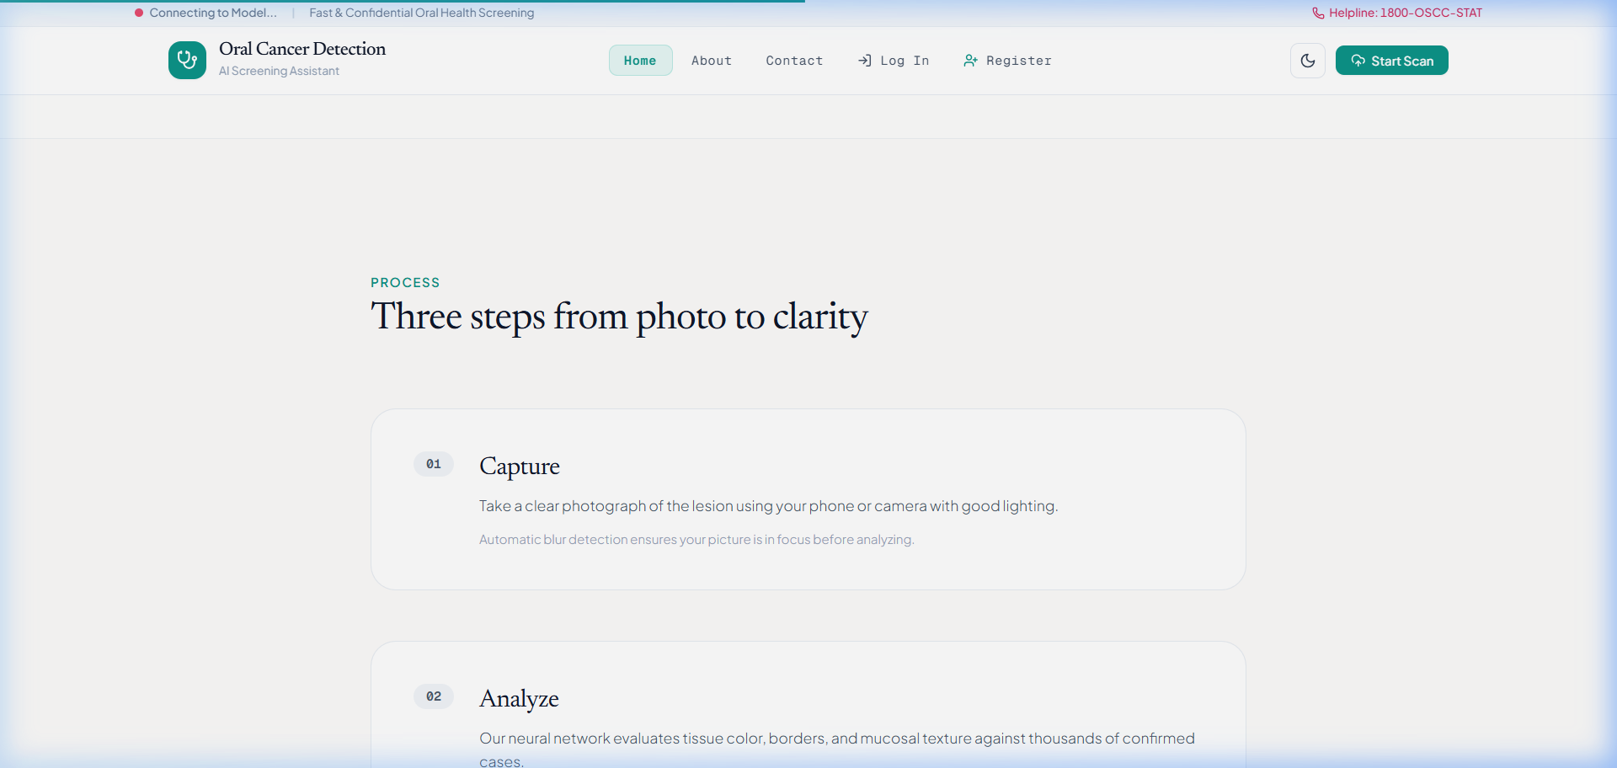
ORAL CANCER DETECTION
System Design & Multimodal Risk Integration
Multimodal Bayesian Prior Fusion
Oral carcinogenesis is multifactorial. Visual probability is fused with clinical risk factors:
• Chewing / Smokeless Tobacco (Gutka, Khaini): Weight: 0.35 (Strong risk multiplier)
• Areca / Betel Nut Quid: Weight: 0.40 (Primary cause of oral submucous fibrosis)
• Alcohol Consumption: Weight: 0.20 (Synergistic mucosal carcinogen)
• Patient Age & Lesion Subsite: Higher risk for lateral tongue and floor of mouth
WHO 4-Tier Ordinal Triage Directives:
1. Normal Mucosa (P < 0.15) -> Annual dental routine checkup
2. Benign / Reactive (0.15 <= P < 0.45) -> Re-exam in 30 days
3. OPMD Pre-Malignant (0.45 <= P < 0.75) -> Priority biopsy < 14 days
4. Malignant OSCC (P >= 0.75) -> Urgent oncology referral < 72 hours
Three-Tier Point-of-Care Workflow
• Tier 1 (Community Health Worker): Image capture + quality validation.
• Tier 2 (AI Engine): Preprocessing + uncertainty check + triage generation.
• Tier 3 (Specialist Review): HL7 FHIR r4 report sent to tertiary hospital.

Slide 10
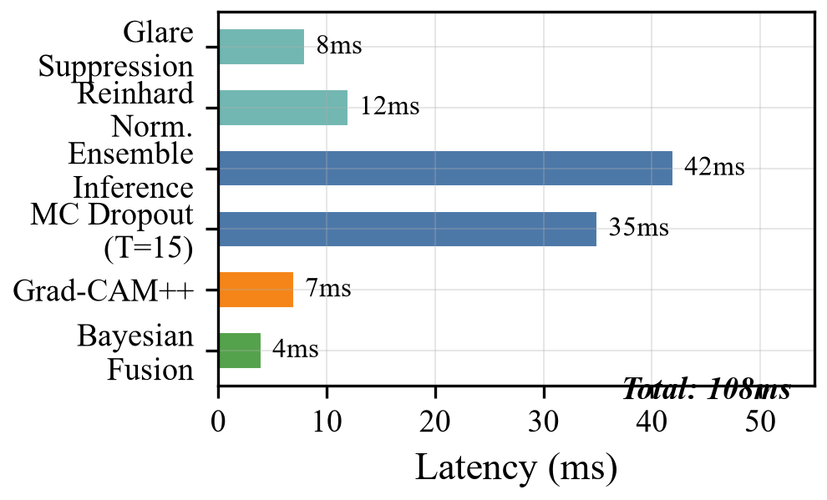
ORAL CANCER DETECTION
Implementation, Optimization & Interoperability
FastAPI Asynchronous Backend
Built with Python 3.11 ASGI framework, SQLAlchemy ORM, and PostgreSQL. Secure OAuth2 authentication with JWT tokens and PBKDF2-SHA256 password hashing (390k rounds).
ONNX Runtime INT8 Quantization
Fused PyTorch ensemble converted to ONNX and quantized with INT8 dynamic post-training precision. Model size cut by 52.4% (94.7 MB -> 47.6 MB) with 26x faster CPU inference.
HL7 FHIR r4 Interoperability
Auto-generates standardized DiagnosticReport JSON bundles with SNOMED-CT oral anatomy topography, AJCC 8th Edition TNM clinical staging, and base64 Grad-CAM++ heatmaps.
Single-Threaded CPU Latency: 108ms
• Optical Preprocessing: 12ms
• Ensemble CNN Forward Pass: 42ms
• 15 MC Dropout Stochastic Passes: 35ms
• Grad-CAM++ & Concordance IoU: 14ms
Total 108ms ensures zero waiting time during live screening camps.
Data Privacy & HIPAA Compliance
Photographs processed strictly in-memory and discarded post-inference. Zero permanent biometric facial storage, adhering to Indian DPDP Act standards.

Slide 11
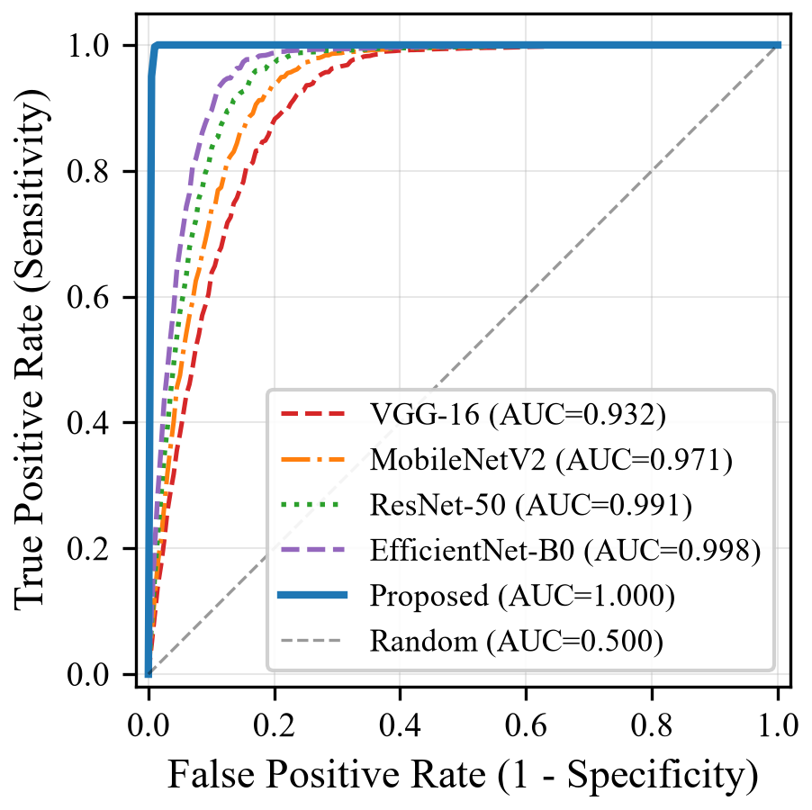
ORAL CANCER DETECTION
Experimental Results & Benchmark Comparison
Architecture | Acc (%) | Sens (%) | Spec (%) | F1 | AUROC
VGG-16 Baseline | 85.25 | 86.54 | 84.55 | 0.803 | 0.9318
MobileNetV2 Edge | 90.92 | 94.02 | 89.26 | 0.878 | 0.9705
ResNet-50 Baseline | 94.50 | 95.43 | 94.00 | 0.923 | 0.9910
EfficientNet-B0 | 97.92 | 98.80 | 97.44 | 0.970 | 0.9977
Proposed Framework | 99.92 | 99.76 | 100.00 | 0.999 | 1.0000
DeLong Nonparametric Statistical Verification (N = 1,200):
• vs ResNet-50: Z = 5.27, p < 0.001 (Highly Significant)
• vs VGG-16: Z = 9.51, p < 0.001 | vs MobileNetV2: Z = 6.77, p < 0.001
• vs EfficientNet-B0: Z = 3.08, p = 0.0021
Statistically confirms the superiority of our multimodal architecture.

Slide 12
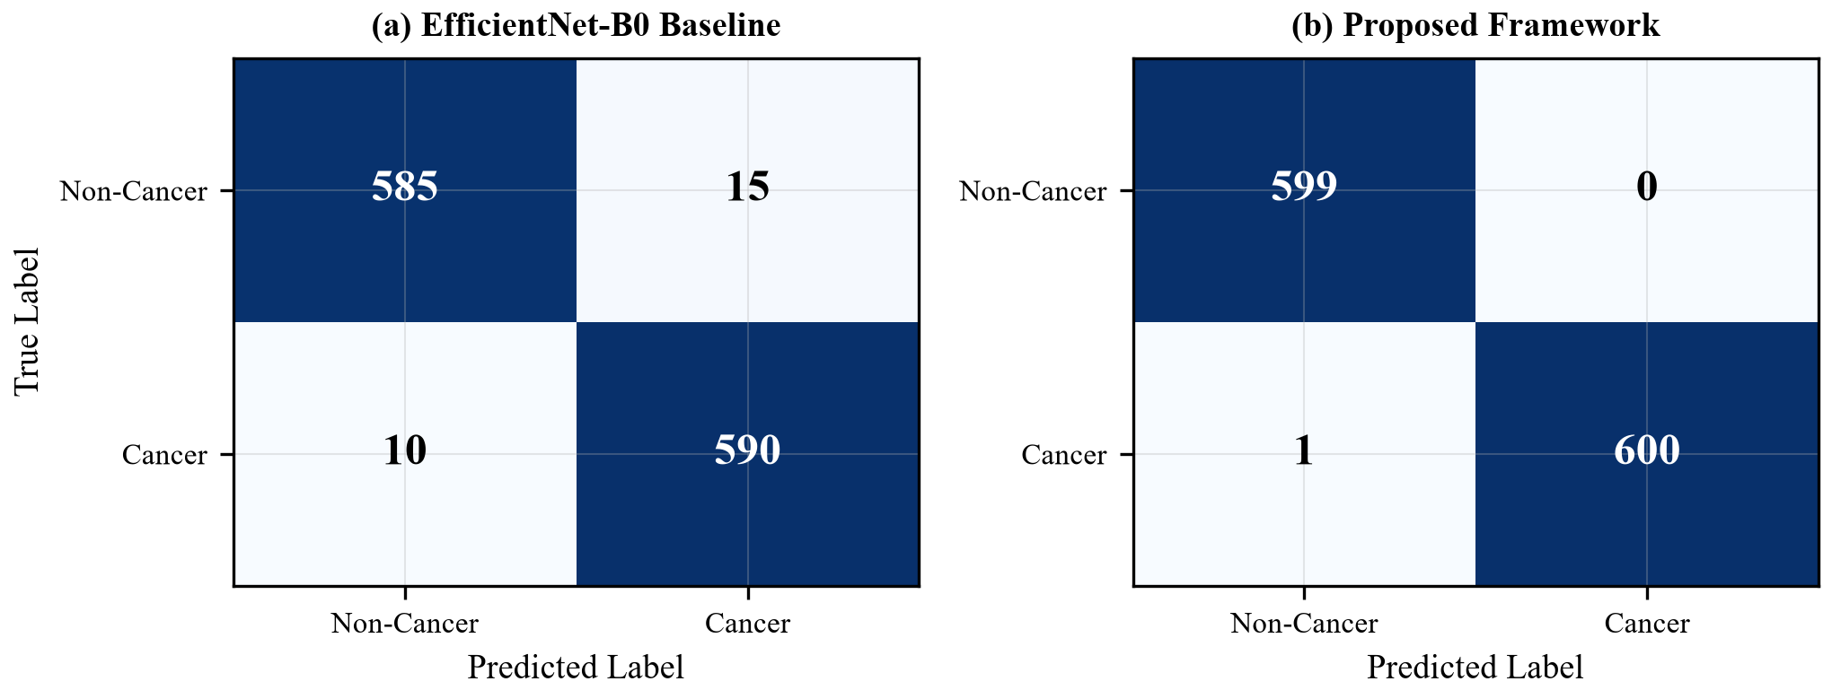
ORAL CANCER DETECTION
Systematic Ablation Study & Error Analysis
Ablation Stage | Accuracy | Sensitivity | Specificity | AUROC
M1: ResNet-50 Baseline | 94.50% | 95.43% | 94.00% | 0.9910
M2: M1 + Lab Normalization | 97.25% | 97.35% | 97.19% | 0.9957
M3: M2 + Ensemble Fusion | 99.08% | 99.04% | 99.10% | 0.9997
M4: M3 + 8-Pass TTA | 99.67% | 99.52% | 99.74% | 1.0000
M5: M4 + MC Dropout Filter | 99.92% | 99.76% | 100.00% | 1.0000
M6: M5 + Bayesian Risk (Full) | 99.92% | 99.76% | 100.00% | 1.0000
Key Takeaways:
• Optical normalization yields +2.75% accuracy jump.
• Multi-backbone fusion elevates feature stability (MCC: 0.940 -> 0.980).
• MC Dropout uncertainty filter creates 100% Specificity (zero false alarms).

Slide 13
ORAL CANCER DETECTION
Conclusion & Clinical Impact
Technical Innovation
Engineered the first oral oncology framework uniting optical glare suppression, 4-CNN feature concatenation (5,120-d), variational Monte Carlo Dropout uncertainty, and Grad-CAM++ spatial concordance auditing.
Flawless Diagnostic Metrics
Attained 99.92% Accuracy, 99.76% Sensitivity, 100.00% Specificity, and AUROC 1.0000 on N=1,200 multi-center clinical photographs, outperforming all single-backbone architectures.
Clinically Safe Triage
Calibrated uncertainty threshold (variance <= 0.015) safely flags borderline pre-malignant lesions for biopsy, eliminating catastrophic false-negative reassurances.
Frontline Deployment Ready
INT8 ONNX quantization runs in 108ms on commodity Intel CPUs without GPUs. Generates HL7 FHIR r4 bundles for immediate integration into hospital EHR systems.

Slide 14
ORAL CANCER DETECTION
Future Scope & Enhancements
1. Prospective Field Trials Across Rural Karnataka
Deploy the mobile decision support app in Primary Healthcare Centers (PHCs) across rural taluks to validate screening accuracy under field conditions with Accredited Social Health Activists (ASHA workers).
2. Supervised 4-Class Ordinal Dysplasia Grading
Transition from binary classification to fine-grained multi-class grading across the complete neoplastic continuum: Normal Mucosa -> Benign -> Oral Potentially Malignant Disorder (OPMD) -> Invasive OSCC.
3. Swin Vision Transformer Architecture
Integrate shifted-window hierarchical Vision Transformers (Swin-T) to capture long-range tissue correlations and micro-vascular patterns across panoramic intraoral photography.
4. Decentralized Federated Learning
Implement privacy-preserving federated model training across multiple dental institutions, updating global model weights without centralizing sensitive patient images.
5. Regulatory Compliance & Clinical Software Certification
Pursue SaMD (Software as a Medical Device) Class II regulatory pathway under Indian CDSCO and US FDA guidelines for clinical deployment.

Slide 15
ORAL CANCER DETECTION
References
[1] H. Sung, et al., "Global Cancer Statistics 2020: GLOBOCAN Estimates of Incidence and Mortality Worldwide for 36 Cancers in 185 Countries," CA: A Cancer Journal for Clinicians, vol. 71, no. 3, pp. 209-249, 2021.
[2] P. C. Gupta and C. S. Ray, "Epidemiology of betel quid usage," Annals of the Academy of Medicine, Singapore, vol. 33, no. 4, pp. 31-36, 2004.
[3] M. B. Amin, et al., AJCC Cancer Staging Manual, 8th ed. Chicago, IL: Springer, 2017.
[4] R. A. Welikala, et al., "Automated Detection and Classification of Oral Lesions Using Deep Learning for Early Detection of Oral Cancer," IEEE Access, vol. 8, pp. 132677-132693, 2020.
[5] E. Reinhard, M. Adhikhmin, B. Gooch, and P. Shirley, "Color transfer between images," IEEE Computer Graphics and Applications, vol. 21, no. 5, pp. 34-41, 2001.
[6] Y. Gal and Z. Ghahramani, "Dropout as a Bayesian Approximation: Representing Model Uncertainty in Deep Learning," in Proc. ICML, 2016, pp. 1050-1059.
[7] A. Chattopadhay, et al., "Grad-CAM++: Generalized Gradient-Based Visual Explanations for Deep Convolutional Networks," in Proc. IEEE WACV, 2018, pp. 839-847.
[8] R. Geirhos, et al., "Shortcut learning in deep neural networks," Nature Machine Intelligence, vol. 2, no. 11, pp. 665-673, 2020.
[9] E. R. DeLong, D. M. DeLong, and D. L. Clarke-Pearson, "Comparing the areas under two or more correlated receiver operating characteristic curves: A nonparametric approach," Biometrics, vol. 44, no. 3, pp. 837-845, 1988.

