Slide 1
AI Health Monitoring
Guide
❤
A LightGBM-powered health risk prediction app with Gemini explanation, RAG, Q&A, voice summary, and health-report summarization.
Main file: health_monitor_FINAL.py
Requirements: requirements_health_monitor_FINALtxt
Risk: Medium
Patient monitoring assistant
Model
GenAI
Interface
LightGBM
Gemini
Streamlit
AI Health Monitoring Guide | LightGBM + GenAI + RAG + Voice
Notes:
Introduce the project as an AI-powered health monitoring assistant. Mention that it predicts risk from patient readings and explains results using GenAI layers.

Slide 2
Problem & User Need
Daily health data is available, but interpretation is difficult.
👵
Who is affected?
📉
What goes wrong?
💡
Our opportunity
Elderly patients with chronic conditions
Caregivers who need simple guidance
Families monitoring readings every day
One day’s reading can mislead
Trends are hard to interpret
Generic alerts do not explain why
Use 3–5 day history
Predict risk level
Explain in patient-friendly language
AI Health Monitoring Guide | LightGBM + GenAI + RAG + Voice
Notes:
Explain that the core problem is not collecting readings, but understanding them. Our project tries to make the interpretation clear and usable.

Slide 3
Proposed Solution
A hybrid ML + GenAI health monitoring assistant.
User enters readings
History features
LightGBM model
GenAI layer
glucose, BP, pulse, cholesterol
3-day and 5-day averages
predicts risk label
explains + answers + voice
Final output: Risk Label + Explanation + Weekly Trend + Voice Summary + Q&A
Designed for demo, presentation and academic evaluation
AI Health Monitoring Guide | LightGBM + GenAI + RAG + Voice
Notes:
Walk through the full flow from user input to ML prediction and GenAI output.

Slide 4
Dataset & Feature Engineering
The model uses both current readings and recent history-aware features.
Input columns
History features
Guideline features
Patient ID, Date, Day
Age, Gender, BMI
Blood Glucose
Systolic / Diastolic BP
Pulse, Cholesterol
Diabetes, Hypertension, Heart Disease
3-day previous average
5-day previous average
Difference from yesterday
Difference from 3-day average
High-risk days in last 5 days
BP stage
Glucose band
Cholesterol band
Comorbidity count
Rule-based risk score
AI Health Monitoring Guide | LightGBM + GenAI + RAG + Voice
Notes:
Highlight that the model does not only use today’s readings. It also uses history and engineered features to capture trends.

Slide 5
Model Development
LightGBM selected as final model for structured health-risk prediction.
Training
Validation
Testing
Final Model
70%
20%
10%
LightGBM
Why LightGBM?
Model alternatives tested
Strong for tabular datasets
Fast training and prediction
Handles non-linear health patterns
Works well with engineered trend features
Random Forest
XGBoost
LightGBM
Other PyCaret baseline models
AI Health Monitoring Guide | LightGBM + GenAI + RAG + Voice
Notes:
Mention that multiple models were tested, but LightGBM was chosen because it had the strongest overall testing performance.

Slide 6
Model Performance
LightGBM performed strongly across training, validation and testing.
Key results
Training accuracy: 100%
Validation accuracy: 98.78%
Testing accuracy: 99.02%
Testing weighted F1: 99.01%
Important limitation
Rare critical-risk cases were limited in the split, so rare-class evaluation should be improved in future work.
AI Health Monitoring Guide | LightGBM + GenAI + RAG + Voice
Notes:
Present the numbers clearly. Be honest that rare Critical class evaluation needs more samples.

Slide 7
GenAI Integration Layers
The project goes beyond prediction by making outputs explainable and interactive.
RAG Layer
Document / Image
Summarization
Gemini Explanation
Q&A Assistant
🔎
✨
💬
Retrieves guidance snippets and summarizes uploaded health reports, scans or PDFs in simple language.
Turns prediction into simple patient-friendly language
Allows follow-up questions about risk, trends, diet and uploaded report summary
Weekly Insight
Voice Summary
📅
🔊
Summarizes what improved or worsened over 7 days
Reads a short health summary for easier access
AI Health Monitoring Guide | LightGBM + GenAI + RAG + Voice
Notes:
Explain that these GenAI layers make the app more human-friendly and interactive, rather than just showing a raw prediction.

Slide 8
System Architecture
A simple Streamlit app connects data, model, RAG and GenAI outputs.
Patient Dataset
Uploaded Report / Image
Preprocessing
+ Feature Engineering
LightGBM
Risk Prediction
RAG + Gemini
GenAI Outputs
Streamlit UI
Demo App
Main App File: health_monitor_FINAL.py
AI Health Monitoring Guide | LightGBM + GenAI + RAG + Voice
Notes:
Show how the pipeline works at a high level: data, feature engineering, ML prediction, GenAI outputs, and Streamlit interface.

Slide 9
Demo Flow
What the evaluator will see while using the app.
Select Patient ID
Upload health report / image
Enter Today’s Readings
1
2
The app updates the patient’s last 5 days of readings and can summarize the uploaded document.
User enters glucose, BP, pulse, cholesterol and health conditions.
Predict Risk
Use GenAI Layers
3
4
LightGBM predicts risk label and displays health index information.
Generate explanation, weekly insight, voice summary, uploaded-report summary and Q&A.
AI Health Monitoring Guide | LightGBM + GenAI + RAG + Voice
Notes:
Use this slide to explain the demo in a simple sequence. It helps the audience understand before seeing the live app.

Slide 10
Limitations & Future Scope
Clear next steps to make the system stronger.
Current limitations
Future improvements
Gemini free-tier quota may limit live demo
Rare Critical class needs more samples
System is a support tool, not a diagnosis tool
Dataset quality affects model reliability
Doctor/caregiver report generator
Autonomous alert escalation
Multilingual Q&A and voice output
Better rare-risk data collection
Deployment with secure API management
Final positioning: GenAI-enabled health monitoring assistant with early agentic elements.
AI Health Monitoring Guide | LightGBM + GenAI + RAG + Voice
Notes:
End by being honest about limitations while showing clear future scope.

Slide 11
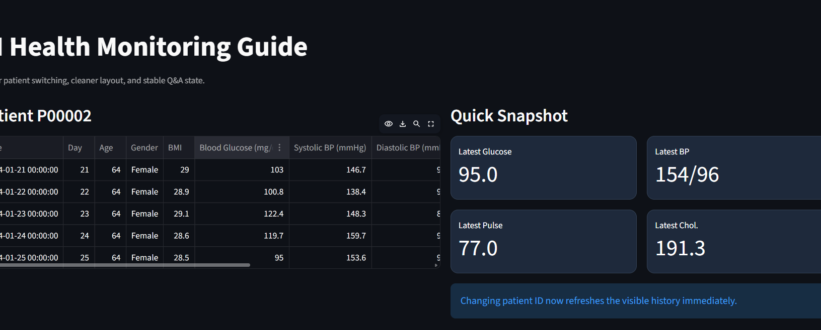
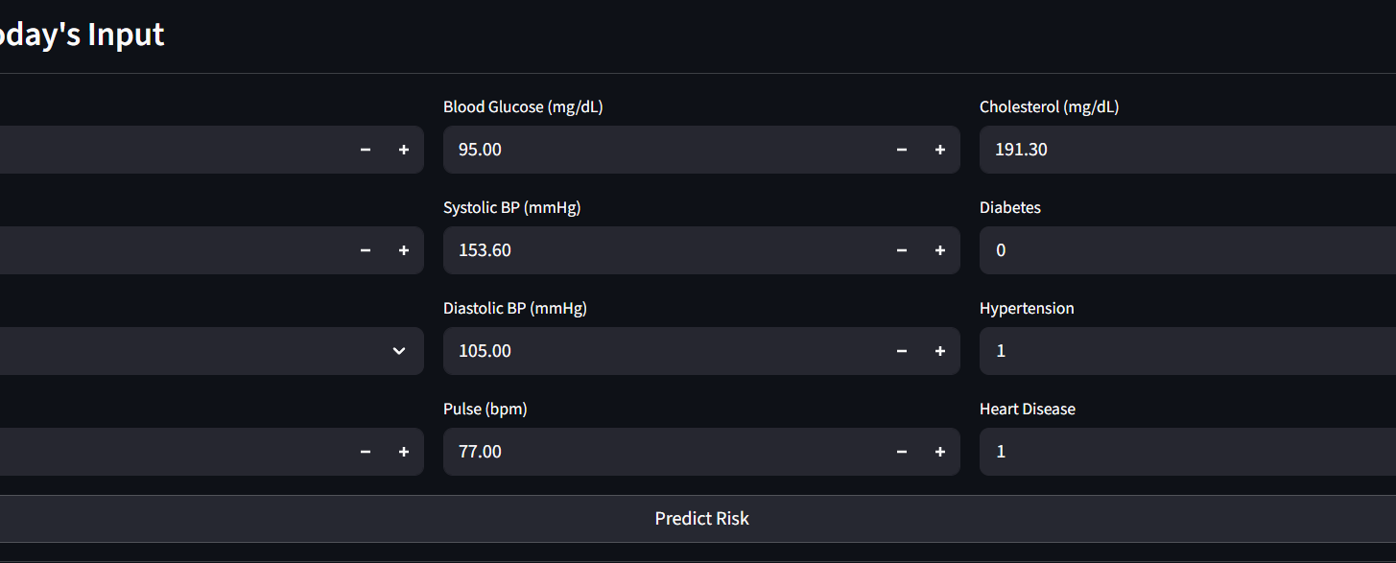
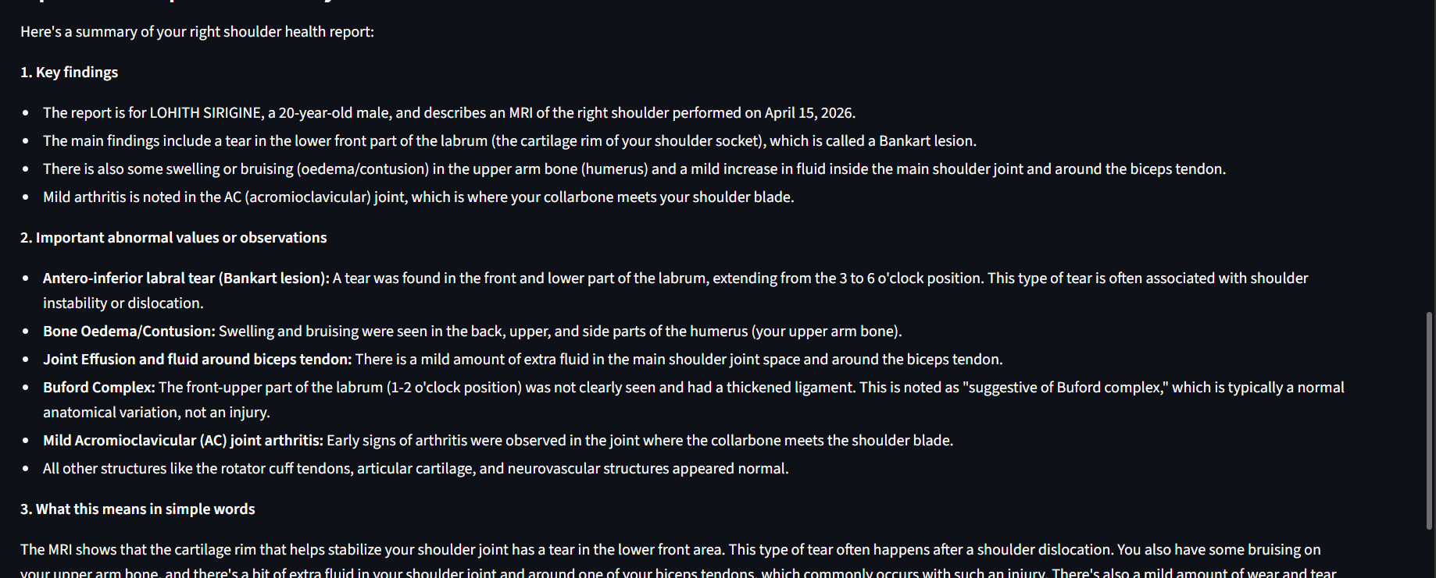
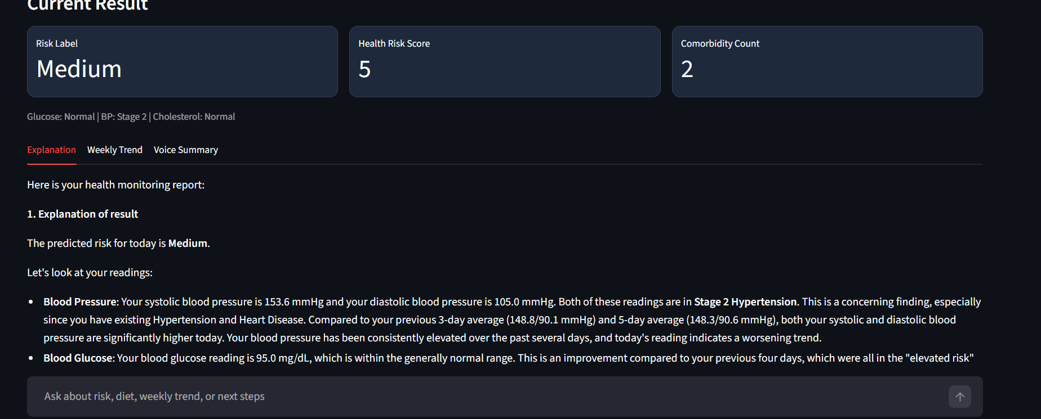
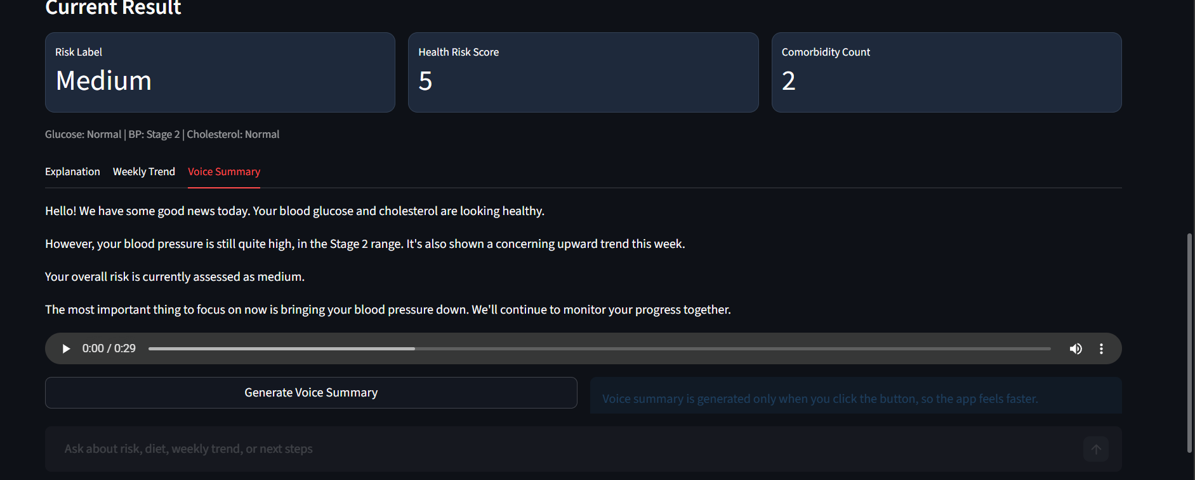
App Interface
Patient history & quick snapshot
Today's input form
Predicted result & explanation
Uploaded report summary

