Slide 2
Make FHIR work for you effectively
Grahame Grieve
HL7 FHIR Product Director
11-Oct 2017

Slide 3
Lightning Introduction to FHIR
Web Technologies
“Resources”
JSON / XML
HTTP / RESTful API
URIs / linked data / RDF
Other Facilities
Terminology Services
Profiling Language
Functional Scope
Patient / Provider Administration
Core Clinical Data Set
Medications Management
Documents, Scheduling
Care Planning / Process
Financial Mgmt / Claims
Decision Support Framework

Slide 4
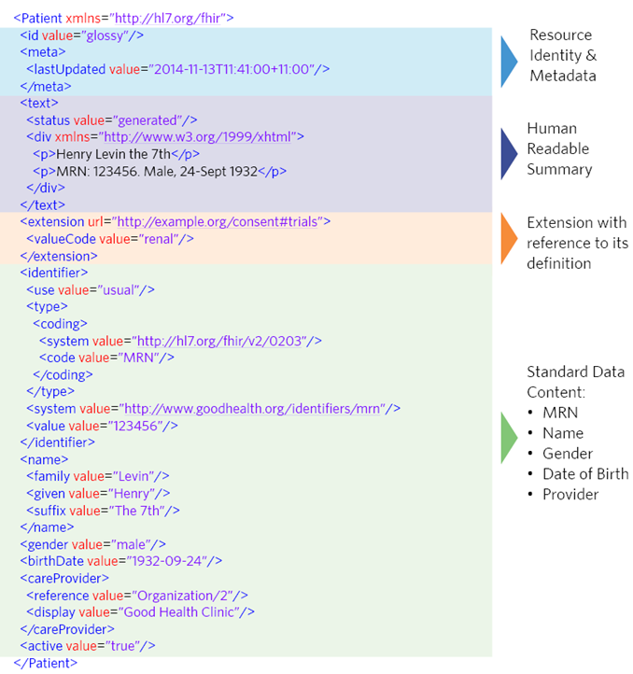

Slide 5
Lightning Introduction to FHIR
C/R/U/D/E
Create: POST [base]/[Type] (e.g. /open/Patient)
Read: GET [base]/[Type]/[id] (e.g./open/Patient/123) + Search: GET [base]/[Type]?params (e.g. name=Cerner)
Update: PUT [base]/[Type]/[id]
Create: DELETE [base]/[Type]/[id]

Slide 6
Understanding the FHIR Process

Slide 7
The FHIR Ethos
Focus on Implementers
Target support for common scenarios
Leverage cross-industry web technologies
Require human readability as base level of interoperability
Make content freely available
Support multiple paradigms & architectures
Demonstrate best practice governance

Slide 8
Focus on Implementers
Specification is written for one target audience: implementers
Rationale, modeling approaches, etc. kept elsewhere
Developers / Architects / business analysts / clinical rule makers
Publicly available test servers
Multiple open source libraries from beginning
Java, C#, Pascal, Javascript, Swift, Python etc
Connectathons to verify specification approaches
Instances you can read and understand
Lots of examples (and they’re valid too)

Slide 9
Common Scenarios
Focus on scenarios implementers ask for
Inclusion of content in core specification is based on core content rule
“We only include data elements if we are confident that most normal implementations using that resource will make use of the element”
Keep disagreements & weird cases out of the specification
Easy to say, governance challenge to achieve
Resources are simple and easy to understand and use

Slide 10
Human Readability
Clinical Documents have both narrative and data
The data / narrative dynamic exists throughout the process
In FHIR, every resource has a human-readable form (XHTML)
Can be direct rendering or human entered
Makes lots of processing easy
Duality of text vs data is an ongoing clinical issue
Within teams – use data with some narrative
Cross team referrals – narrative with some data

Slide 11
Freely Available
Published at http://hl7.org/fhir
License: Creative Commons Public Domain (CC0) “No Rights Reserved”
The most open of open licenses: HL7 waived it’s rights
HL7 owns the “FHIR” trademark & defends it
Fair use of the name and icon is great
Trademark use (use FHIR for your own product/event) needs written permission (see http://fhir.org)

Slide 12
The FHIR Ethos
Focus on Implementers
Target support for common scenarios
Leverage cross-industry web technologies
Require human readability as base level of interoperability
Make content freely available
Support multiple paradigms & architectures
Demonstrate best practice governance

Slide 13
The Maturity process
Indicates level of stability:
FMM1 – 1st Draft of Resource is “done”, no build warnings
FMM2 – Tested at approved Connectathon
FMM3 – Passes QA, has passed ballot
FMM4 – Tested across scope, published, prototypes
FMM5 – 5+ production implementations in multiple countries
Normative - Production experience confirmed
Breaking changes at level 4 and 5 need community discussion. No breaking changes once normative

Slide 14
Connectathons
Fundamental Development step in FHIR:
Add functionality, have a connectathon to test it
Story board that tests out connections between systems
Who comes? (>200, growing continuously)
Anyone who wants the functionality to work
No interest: no connectathon, no maturity
Any organization can hold a ‘FHIR connectathon’ (some rules)
IHE also have connectathons - more formal process

Slide 15
Profiling FHIR

Slide 16
Healthcare Variability
In most areas of healthcare standards, there is wide variability
No central clinical authorities
Permutation of biological and sociological complexity
Fractal use cases
Economics favours balkinization
Externalizing complexity
Legacy Data
Much confusion about the problem

Slide 17
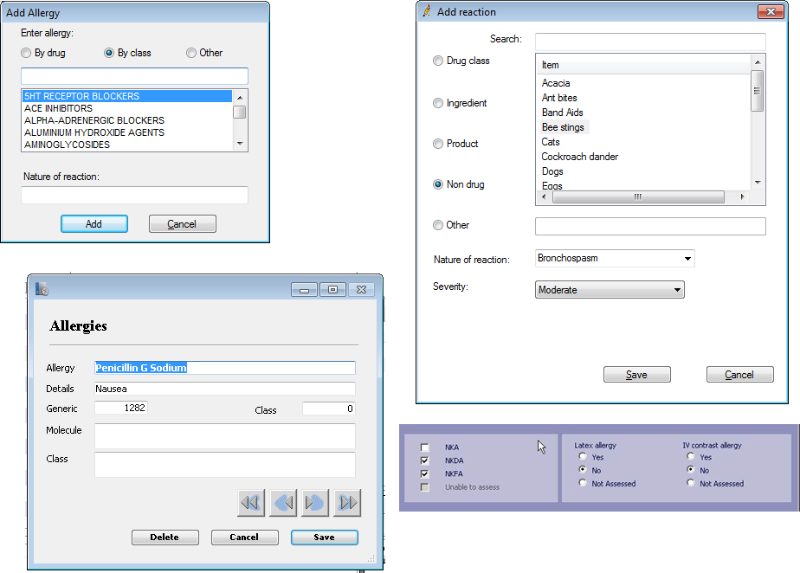
Example: Allergy Tracking

Slide 18
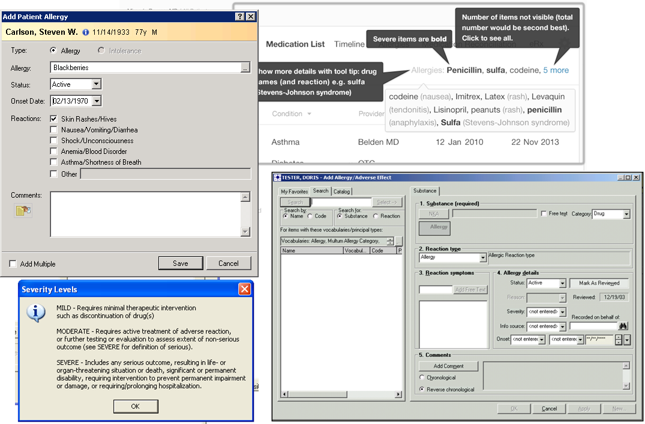
Example: Allergy Tracking

Slide 19
Handling Variability
Bad Choices:
Specification only supports core – no one can use it
Specification adds everything – no one understands it
Specification picks winners – only they can use it
FHIR Approach
Extensions - a consistent framework for extending the resources
Extensions tame the specification

Slide 20
FHIR Extension Framework
Every FHIR element can be extended
Every extension has:
Reference to a computable definition
Value – from a set of known types
Every system can read, write, store and exchange all legal extensions
All extensions are valid by schema etc
Handled properly by code generators, persistence tools etc

Slide 21
FHIR Extensions
Extensions are not a silver bullet
FHIR has a sliding scale governance for extensions
Local Projects
Domain standards (e.g. Best Practice Cardiology)
National Standards (e.g. Standard Finnish Extensions)
HL7 published extensions (corner cases with international scope)

Slide 22
Profiling FHIR
Need to describe ‘usage of FHIR’ for your context:
Authored in a structured manner
Published in a registry & Discoverable
Used as the basis for validation, code, report and UI generation.
3 main aspects:
Remove element/change multiplicity, fixed values
Change coded element binding to ValueSet
Adding extensions
Profiling adapts FHIR for specific scenarios

Slide 23
Implementation Guide
Set of formal computable statements:
Code Systems, Value Sets, StructureDefinitions
Capability Statements, Search Parameters
Examples, Maps, Test Cases
Published as HTML & FHIR Resources
read on the web (e.g. http://hl7.org/fhir/us/core)
registered at http://registry.fhir.org (prototype)
use from a code generator
reference in the validator
Tools, Community, Tutorials, Ecosystem all in progress

Slide 24
Open source / Generate your own?

Slide 25
Open Source Options
Multiple open source options
Commercial friendly licenses + IP processes
All: client frameworks
Most: server implementations
Lots of work & testing invested in them
Java, C#, Pascal, Javascript, Swift, Python etc
Main registry: http://wiki.hl7.org/index.php?title=Open_Source_FHIR_implementations

Slide 26
Reasons not to use Open Source Libraries
Restrictive Licensing regimes
Incompatible Platforms
Internal Architectural Standards
Restrict external dependencies / internal knowledge gaps

Slide 27
Generating your own code
No need to generate anything
e.g. use generic objects in Javascript
But need arises quickly
~150 types in FHIR, ~ 3200 elements
Rough generation process
Know your source format options
Understand your challenges
Choose your tool (or write your own)

Slide 28

Source Options
Format | Structure | Terminology Bindings | Invariants? | Additional Metadata | Search Parameters
XML Schema | ✅
XML Schematron |  |  | ✅
JSON Schema | ✅
ShEx | ✅
RDF Declarations |  | ✅ |  | ✅
Internal FHIR Definitions | ✅ | ✅ | ✅ | ✅ | ✅

Slide 29
Code Generation Challenges
How much metadata do you want?
Terminology Bindings
Definitional Mappings
Search Parameters
XML / JSON information gaps
Polymorphism - or not?
Profiles are not specializations

Slide 30
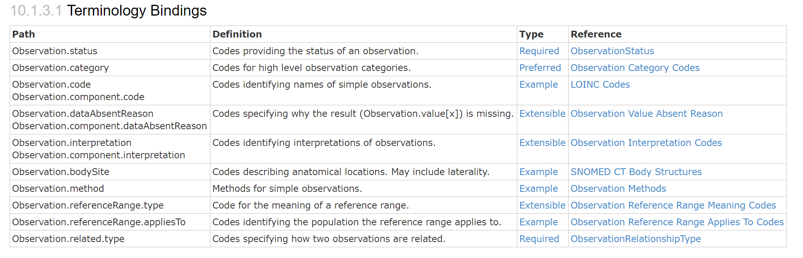
Terminology Bindings

Slide 31
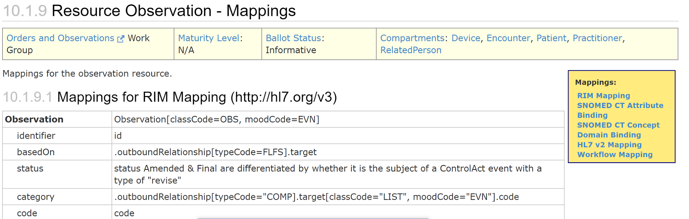
Definitional Mappings

Slide 32
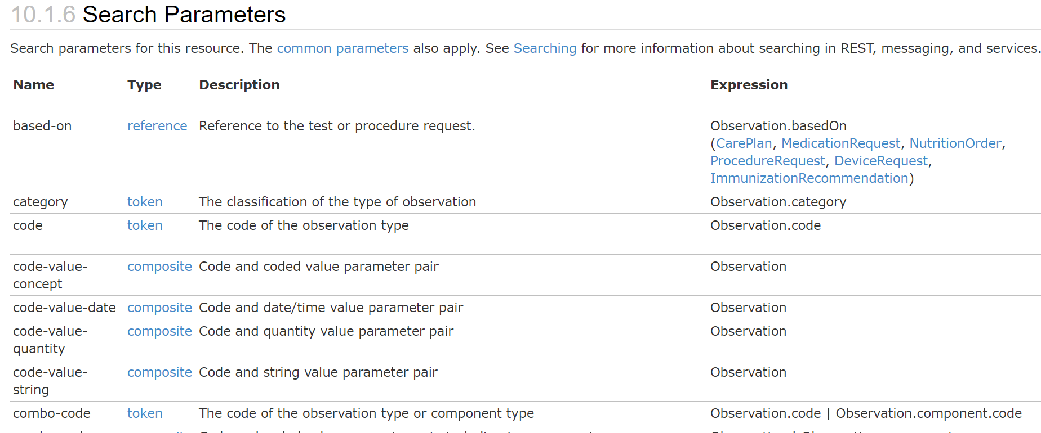
Search Parameters
How much metadata do you want?
Terminology Bindings
Definitional Mappings
Invariants
Indexing
XML / JSON information gaps
Polymorphism - or not?
Profiles are not specializations

Slide 33
XML vs JSON
XML Issue:
Element Order - Order must be correct, not in JSON
JSON Issues:
Arrays - Properties that can repeat must be in arrays
Extensions on primitives

Slide 34
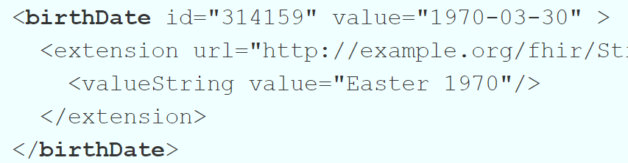
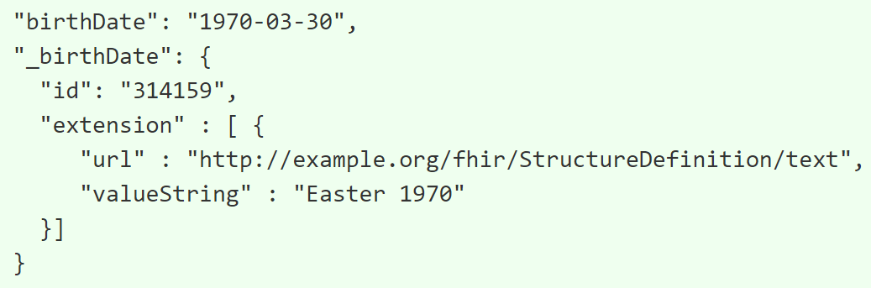
XML vs JSON

Slide 35
Polymorphism
Polymorphism?
or a constraint on a set of elements?

Slide 36
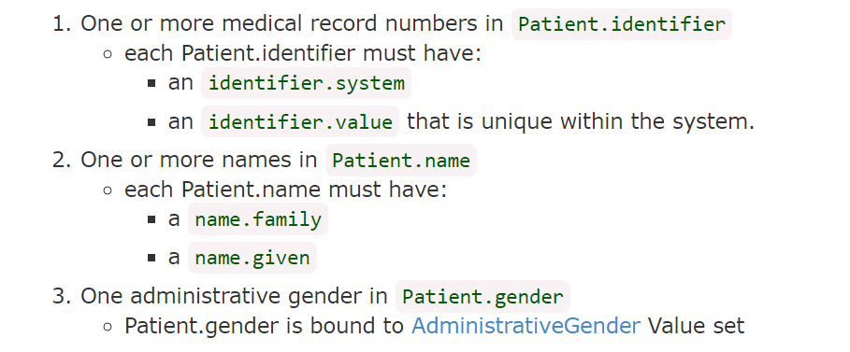
Profiles
US Core Patient: Rules that apply to all patients in USA

Slide 37
Profiles
Profiles are not specializations:
A resource can conform to multiple profiles at once
Resources often don’t claim to conform
Technically, this is Design by Constraint
Profiles can be treated as facades / simplified views of a resource e.g. USCorePatient us_p = new USCorePatient(patient); System.out.println(us_p.race);

Slide 38
Code Generation
The complexities of XML vs JSON and the variation in healthcare complicate code generation
The open source libraries have deep investments in this space

Slide 39
Security and Safety

Slide 40
Security
FHIR does not define or dictate a security model
Wide variety in security requirements and applicable law
Production PHI should always be secured
Communications (SSL/TLS)
Authentication / Access Control / Authorization
System should keep good audit logs and control over provenance

Slide 41
OAuth
FHIR recommends the use of OAuth to delegate authorization (and authentication)
Josh Mandel talked about OAuth

Slide 42
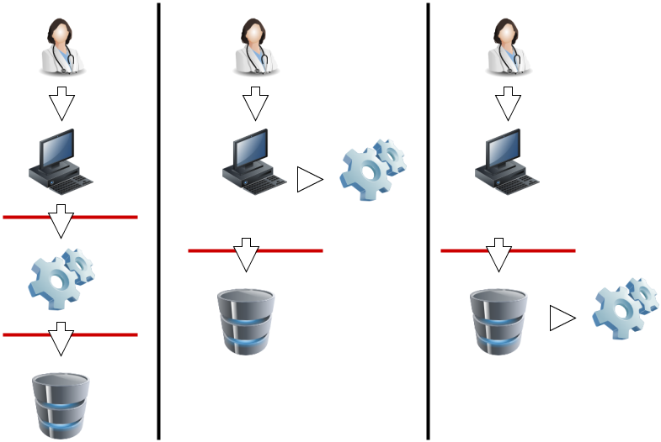
Security Choices

Slide 43
Access Control Considerations
Can client read/search/create/update/delete resource?
Search
Can client use chained parameters?
What additional resources can be included?
Contained resources?
Transaction/Batch/Operations
Context (e.g. Break the Glass)
Security Labels

Slide 44
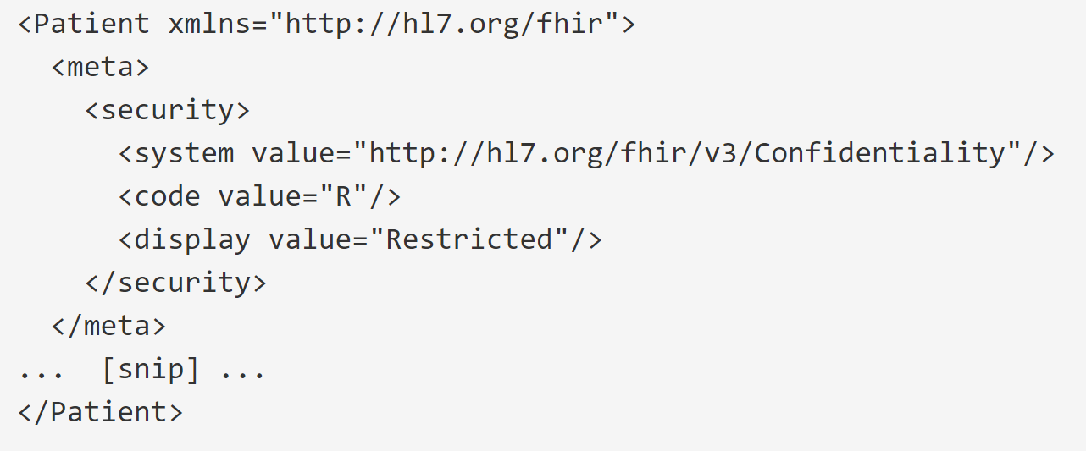
Security Labels
Mark resources for special consideration by Access Control

Slide 45
Security Labels
Common Labels implementations must understand:
Confidentiality Codes (Unrestricted → Normal → Very Restricted)
Purpose of Use (Treatment, Research, Payment, Patient Request)
Delete After use: no local store, even in audit trail(?)
Do Not Re-use: cannot distribute further (definition?)

Slide 46
Audit Logging
Log everything (sign audit log)
AuditEvent allows access/sharing of the audit log
Contents:
Event Details including outcomes
Source / Agent Attribution
Data referenced
Based on IHE ATNA work

Slide 47
Provenance
Track the source of all information
Provenance allows access/sharing of the source information
Contents:
Target Data Reference + Action details
Agent information
Source Data information
Based on W3C Provenance work

Slide 48
Web Security
Sanitize inputs (SQL injection, etc)
Careful Error Management (‘not found’ vs ‘denied’)
Watch HTML implementations carefully
test your escaping consistency
no active content (validators enforce this)
whitelist stylesheets
careful with attachments and external references

Slide 49
Digital Signatures
Digital Signatures on RESTful APIs is not a well explored area
FHIR has various provisions for digital signatures
Provenances
Bundles
Not a lot of experience yet

Slide 50
Safety
Safety is a property of systems
FHIR is an API - a component of a system
FHIR has no inherent safety on it’s own
System meets the user’s expectations
Intersection between systems - expectation mismatches common

Slide 51
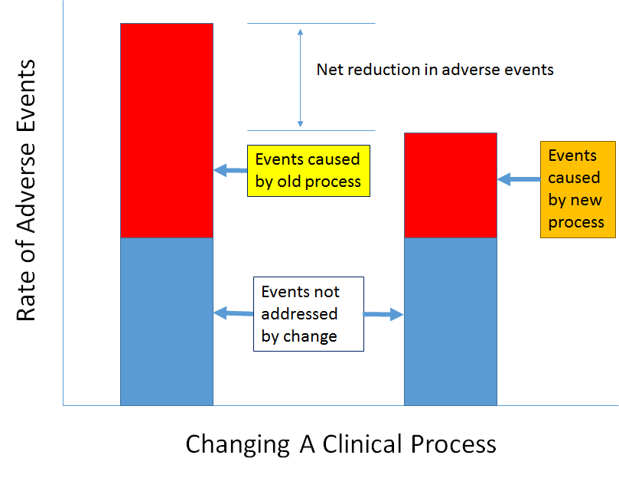
Safety Principle

Slide 52
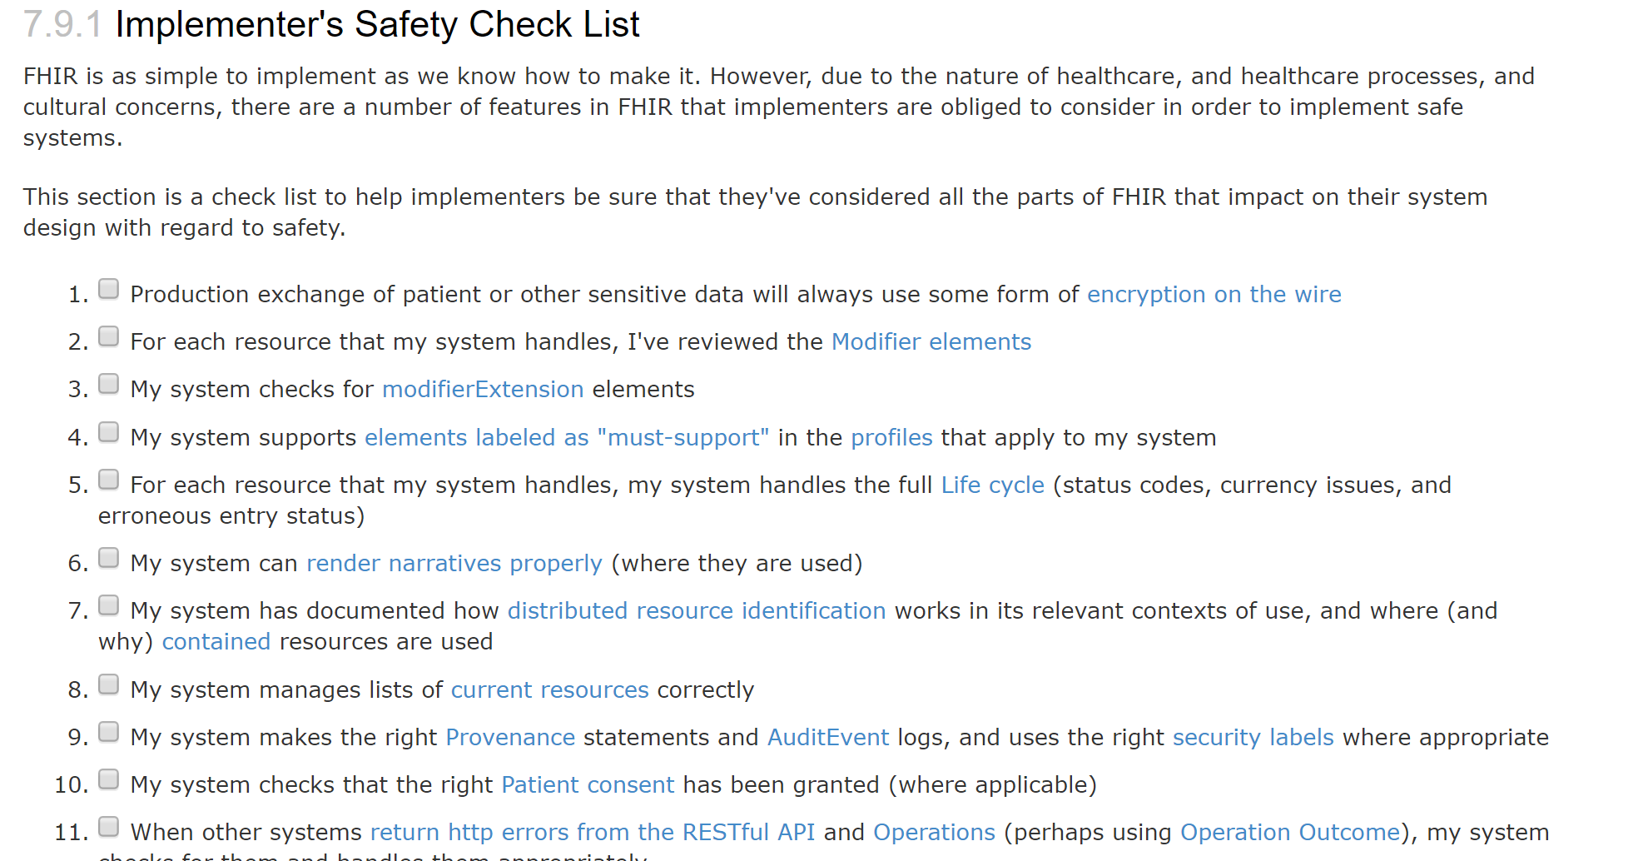
Safety Check List

