Slide 1



CROP & FERTILIZER RECOMMENDATION SYSTEM USING
MACHINE LEARNING PROJECT

Slide 2

Learning Objectives
Understand how to handle missing data, outliers, and ensure data quality for machine learning models.
Learn how to transform and scale data appropriately for model training.
Understand the basics of machine learning algorithms.
Learn how to select appropriate models for predicting crop yield and recommending fertilizer types and quantities.
Explore common ML libraries in Python (e.g., Scikit-learn, TensorFlow, Keras, Pandas, NumPy).
GOAL
Source :
www.freepik.com/

Slide 3
Tools and Technology used
Python Libraries:
Pandas: For data manipulation and preprocessing (e.g., handling missing data, merging datasets, and performing exploratory data analysis).
NumPy: For numerical operations and handling arrays, matrices, and mathematical calculations.
OpenCV : Its is used to import the dataset to the algorithm to predict the crop and fertilizer.
Decision Trees (for tree-based models that can handle both numerical and categorical data)
Random Forest (for better performance and handling overfitting in decision trees)
Matplotlib / Seaborn: For data visualization (e.g., plotting graphs like histograms, bar charts, or scatter plots to understand crop growth trends, fertilizer efficiency, etc.).

Slide 4
Methodology
Import necessary Library like numpy ,pandas ,mathplotlib ,seaborn etc.
Collecting the data and cleaning the data to remove the duplicates.
Checks the target feature distribution function.
Visualize the distribution of each feature.
Plotting scatter plot and Finding outliers – boxplot.
Train test split and training the model.
Prediction of crop and fertilizer.

Slide 5
Problem Statement:
Farmers often face challenges in selecting the right crops and fertilizers that align with local soil conditions, climate, and available resources.
Improper fertilizer use or suboptimal crop selection can lead to reduced productivity, increased costs.
To help the farmer about the crop and fertilizer uses based on the climatic changes and condition this model was developed using machine learning algorithm which will recommend the crop and fertilizer based on N, P,K,temp,hum,ph,rain.

Slide 6
Solution:
The goal of this project is to develop a Machine Learning-based Crop and Fertilizer Recommendation System that helps farmers make informed decisions by providing data-driven recommendations.
The system should take into account soil quality, climate conditions, and crop-specific requirements to suggest the most suitable crops to plant and the optimal amount of fertilizers to use.
This will not only help farmers improve their crop yields but also reduce environmental impact by preventing excessive fertilizer use.
It will be designed to empower farmers by providing actionable, real-time insights that improve their decision-making process, ultimately contributing to higher agricultural productivity, cost savings, and more sustainable farming practices.

Slide 7
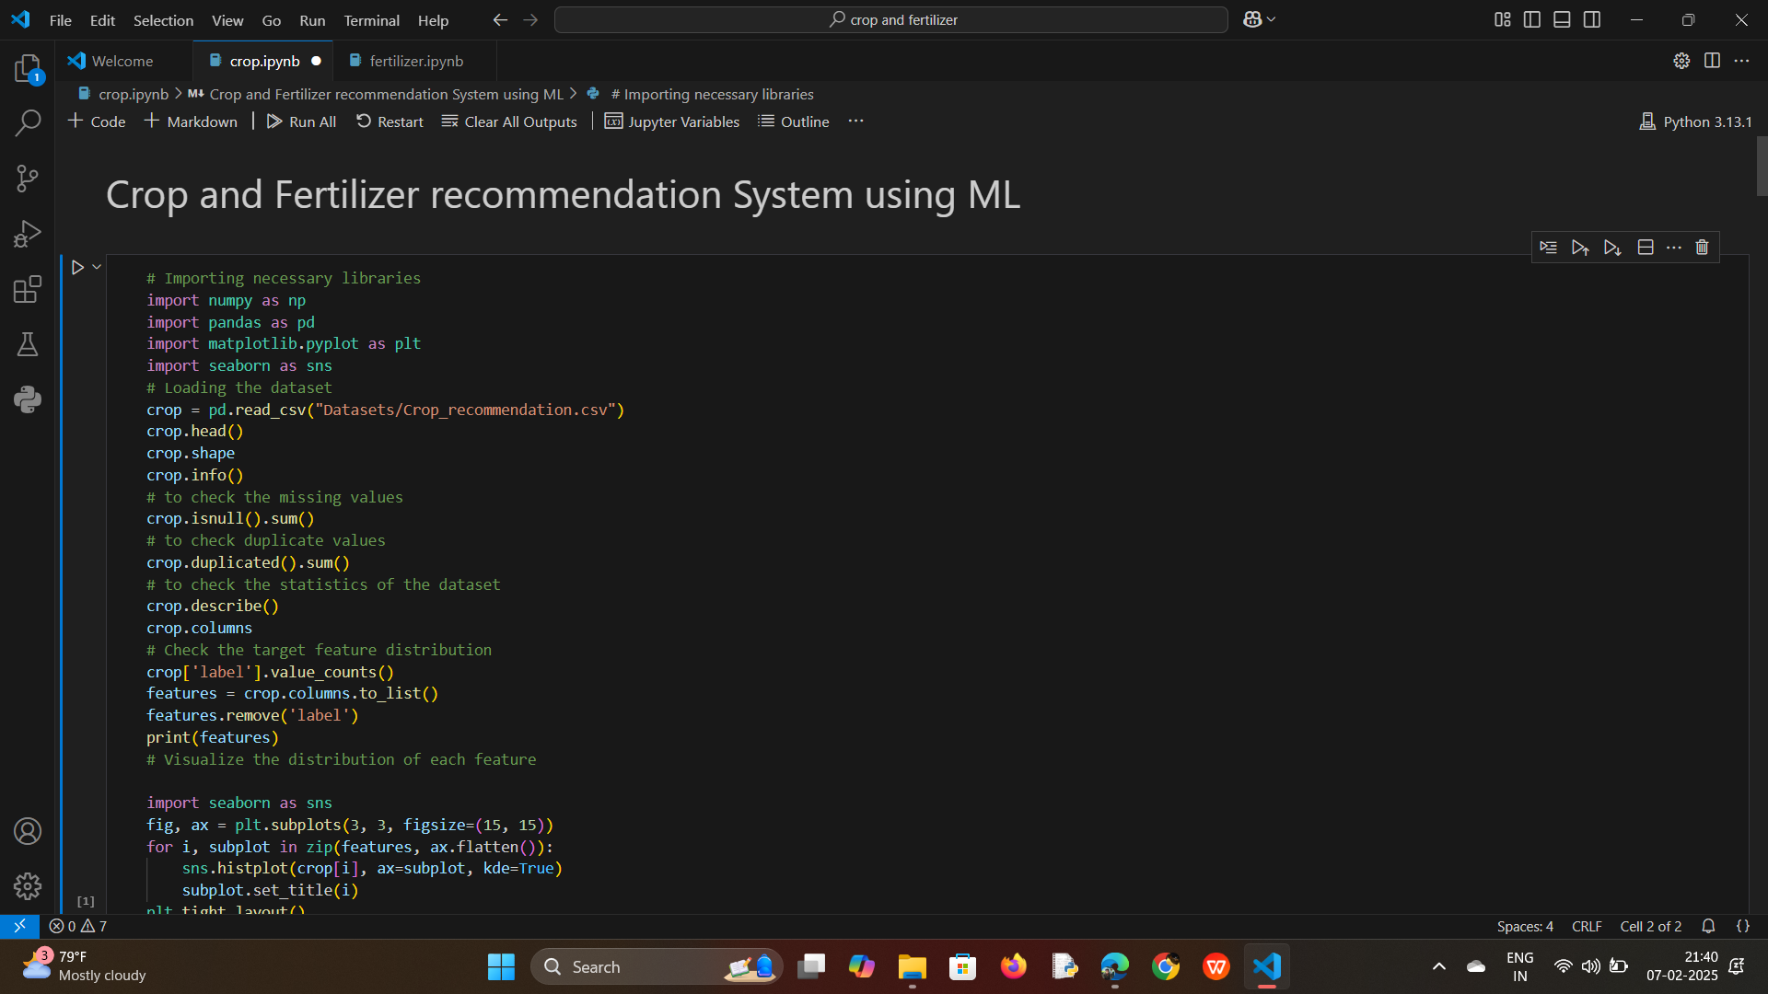
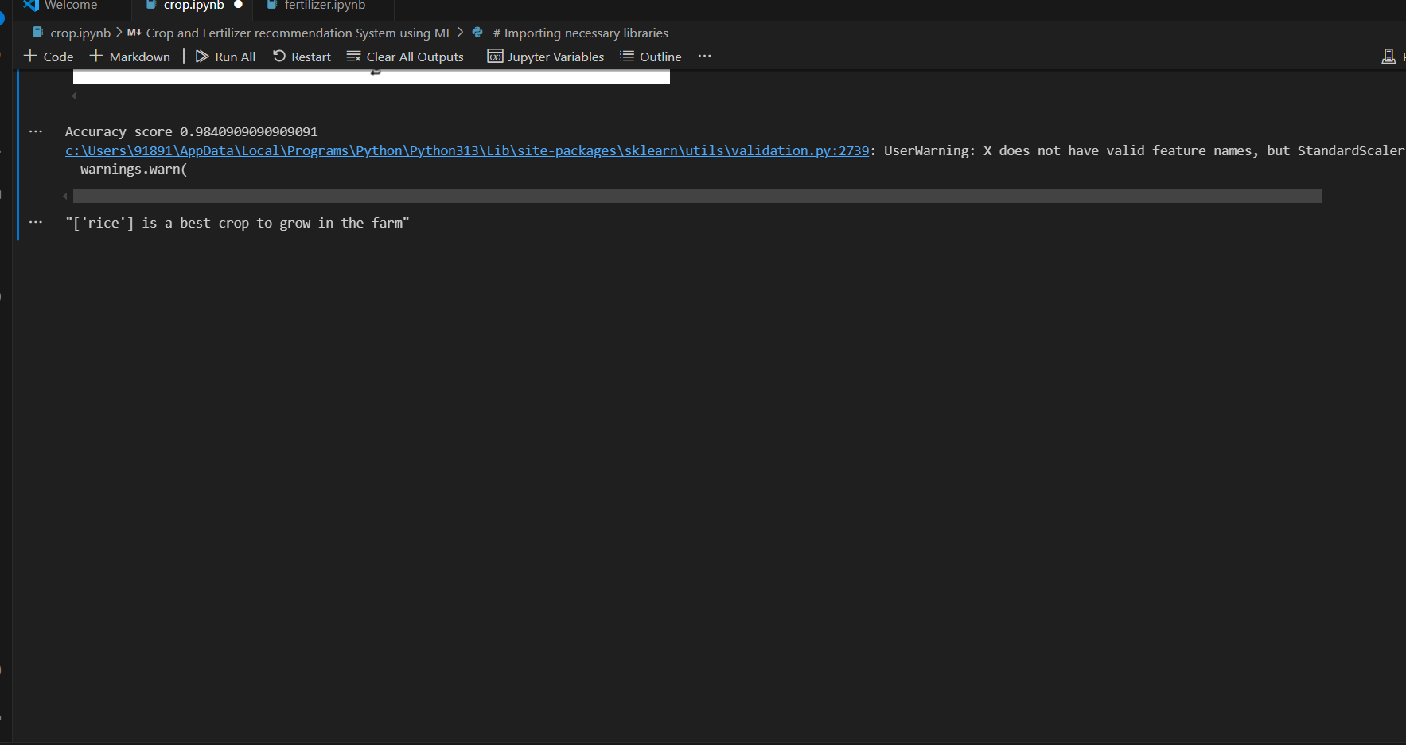
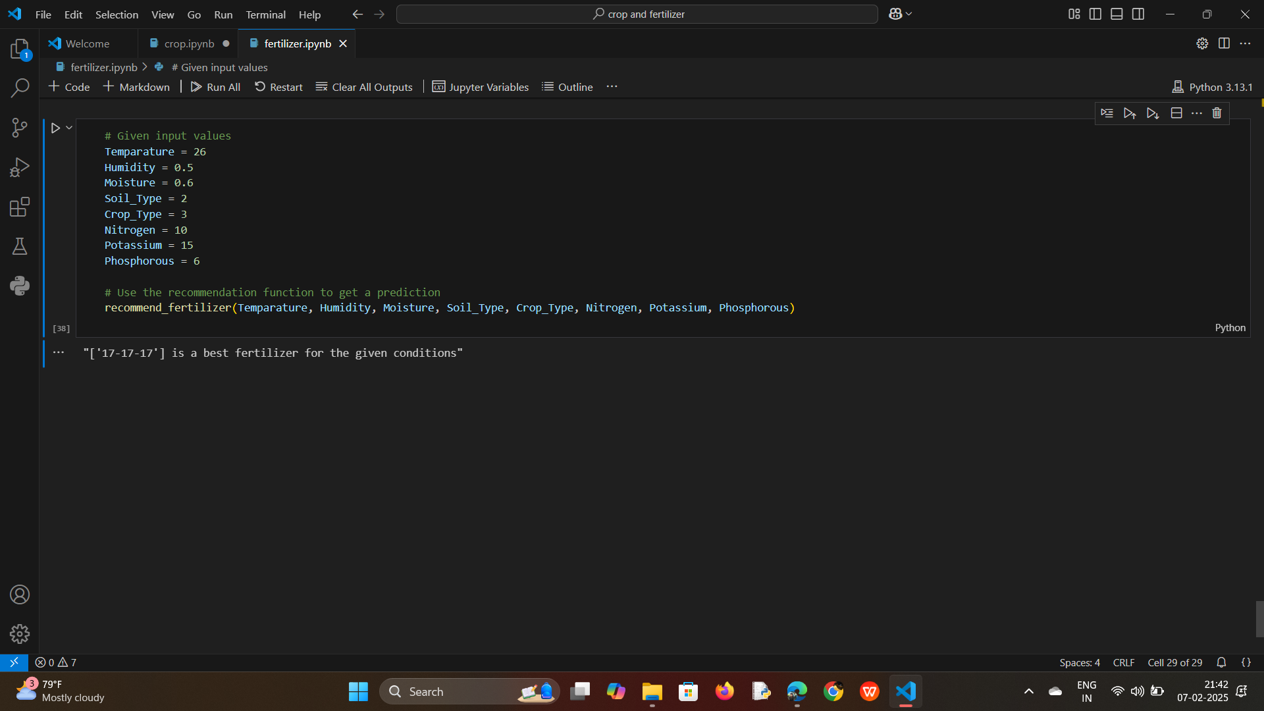
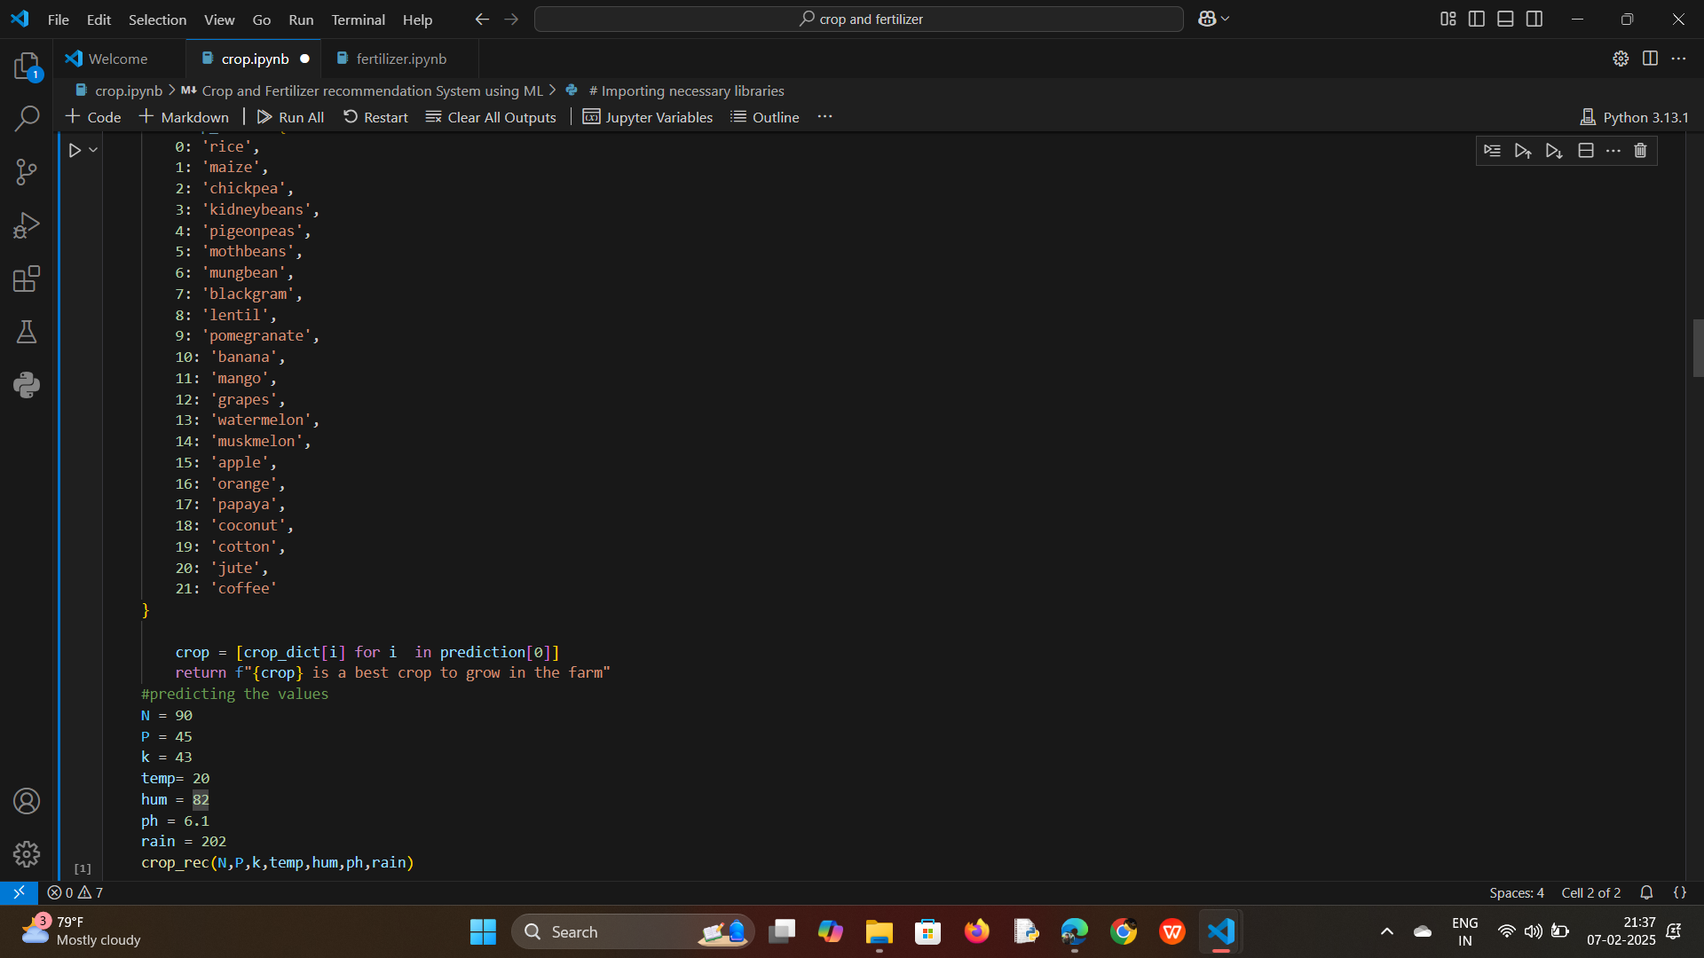
Screenshot of Output:

Slide 8
Conclusion:
The development of a Crop and Fertilizer Recommendation System using Machine Learning (ML) and Python represents a significant step toward transforming agricultural practices through data-driven decision-making.
By leveraging advanced ML algorithms, the system can accurately recommend the most suitable crops and optimal fertilizer quantities based on key factors like soil composition, climate conditions, and crop-specific needs.

Slide 9
