Slide 1
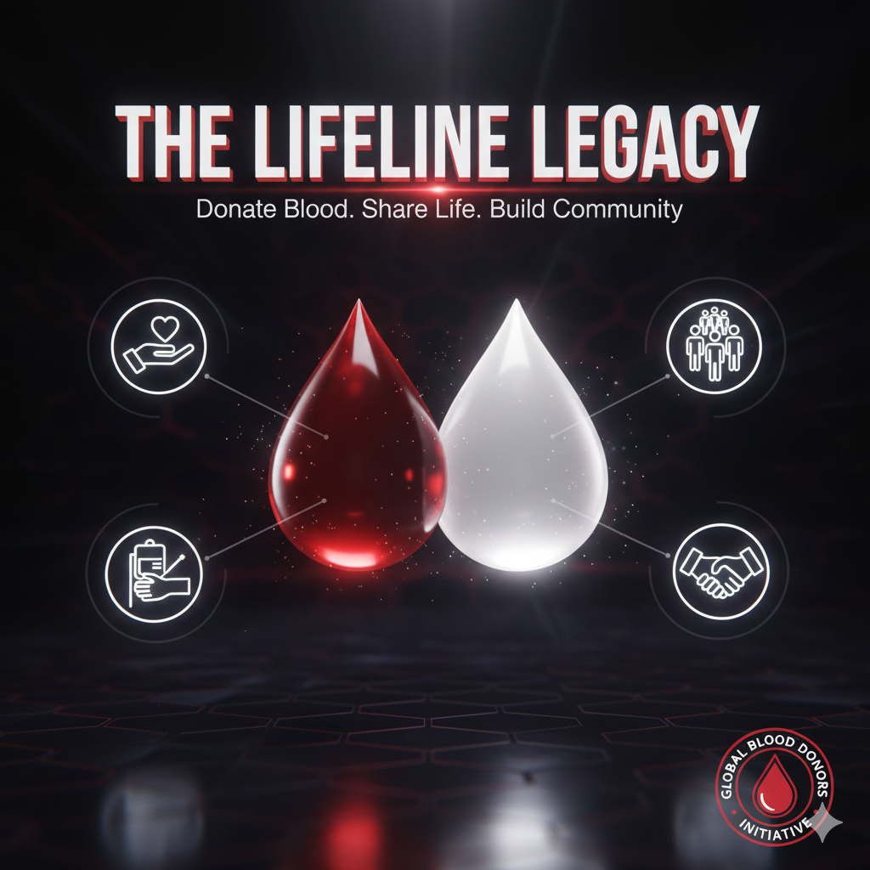

Slide 2
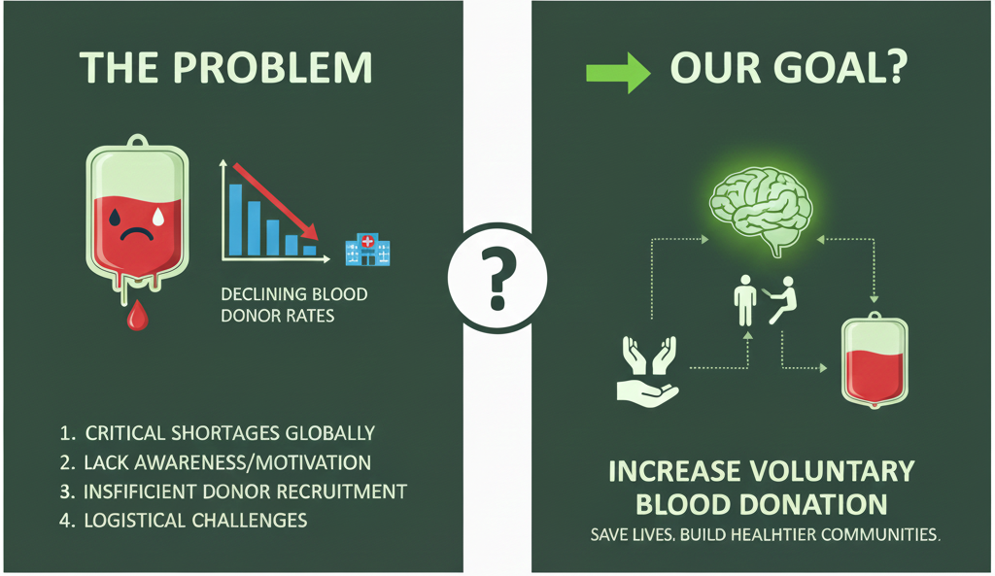
PROBLEM STATEMENT:
Millions of lives are lost every year due to the lack of timely blood, organ, and plasma donations. People in need often struggle to find reliable donors quickly, while willing donors are unaware of opportunities to contribute. This gap leads to critical delays in treatment and sometimes preventable fatalities.

Slide 3
WORKING PROCESS OF LIFEGIVERS:
Our platform is designed to minimize friction and maximize engagement for the donor, making saving a life as easy as a few taps.
Step 1: Register & Profile
The donor signs up quickly, securely entering their blood type, preferred donation location (home/work), and general availability.
Step 2: Receive Smart Alert
Our smart matching algorithm immediately connects the donor with the nearest critical need, ensuring the request is tailored to their specific blood type and location.
Step 3: Book & Arrive
The donor confirms their appointment instantly via the app or website. They receive automated reminders, necessary pre-donation information, and directions to the clinic.
Step 4: Track Impact & Engage
After donation, the donor receives a personalized "Thank You," tracks the general area their donation helped, earns rewards and receives smart reminders for their next eligible donation date.

Slide 4
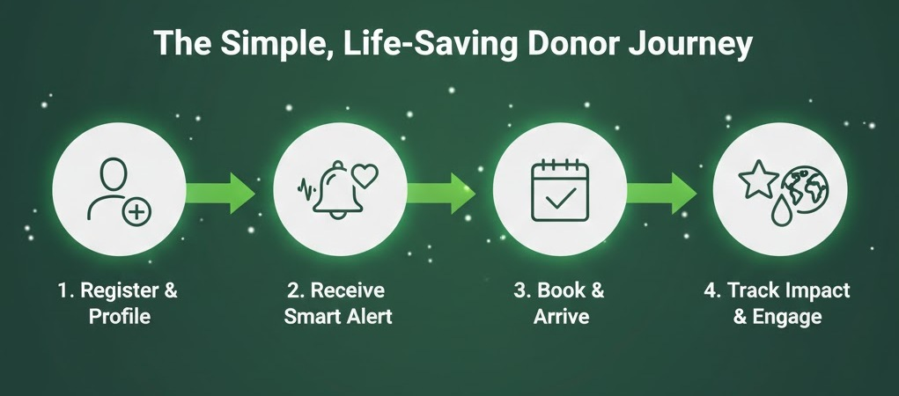

Slide 5
Our Path to Higher Donor Retention:
I am building a Donor Retention Platform, not just a donor search tool. Our focus is on predictive matching and sustained engagement.
1. Predictive Demand Modeling (AI-Powered Matching):
  Unlike static registries, we use Machine Learning to anticipate where and when a specific blood type will be needed before a critical shortage occurs.
  This ensures we alert the most eligible and local donors at the precise moment of maximum impact, reducing blood waste and improving response time.
2. Hyper-Localized & Real-Time Alerts:
Our geo-location services connect the donor to the nearest active donation point (hospital or mobile camp) in seconds, drastically cutting down travel time and administrative delays.
The result: Higher conversion rates from alert to donation.

Slide 6
Deployment Plan :
Title: Phase 1: Focused MVP & Pilot Program
Goal: Launch a stable, core product in a single, defined geographic area and secure our first official partnership with a local blood bank.
I. Minimum Viable Product (MVP) Features:
We will launch with the core features necessary to validate our Smart Matching and Donor Retention thesis:
Donor Portal (Web & Mobile): User registration, secure profile (Blood Type, Location, Eligibility check), and Donation History tracking.
Real-Time Need Alert: Basic geo-based notification system to alert local donors when a general shortage (by blood type) is reported by the partner facility.
Simple Appointment Scheduling: Allows donors to book a time slot directly at the partner facility through the platform.
Partner Dashboard (MVP): A simple interface for the blood bank to manually input critical needs and view a list of scheduled donor appointments.
II. Strategic Focus Area:
Geographic Target: [City/Region Name] (or a specific metropolitan area).
Reasoning: High population density for a large donor pool, presence of [Name a specific hospital/blood bank type] for partnership potential, and manageable size for a pilot test.

Slide 7
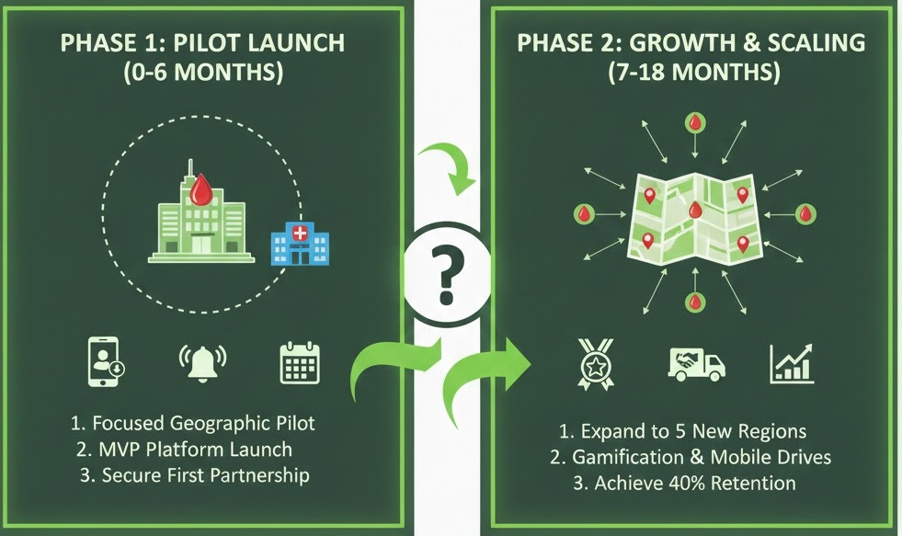
DEPLOYEMENT PLAN: OVERVIEW

Slide 8
Measuring Impact: KPIs for Life-Saving Success
Core Digital Success Metrics (Focus on Engagement & Retention):
These metrics prove the platform's effectiveness in attracting and keeping donors.
Donor Conversion Rate (DCR): The percentage of users who sign up and successfully complete a first donation.
  Target: >20%
Repeat Donor Rate (RDR): The percentage of first-time donors who return within the next eligible period. This is the primary indicator of the Engine's success.
  Target: >40% (Year-over-Year)
Alert-to-Booking Rate: The percentage of users who receive a critical need alert and proceed to book an appointment.
  Target: >60%

Slide 9
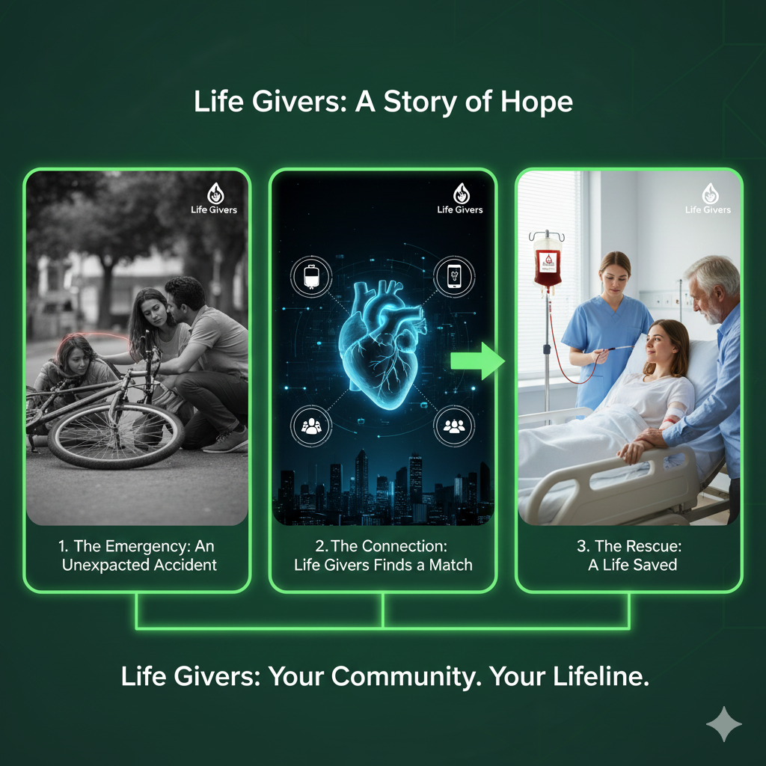

Slide 10
Title: The Future of Blood Donation: Investing in Life Givers
The Challenge is Clear: Critical donor shortages persist globally.
The Solution is Here: Life Givers offers a hyper-local, high-retention platform powered by predictive technology .
Join Us:
Invest in Life Givers to shift from reactive shortage management to proactive, technology-driven supply stability.
Let's turn the vision of sustainable blood donation into a reality.
Contact: [lohithasuper7@gmail.com] | [8466833772].

