Slide 1


Early Detection of Student Burnout
Lohitha V
22MIA1152

Slide 2

PROBLEM STATEMENT
Students show early behavioural signs of burnout and disengagement.
Universities notice problems only after grades drop, making intervention difficult.
Need a system to detect:
Burnout Risk
Academic Disengagement
Dropout Probability
Uses behaviour patterns, not marks.

Slide 3

Key Data Features
Behavioural: LMS logins, attendance rates,submission delay,inactivity gap,Night activity gap and study time variance
Psychological: Sentiment analysis from student feedback responses
Academic: Historical GPA, drop rates, and submission delays

Slide 4

Predictive Modelling Techniques
Random Forest Classifier for accurate burnout predictions and classifications.
XGBoost Regression employed to assess dropout probabilities effectively.
K-Means Clustering used to identify distinct behavioural groupings.

Slide 5
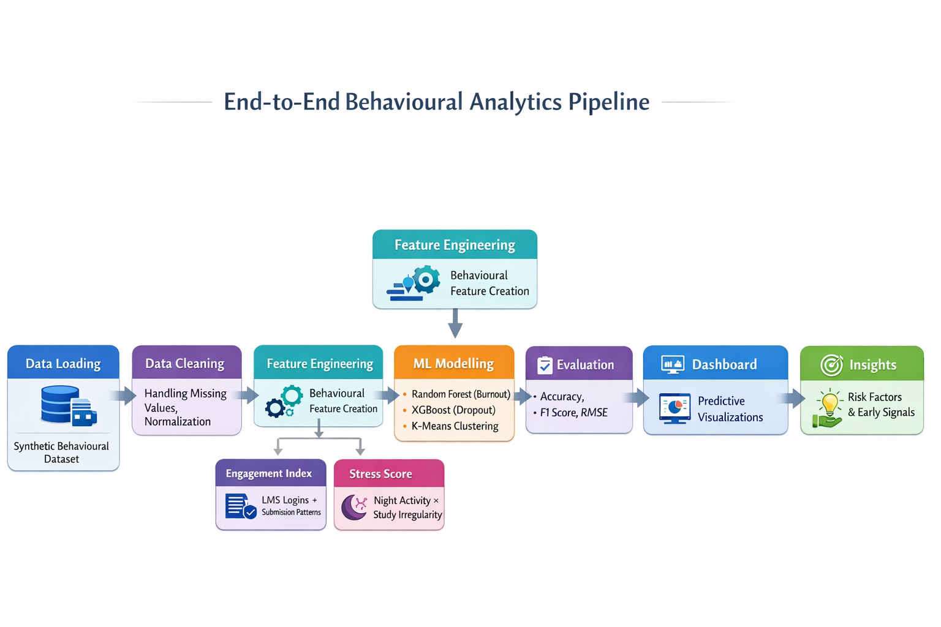
System Architecture Overview
End-to-End Pipeline:
Data Loading
Data Cleaning
Feature Engineering
Engagement Index
Stress Score
ML Modelling
Evaluation
Dashboard
Insights

Slide 6

Results
Burnout Model
Accuracy: ~80–85%
High-impact features: attendance, delays, sentiment
Dropout Model
Low error values (MAE, RMSE)
Strong prediction confidence
Clustering
3 clear behavioural groups
At-risk students strongly match burnout indicators

Slide 7

Behavioural Insights
Linking Patterns to Burnout Risks
Attendance Rates
Submission Delays
Negative Sentiment
Low attendance rates directly correlate with higher burnout levels, indicating students are disengaged and struggling to keep up, necessitating early intervention to support their academic journey.
Frequent submission delays signal potential burnout, suggesting students are overwhelmed and unable to manage their workload effectively, highlighting the need for timely assistance and resources.
Negative sentiments expressed in student feedback are strong indicators of burnout, reflecting emotional distress that can lead to disengagement and dropout if not addressed promptly.
7

Slide 8



Practical Impact
For Students
For Faculty
For Institutions
Early support allows students to thrive academically and manage their emotional well-being effectively.
Faculty can identify at-risk students quickly, enabling timely interventions and support strategies.
Enhancing retention rates through data-driven insights benefits the institution's overall academic performance.

Slide 9

Future Enhancements
Real-time LMS integration
Emotional analytics (voice/face)
AI-based early alerts
Personalized student recommendations
Long-term behaviour tracking

