Slide 1
Automatic Question Paper Generator App
Ramya Boyapati(4)
Kishan Koushik(6)
Aparna Manda(14)
Lohitha Yenugu(34)

Slide 2
System Implementation
Our system divides users in two categories-
Faculty
Student
The Faculty:
Sign ups to the application and selects the courses to generate question paper
Questions List component, to add Descriptive/Multiple Choice Questions per course basis
Student List component, to view the list of students enrolled into courses
Courses component, to generate question paper
The Student :
Sign ups to the application and can enroll into courses
Enrollment component, to view the courses enrolled
Assignments component, to view the question paper

Slide 3
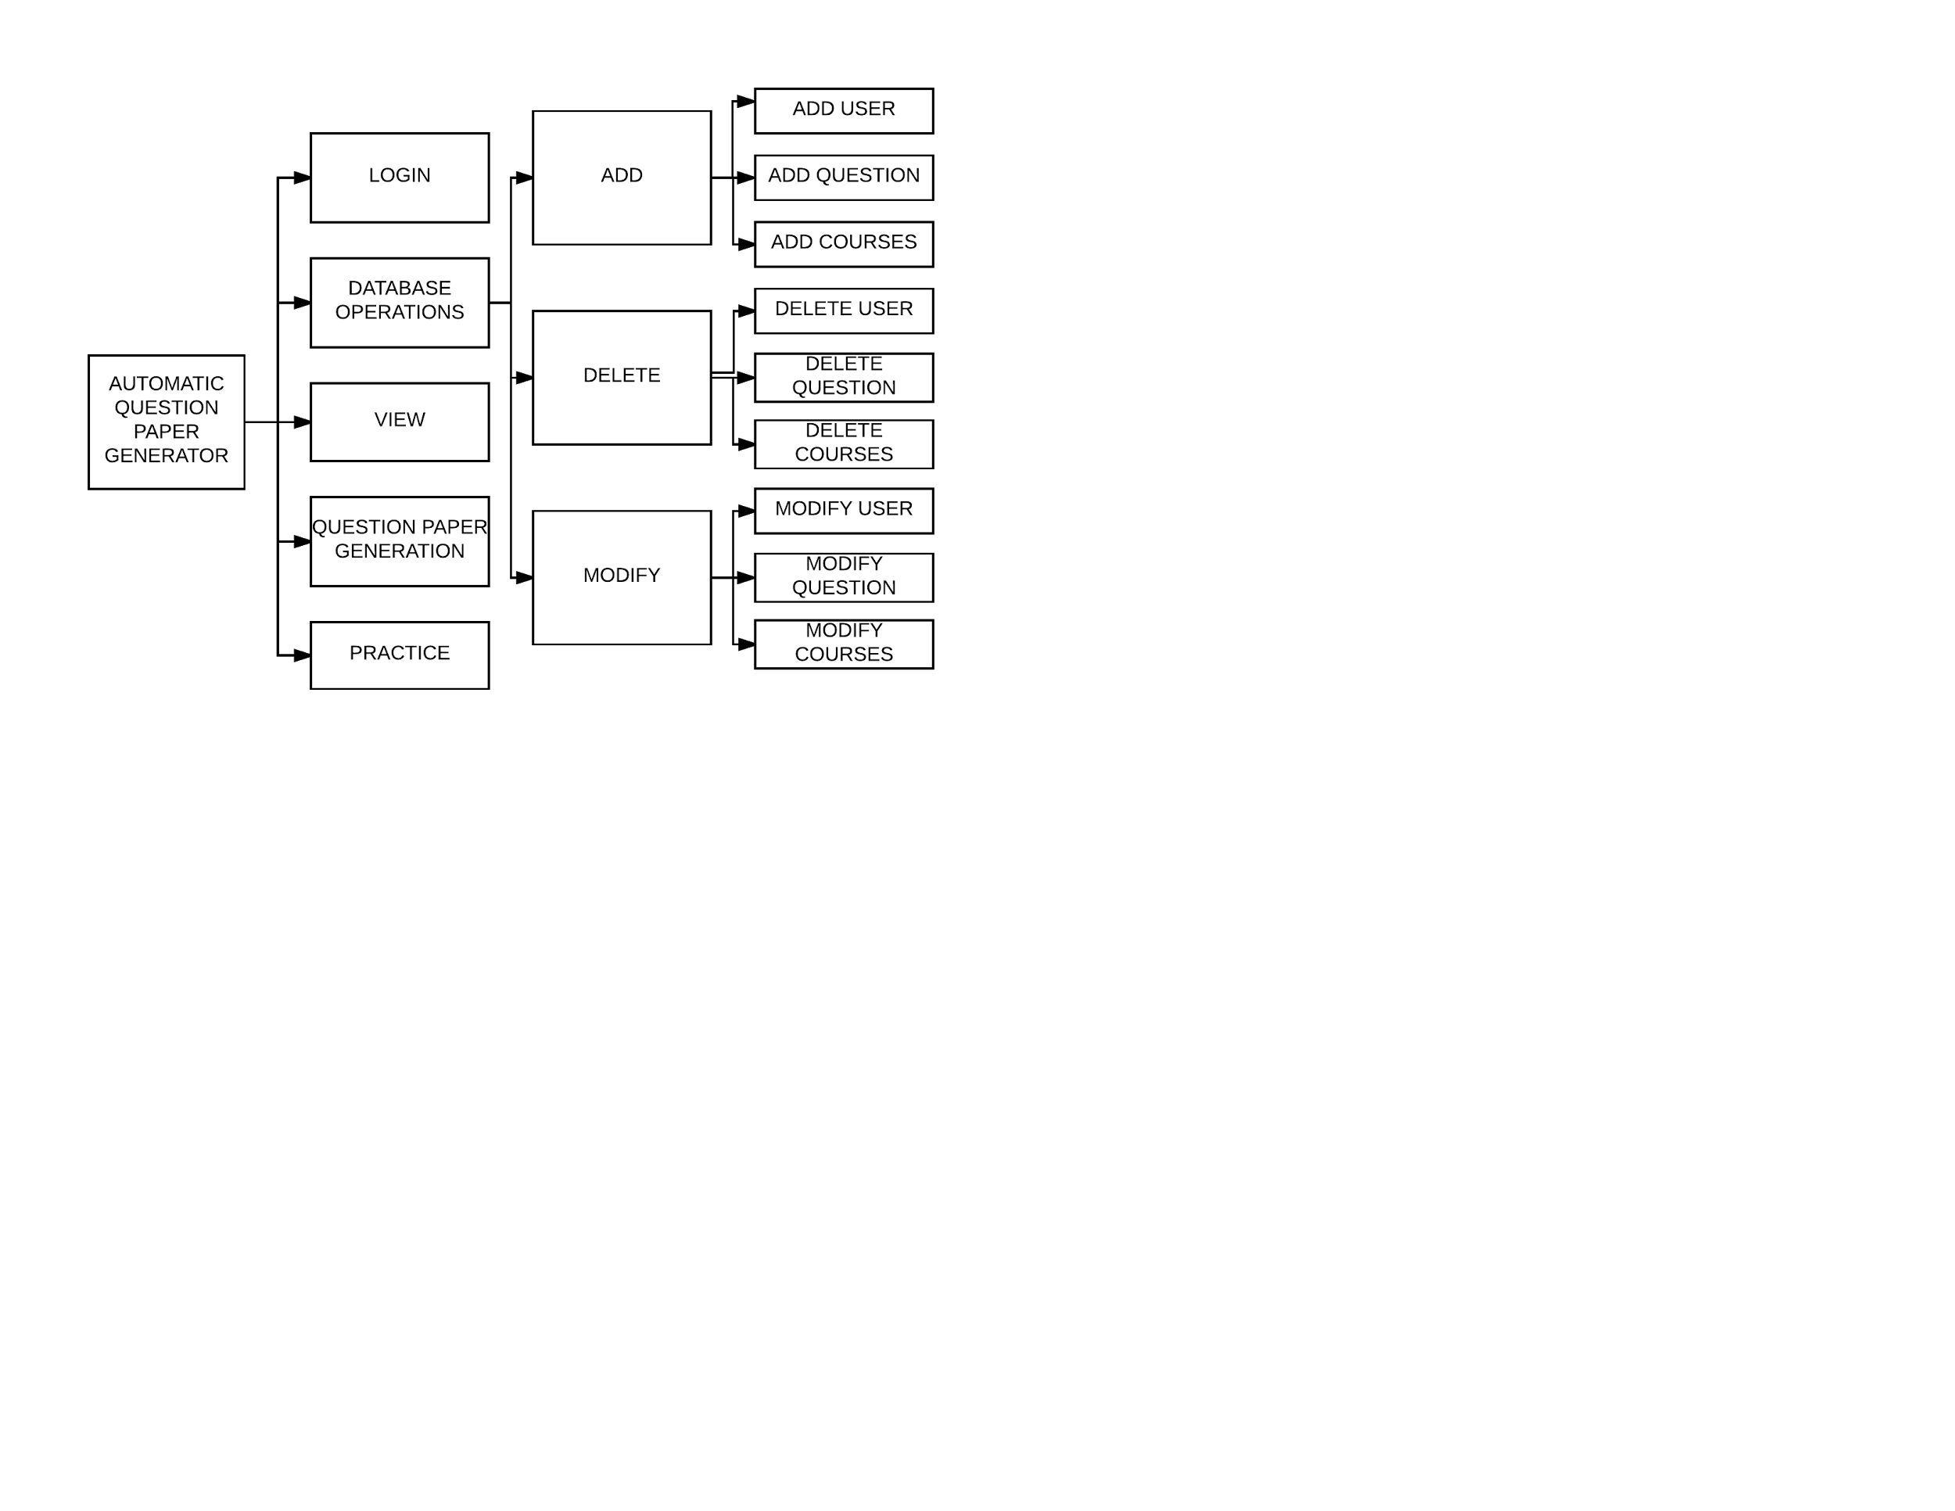
System Design

Slide 4
Technologies Used
Html
CSS
Javascript, jQuery
Technology: MEAN Stack

Slide 5
Contribution
1. Ramya Boyapati- Login Component, Signup Component, Student List Component
2. Koushik Donthineni- MyProfile Component, Enrollments Component, Assignments Component
3. Aparna Manda- Courses Component
4. Lohitha Yenugu- Questions List Component

Slide 6
Future Scope
1. Sending notifications to students when the paper is generated
2. Allowing the students to write exam online

Slide 7
Reference Links
https://stackoverflow.com/questions/3087975/make-the-cursor-a-hand-when-auser-hovers-over-a-list-item
https://blog.angular-university.io/angular-material-dialog/
https://stackoverflow.com/questions/28175381/how-to-access-json-array-object-in
html-using-angular https://www.w3schools.com/angular/ng_ng-repeat.asp
https://stackoverflow.com/questions/43289366/angular2-routing-the-requestedpath-contains-undefined-segment-at-index-1

Slide 8
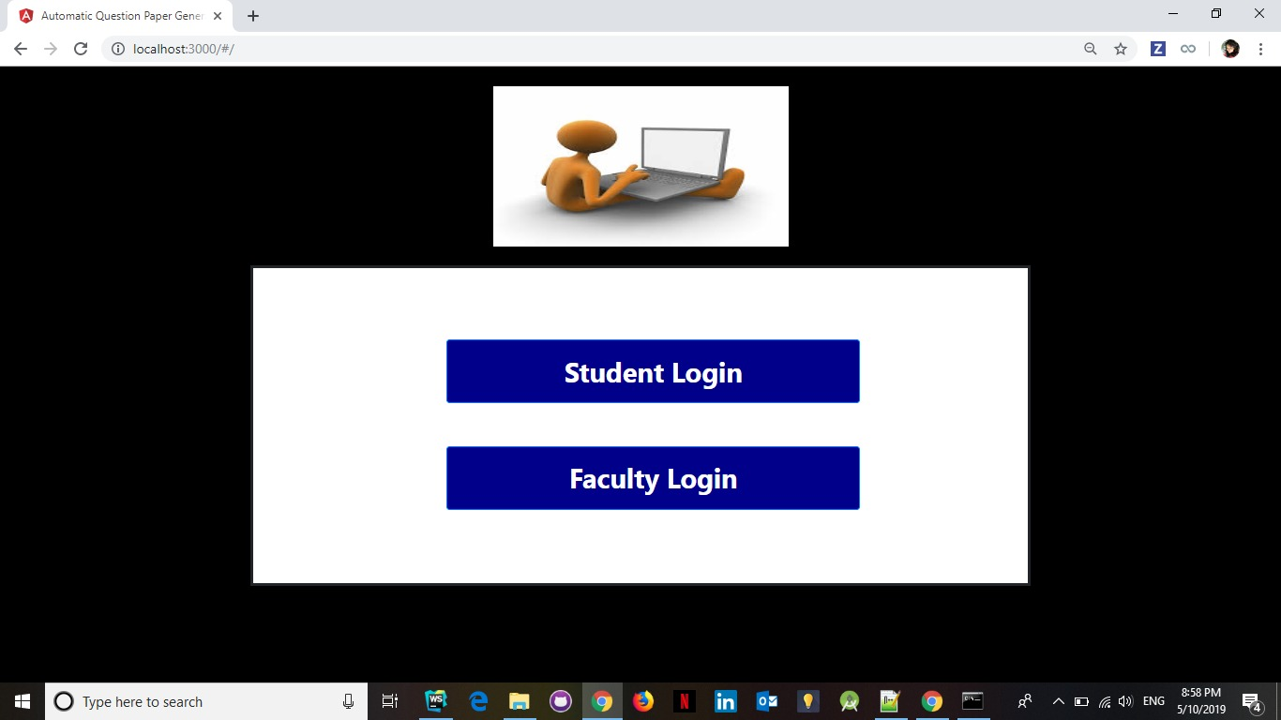

Slide 9
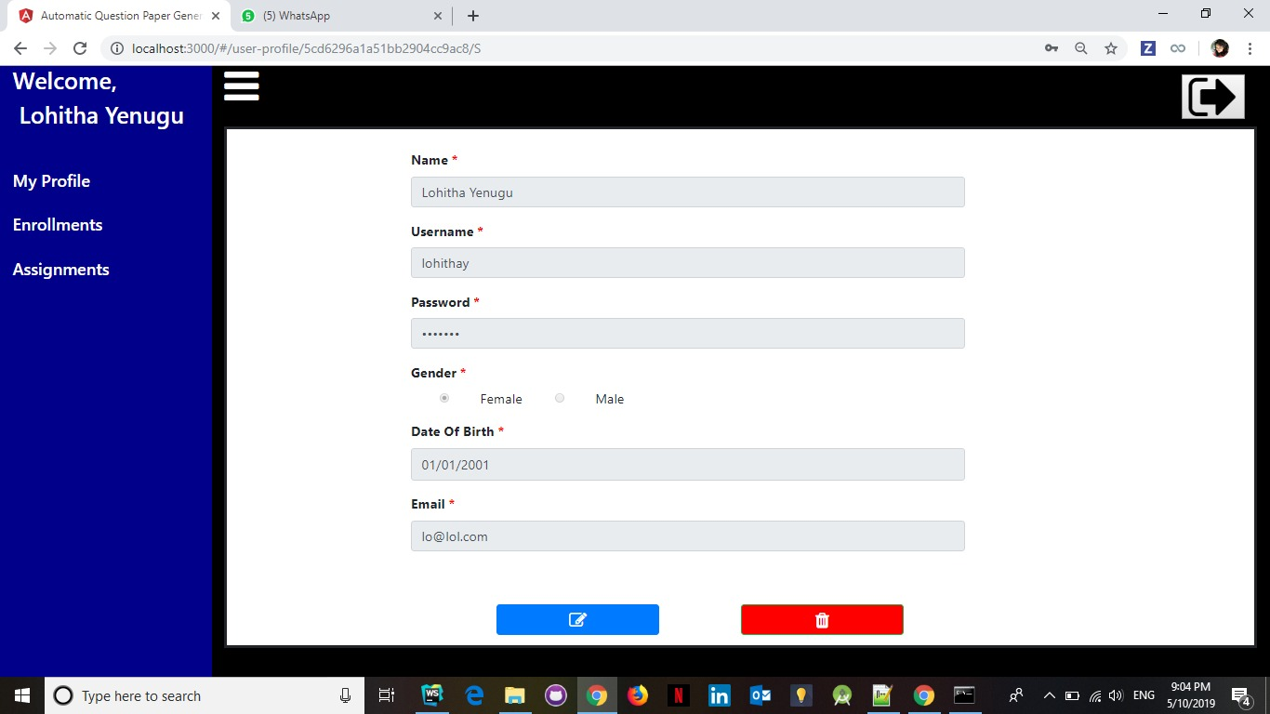

Slide 10
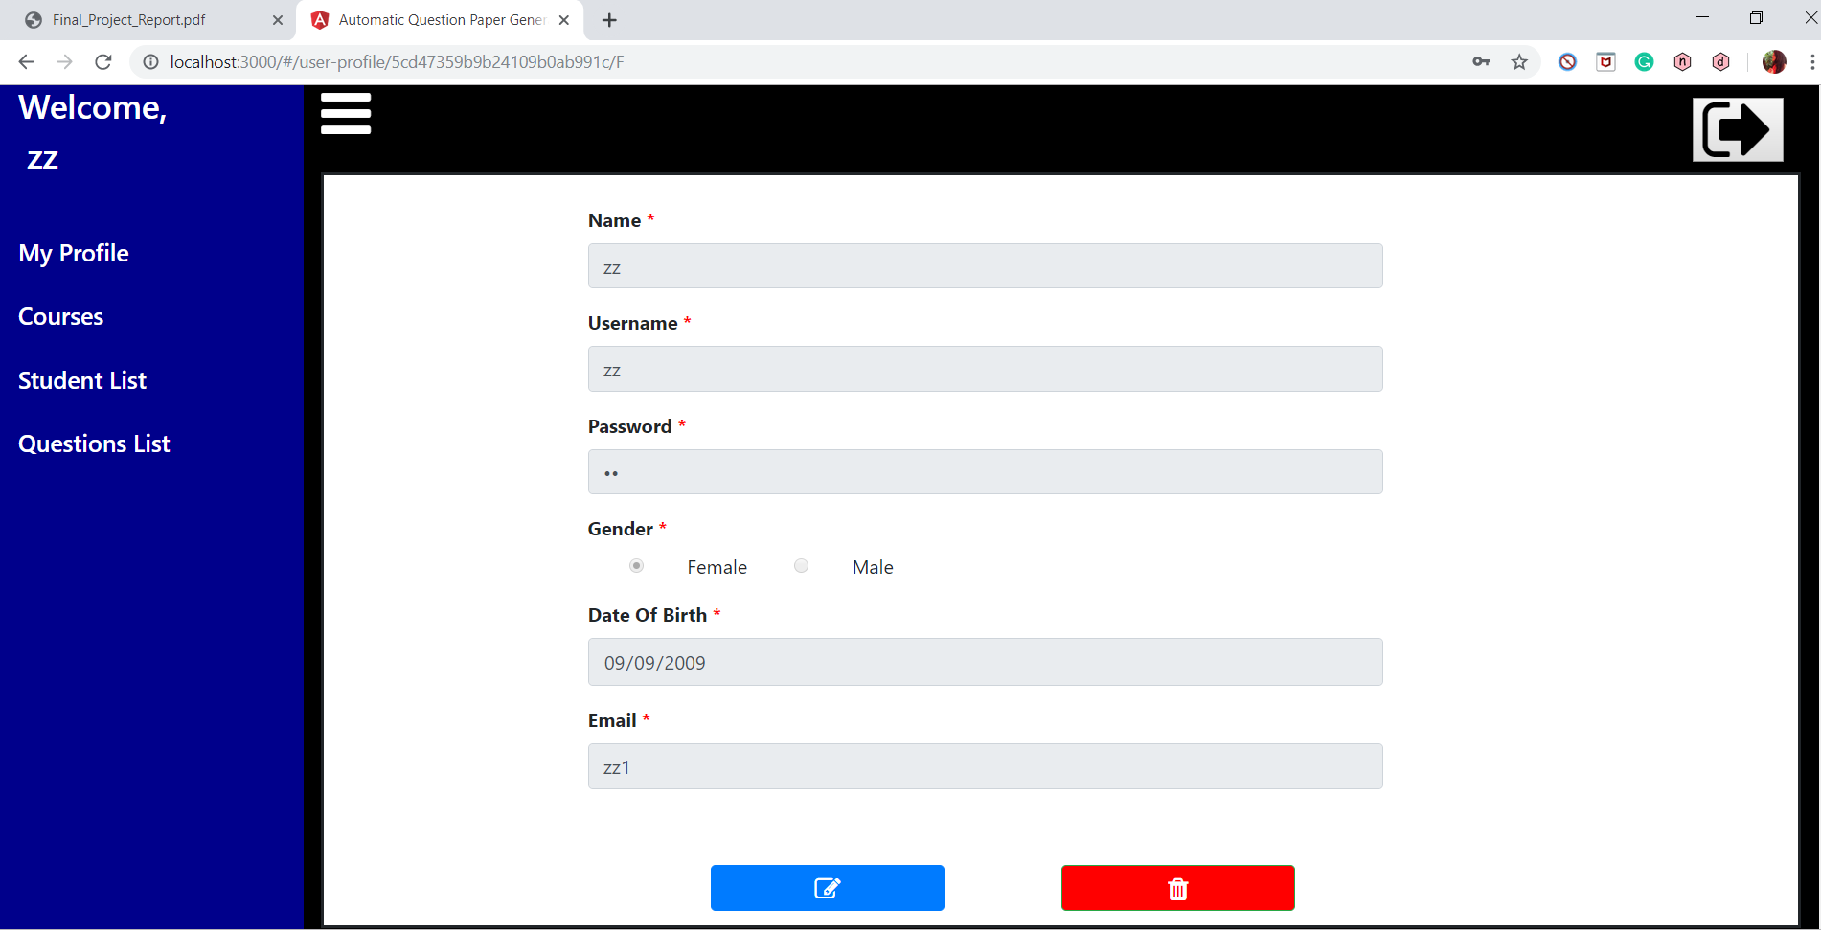

Slide 11
Thank You !

