Slide 1

Credit Card Approval Prediction using Machine Learning and IBM Watson
AI-based banking decision support system — final year major project designed for accurate, fast, and scalable credit decisions.
Footer: Final Year Major Project

Slide 2





Problem Statement
Banks process thousands of credit card applications daily. Manual verification creates bottlenecks and operational risk.
Time-consuming
Slow turnaround for decisions increases customer friction and backlog.
Human errors
Inconsistent checks and accidental oversights lead to incorrect outcomes.
High operational cost
Manual review requires staffing, training, and sustained overhead.
Fraud risk
Difficulty identifying sophisticated or synthetic identity fraud in real time.

Slide 3




Project Overview
We build a supervised ML system that predicts application approval — from data ingestion to cloud deployment.
Collect Applicant Information
Preprocess & Feature Engineering
Train Multiple Algorithms
Deploy Best Model
Compare logistic regression, decision tree, random forest, and XGBoost using cross-validation.
Expose prediction API via Flask and host model on IBM Watson Machine Learning for scalable inference.
Gather demographic, financial, and credit-history fields from bank records and third-party providers.
Clean data, encode categorical variables, scale numeric features, and construct derived indicators.

Slide 4
Objectives
Automate credit approvals
Reduce human effort
Improve accuracy
Reduce financial risk
Use data-driven models to reduce false approvals and rejections.
Reduce manual intervention and standardize decisions.
Free staff for complex exceptions and customer care.
Lower default and fraud exposure with predictive scoring.
Enable real-time predictions
Cloud deployment
Decision within milliseconds for online applications.
Scalable hosting on IBM Watson for enterprise readiness.

Slide 5




Real-World Scenarios
Automated Screening
Fast triage: auto-approve low-risk applicants and flag exceptions for review.
High-Risk Detection
Real-time scoring surfaces potential fraud or credit risk for manual investigation.
Customer Self-Eligibility Checker
Consumers get instant pre-qualification feedback via web or mobile interfaces.

Slide 6

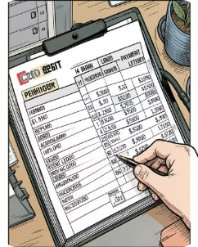

Dataset — Key Features
Applicant Details
Credit & Payment Details
Supervised Learning Setup
Income, Gender, Occupation, Family Size, Education, Housing, Employment status.
Loan history, payment timeliness, credit balance, recent credit inquiries, outstanding obligations.
Historical banking records labeled with approval outcome used to train classifiers.

Slide 7
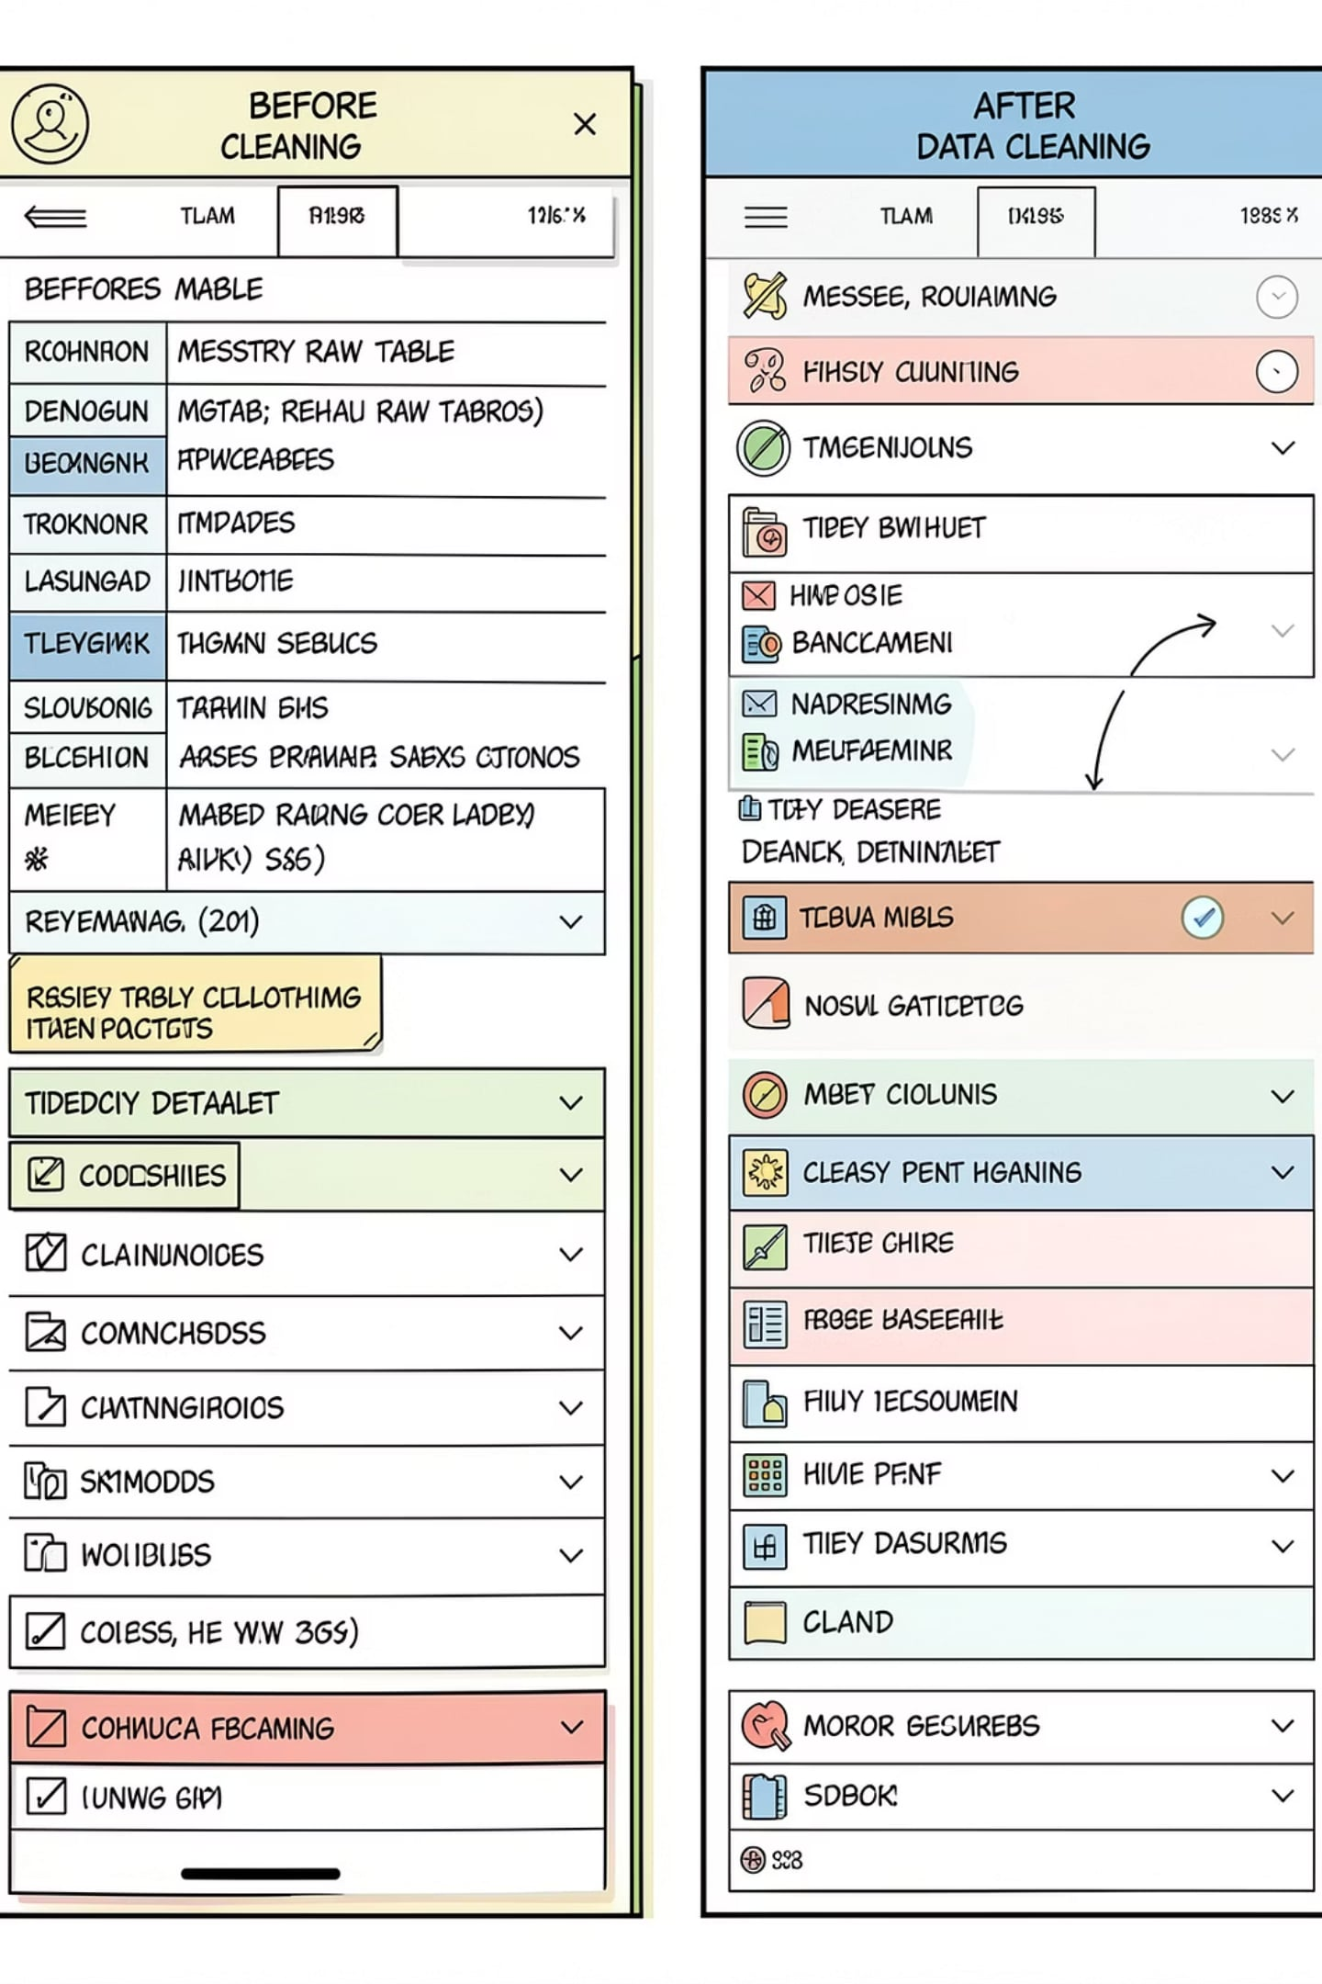




Data Preprocessing
Systematic cleaning and transformation applied to ensure high-quality inputs for modeling.
Missing Value Handling
Impute or drop based on missingness pattern; preserve sample integrity.
Remove Duplicates & Clean
Deduplicate records and standardize formats (dates, currency).
Encoding
Label encoding for ordinal and one-hot for nominal categorical features.
Feature Scaling & Selection
Standardization/normalization where required and recursive feature elimination for parsimony.

Slide 8
Machine Learning Algorithms — Comparison
Algorithm
Advantages
Disadvantages
Accuracy (cv)
Logistic Regression
Interpretable, fast, baseline for binary classification
Limited nonlinear capacity, sensitive to feature engineering
Baseline (e.g., 78–82%)
Decision Tree
Easy to visualize, handles mixed data types
Overfits if unpruned; unstable
Moderate (e.g., 80–85%)
Random Forest
Robust, reduces overfitting, handles feature importance
Less interpretable, slower at inference than linear models
High (e.g., 85–90%)
XGBoost
State-of-the-art gradient boosting; strong performance on tabular data
Requires careful tuning, higher compute for training
Best (e.g., 88–93%)
Note: Accuracy values shown are illustrative ranges from cross-validation. XGBoost selected as best-performing after hyperparameter tuning.

Slide 9
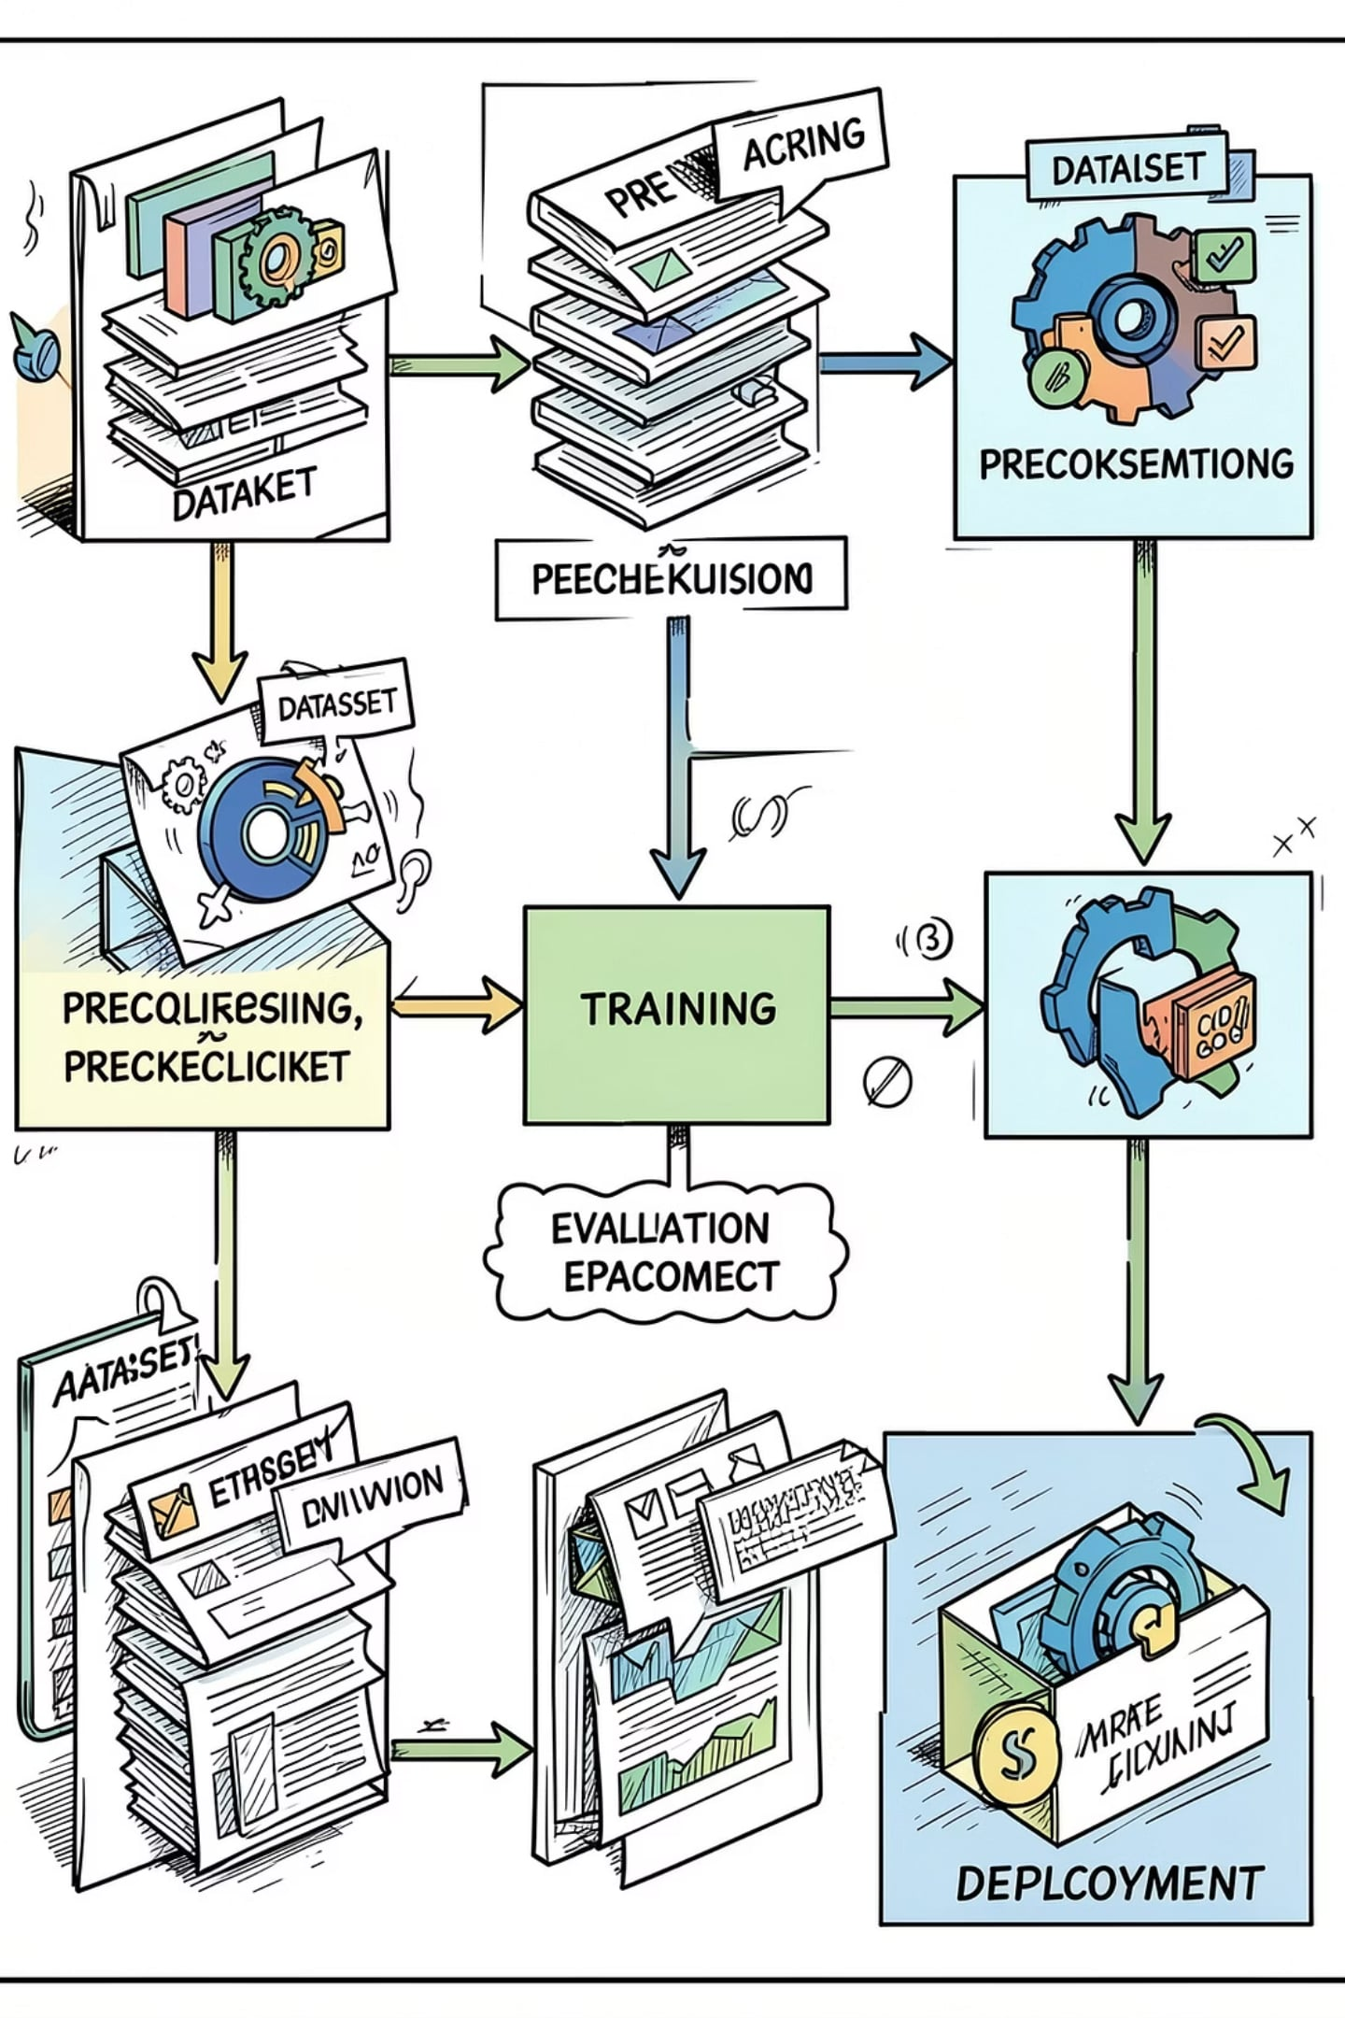
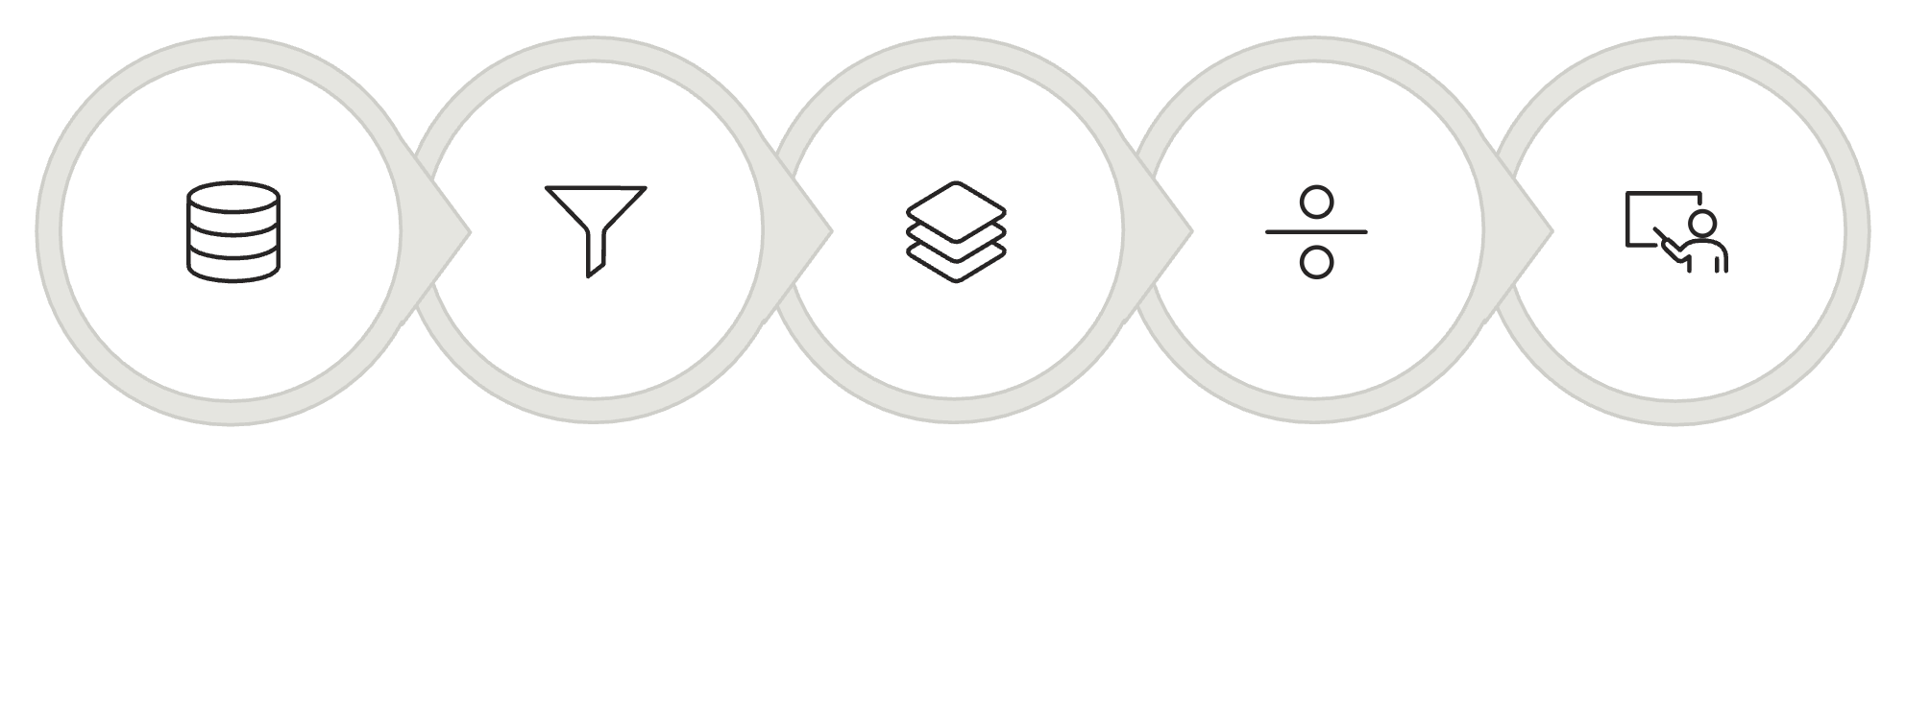
Model Workflow
Raw Data
Preprocess
Feature Eng
Train/Test
Train
This end-to-end flow ensures reproducibility: versioned data → pipeline transforms → model artifacts packaged for cloud deployment.

