Slide 1
Chapter 3

Slide 2
Section 3.1: Algorithms
Definition: An algorithm is a finite sequence of steps for performing a computation or for solving a problem.
We will briefly skim through section 3.1.
You are not responsible for learning or remembering any of specific algorithms presented in the textbook.
The main thing I want you is that you should be able to follow an algorithm. The exercises, and questions you should expect on a quiz or exam, are fairly simple algorithms; You will be expected to be able to follow the steps and find the output (and possibly some intermediate results).

Slide 3
Consider the following algorithm for finding the Maximum Element in a Finite Sequence
procedure max(a₁, a₂, …., a_{n}: integers)
max := a₁
for i := 2 to n
if max < a_{i} then max := a_{i}
return max{max is the largest element}

Slide 4
Example: List all the steps used by the algorithm in the previous slide for finding the maximum value of the list 8, 4, 11, 3, 10.
Solution: Perform the following steps:
Set the temporary maximum equal to the first integer in the sequence: max := 8
Compare the next integer in the sequence to the temporary maximum: 8<4 ?, no→ i : = 2, max := 8
8<11?, yes→ i : = 3, max : = 11
11<3?, no → i : = 4, max : = 11
11<10?, no→ i : = 5, max : = 11
Answer:
max : =8, i : = 2, max : = 8, i : = 3, max : = 11, i : = 4, max : = 11,
i : = 5, max : = 11

Slide 5
The Growth of Functions
Section 3.2

Slide 6
The Growth of Functions
In both computer science and in mathematics, there are many times when we care about how fast a function grows.
In computer science, we want to understand how quickly an algorithm can solve a problem as the size of the input grows.
We can compare the efficiency of two different algorithms for solving the same problem.
We can also determine whether it is practical to use a particular algorithm as the input grows.
Two of the areas of mathematics where questions about the growth of functions are studied are:
number theory
combinatorics

Slide 7
Big-O Notation 1
Definition: Let f and g be functions from the set of integers or the set of real numbers to the set of real numbers. We say that f(x) is O(g(x)) if there are constants C and k such that
whenever x > k. (illustration on next slide)
This is read as “f(x) is big-O of g(x)” or “g asymptotically dominates f.”
The constants C and k are called witnesses to the relationship f(x) is O(g(x)). Only one pair of witnesses is needed.

Slide 8
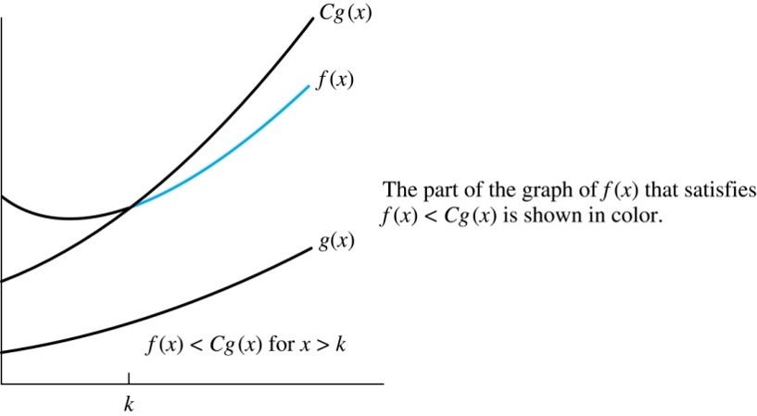
Illustration of Big-O Notation 1
Jump to long description

Slide 9
Some Important Points about Big-O Notation
If one pair of witnesses is found, then there are infinitely many pairs. We can always make the k or the C larger and still maintain the inequality : witness are not unique.
Any pair C ̍ and k̍ where C < C̍ and k < k ̍ is also a pair of witnesses since whenever x > k̍ > k.
You may see “ f(x) = O(g(x))” instead of “ f(x) is O(g(x)).”
But this is an abuse of the equals sign since the meaning is that there is an inequality relating the values of f and g, for sufficiently large values of x.
It is ok to write f(x) ∊ O(g(x)), because O(g(x)) represents the set of functions that are O(g(x)).
Usually, we will drop the absolute value sign since we will always deal with functions that take on positive values.

Slide 10
Using the Definition of Big-O Notation 2
Example: Show that 7x² is O(x³).
Solution: When x > 7, 7x² < x³. Take C =1 and k = 7 as witnesses to establish that 7x² is O(x³).
(Would C = 7 and k = 1 work?)
Example: Show that n² is not O(n).
Solution: Suppose there are constants C and k for which n² ≤ Cn, whenever n > k. Then (by dividing both sides of n² ≤ Cn) by n, then n ≤ C must hold for all n > k. A contradiction!

Slide 11
Using the Definition of Big-O Notation 1
Example: Let
Show that
Solution: We want to find C and k such that
Since x < x² and 1 < x² for x > 1, we have
We can take C = 4 and k = 1 as witnesses.

Slide 12
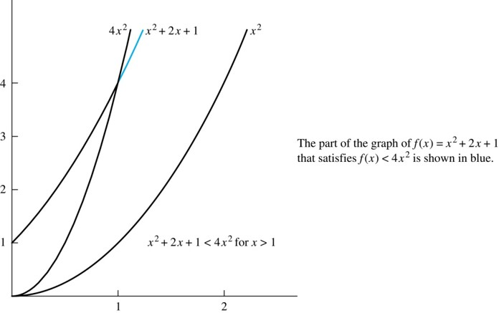
Illustration of Big-O Notation 2
Jump to long description

Slide 13
Big-O Estimates for some Important Functions 1
Example: Use big-O notation to estimate the sum of the first n positive integers.
Solution:
Example: Use big-O notation to estimate the factorial function
Solution:

Slide 14
Big-O Estimates for some Important Functions 2
Example: Use big-O notation to estimate log n!
Solution: Given that
(previous slide)
then
Hence, log(n!) is O(n∙log(n)) taking C = 1 and k = 1.

Slide 15
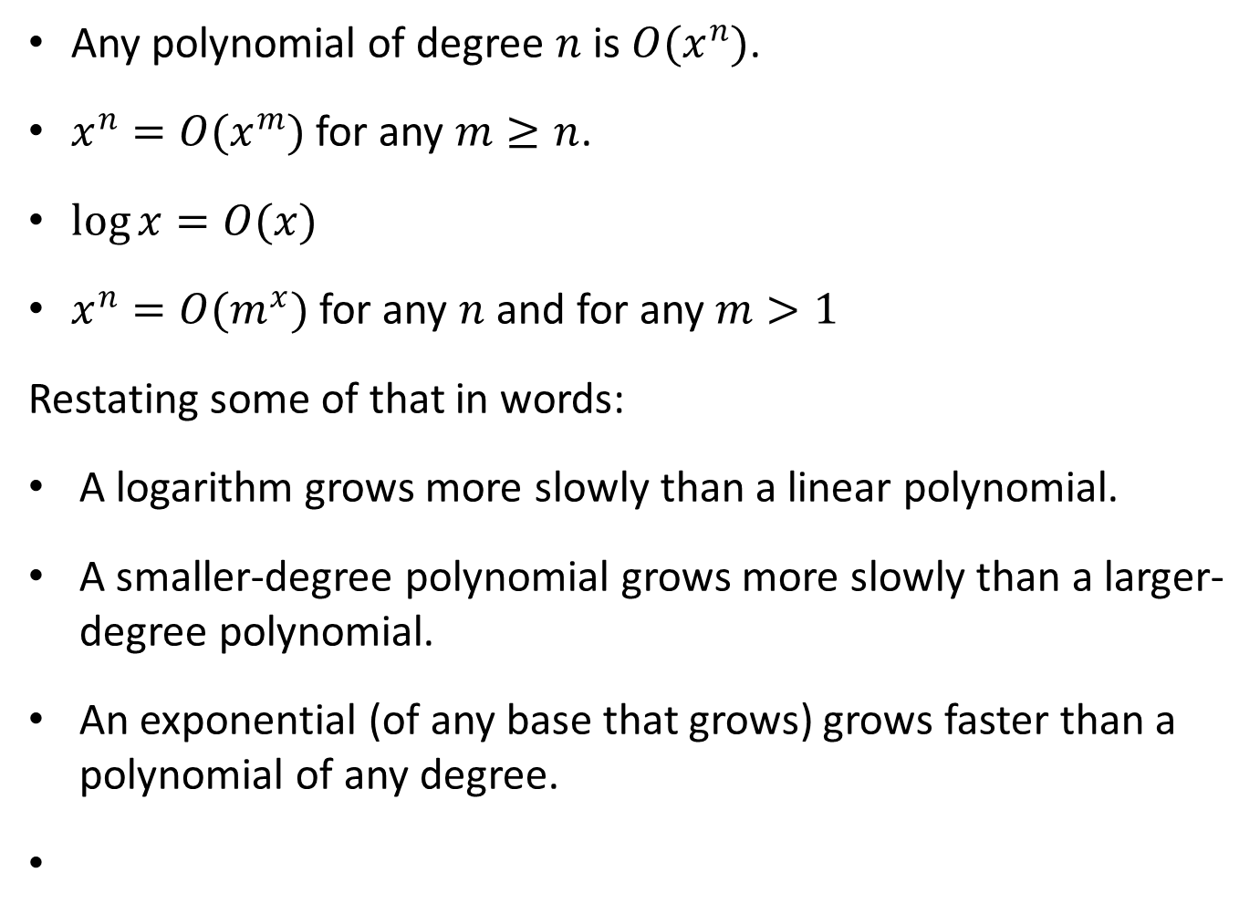
Common Estimates 1
Any polynomial of degree $n$ is $O(x^{n})$.
$x^{n}=O(x^{m})$ for any $m≥n$.
$\log{x}=O(x)$
$x^{n}=O(m^{x})$ for any $n$ and for any $m>1$
Restating some of that in words:
A logarithm grows more slowly than a linear polynomial.
A smaller-degree polynomial grows more slowly than a larger-degree polynomial.
An exponential (of any base that grows) grows faster than a polynomial of any degree.

Slide 16
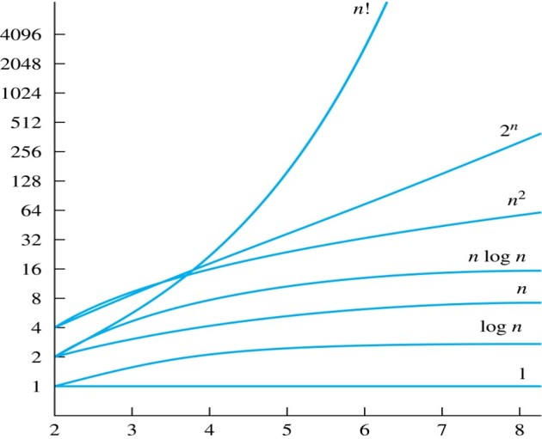
Display of Growth of Functions
Note the difference in behavior of functions as n gets larger
Jump to long description

Slide 17
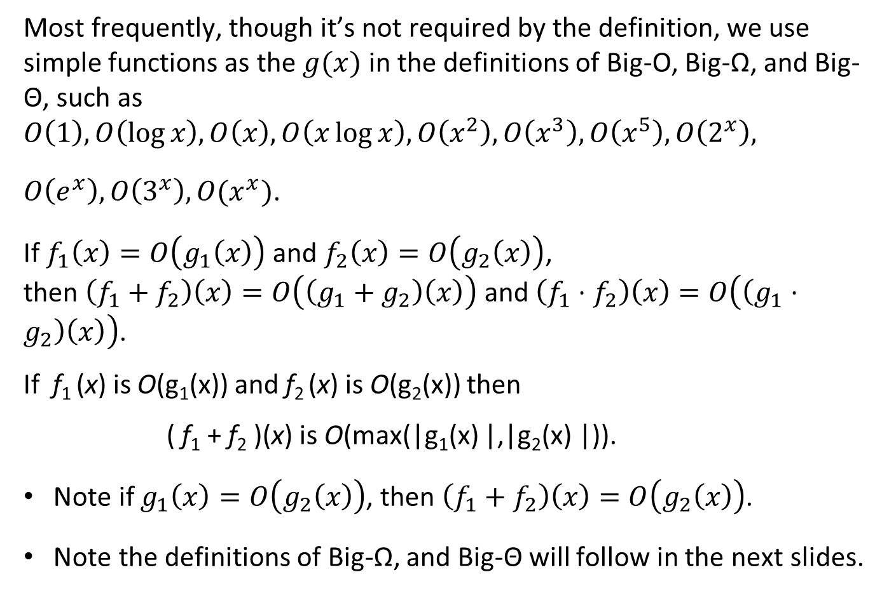
Common Estimates 2
Most frequently, though it’s not required by the definition, we use simple functions as the $g(x)$ in the definitions of Big-O, Big-Ω, and Big-Θ, such as $O\left(1\right),O\left(\log{x}\right),O\left(x\right),O\left(x\log{x}\right), O\left(x^{2}\right), O\left(x^{3}\right),O\left(x^{5}\right),O\left(2^{x}\right),$
$O\left(e^{x}\right),O\left(3^{x}\right),O(x^{x})$.
If $f_{1}\left(x\right)=O\left(g_{1}\left(x\right)\right)$ and $f_{2}\left(x\right)=O\left(g_{2}\left(x\right)\right)$, then $\left(f_{1}+f_{2}\right)\left(x\right)=O\left(\left(g_{1}+g_{2}\right)\left(x\right)\right)$ and $\left(f_{1}⋅f_{2}\right)\left(x\right)=O\left(\left(g_{1}⋅g_{2}\right)\left(x\right)\right)$.
If f₁ (x) is O(g₁(x)) and f₂ (x) is O(g₂(x)) then
( f₁ + f₂ )(x) is O(max(|g₁(x) |,|g₂(x) |)).
Note if $g_{1}\left(x\right)=O\left(g_{2}\left(x\right)\right)$, then $\left(f_{1}+f_{2}\right)\left(x\right)=O\left(g_{2}\left(x\right)\right)$.
Note the definitions of Big-Ω, and Big-Θ will follow in the next slides.

Slide 18
Using the Definition of Big-O Notation 1
Example: Let
Find the smallest integer n such that f(x) is
Solution: Note that
So,
Note that n=2 is too small.

Slide 19
Big-Omega Notation 1
Definition: Let f and g be functions from the set of integers or the set of real numbers to the set of real numbers. We say that if there are constants C and k such that
Ω is the upper case version of the lower case Greek letter ω.s
when x > k.
We say that “f(x) is big-Omega of g(x).”
Big-O gives an upper bound on the growth of a function, while Big-Omega gives a lower bound. Big-Omega tells us that a function grows at least as fast as another.

Slide 20
Big-Omega Notation 2
Example: Show that
Solution:
positive real numbers x.

Slide 21
Big-Theta Notation 1
Θ is the upper case version of the lower case Greek letter θ.
Definition: Let f and g be functions from the set of integers or the set of real numbers to the set of real numbers. The function
We say that “f is big-Theta of g(x)” and also that “f(x) is of order g(x)” and also that “f(x) and g(x) are of the same order.”
if and only if there exists constants C₁ , C₂
and k such that C₁g(x) < f(x) < C₂ g(x) if x > k. This follows from the definitions of big-O and big-Omega.

Slide 22
Big-Theta Notation 3
Example: Show that Solution:

Slide 23
Big-Theta Notation 4
When
it must also be the case that
Note that
if and only if it is the cases
Sometimes writers are careless and write as if big-O notation has the same meaning as big-Theta.

Slide 24
Big-Theta Estimates for Polynomials
Theorem: Let
are real numbers with a_{n} ≠0.
Then f(x) is of order x^{n} (or Θ(x^{n})).
Example:
The polynomial
is order of x⁵ (or Θ(x⁵)).
The polynomial
is order of x¹⁹⁹ (or Θ(x¹⁹⁹) ).

Slide 25
Complexity of Algorithms
Section 3.3

Slide 26
The Complexity of Algorithms 1
Efficiency of an algorithm is generally measured in following terms:
the running time (i.e. the time it takes to terminate);
the amount of memory it requires and
other required computation resources

Slide 27
The Complexity of Algorithms 1
When we analyze the time the algorithm uses to solve the problem given input of a particular size, we are studying the time complexity of the algorithm.
We will measure time complexity in terms of the number of operations, such as comparisons and arithmetic operations (addition, multiplication, etc.).
We will use big-O and big-Theta notation to estimate the time complexity.

Slide 28
Time Complexity
There are two somewhat different measures of complexity: worst-case complexity and average-case complexity.
We will focus on the worst-case time complexity of an algorithm. This provides an upper bound on the number of operations an algorithm uses to solve a problem with input of a particular size.

Slide 29
Example: Describe the time complexity of the algorithm for finding the maximum element in a finite sequence.
procedure max(a₁, a₂, …., a_{n}: integers)
max := a₁
for i := 2 to n
if max < a_{i} then max := a_{i}
return max{max is the largest element}
Solution: Count the number of comparisons
The max < a_{i} comparison is made n − 1 times.
Each time i is incremented, a test is made to see if i ≤ n.
To exit the loop, one last comparison determines that i > n.
Exactly 2(n − 1) + 1 = 2n − 1 comparisons are made.
Note that two comparisons are used for each of the second through nth element and one more comparison is used to exit the loop when i = n+1.
Hence, the time complexity of the algorithm is Θ(n).

