Slide 1

Stream API
streams were introduced starting in Java 8 – introduces functional
programming to the Java programming ecosystem

Slide 2
Stream API
streams were introduced starting in Java 8 – introduces functional
programming to the Java programming ecosystem
streams rely heavily on lambda expressions

Slide 3
Stream API
streams were introduced starting in Java 8 – introduces functional
programming to the Java programming ecosystem
streams rely heavily on lambda expressions
we can construct parallel operations quite easily

Slide 4

Stream API
a stream is a sequence of elements from a source
that supports data processing operations
(data structures are about storing items
and streams are about computation)

Slide 5

Stream API
a stream is a sequence of elements from a source
that supports data processing operations
(data structures are about storing items
and streams are about computation)
streams support database-like operations and common
operations from functional programming languages
(filter, map, reduce etc.)
stream operations can be executed
either sequentially or in parallel

Slide 6
Stream API
we can define intermediate operations that return a stream as
well – allowing multiple operations to be chained
(these are similar to database queries)
THIS IS CALLED PIPELINING !!!

Slide 7
Stream API
we can define intermediate operations that return a stream as
well – allowing multiple operations to be chained
(these are similar to database queries)
THIS IS CALLED PIPELINING !!!
S O U R C E
source of the stream
(collection of data)

Slide 8
Stream API
we can define intermediate operations that return a stream as
well – allowing multiple operations to be chained
(these are similar to database queries)
THIS IS CALLED PIPELINING !!!
S O U R C E
INTERMEDIATE
OPERATIONS
(filtering, sorting etc.)
source of the stream
(collection of data)

Slide 9
Stream API
we can define intermediate operations that return a stream as
well – allowing multiple operations to be chained
(these are similar to database queries)
THIS IS CALLED PIPELINING !!!
S O U R C E
TERMINAL
OPERATION
INTERMEDIATE
OPERATIONS
(filtering, sorting etc.)
source of the stream
(collection of data)
returns scalar or void
(collect, reduce etc.)

Slide 10
Stream API
collections are iterated explicitly with iterators (external iteration)
but we can use a different approch with streams
THIS IS CALLED INTERNAL ITERATION !!!

Slide 11
Stream API
Stream<Book>

Slide 12
Stream API
Stream<Book>
filter()
Stream<Book>

Slide 13
Stream API
Stream<Book>
filter()
Stream<Book>
map()
Stream<String>

Slide 14
Stream API
Stream<Book>
filter()
Stream<Book>
map()
Stream<String>
limit()
Stream<String>

Slide 15
Stream API
Stream<Book>
filter()
Stream<Book>
map()
Stream<String>
limit()
Stream<String>
collect()
List<String>

Slide 16
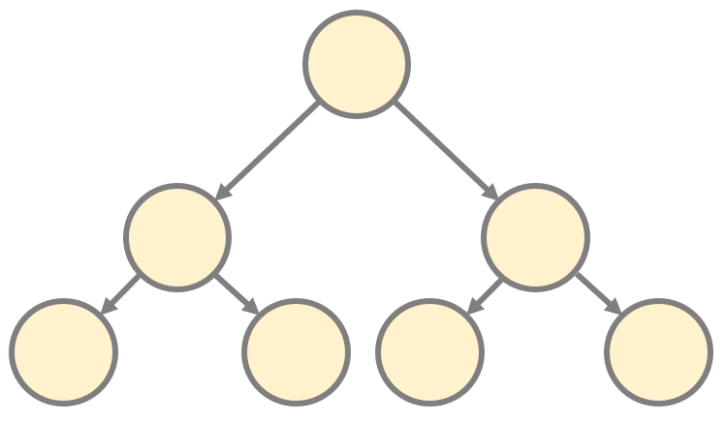
Streams and Collections
collections are essentially data structures in the RAM
collections need the whole data
in advance – every element in the collection
must be computed before it can
be added to the collection

Slide 17
Streams and Collections
collections are essentially data structures in the RAM
collections need the whole data
in advance – every element in the collection
must be computed before it can
be added to the collection
THIS IS WHY IT TAKES MORE TIME TO HANDLE A COLLECTION !!!

Slide 18
Streams and Collections
streams provide interfaces to data structures
representing a sequenced set of values
(like video frames being streamed over the internet)
streams are fixed data structures whose elements
are computed on demand (lazy collections)

Slide 19
Streams and Collections
streams provide interfaces to data structures
representing a sequenced set of values
(like video frames being streamed over the internet)
streams are fixed data structures whose elements
are computed on demand (lazy collections)
THIS IS WHY STREAMS ARE FASTER !!!

Slide 20
Streams and Collections
streams provide interfaces to data structures
representing a sequenced set of values
(like video frames being streamed over the internet)
streams are fixed data structures whose elements
are computed on demand (lazy collections)
THIS IS WHY STREAMS ARE FASTER !!!

Slide 21

Streams and Collections
calculating all the prime numbers
takes infinite time with collections
as we have to fetch all of them
one by one
finding all the prime numbers can be
done easily with streams because
the items are calculated when needed

Slide 22
Streams and Collections
calculating all the prime numbers
takes infinite time with collections
as we have to fetch all of them
one by one
CAN BE TRAVERSED AS MANY TIMES AS WE WANT !!!
finding all the prime numbers can be
done easily with streams because
the items are calculated when needed
CAN BE TRAVERSED ONLY ONCE !!!

Slide 23
Stream API
hello
shell

Slide 24
Stream API
hello
shell
map()
h
e
l
l
o
s
h
e
l
l
Stream<String[]>

Slide 25
Stream API
hello
shell
map()
h
e
l
l
o
s
h
e
l
l
Stream<String[]>
flatMap()
h
e
l
l
o
s
h
e
l
l
Stream<String>

Slide 26
Stream API
hello
shell
map()
h
e
l
l
o
s
h
e
l
l
Stream<String[]>
flatMap()
h
e
l
l
o
s
h
e
l
l
Stream<String>
distinct()
h
e
l
o
s
Stream<String>

Slide 27
Stream API
hello
shell
map()
h
e
l
l
o
s
h
e
l
l
Stream<String[]>
flatMap()
h
e
l
l
o
s
h
e
l
l
Stream<String>
distinct()
h
e
l
o
s
Stream<String>
collect()
h
e
l
o
s
List<String>

