Slide 1









Project S10: Tetris project
24/01/2022
Student of Project:
MARCHAND Loïc
Tutor of Project:
WEBER Rodolphe

Slide 2
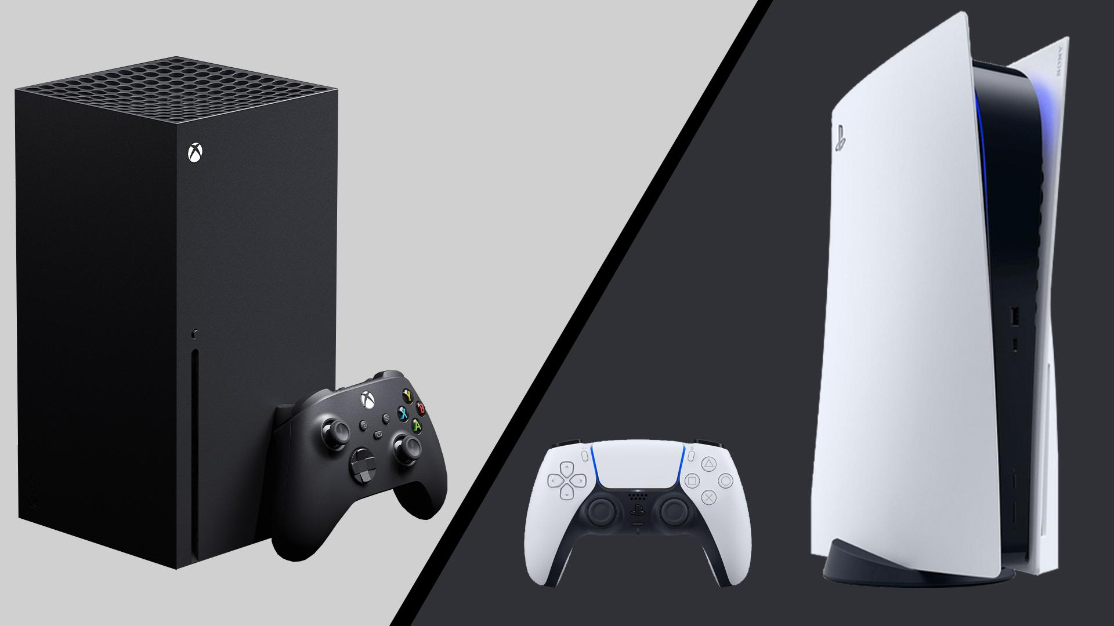
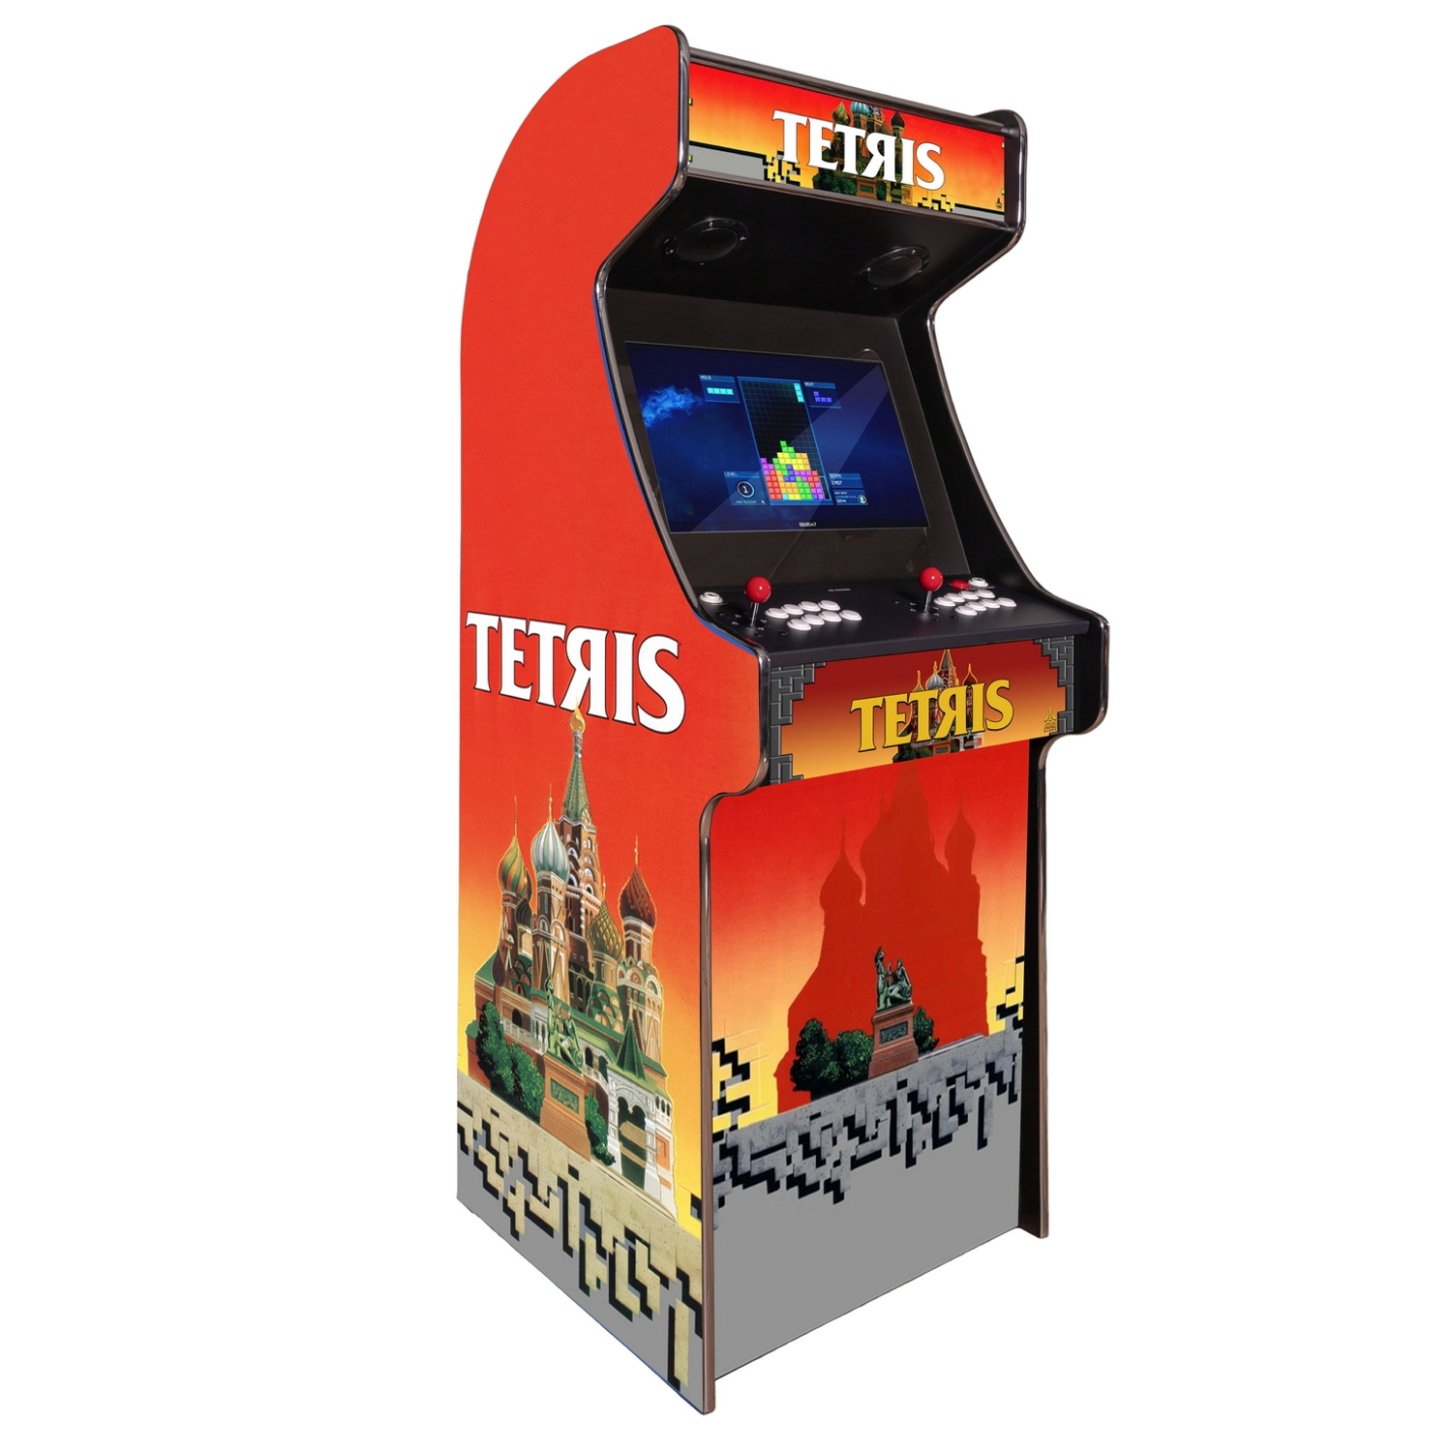
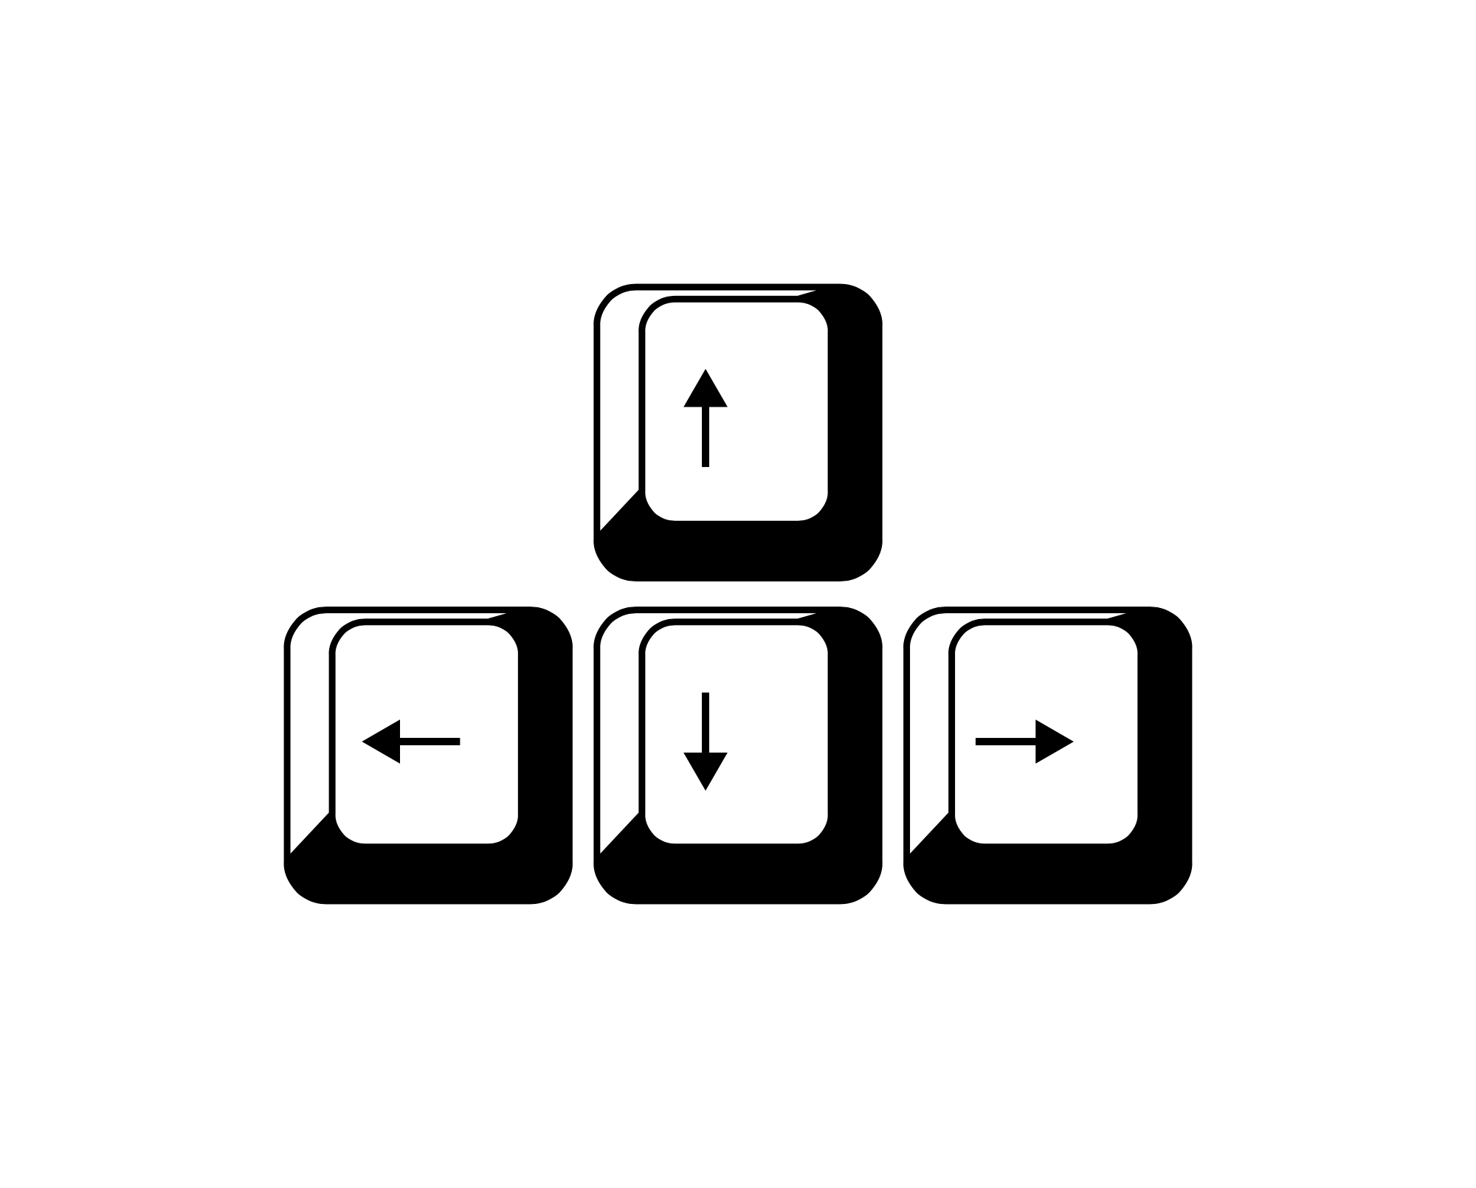
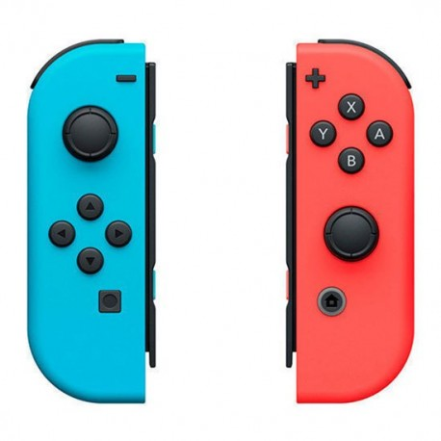
Context
Loïc Marchand
5A GPSE

Slide 3
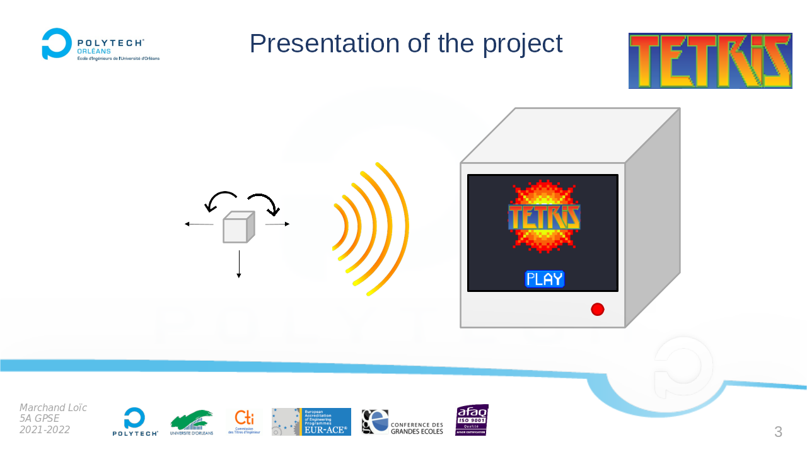
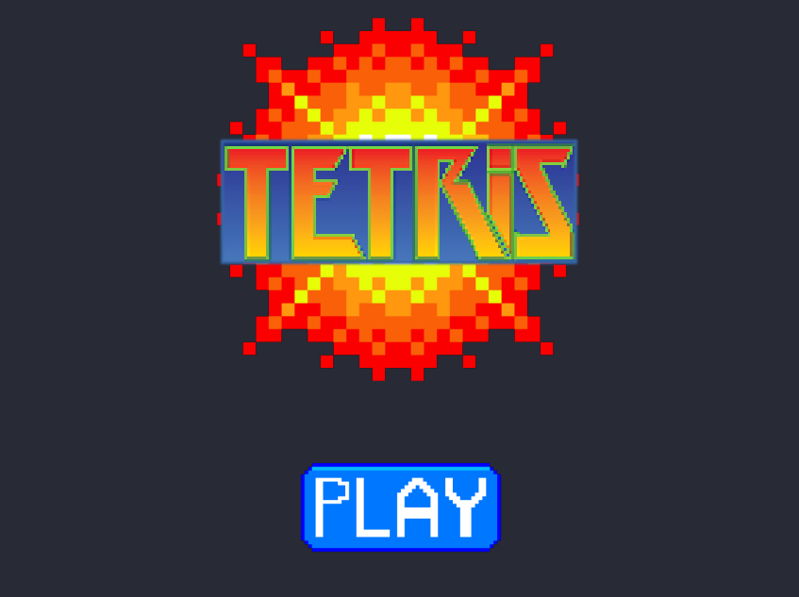
Context
Loïc Marchand
5A GPSE

Slide 4

Objectives
Playable by a child :
Operating time : > 1h
Operating distance : ~ 2m
Response time : < 250ms
Weight of the controller : < 500g
Reload time of the controller : < 30 min
Size of the controller : 7x7x7 cm
Power Supply of arcade terminal : 230V
Loïc Marchand
5A GPSE

Slide 5





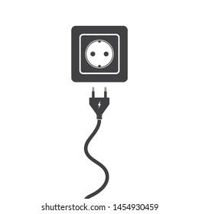
Global operation
Arduino Nano Every
AVR ATMega 4809
Raspberry Pi 3B+
Serial communication : Rx / Tx
Loïc Marchand
5A GPSE

Slide 6
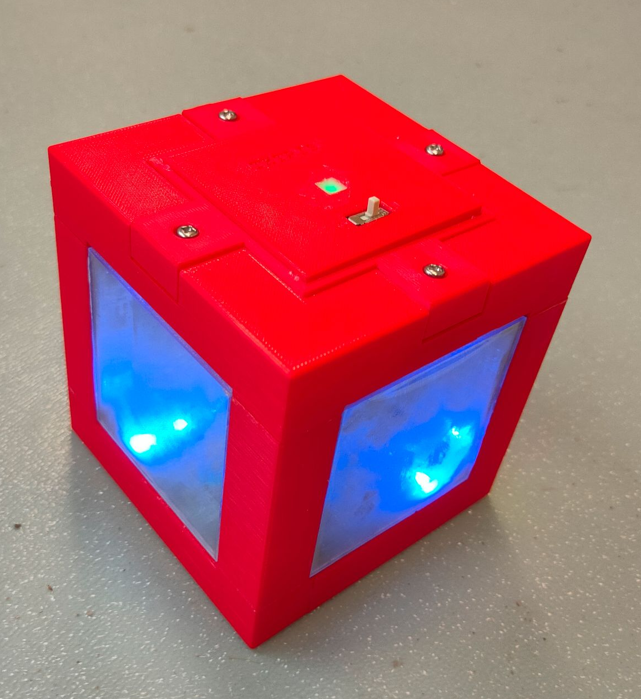
The controller
The design
Size : 10 x 10 x 10 cm
Weight : 373 g
Number of LEDs : 61 LEDs
Loïc Marchand
5A GPSE

Slide 7
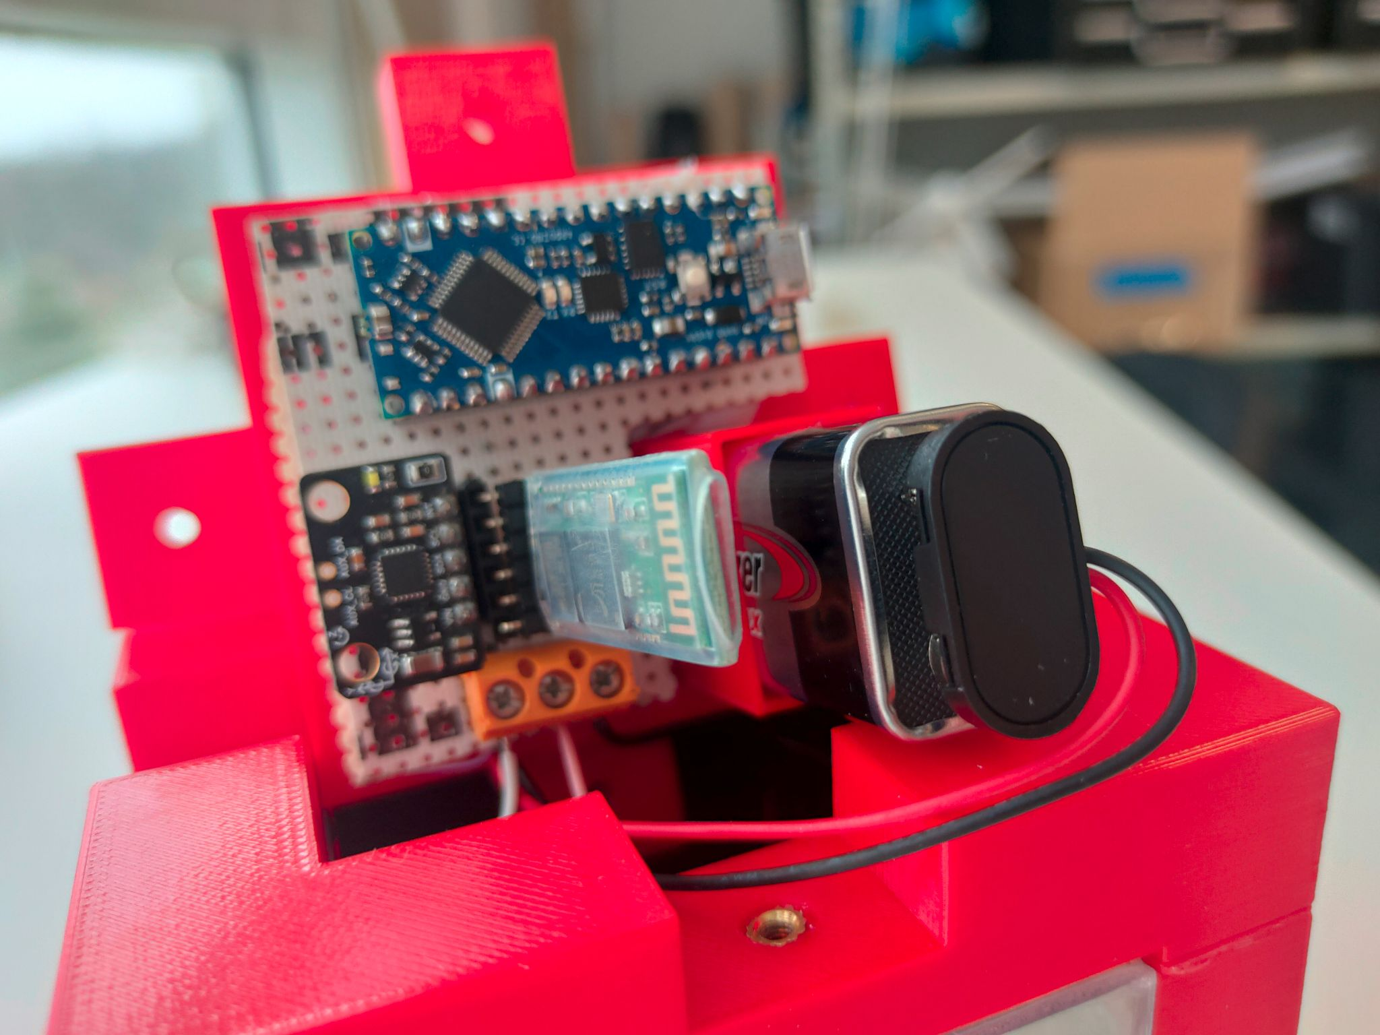
The controller
Battery
9V
(3h of autonomy)
The electronic part
LED power SJ-10060-2811
+
Power switch
Analogic
FastLED / leds[i]
AVR ATMega4809
MPU-6050
I2C
FastLED / leds[i]
LED strip iPixel
SJ-10060-2811
Rx/Tx
Serial
HC-05
(10 meters of
operating
distance)
Loïc Marchand
5A GPSE

Slide 8
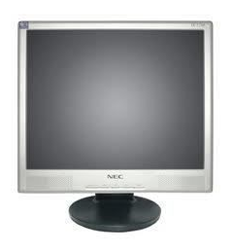
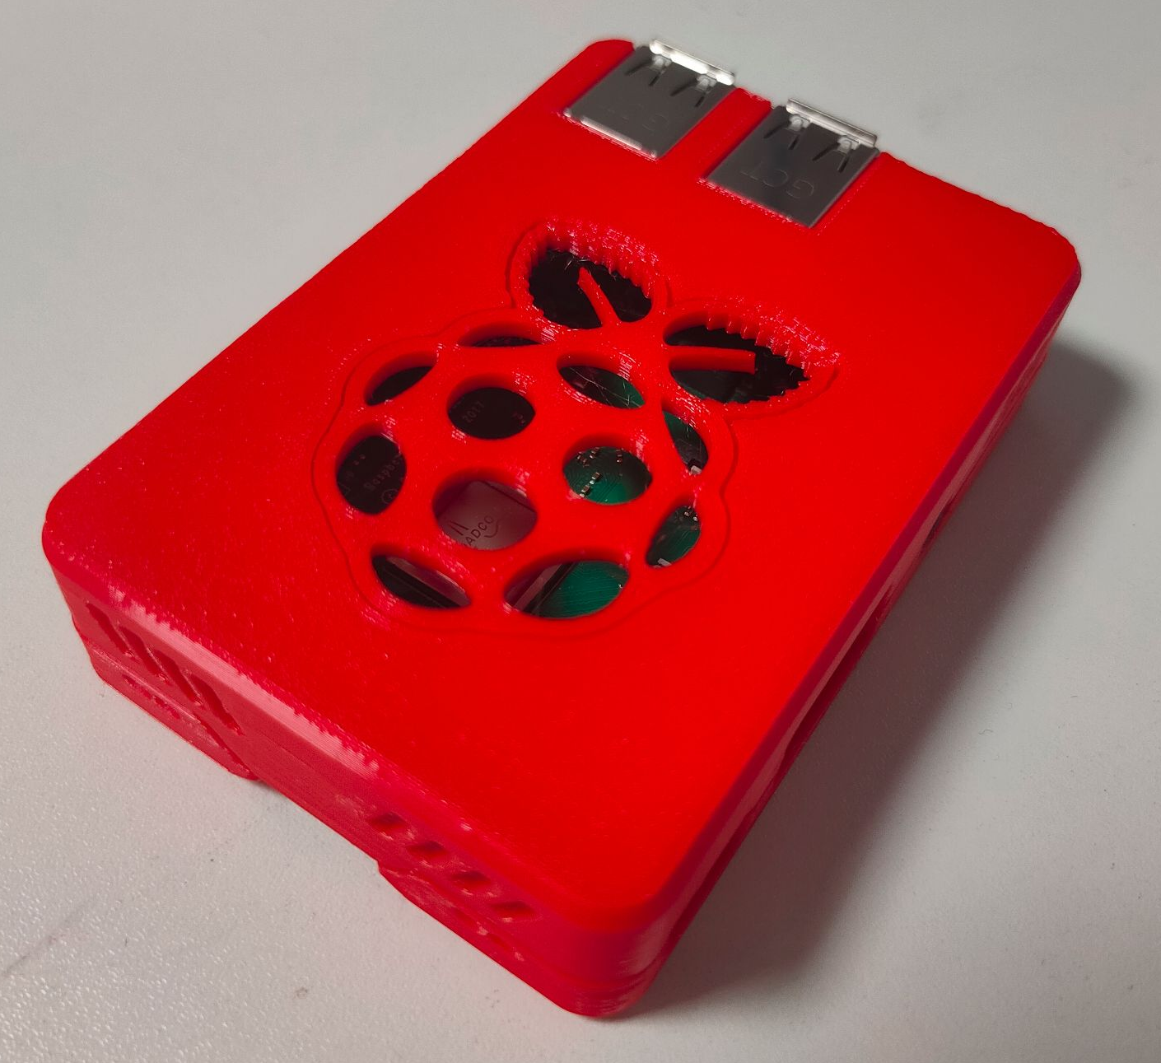
The arcade terminal
Raspberry Pi 3B+
Screen NEC lc17m (17 inches)
Loïc Marchand
5A GPSE

Slide 9
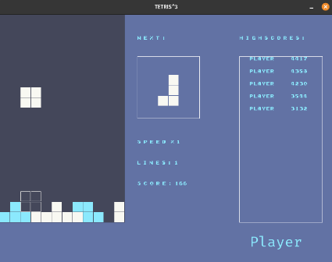
The arcade terminal
‘s’
‘w’
Raspberry part
‘g’
‘j’
‘h’
Received by the Raspberry :
g = b’left\r\n’
j = b’right\r\n’
h = b’down\r\n’
s = b’rotleft\r\n’
w = b’rotright\r\n’
(Inspired by “farhan” Tetris program)
Loïc Marchand
5A GPSE

Slide 10
Skills developed
The controller | The arcade terminal
SolidWorks | Pygame : the Python library
The bluetooth of the HC-05 | The bluetooth of the Raspberry
State machine | Python
C language
Kicad
Loïc Marchand
5A GPSE

Slide 11
Budget
Controller |  | Arcade terminal
Components | Price | Components | Price
Arduino Nano Every | 11,35 € (RS Component) | Screen (NEC LC17m) | 89,95 € (Amazon)
HC-05 | 14,50 € (Go Tronic) | Raspberry 3B+ | 28,56 € (RS Component)
MPU6050 | 10,50 € (Go Tronic) | SD card (16Go) | 8,44 € (RS Component)
Battery 9V / 6LR61 | 3,62 € (Conrad)
LED strip (iPixel SJ-10060-2811) | 6,25 € /m (60 LEDs/m) (Alibaba)
PLA (173,09 g) | 18,20 € (filament bobbin of 750 g) (Smart Material 3D)
Power switch | 1,10 € (RS Component)
Resistances (2*330Ω/100kΩ/220kΩ) | 4 * 0,038 € (RS Component)
Time spent : 336 h
Total components : 198,88 €
Loïc Marchand
5A GPSE

Slide 12
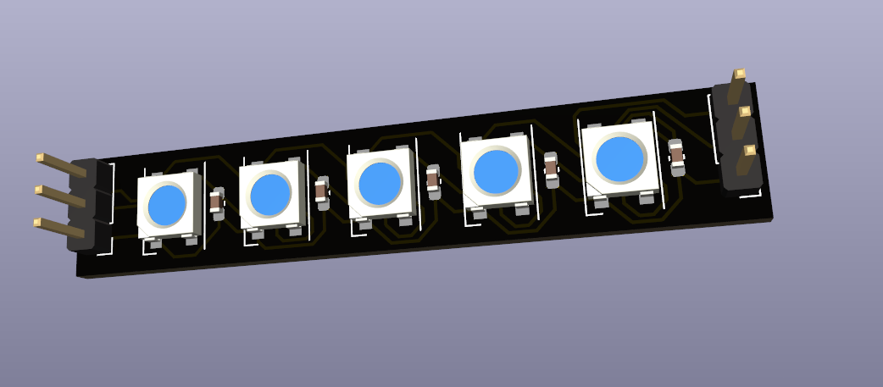
Improvements
Create two PCBs :
LEDs
Controller
Consolidate the controller to be shock resistant and waterproof
Add another game (PacMan) with a menu to choose the game we want
Create the box of the arcade terminal with interactive light
Loïc Marchand
5A GPSE

Slide 13
Conclusion
Loïc Marchand
5A GPSE

Slide 14


https://github.com/LoicM22/Tetris_project.git
Loïc Marchand
5A GPSE

Slide 15
Demonstration
Loïc Marchand
5A GPSE

