Slide 1
Burger Specialist - the architecture of a web social platform
Jiahui TANG
2023/03/16

Slide 2
Content
General Design
Simple Specification
System Context
Containers
Data Security & User Privacy Solution
Increased Workloads Solution
Further Thoughts and Design
Demo Detail

Slide 3
Simple Specification
A new social platform
Review local burger places
Store the information of burger places
Score the burger places
User can make a comment on the burger places
Upload pictures
Contain file servers to save pictures or other media data
Find nearby restaurants
Find restaurants according to a confirmed location
Available on multi-platform
A Web application
Should be abled to be deployed on multi-platform
Need a file system to save pictures and videos
Need a database to save user information and other records
Data security and user privacy should be concerned
The system should be able to handle the increased workloads

Slide 4
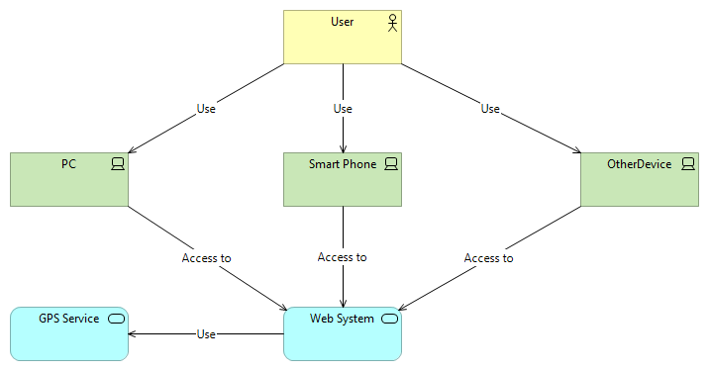
System Context

Slide 5
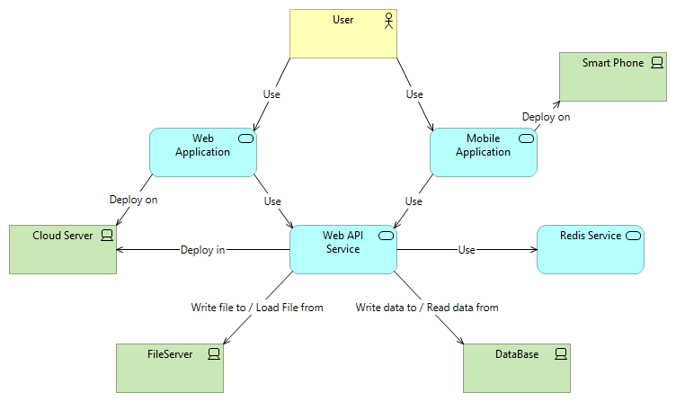
Container
Three Container:
Web application
Mobile Application
Asp .NET Application
Multi-Platform:
Ionic + Cordova + Web application

Slide 6
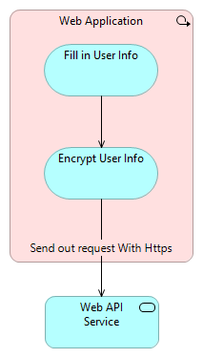
Data Security & User Privacy
Use Https protocol and pre-encryption process to ensure the data security and User privacy
Https:
Https protocol ensures the data security when transmitting request between servers
Pre-encryption process:
Encrypting the user info (name, password, etc.) before sending out the https request ensures all the user data could be saved in the system in the encrypted state and can only be decrypted by our own system.

Slide 7
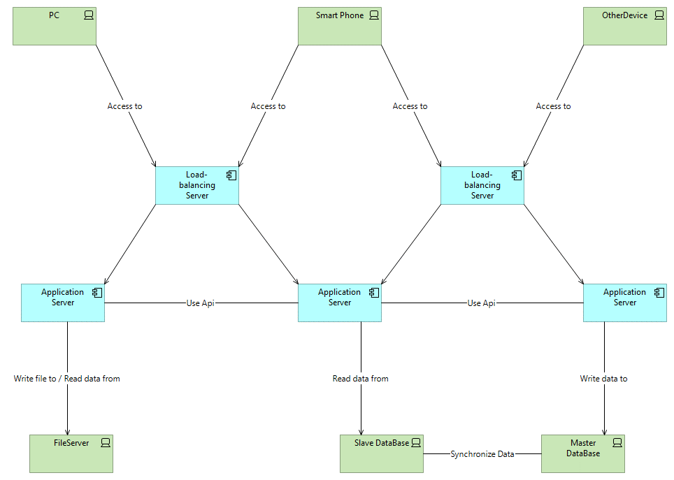
Increased workloads
Bottlenecks:
Server’s load
I/O Bottleneck
DB Bottleneck
Solutions:
Use load-balancing server
Use Redis service
Use master-slave database
Partition the db. tables

Slide 8
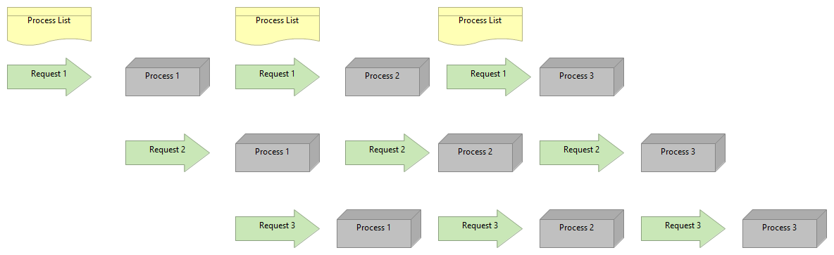
Further Design – pipeline mode
A function would be separate into many process node, each node should cost almost the same amount of time.
After a process node is finished, re-query a free node resource to execute next process.
The API behavior could be totally described by a config file.

Slide 9
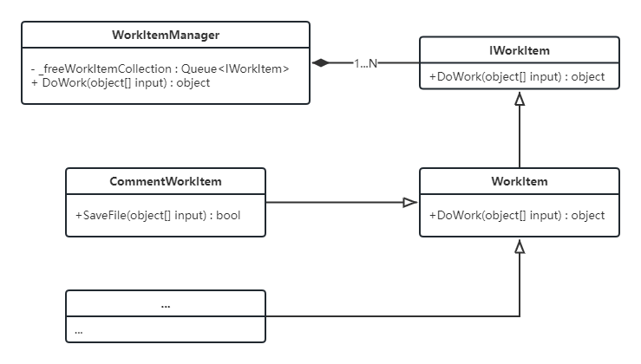
Detail Info of Demo
WorkItemManager: Manage the workitem resource of the system
IWorkItem: The Interface which defines the behavior of WorkItem
WorkItem: The abstract implement class of IWorkItem
CommentWorkItem: The actual class managed by the WorkItemManager

Slide 10
Thank you for your watching!

Slide 11
Q&A

