Slide 1

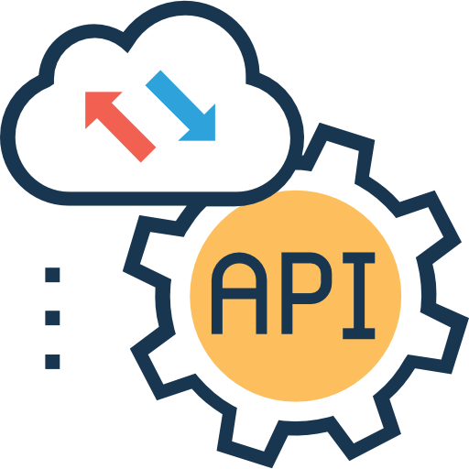












Data Sources
User
Email
Real-Time API
Fraud Detection
History database
Dashboard
Workflow orchestration
Performed on scikit-learn
Tracked on Mlflow
Amazon S3 : Model and Tracking
NeonDB : Databases
HuggingFace : Dashboard deployment
Machine Learning
Storage

