Slide 1

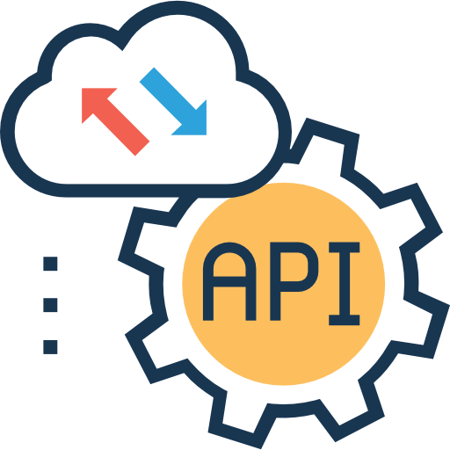












Data Sources
User
Email
Real-Time API
Fraud Detection
History database
Dashboard
Workflow orchestration
Performed on scikit-learn Tracked on Mlflow
Amazon S3 : Model and Tracking
NeonDB : Databases
HuggingFace : Dashboard deployment
Machine Learning
Storage

Slide 2


Live Youtube or Twitch streaming
Mesure de l’ambiance du chat
en temps réel
History database
Dashboard Ambiance, nb viewers, nb messages par min. …

