Slide 1
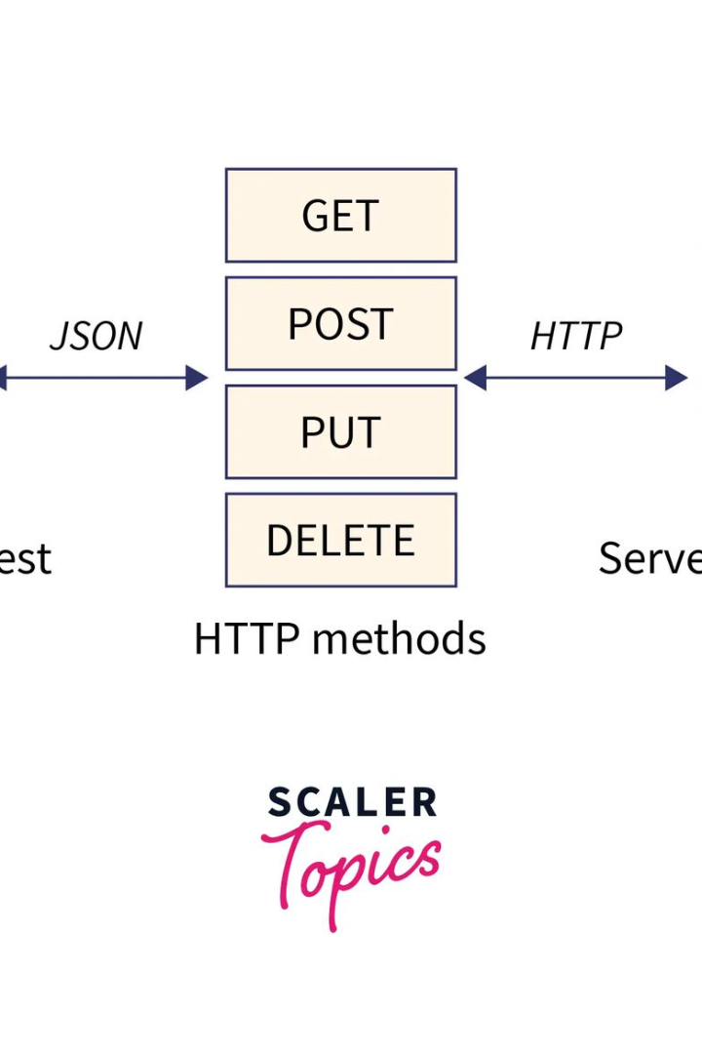

Axios and CORS
Axios is a popular JavaScript library that allows you to make HTTP requests from your web applications. In this presentation, we will explore how axios handles Cross-Origin Resource Sharing (CORS) and discuss key concepts and best practices.
by Lokaranjan R

Slide 2
What is Axios?
Simplified Requests
Browser Compatibility
Additional Features
Axios provides a simple and intuitive API to send HTTP requests, making it easier to work with backend services and APIs.
Axios offers powerful features like automatic JSON data parsing, interceptors for request and response handling, and canceling requests.
Unlike other libraries, Axios supports all major browsers and provides consistent behavior across different environments.

Slide 3
How Does Axios Handle CORS?
1
Automatic Handling
Axios automatically sends an "OPTIONS" pre-flight request to check the server's CORS policy before sending the actual request.
Headers Configuration
2
You can configure headers such as "Access-Control-Allow-Origin" and "Access-Control-Allow-Headers" to control CORS behavior in axios.
3
Proxy Server
A proxy server can be used to bypass CORS restrictions by making the request from the server-side instead of the client-side.

Slide 4

Understanding CORS and Its Limitations
1
Origin Policy
2
Browser Restrictions
3
Cookie and Authorization
CORS enforces same-origin policy, allowing resources to be shared only between the same origin to prevent unauthorized access.
Browsers restrict cross-origin requests by default, requiring server-side configuration to allow access from different origins.
CORS limits the ability to read cookies or send authorization headers on cross-origin requests, ensuring data security.

Slide 5

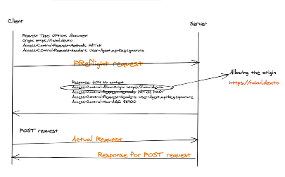
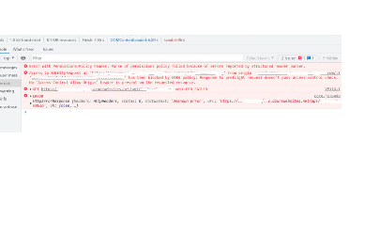
Common CORS Error Messages and Troubleshooting
Origin is Not Allowed
Invalid Preflight Request
Blocked by Browser
This error occurs when the server restricts requests from certain origins. Check server configurations.
If the browser blocks a cross-origin request, verify that your CORS configuration allows the specific origin.
Ensure that the preflight request headers match the server's CORS policy, often caused by missing or incorrect headers.

Slide 6
Tips for Handling CORS Issues with Axios
1
Specify Request Origin
Set the "Origin" header in axios to specify the origin from which the request is being made.
Use Proxy Servers
2
Employ a proxy server to bypass CORS restrictions by forwarding requests from the client to the server.
3
Configure CORS Headers
Ensure that the server-side application is properly configured to include appropriate CORS headers.

Slide 7
Best Practices for Securing Axios Requests
Add CSRF Protection
Implement Authentication
Validate Input Data
Include CSRF tokens in your axios requests to protect against cross-site request forgery attacks.
Handle input data validation on the server-side to prevent security vulnerabilities and ensure data integrity.
Use authentication mechanisms like JWT or OAuth to secure your axios requests and authorize access to protected resources.

Slide 8

Conclusion and Next Steps
In this presentation, we explored axios, its handling of CORS, and the best practices for secure requests. Take this knowledge and apply it to your projects to enhance the functionality and security of your web applications.

