Slide 1

Basic Details of the Team and Problem Statement
Ministry/Organization Name/Student Innovation: Student
Innovation
PS Code: 1483
Problem Statement Title: Student Innovation
Team Name: BINARY BRAINS
Team Leader Name: Sankalp Tyagi(22104026)
Institute Code (AISHE): U-0522
Institute Name: JAYPEE INSTITUTE OF INFORMATION TECHNOLOGY
Theme Name: MISCELLANEOUS

Slide 2
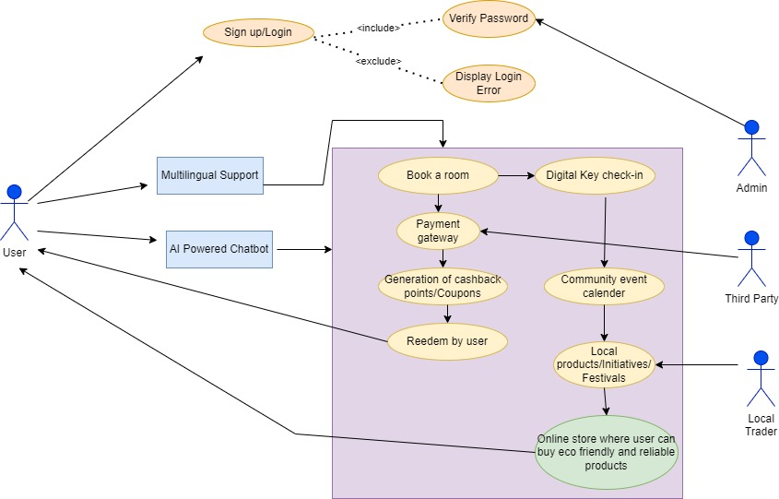
Idea/Approach Details
Describe your idea/Solution/Prototype here:
We’re providing a solution by creating a web portal that will serve as a platform for hospitality, financial services and retail at one place only.
The functionalites are:
Profile creation/login by user on the portal.
User generate rewards/cashback by using the payment gateway.
Amount of reward/cashback is decided by AI and ML.
The nearest local trader/vendor is assigned based on customer’s location.
Customers can purchase the products on an online store interface.
Also a calender is added which will show the local communities events with date and images based on customer’s location.
Describe your Technology stack here:
HTML,CSS,JAVASCRIPT
PHP,XAMP,APACHE,JSON,NODE.JS,POSTGRESQL,MYSQLi
BOOTSTRAP,AI,MACHINE LEARNING

Slide 3
Idea/Approach Details
Describe your Use Cases here
Describe your Dependencies / Show stopper here
Simply the user can make a profile/login into the portal.
Easy payment transaction.
An automated system made using AI and ML can offer rewards/cashback.
A local trader/vendor will be shown based on realtime location.
Digital key checkin is offered to user(QR-code can also be provided in user’s portal only).
A calender is also added with events and images data.
A multilingual web based platform.
Secure and authenticated payment environment to users.
A stable source of income for local vendors/traders.
Once a local vendor/trader is assigned to user,an AI powered 24/7 chatbot will show location and prices.

Slide 4
Team Member Details
Team Leader Name: Sankalp Tyagi
Branch : Btech Stream : IT Year : ll
Team Member 1 Name: Sudiksha Chitranshi
Branch : Btech Stream : IT Year : ll
Team Member 2 Name: Lokendra Singh Shekhawat
Branch : Btech Stream : IT Year : ll
Team Member 3 Name: Abhay Kumar
Branch : Btech Stream : IT Year : ll
Team Member 4 Name: Shreevardhan Nautiyal
Branch : Btech Stream : IT Year : ll
Team Member 5 Name: Devansh Sharma
Branch : Btech Stream : IT Year : ll

